Slide 1
The Effects of a missense mutation on an MSH2 gene
Ada Gil Jimenez, Amonie M. Robins
Dr. Hong Qin
Bio 125 Section 2

Slide 2
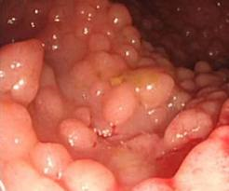
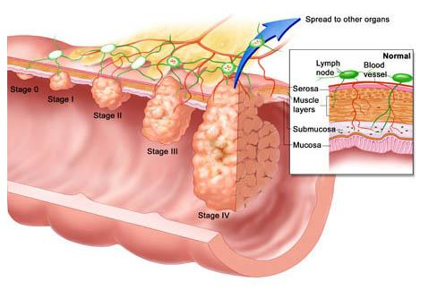
Colorectal Cancer
Colorectal Cancer is cancer of the large intestine.
It is the 3rd most diagnosed Cancer in the United States.
Two types of Hereditary Colorectal Cancer Are:
1. Familial Adenomatous Polyposis (FAP)
a genetic condition & is diagnosed when more than
100 adenomatous polyps develop inside the colon.
2.Hereditary Non-Polyposis Colorectal Cancer (HNPCC)
Hereditary nonpolyposis colorectal cancer (HNPCC) is a disease caused by an inherited mutation in genes that normally repair DNA.
HNPCC accounts for 5-10% of all Colorectal Cancers
30%-31% of HNPCC is caused by mutations in one, or several mismatch-repair genes.

Slide 3
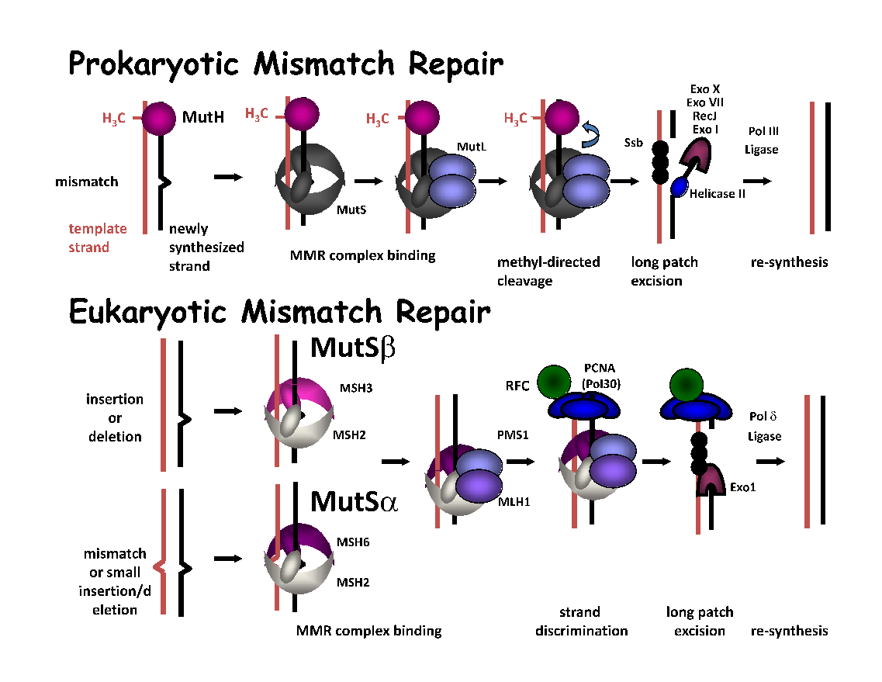
Hereditary Non-Polyposis Colorectal Cancer
Caused by a defect in Mismatch repair system (MMR)
DNA mismatch repair protein (MSH2) recognizes and repairs insertion, deletion, and misincorporation of nucleotides after DNA replication.
Defective MSH2 is associated with an increased mutation rate. Thus, it is correlated with the development of HNPCC.
Key Component: MSH2 Gene
MSH2 Function: Provides instructions for making a protein in DNA repair. Identifies where mutations are located.

Slide 4
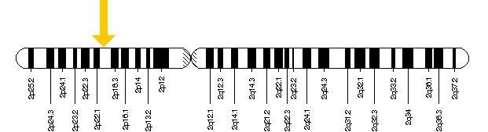
MSH2
The official name of this gene is “mutS homolog 2.”
The MSH2 gene is located on the short (p) arm of chromosome 2 at position 21.
More precisely, the MSH2 gene is located from base pair 47,403,066to base pair 47,512,576 on chromosome 2.

Slide 5
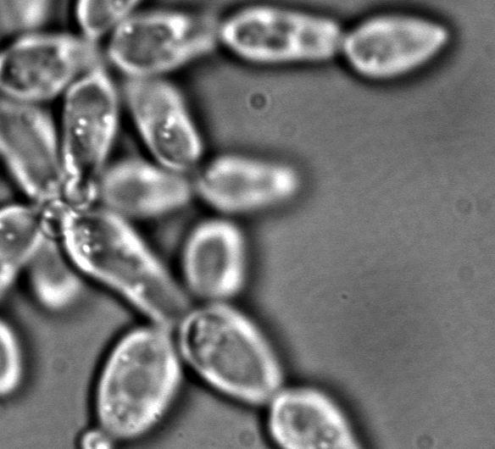
Saccharomyces cerevisiae (Yeast) Model
MSH2: Present in Yeast, Humans, Bacteria
Primer Directed Mutagenesis
Missense Mutation: msh2-G693D

Slide 6
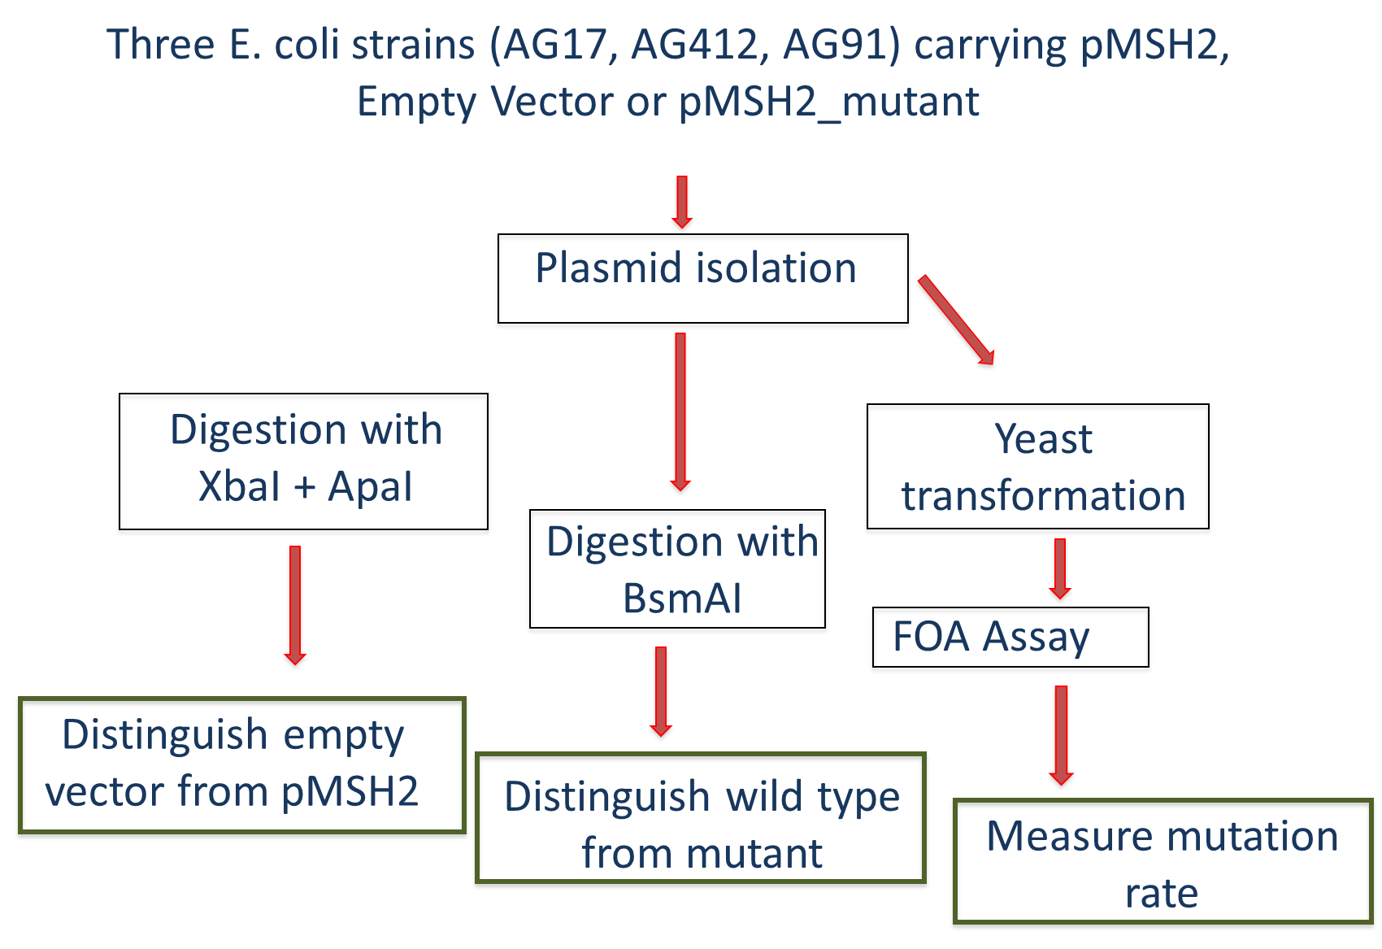
Experimental Methods
The goal of this project is to identify which mutations affect the repair function of MSH2.
Extracted DNA into Three Plasmids
Wild Type MSH2 gene
Mutant msh2-G693D
Vector RS413

Slide 7
Restriction Enzyme Digestion
Used BSMA1 as restriction enzyme (Nebcutter)
1% agarose gel electrophoresis was used to confirm the presence of a mutation in our mutant plasmid.

Slide 8
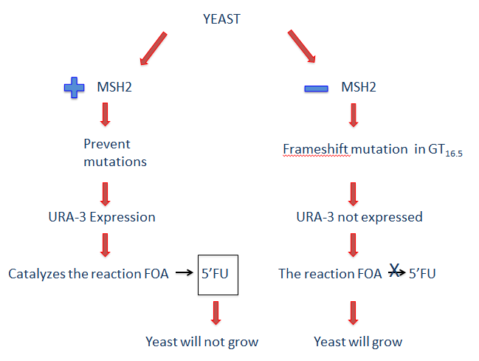
Yeast Transformation
Used to the functionality of the MSH2 protein containing the G693D mutation
Yeast transformed with WT MSH2, msh2-G693D, and an empty vector
The yeast strain used:
msh2Δ
His-
Trp-
Each cell contains:
microsatellite region upstream of URA3 gene
trp+ positive selection marker

Slide 9
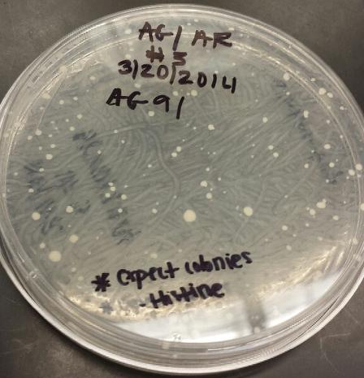
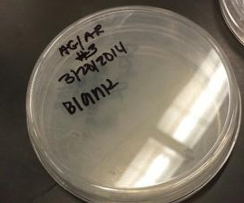
Results – Yeast Transformation
Yeast cell growth on plates containing media without histidine or tryptophan
Yeast cell plasmid transformation confirmed
His+ selective marker confirmed MSH2, msh2-G693S, or RS413 plasmids
Trp+ selective marker confirmed reporter plasmids

Slide 10
FOA Functional Assay
Used to determine whether the mutant msh2-G693D is able to restore the function of the Mismatch repair system (MMR)
Yeast cells were spotted on a plate containing 5-fluororotic acid (5FOA)
Notes:
Using 5-Fluoroorotic Acid (5-FOA) for the counter-selection of yeast is a common genetic screening method. Curing yeast strains of plasmids, plasmid shuffling, allelic replacement, and two-hybrid screens are methods that can employ the use of 5-FOA. Otherwise nontoxic to yeast, 5-FOA is converted to the toxic form (i.e., 5-flurouracil) in strains expressing the functional URA3 gene coding for orotine-5-monophosphate decarboxylase that is involved in the synthesis of uracil. Yeast strains that are phenotypically Ura+ become Ura- and 5-FOA(R) (resistant) after selection.
URA3 is gene on Chromosome V in Saccharomyces (yeast). Its systematic name is YEL021W. URA3 is a gene that encodes Orotidine_5'-phosphate_decarboxylase (ODCase), which is an enzyme that catalyzes one reaction involved in the synthesis of pyrimidine ribonucleotides in yeast RNA.
Loss of ODCase activity leads to a lack of cell growth unless uracil or uridine is added to the media. When the URA3 gene is added, auxotrophic cells can now grow (positive selection^{[disambiguation needed]}). In contrast, if 5-FOA (5-Fluoroorotic acid) is added to the media, the active ODCase will convert 5-FOA into the toxic compound (a suicide inhibitor) 5-fluorouracil causing death (negative selection^{[disambiguation needed]}: The yeast containing the gene would die, while cells that lack the gene would live as long as the composition of the media allows for it).

Slide 11
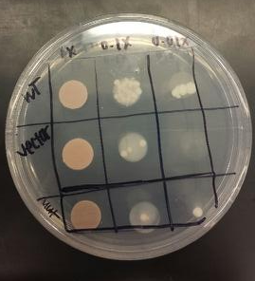
Results – FOA/URA3
Expected results
Wild type will have few colonies
Vector will have a lot of colonies
Actual results
(Note: WT and Vector are mislabeled. Switch the labels)
Wild type grew a small amount of colonies
Vector only grew a lot of colonies
*EXPECTED RESULTS WERE CONFIRMED!
Speculate our msh2-G693D is benign

Slide 12
Protein Extraction and Western Blot Analysis
To determine the effect of mutation in MSH2 gene on the amount of the protein; total protein extraction from yeast cells was performed following a denaturing.
Extracted protein was then separated on SDS-PAGE gel followed by western blotting

Slide 13
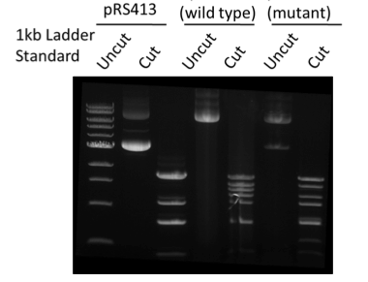
Results – Plasmid Analysis
Gel electrophoresis used to analyze plasmids
Enzyme digestion was successful
Mutation in msh2-G693D plasmid was confirmed

Slide 14
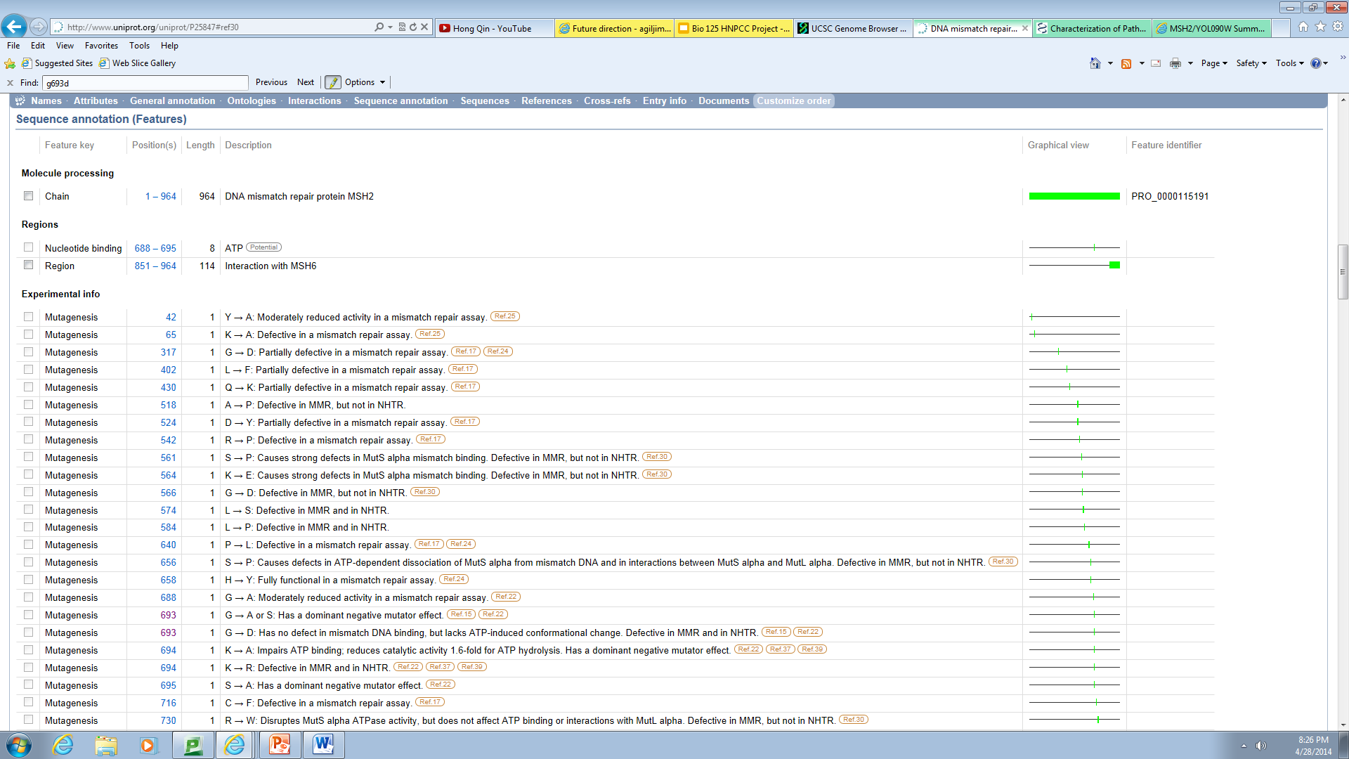
Relevance of Experiment

Slide 15
Future Directions
Future Direction: To show that increasing gene dosage of more than half of the missense alleles fully restored function
How: A titration experiment revealed that raising the expression level of one variant to less than wild-type levels restored mismatch repair.
Suggestion: Overexpression is not always required to regain function
Future Direction: To show that increased protein turnover is responsible for the reduced cellular levels.
How: Ubiquitin-mediated proteasome degradation pathway is the major mechanism for increased turnover of the Msh2 variants.
Suggestion: The clinically approved drug Bortezomib partially restored protein levels and mismatch repair function for low-level variants and reversed the resistance to cisplatin, a common chemotherapeutic.

Slide 16
References
Gammie, A. E., N. Erdeniz, J. Beaver, B. Devlin, A. Nanji, and M. D. Rose. "Functional Characterization of Pathogenic Human MSH2 Missense Mutations in Saccharomyces Cerevisiae." Genetics 177.2 (2007): 707-21. Print.
Gammie, A. E., and N. Erdeniz. "Characterization of Pathogenic Human MSH2 Missense Mutations Using Yeast as a Model System: A Laboratory Course in Molecular Biology." Cell Biology Education 3.1 (2004): 31-48. Print.
"What Are the Key Statistics about Colorectal Cancer?" What Are the Key Statistics about Colorectal Cancer? N.p., n.d. Web. 20 Apr. 2013. http://www.uniprot.org/uniprot/P25847#ref30
Lang GI, Parsons L, Gammie AE. (2013) Mutation rates, spectra, and genome-wide distribution of spontaneous mutations in mismatch repair deficient yeast. G3. 3: 1453-65. Pubmed
Arlow T, Scott K, Wagenseller A, Gammie A. (2013) Proteasome inhibition rescues clinically significant unstable variants of the mismatch repair protein Msh2. Proc Natl Acad Sci. 110: 246-51. Pubmed
Tennen RI, Haye JE, Wijayatilake HD, Arlow T, Ponzio D, Gammie AE. (2013) Cell-cycle and DNA damage regulation of the DNA mismatch repair protein Msh2 occurs at the transcriptional and post-transcriptional level. DNA Repair 12: 97–109. Pubmed
Naka H, Chen Q, Mitoma Y, Nakamura Y, McIntosh-Tolle D, Gammie AE, Tolmasky ME, Crosa JH. (2012). Two replication regions in the pJM1 virulence plasmid of the marine pathogen Vibrio anguillarum. Plasmid 67: 95-101. Pubmed

