Slide 1
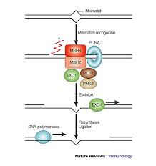
Functional Studies of MSH2 Missense Mutations in Yeast Provide Insight to HNPCC
Zhane Cruickshank and Keyana Scott
Bio 125
4/17/14

Slide 2
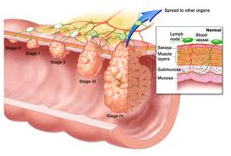
Abstract
Both the wild type MSH2 and mutant msh2-D621N are cloned into vector pRS413. Mutation of D621N can be monitored by restriction enzyme SwaI. To measure the DNA mismatch repair function in yeast, a report plasmid pMSH2 with microsatellite fused URA3 is used.
Functional URA3 on FOA plate will lead to viable cells, and effective mismatch repair will lead to dysfunction URA3 and give to viable cells. Primers are used to amplify a specific location on the plasmid used for PCR amplification.
The primer has a reverse and forward marker that examines a particular amount of base pairs that will help examine the mutation better. By comparing WT and D621N mutant, we expect that D621N mutants should have compromised mismatch repair mechanism. The significance of this experiment will examine the importance of DNA mismatch repair and how mutations affect the cell.
We started with a human cancer called hereditary nonpolyposis colorectal cancer, which contained a mutation in MSH2, we then designed similar mutations in the cognate positions in yeast MSH2.
DNA mismatch repair is a method or procedure used to repair DNA damages, insertions, deletions, and disincorporation of bases. MSH2 is a repair protein and is used as a tumor suppressor. It creates a heterodimer with MSH6 to make the human MutS mismatch repair complex. The mutation was D621N, replacement of aspartic acid residue to asparagine.

Slide 3
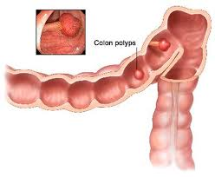
Introduction
Colorectal cancer was diagnosed in about 153,000 Americans in 2006 and resulted in 56,000 deaths. 2-7% of the results showed that the cancer was inherited (hereditary nonpolyposis colorectal cancer).
This cancer is associated with defects in DNA mismatch repair. DNA mismatch repair contributes to the preservation of genetic material.
One of the main mismatch repair system genes is MSH2, which is highly conserved in both prokaryotes and eukaryotes
Without an intact mismatch repair system, numerous mutations can accumulate, some of which eventually lead to cancer such as hereditary nonpolyposis colorectal cancer. In this experiment, strains of Saccharomyces cervisiae, a budding yeast was used because it is possible to test for MSH2 function and the similarity of its mismatch repair system to humans.

Slide 4
Experimental objective
The objective of this research is to locate the mutation in the MSH2 gene and distinguish it from an empty vector type, wild type, and a mutant type. In order to learn more information about HNPCC in humans.

Slide 5
Materials and Methods
Restriction Enzyme Protocol:
Used to cut enzymes at restriction sites.
Materials:
1mL APA, 1 mL Xbal, 2 mL buffer, .5 mg DNA, H2O
Protocol:
1.Prepare the 3 solutions, mix gently and spin down.
2. Incubate @37C in a heat block or water thermostat for 5 minutes.
3. Inactivate the enzyme (optional)
Running gels:
1. DNA is negative, it runs to the red side on the gel box because red is positively charged
2.Ethidium bromide inserts itself into the groove of double helix DNA. (its a carcinogen)
Polymerase Chain Reaction (PCR):
amplify and make multiple copies of a DNA sequence.
Protocol:
1. Dilute each of your Plasmids to 5ng/μl using nuclease-free water. Label each tube appropriately and store after use at -20oC in your group’s box.
2. Label 3Ready-To-Go Bead tubes, corresponding to your 3reactions. These will go into the thermo-cycler with tubes from other groups, so make sure you can identify your tubes! Make sure the bead is at the bottom of the tube.

Slide 6
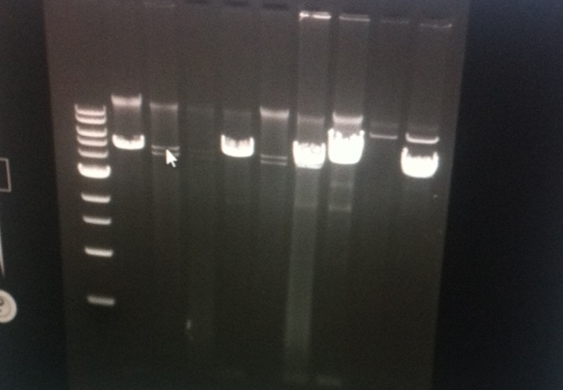
Materials and Methods
Polymerase Chain Reaction (PCR):
(continued)
3. Prepare PCR master mix as follows: 105μl Nuclease free water and 10μlPrimer mix. Gently tap tube and quick spin to bring the contents of the tube to the bottom.
4. Dispense 23 μl of PCR master mix to each0.2 ml PCR tube containing the ready-to-go beads.
5. Add 2 μl of each of your DNA templates to the appropriate PCR tubes. The total amount of DNA added in each tube is 10ng.
6. Flick the tubes gently to mix and then centrifuge briefly. Use the rack provided to support the 0.2ml tubes. Your instructor will collect the samples and load the thermo-cycler
7. The thermo-cycler program is given below. The cycling parameters will be as follows
:95oC for 5 minutes, 95oC for 1 minute, 55oC for 1 min, 72oC for 1 minute, Return to Step 2 for 34 more times, 72oC for 10minutes and Hold PCR at 4oC.
8. After approximately 2 hours, take your tubes out of the thermo-cycler and store your reactions at -20oC until next class period when we will run gels to visualize the results of your reactions

Slide 7
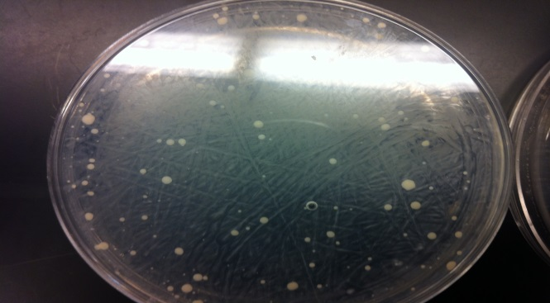
Materials and Methods
Transformation of MSH2:
Protocol:
1. Divide your culture tube of yeast, grown overnight at 30°C into two 1 ml aliquots. Collect the cells by centrifuging for 2 minute at 5000 rpm. You should observe a cell pellet at the bottom of the tube. Carefully decant the supernatant, and gently re-suspend the pellet in 1 ml of sterile water. Centrifuge again.
2. Remove the supernatant completely by pouring off and then by removing residual volume with a pipette. Carefully re-suspend the cell pellet in 0.5 ml PLATE solution from the stock tube provided.
3. To each of your two tubes, add the following transformation components:
Ø 0.5 ml yeast suspended in PLATE solution (what you just prepared)
Ø 20 μl 1M DTT (caution: this solution has an odor)
Ø 5 μl boiled Carrier DNA
Ø 1 μg of plasmid DNA (mutant-MSH2) in a final volume of 10 μl: or 10μl water that will be added to the un-transformed cells as a negative control.
4. Mix the contents of each tube carefully by pipetting gently up and down with a blue tip. Incubate tubes for 30-45 minutes at 30°C.
5. Heat shock the cells for 15 minutes at 42°C in the water bath provided.
6. Centrifuge the transformation mixture for 10-15 seconds in a microfuge to collect the cells. Remove the supernatant and gently re-suspend the cell pellet in 100 μl sterile water.
7. Transfer the entire volume of cells to the surface of an SD ‒his plate (to select for transformants) and spread evenly across the plate using sterile glass beads.
8. Incubate the transformation plates for 24-48 hours at 30°C in inverted position (upside down) in an incubator. Check for the presence of colonies after 48 hours; these represent transformants that have taken up the plasmid and are now able to grow in the absence of histidine (due to the presence of the His marker on MSH2 plasmids).

Slide 8
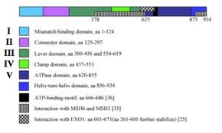
Conclusion
The objective of this research was to determine how much damage to the mutant MSH2 occurred. Our mutant type consisted of D621N strain AG422. We used the Enzyme Swal and approximately came to the conclusion that the mutant was quite similar to the wild type.
In comparing the Empty Vector, Wild Type and Mutant we saw that there was little damage to the MSH2 which allowed for only small colonies to occur on the FOA plate. There were some small errors that occurred for example contamination and the data was mixed up where the wild type and the empty vector where labeled wrong on the FOA plate that could have resulted in false evaluation. As a result of the experiment we were able to recognize the importance of MSH2 and why mismatch repair is needed.
We determined that our mutation was not entirely a result of the mismatch binding domain, but more of the ATPase domain.

