Slide 1
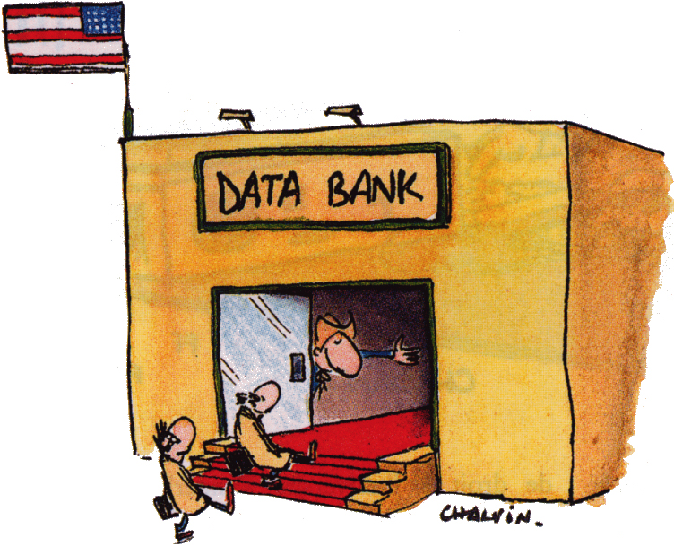
Ch2 Introduction to biological databases

Slide 2
Overview
What is a database?
What is basis of database?
What is the purpose of database?
How many types of databases?

Slide 3
What is database?
Database: a computerized archive to store and organize data in such a way that information can retrieved easily according various criteria.

Slide 4
What is the basis of databases?
Basis: computer hardware and computer software for data management.

Slide 5
What is the purpose of database?
1. Data retrieval
2. Knowledge discovery
3. Reliable source of information

Slide 6
Terminology
Entry
Field
Query
Notes:
A new slide….

Slide 7
Entry, Field, and Query in PubMed
http://www.ncbi.nlm.nih.gov/

Slide 8
Types of Databases
Flat files
Relational Database
Object oriented Databases

Slide 9
Flat files
A text file that can be edited by a text editor, such as Microsoft “notepad”.
Often, it contains many entries separated by a special delimiter such as tab or comma. Each field within an entry can be separated by other delimiters, such as “|”.
Example: FASTA files

Slide 10
Flat files
Pros: easy for human to read and edit.
Easy for programming using SHELL, PERL and Python.
(Demo of SHELL and PERL script on flat files under Linux.)‏
Cons: very inefficient for computer to search for specific field or record because it would have to would have to read through the entire file, i.e. very slow.

Slide 11
Relational Databases
Relational databases use a set of tables to organize data. Each table is called a “relation” and is made up of columns and rows.
Columns represent individual fields in a table.
Rows represent records of data in a table.
Columns in a table are indexed and linked so that they can be cross-referenced in other tables.

Slide 12
SQL and Relational DB
Relational databases use a set of tables to organize data. Each table is called a “relation” and is made up of columns and rows.
Columns represent individual fields in a table.
Rows represent records of data in a table.
Columns in a table are indexed and linked so that they can be cross-referenced in other tables.

Slide 13
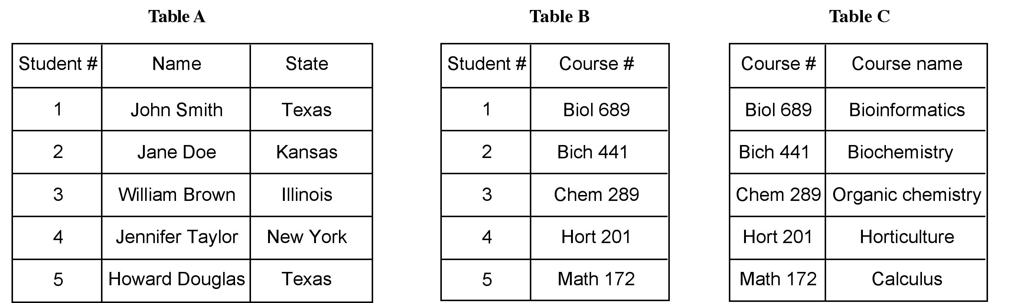
Tables in Relational DB
Select * from TableA and TableB where
TableA.Student# = TableB.Student#
And TableA.State = “Texas”;
(See demonstration in Linux)

Slide 14
The key thinking process when building a relationship database
Abstraction
  Abstract the biological data into multi-leveled information (fields, tables, etc).
  Identify the relationship among the abstractions (fields, tables)

Slide 15
Object-oriented databases
Object-oriented databases store data as “objects” which are linked by pointers. In programming language, an object is like a module that combines data and mathematical routines that act on the data. Between objects are a set of pointers that define the predetermined relationships between objects. Searching the database is to navigate through the objects, which relies on predefined pointers.
Programming languages like C++, JAVA can be used to create object-oriented databases.

Slide 16
Biological Databases
Current biological databases use all three types of database, flat files, relational, and objected-oriented. Despite obviously drawback of flat files in database management, many biological databases are still use this format. A justification for that is that it is easy to understand by working biologists and easy to be handled by some sequence analysis tools.

Slide 17
Biological Databases
Primary databases: contain original biological data, raw sequence or structural data submitted by the scientific community. Ex. GenBank and protein data bank.
Secondary databases: contain computationally processed or manually curated information based on original information from primary databases. Ex. Swiss-Prot, InterPro, Ensembl.
Specialized databases: those that cater a particular research interest. Ex. Flybase, SGD, HIV sequence database, and Ribosomal Database Project.

Slide 18
Primary Sequence Databases
Three major public sequence databases: GenBank, EMBL, DDBJ.
They store raw nucleic acid sequence data submitted by scientific community worldwide. There is only a minimal level of annotation.
The three databases collaborate and share new data on a daily basis
Nowadays, sequence submission to one of these three databases is a precondition for publication in most scientific journals.

Slide 19
SWISS-PROT
  An example of secondary database.
  (http://us.expasy.org/sprot/) An extensively curated protein sequence database with detailed annotation for confirmed protein sequences. The annotations include structure, function, and protein family assignment. It maintains a low level of redundancy by merging variants and fragments of a sequence into a single entry.

Slide 20
Specialized Databases
  Specialized databases normally serve a specific research community or focus on a particular organism. The content of these databases may overlap with the primary database but may have new data directly submitted by authors. Since they are often curated by experts in the field, they may have unique organizations and additional annotations associated with the sequences.
  Ex. genome databases (TIGR microbial genome database, Flybase, AceDB, TAIR, Ensembl).
  Ex. functional databases. GenBank EST database and Microarray Gene Expression Database at EBI

Slide 21
Interconnection between databases
  Except a few cases, poor coordination.
  Often incompatible file formats.

Slide 22
Pitfalls of Databases
One of the problems associated biological databases is over-reliance sequence information and related annotations without understanding the reliability of the information.
Sequence errors.
Redundancy.
Errorneous annotations.
The errors are passed onto other databases causing propagation of errors.

Slide 23
Errors
Mostly experimental problems.
Sequencing errors which exhibit in the form of substitutions, insertions , deletions or contamination. Some of these errors cause frameshits that make whole gene identification difficult. Sometimes, gene sequences are contaminated by sequences from cloning vectors.
Errors are more common for sequences produced before 1990s. Therefore, excessive care should be taken when dealing with those dated sequences.

Slide 24
Redundancy
There is tremendous duplication of information in the databases due to :
repeated submission of identical or overlapping sequences by the same or different authors;
revision of annotations;
dumping of EST data;
poor database management that fails to detect the redundancy.
This makes databases excessively large and unwieldy for information retrieval.
Many sequences are duplicated either entirely or partially.
Notes:
Explain EST and its number of entries.

Slide 25
RefSeq
NCBI has now created a non-redundant database, called RefSeq.
Identical sequences from the same organism and associated fragments are merged into a single entry. That involves sequence similarity comparison of every entry.
RNA and proteins sequences derived from the same DNA sequences are explicitly linked as related entries.
Sequences variants from the same organism with very minor differences, which may well be due to sequencing errors, are treated distinctly related entries.

Slide 26
NCBI
National Center for Biotechnology Information: integrated databases and analysis tools.
Entrez: integrated gateway. It allows text-based searches for annotated genetic sequence information, structural information, and citations and abstracts, full papers, taxonomic data. BLAST searching allows one to connect one sequence with other sequences by underlying evolutionary relationships.

Slide 27
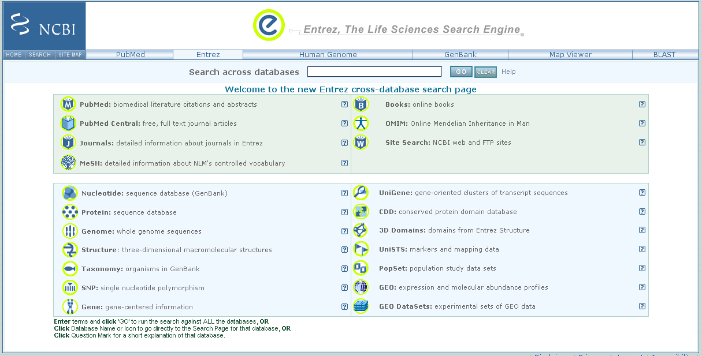
Notes:
Go to NCBI web site.

Slide 28
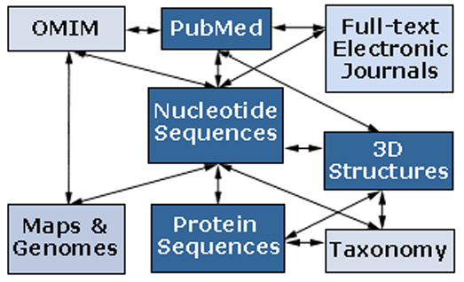
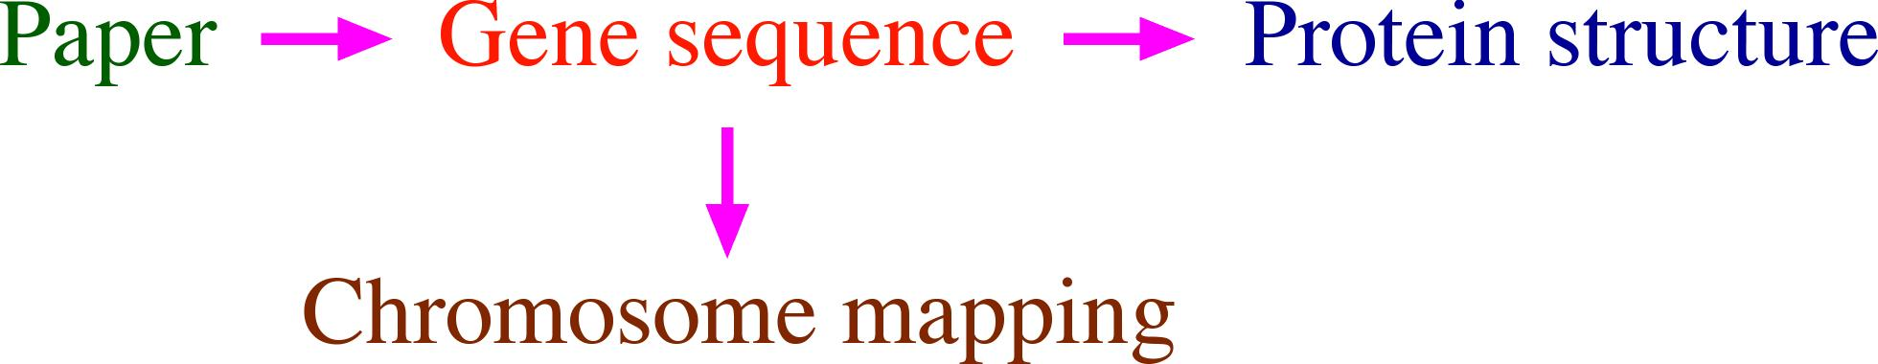
NCBI
Integrated Database: Interconnection between databases is the emphasis. Instead of having to visit multiple databases located in disparate places, the gateway allows access to various types of information by issuing only one query. Ex. nucleotide sequence linked to translated protein sequences to literature citations, and phylogeny of the organism and PubMed citations as well as full text articles whenever available.

Slide 29
Unified Search Across Databases
http://www.ncbi.nlm.nih.gov/gquery/gquery.fcgi

Slide 30
PubMed
  A biomedical literature database containing abstracts from nearly 4,000 journals.
  Some abstracts have links to full text articles in journals’ or publishers’ websites or in a related database PubMed Central.
  Major feature: MeSH terms.

Slide 31
PubMed Tutorials
http://www.nlm.nih.gov/bsd/disted/pubmed.html

Slide 32
PubMed Searches
Search by Authors and key words
Use Boolean operations, AND, OR, NOT
Use tags, [AU] [TI] etc
Use “Limits” (Journal and Dates)‏
“Preview/Index” to help combine searches
“History”,
“Clipboard”, store temporary hits
“Related links” to expand the searches
PudMed services (Journal, Citation)
Personalized search (MyNCBI)‏

Slide 33
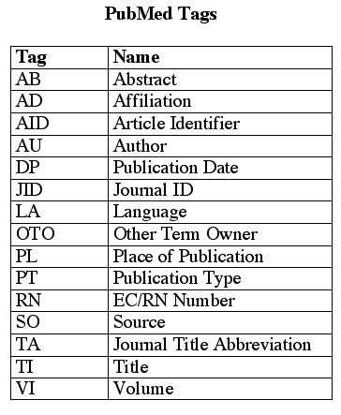
PubMed Tags

Slide 34
GenBank
  The most complete collection of annotated nucleic acid sequence data for almost every organism.
  Contents: genomic DNA, mRNA, cDNA, ESTs, genome sequence raw data, sequence polymorphisms (SNPs).
  Protein sequences (GenPept), the majority of which are conceptual translations from DNA sequences, but a small number of amino acid sequences are derived from peptide sequencing techniques.

Slide 35
Two ways to search GenBank
Key words search
BLAST by sequence

Slide 36
GenBank file format
  Header
  Features
  Sequence entry

Slide 37
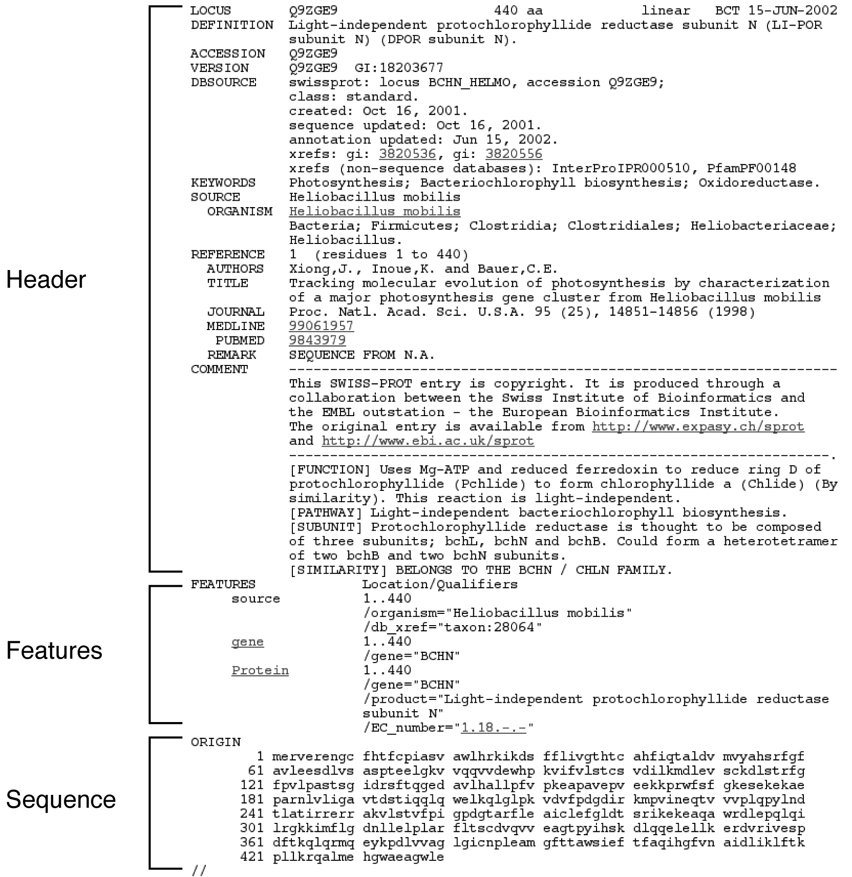
An Genbank File Example

Slide 38
Accession numbers and gi numbers
  Accession number is unchanged, but the gi number are changeable.
  So, always use accession number when searching.

Slide 39
FASTA
>gi|5106368|dbj|AB009351.1| Citrus sinensis mRNA for chalcone synthase, complete cds
AAACATATTCATTAAGGGTTCAACTTGAAATGGCAACCGTTCAAGAGATCAGAAACGCTCAGCGTGCCGA
CGGCCCGGCCACCGTCCTCGCCATCGGTACGGCCACGCCTGCCCACAGTGTCAACCAGGCTGATTATCCC
GACTATTACTTCAGGATCACAAAGAGCGAGCATATGACGGAGCTTAAAGAGAAGTTCAAGCGCATGTGTG
ACAAGTCGATGATTAAGAAGCGTTACATGTACTTAACGGAAGAGATTTTGAAGGAAAACCCCAACATGTG
CGCTTACATGGCTCCATCACTCGACGCACGTCAAGACATTGTGGTGGTCGAAGTGCCGAAGCTCGGGAAA
GAAGCTGCTACAAAGGCCATCAAAGAATGGGGCCAGCCCAAGTCTAAGATCACCCACCTCATCTTCTGCA
CCACCTCCGGCGTCGACATGCCCGGCGCCGACTACCAGCTCACCAAACTGATCGGCCTGCGCCCCTCCGT
CAAGCGCTTCATGATGTACCAACAAGGATGTTTCGCCGGCGGCACTGTTCTTCGCCTCGCTAAAGACTTG
GCTGAGAACAACAAGGGCGCTCGCGTTCTTGTTGTCTGTTCGGAGATCACGGCAGTCACTTTCCGCGGCC
CTGCCGATACTCATCTTGATTCTCTTGTGGGCCAGGCTTTGTTCGGTGATGGTGCTGCTGCTGTGATCGT
GGGTGCCGATCCTGACACGTCGGTCGAGCGTCCGTTGTATCAGCTCGTGTCGACTTCGCAGACGATCCTC
CCTGACTCTGACGGTGCAATTGACGGACACTTGCGCGAAGTCGGTCTCACTTTCCATTTGCTTAAAGACG
TCCCCGGCTTGATCTCAAAGAATATAGAGAAAAGCCTGTCTGAAGCGTTCGCCCCGCTTGGCATCAGCGA
CTGGAACTCGATATTCTGGATCGCTCACCCCGGTGGGCCCGCAATTCTGGACCAAGTGGAGTCTAAACTG
GGCCTCAAAGGGGAGAAGCTGAAGGCCACACGTCAAGTGTTGAGTGAGTACGGTAACATGTCAAGCGCTT
GTGTCTTGTTCATCCTTGACGAGATGAGAAAGAAGTCTGTTGAGGAAGCGAAAGCCACCACCGGCGAAGG
GCTTGATTGGGGTGTGCTGTTCGGGTTCGGGCCGGGGCTCACCGTCGAGACCGTTGTGCTGCACAGTGTC
CCCATCAAAGCTTGAAGTGAGAACTCCATCAGTATGTTTAGTAGTTCAGTAACTTTATGTTGTATGCTTT
CACAGTTGAGTTATTGGTTGATCGTGTGAAGGTTTAGTTTTGTCAATTGAGTTTAAGGCATCGTGCCTTT
TCTCTTATGACGTCACCAAACCTGGGCAACGCTTTGTGTTTATGCATAAATTCTTGGGAATTTGAGAAAG
TAGTAAATTTGT

Slide 40
Summary
Flat files can be parsed by PERL.
Relational DB
  Relational DBs are made of tables.
  In each entry (row) of a table, at least one field (column) must be unique.
  Fields (columns) can be shared by different tables.
  Different tables can be connected through shared fields.
PubMed search
  Use of tags
  Boolean operators are always capitalized. “AND”
GenBank sequence format
FASTA sequence format
Abstraction of data into fields and tables

Slide 41
What are PubMed tags?
PubMed “tags” correspond to “columns” or “fields” in tables of a relational DB. Image that there are many tables in the PubMed databases. Some of the “columns” are author names, which can tagged as “[au]” in the search, some are “journal titles”, which can be tagged as “[ta]”.

Slide 42
Reading assignment
  PubMed tutorial http://www.nlm.nih.gov/bsd/disted/pubmed.html
  Chapter 2, Xiong Book

Slide 43
END

