Slide 1
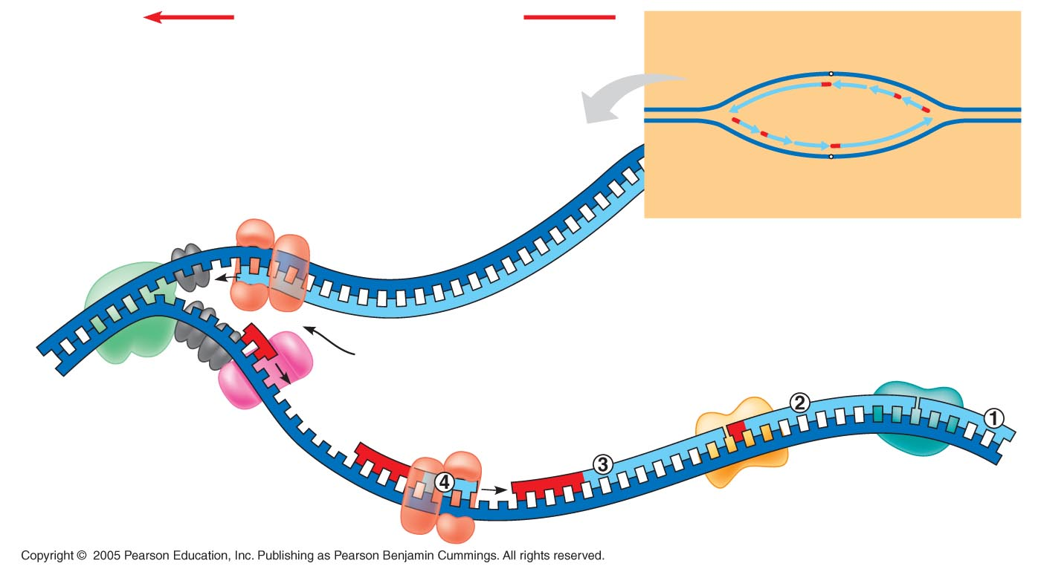
DNA Replication
Overall direction of replication
Leading
strand
Lagging
strand
Origin of replication
Topoisomerase
Separates strands
Helicase
Lagging
strand
Leading
strand
OVERVIEW
DNA pol III
Leading
strand
Replication fork
DNA ligase
5′
DNA pol I
3′
Primase
Parental DNA
DNA pol III
Lagging
strand
Primer
3′
SSBP
5′

Slide 2
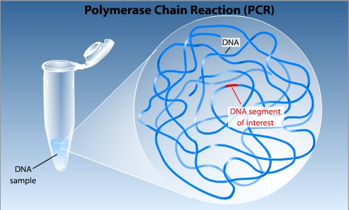

Copying DNA

Slide 3
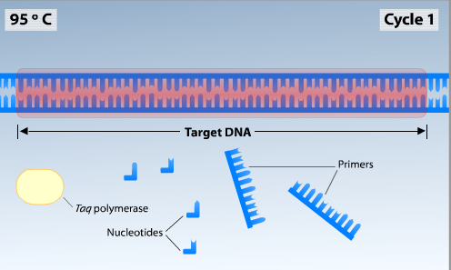


PCR Reaction

Slide 4

Step 1: Denaturation

Slide 5
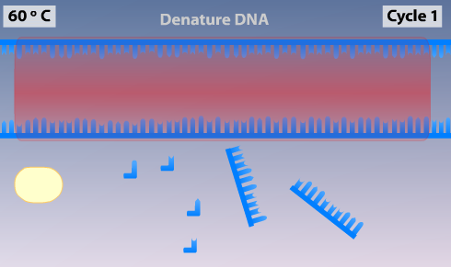

Lower Temperature to Anneal Primers

Slide 6
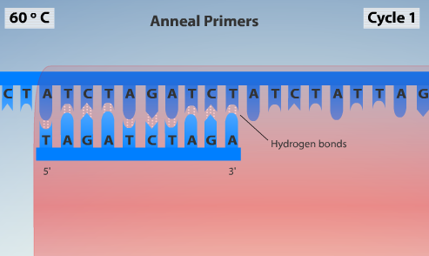
Step 2: Primer Annealing

Slide 7
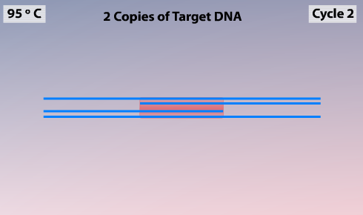


Step 3: Elongation

Slide 8
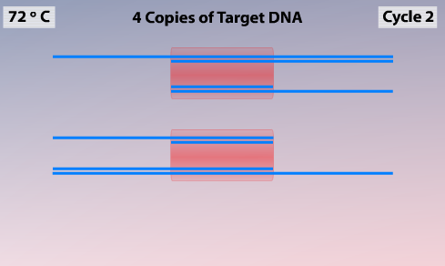

20 to 35 Repeating Cycles

Slide 9
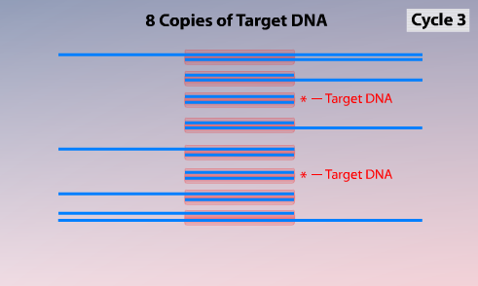

Flanking and Target DNA

Slide 10
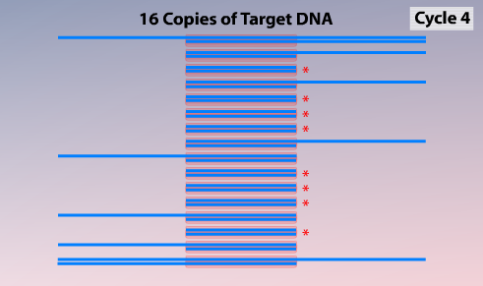


Greater Proportion of (just) Target DNA

