Slide 1
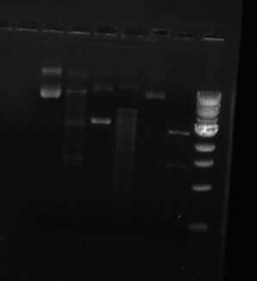
Figure 1
A.
B.
1 2 3 4 5 6 7
Figure 1. Plasmid MSH2 Mutant analysis. A) image of gel electrophoresis, Lane 1. 1kb DNA ladder, 2. pMSH2 Mutant- cut, 3. pMSH2 Mutant – uncut, 4 ……etc. B) Graph represents Standard Curve prepared using the 1 kb DNA Ladder. Y axis corresponds to the distance of each band passed during gel electrophoresis in (mm), Y-axis corresponds to the DNA band size in bp. Standard

Slide 2
Table 1. 1 kb DNA Ladder based on the agarose gel electrophoresis.
Table was prepared based on single measurement
Distance [mm]* | 1 kb Standard Curve bands [bp]
27 | 10000
30 | 6000
35 | 5000
41 | 3000
45 | 2000
52 | 1500
61 | 750
77 | 250
* Distance covered by each band was measured in mm.
Table 2. Estimates of the DNA fragment sized based on the 1 kb DNA Ladder standard curve
Table was prepared based on single measurement.
Estimated | Fragment 1 |  | Fragment 2
 | Distance [mm] | Size [bp] | Distance [mm] | Size [bp] | Distance [mm] | Size [bp]
Lane 3 Mut -uncut | 29 | 9 000 | 40 | 3800 | 56 | 1300
Lane 3 Mut –uncut | 15 | 15000 | NA | NA | NA | NA
Lane 4 – WT –cut | 25 | 12000 | 35 | 5000 | NA | NA
Etc….

