Slide 1
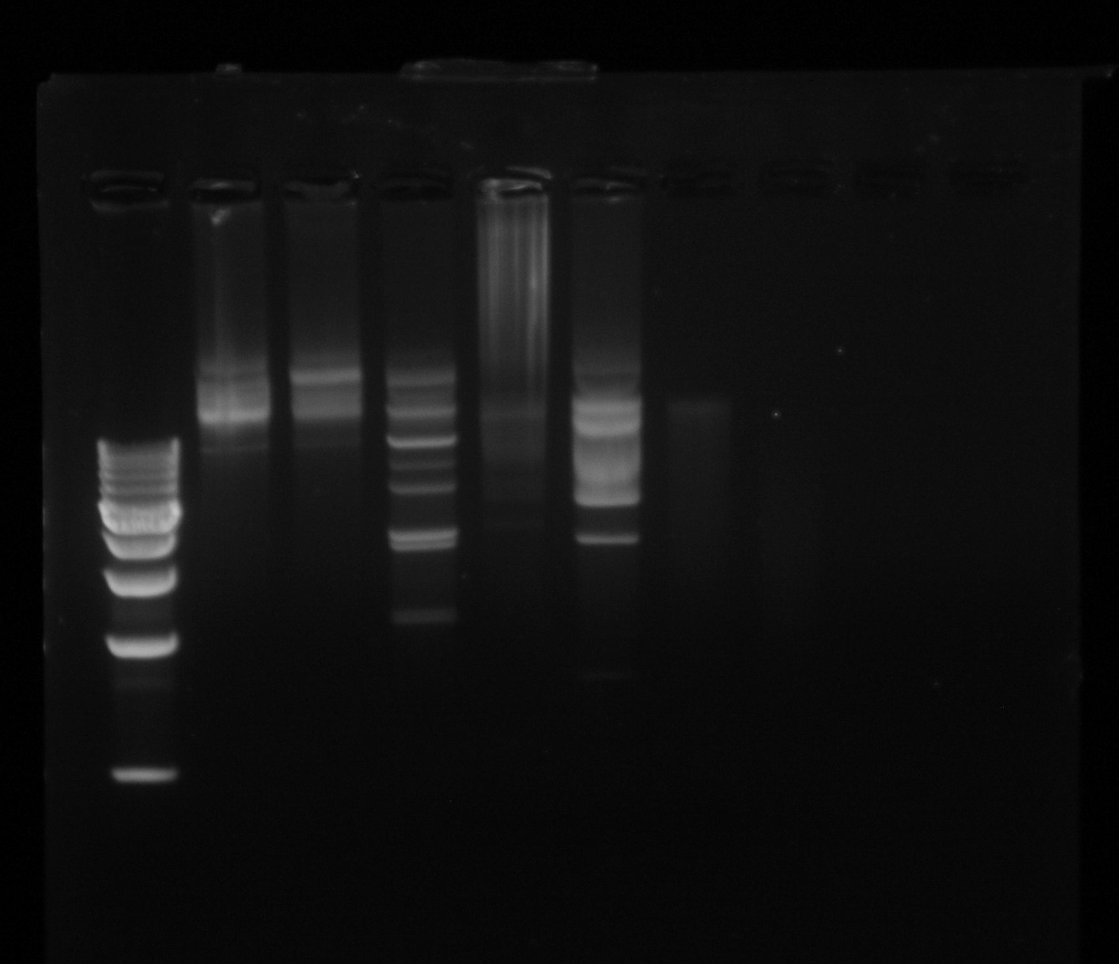
Jessica, Alysia ,
Kayla

Slide 2
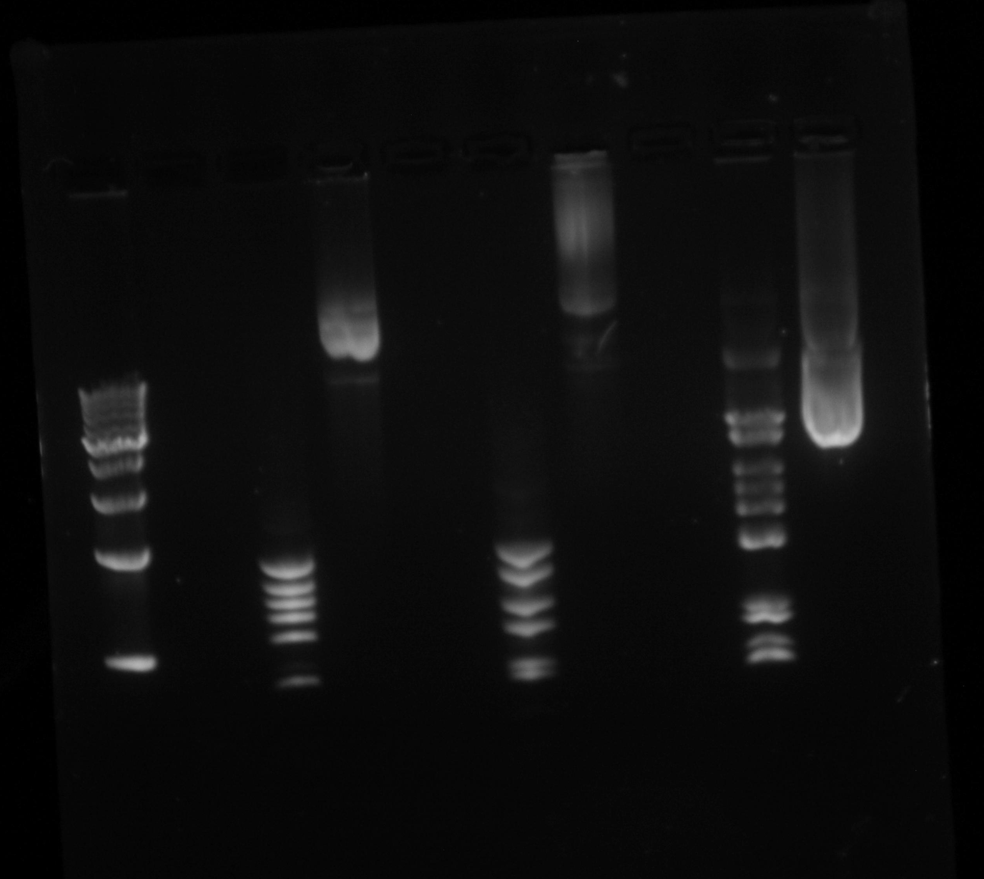
Mislie, Lawe, Stroughn

Slide 3
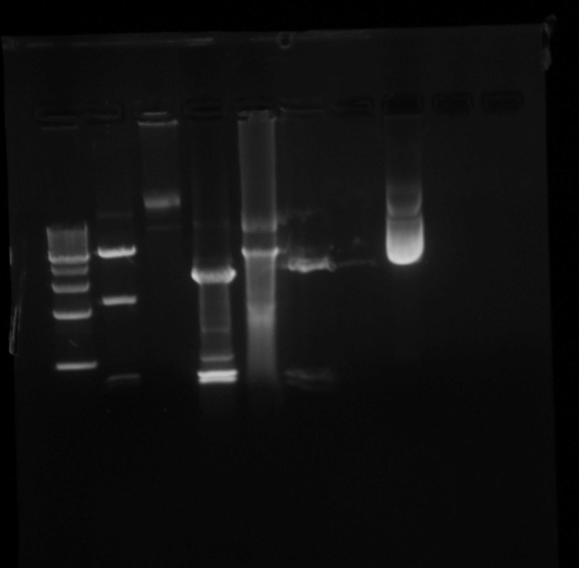
Group 7 Karyn, Liz, Sam

Slide 4
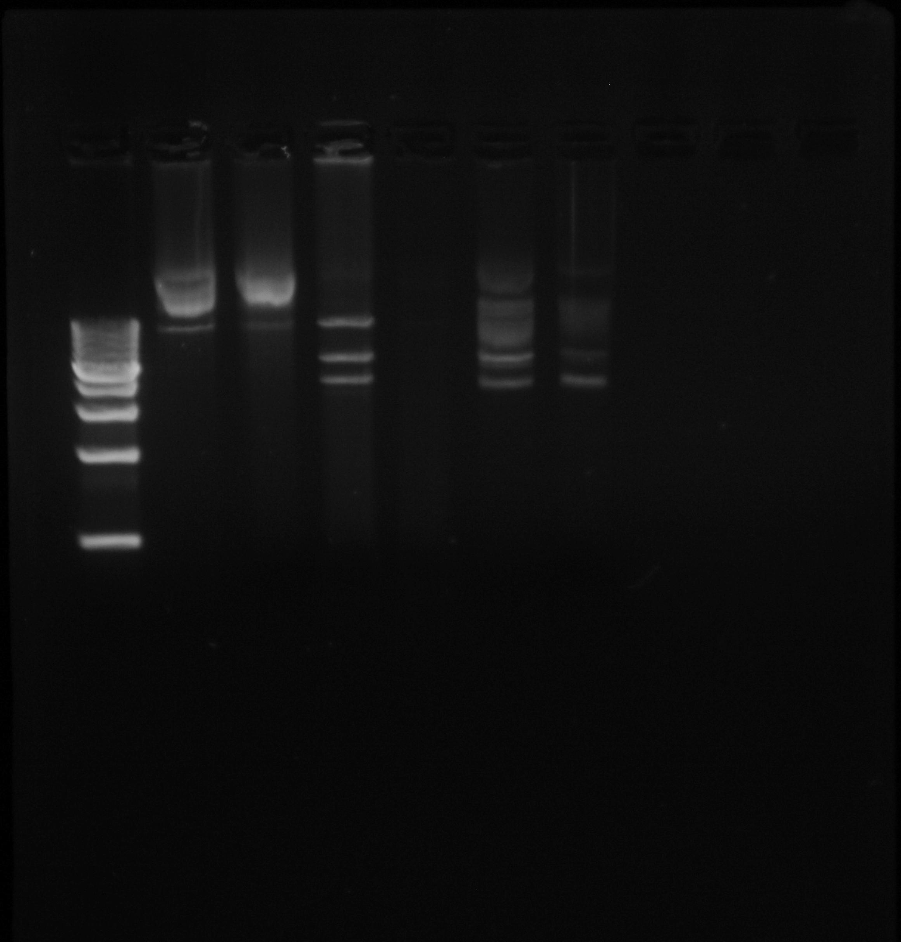
Group 6 Hopkins, Wicks, Ford

Slide 5
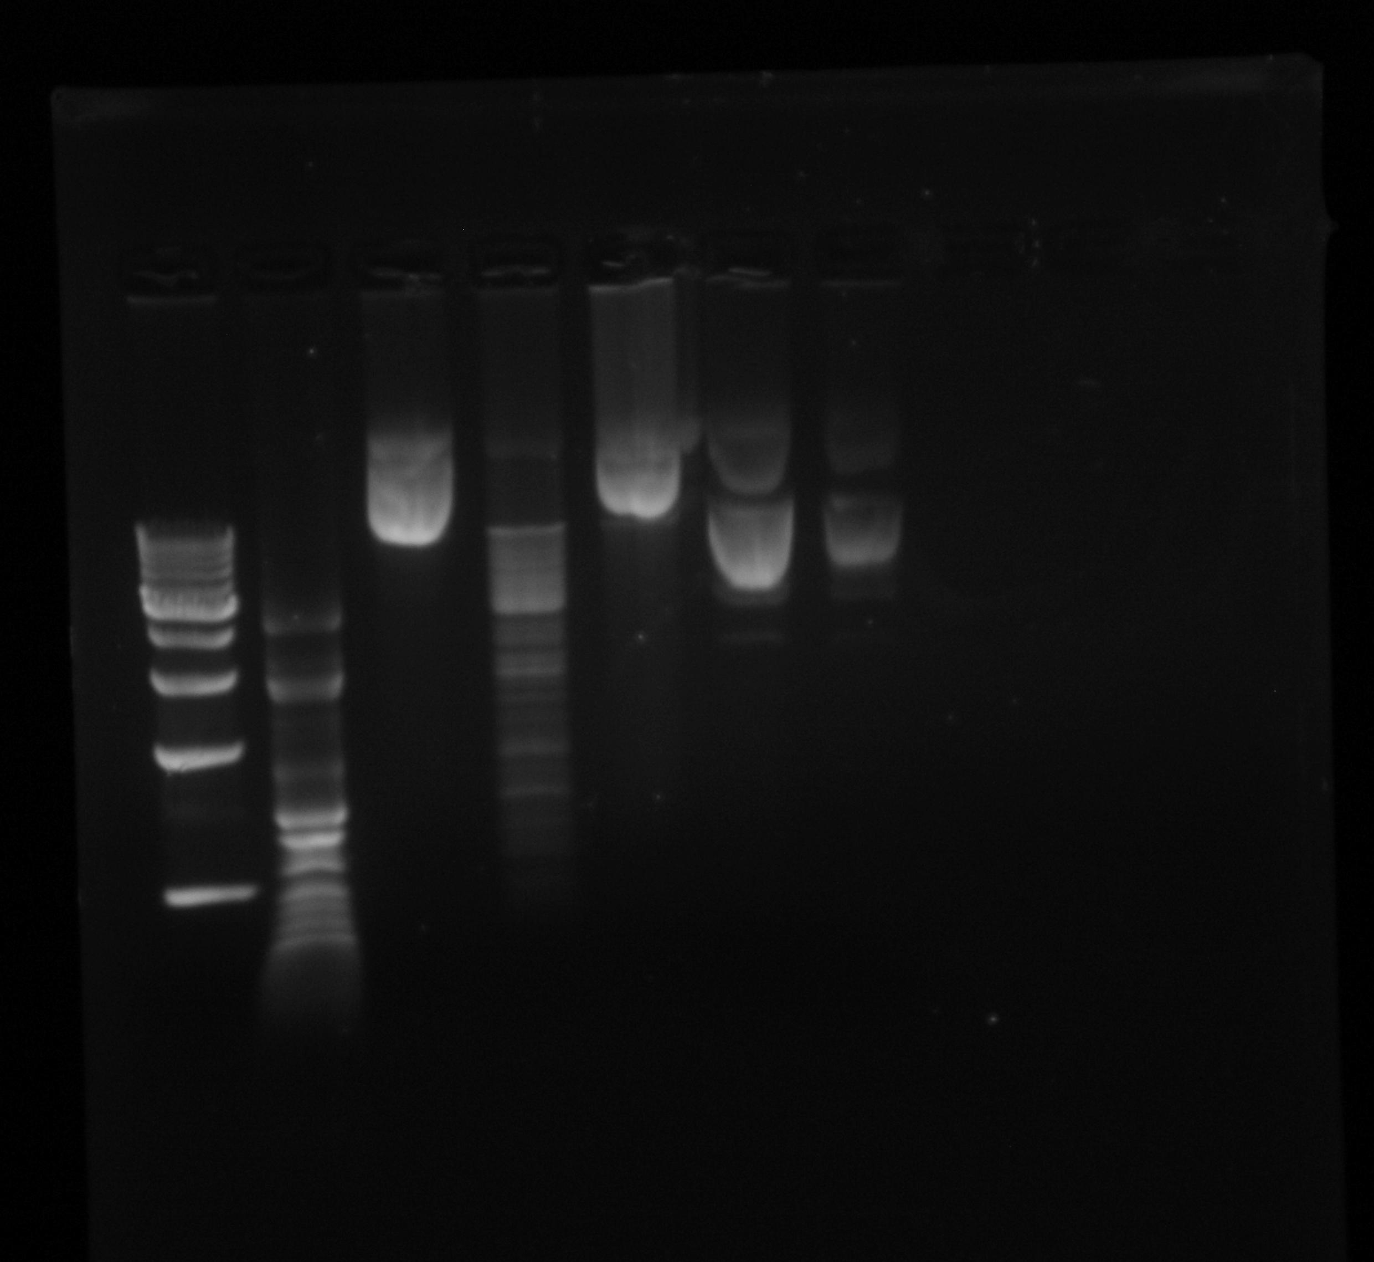
Group 2 DH, BJ, TR

Slide 6
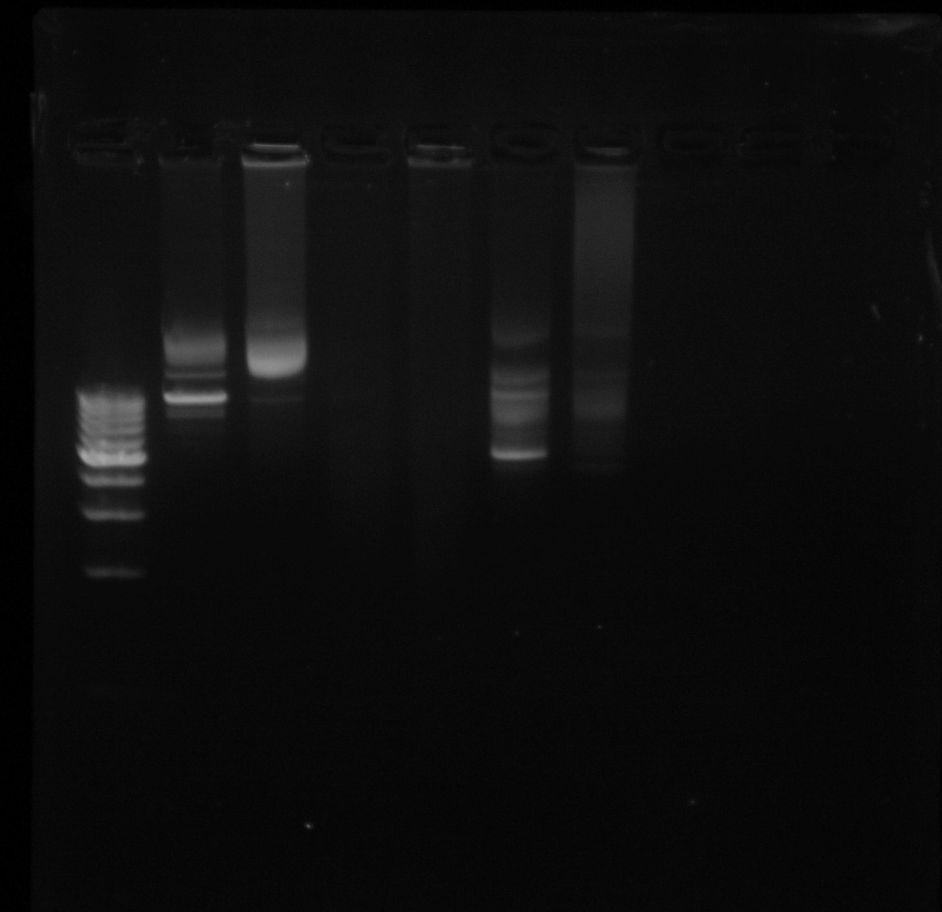
Group 1 (?) AM

Slide 7
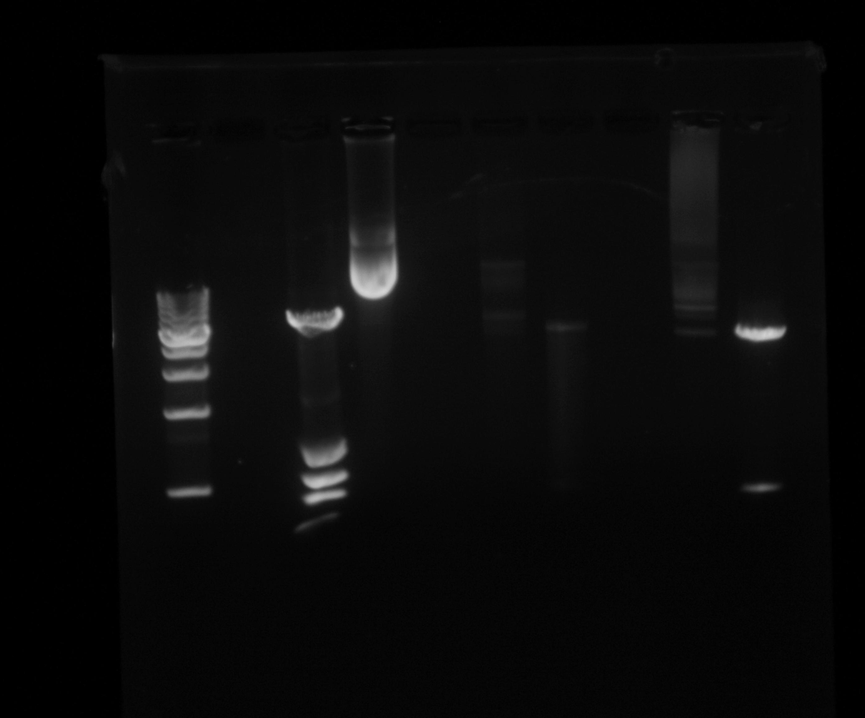
Group 3 PWF

