Slide 1
Database Similarity Search

Slide 2
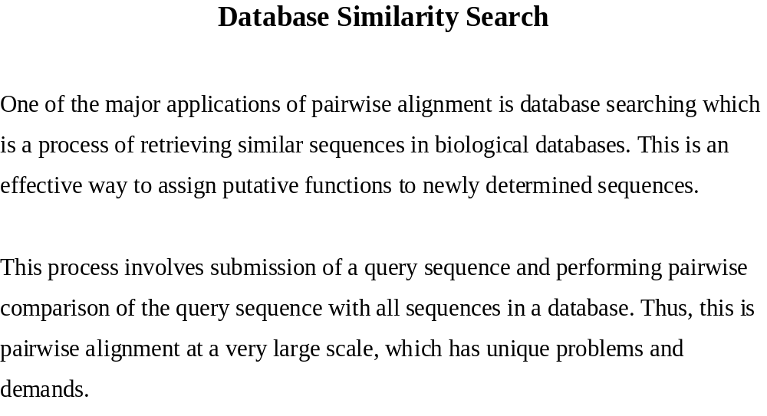

Slide 3
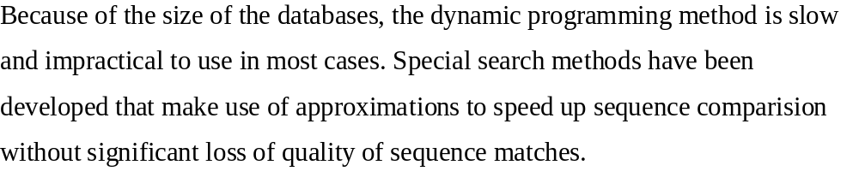

Slide 4
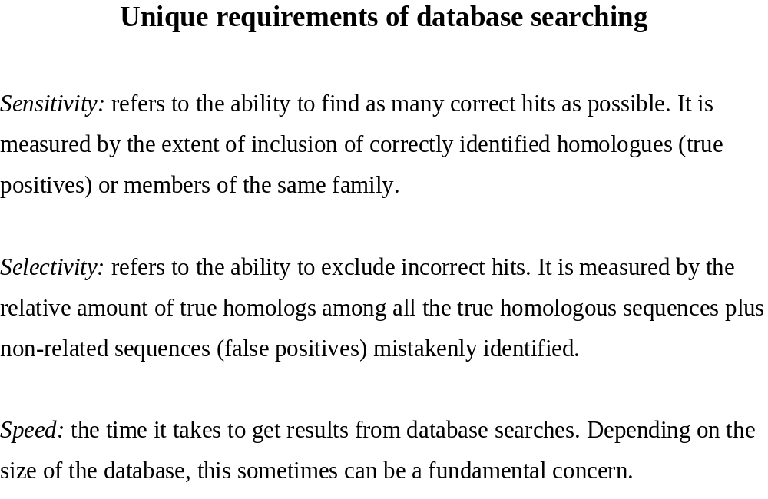

Slide 5
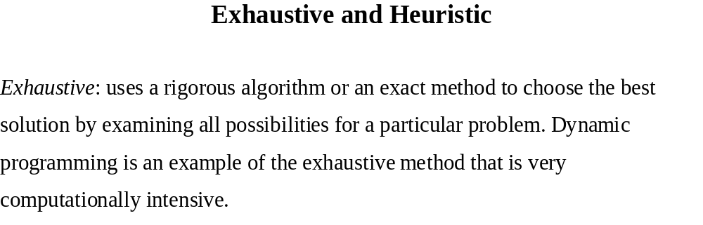

Slide 6
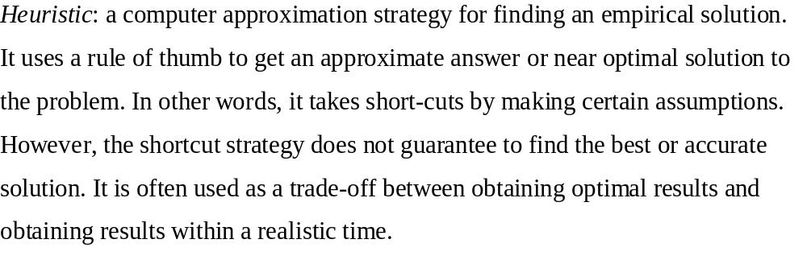

Slide 7
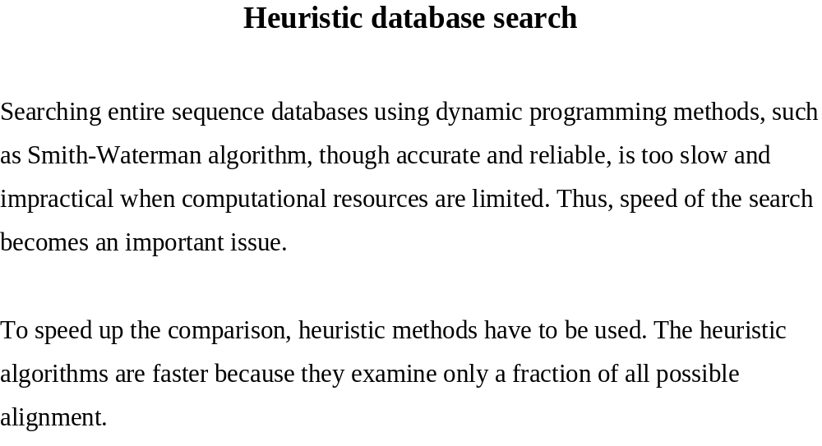

Slide 8
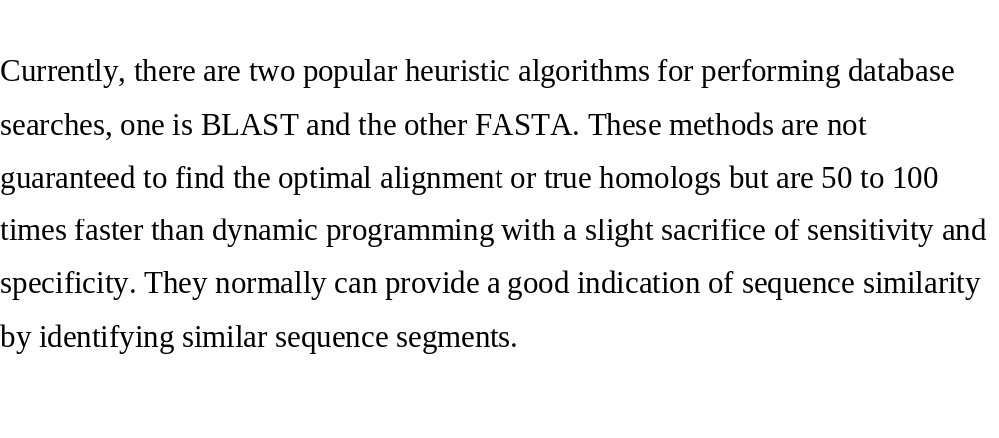
BLAST and FASTA

Slide 9
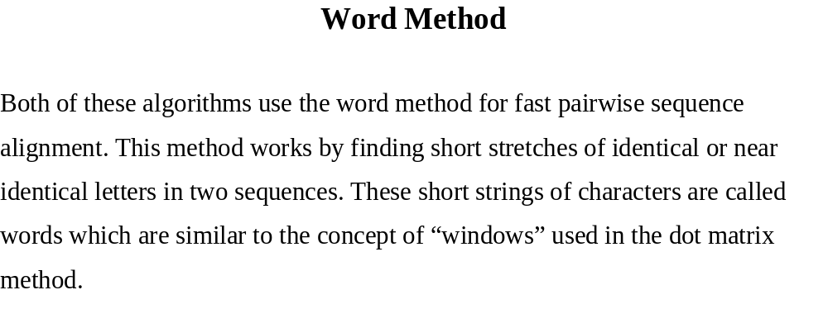

Slide 10
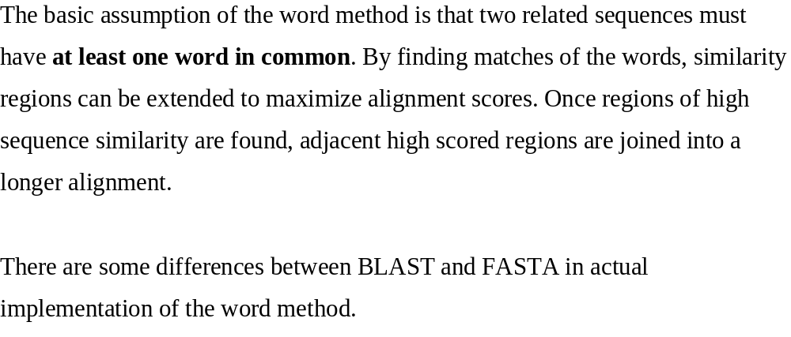

Slide 11
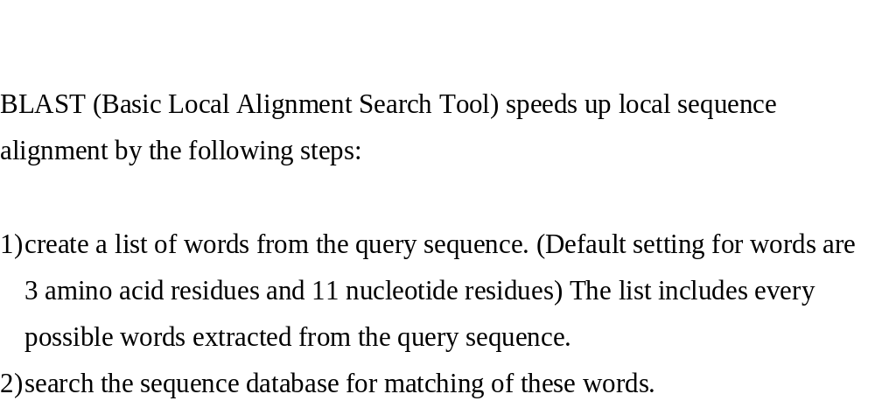
How BLAST works?

Slide 12
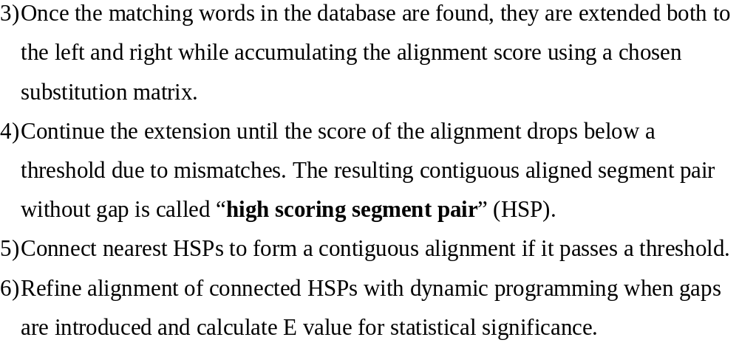

Slide 13
How does BLAST work?
— An example
1. There are highways petween Atlanta and Nashville
2. There are flights petween Atlanta and Nashville
3. There are a few flights petween Atlanta GA and Nashville TN

Slide 14
How does BLAST work?
— An example
Thereareh-ighwayspetweenAtlantaandNashville
Thereareflight--spetweenAtlantaandNashville

Slide 15
How does BLAST work?
— An example
Thereareh-ighwayspetweenAtlantaandNashville
Thereareflight--spetweenAtlantaandNashville
Thereareh-----ighwayspetweenAtlant--aandNashville--
Thereareafewflight--spetweenAtlantaGAandNashvilleTN
Notes:
a—a-n?? No

Slide 16
How a BLAST search works
“The central idea of the BLAST
algorithm is to confine attention
to segment pairs that contain a
word pair of length w with a score
of at least T.”
Altschul et al. (1990)‏
3-letter word in protein: 20³=8000
11-letter word in nucleotide 4¹¹=4.2 million

Slide 17
BLAST first finds a word and then extends to find a segment of alignment.
Thereareh-----ighwayspetweenAtlant--aandNashville--
Thereareafewflight--spetweenAtlantaGAandNashvilleTN
?
Notes:
a—a-n?? No

Slide 18
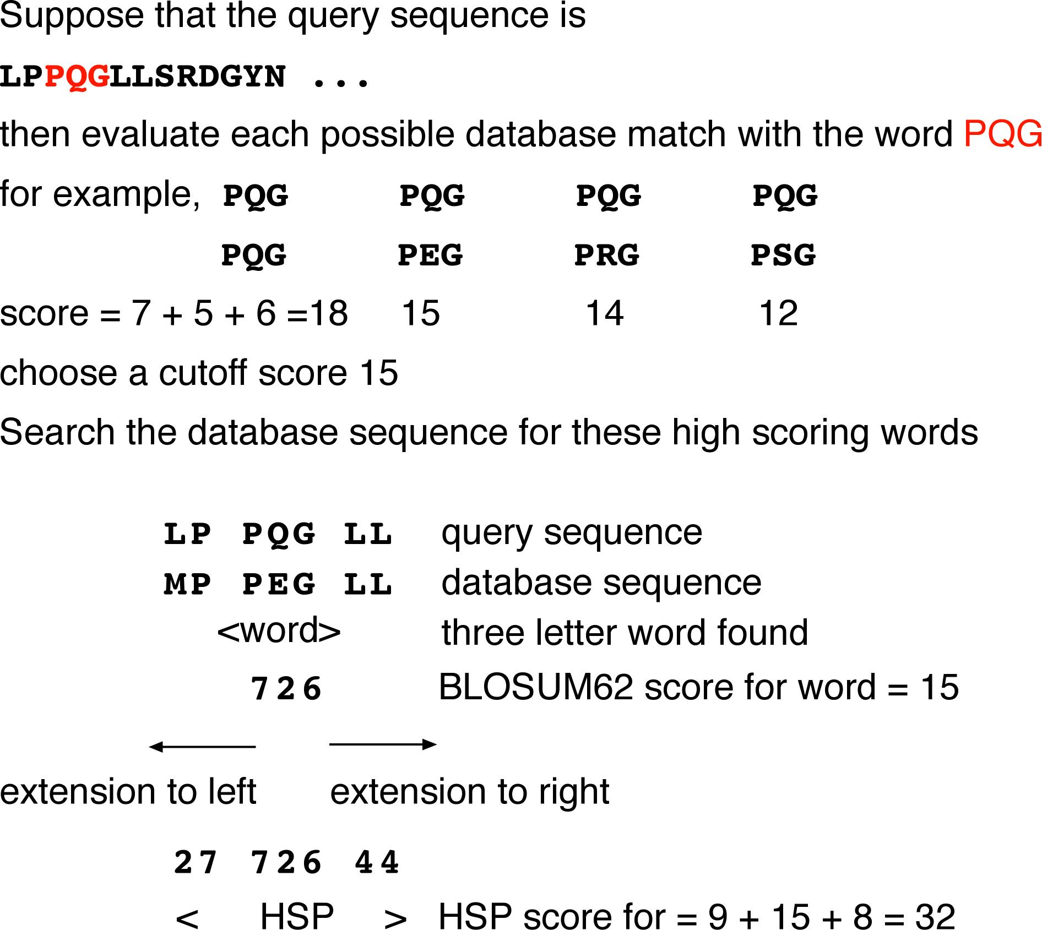

Slide 19
Why is BLAST fast?
BLAST only focuses on selected regions in the “search space”.
See figure 3 on this site:
http://en.wikipedia.org/wiki/BLAST#BLAST

Slide 20
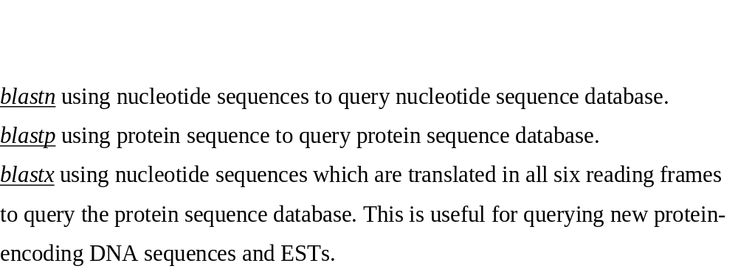
Blast variants

Slide 21
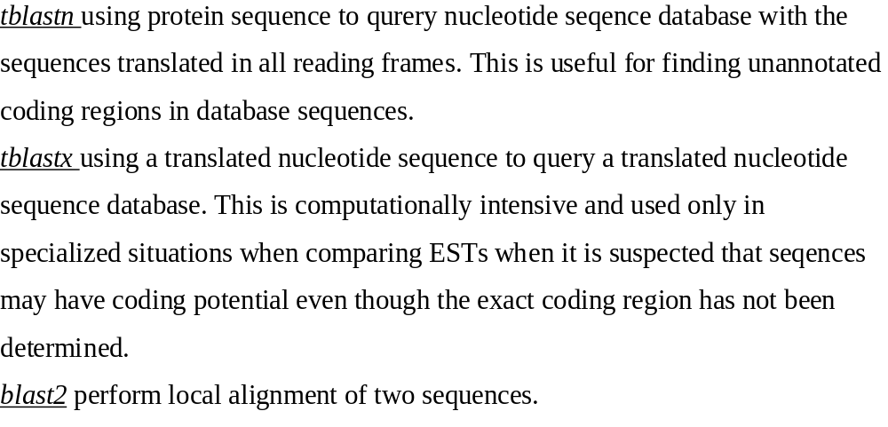
Blast variants

Slide 22


Slide 23
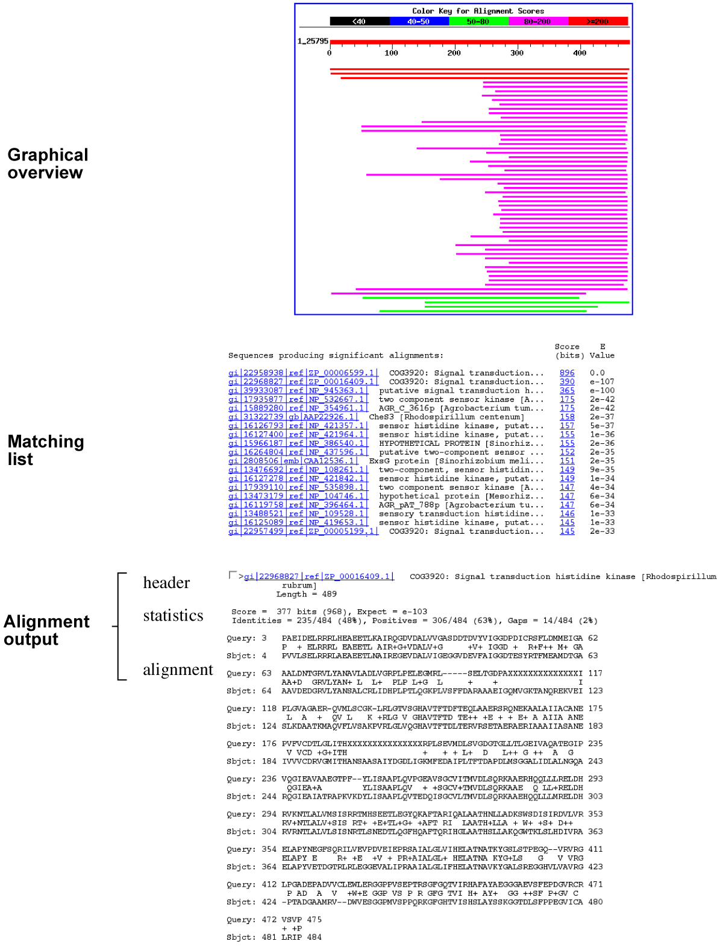

Slide 24
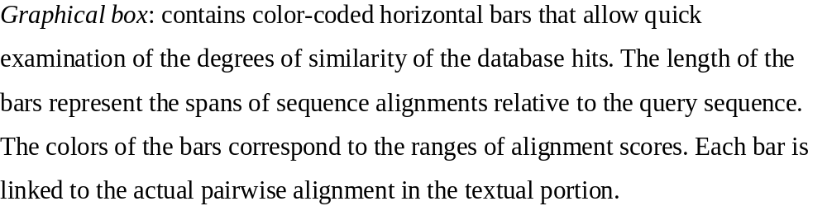

Slide 25
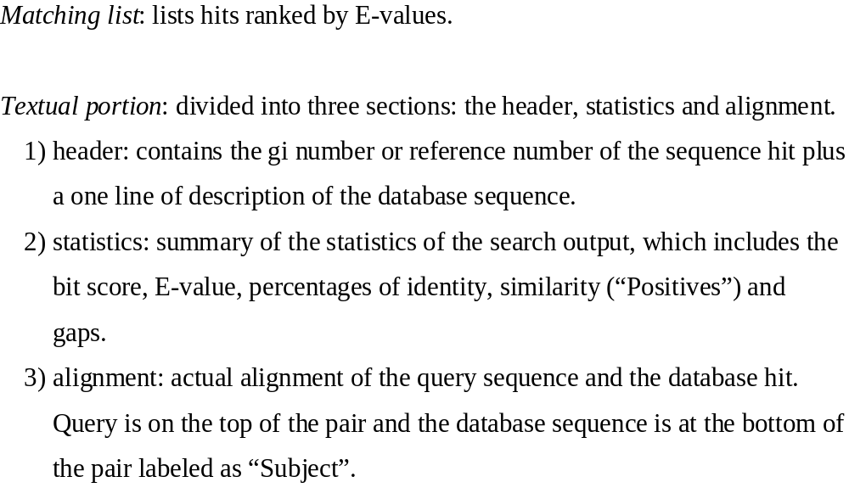

Slide 26
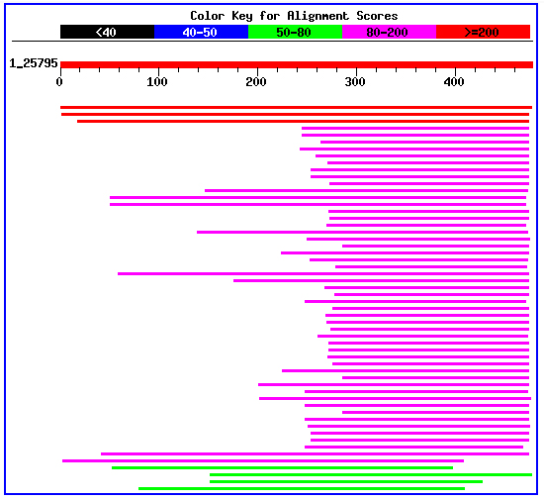
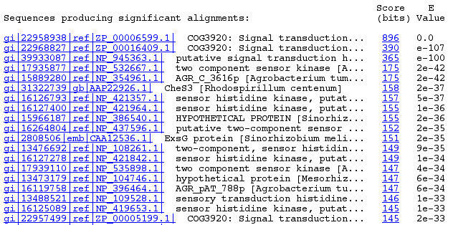

Slide 27
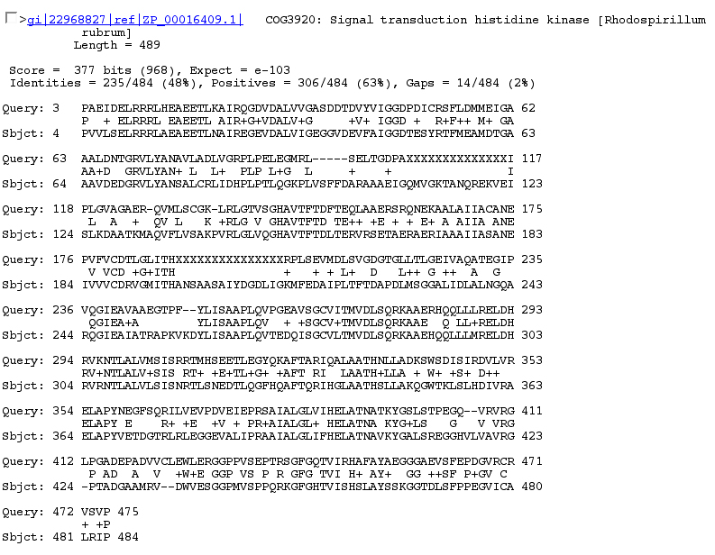

Slide 28
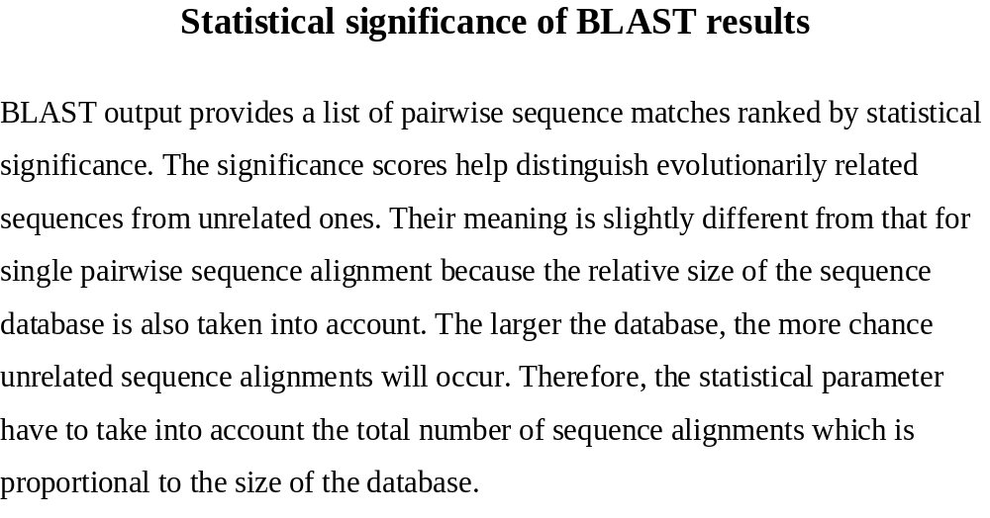

Slide 29
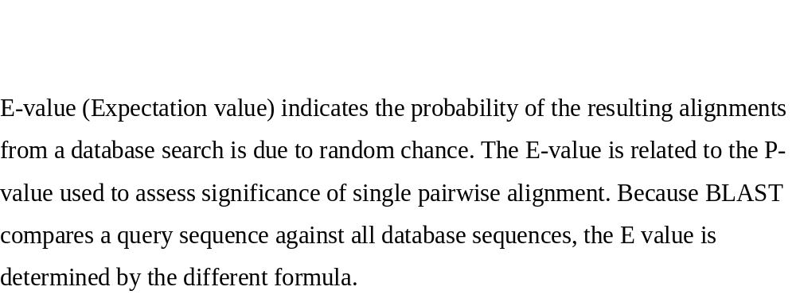
E-value

Slide 30
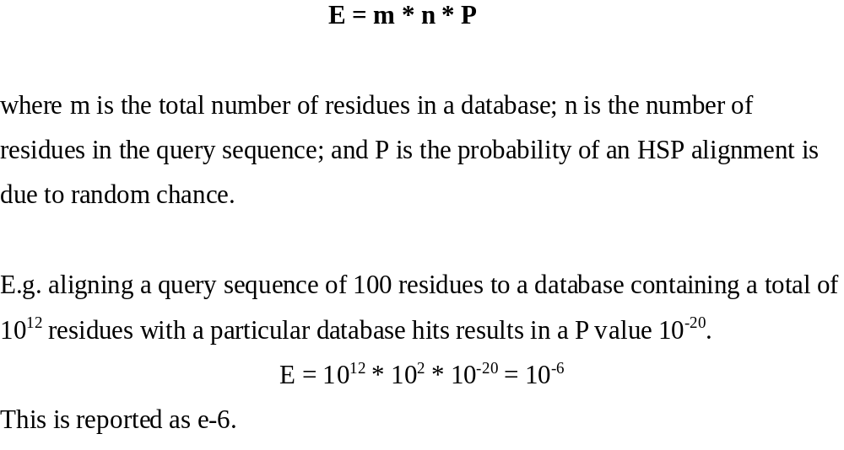
E-value

Slide 31
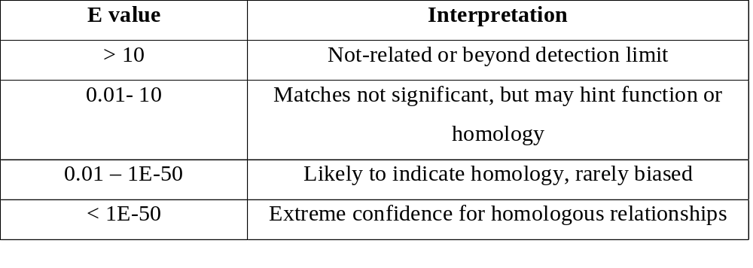

Slide 32
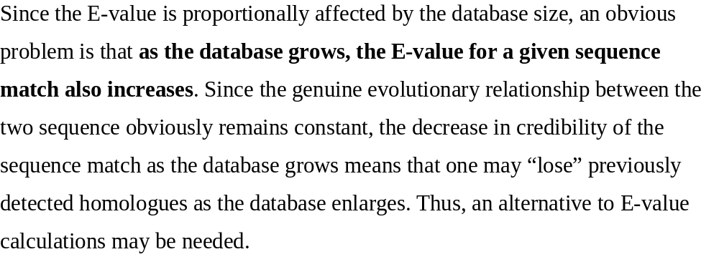
E-value and DB size

Slide 33
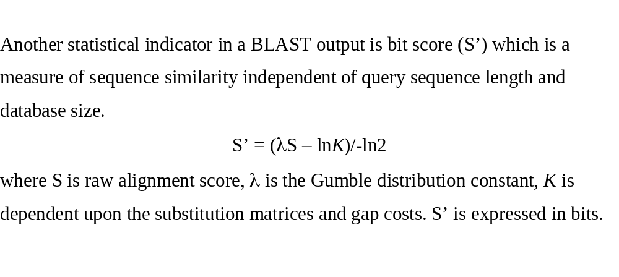
Bit score

Slide 34
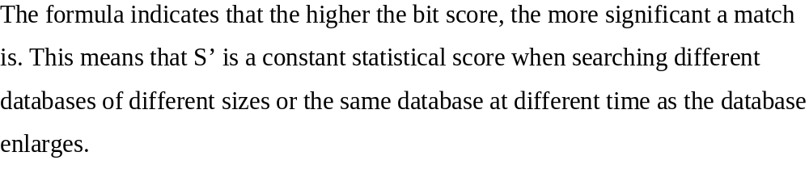

Slide 35
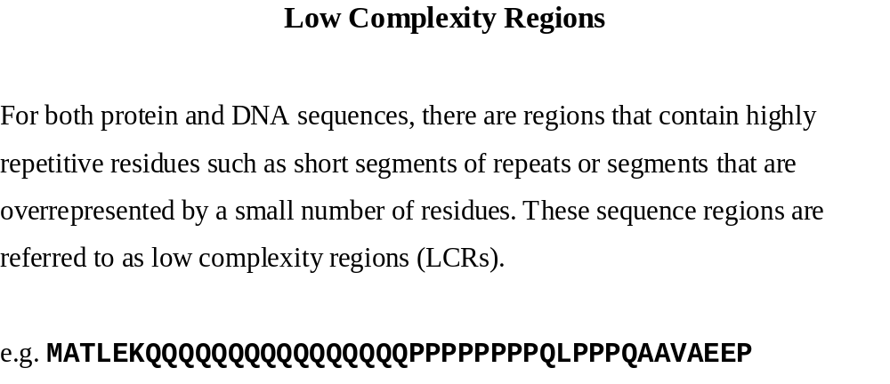
Low complexity regions

Slide 36
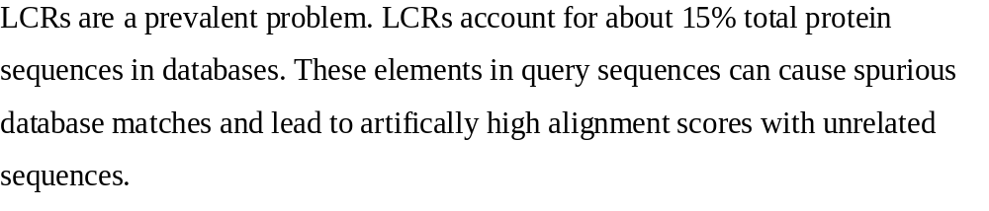

Slide 37
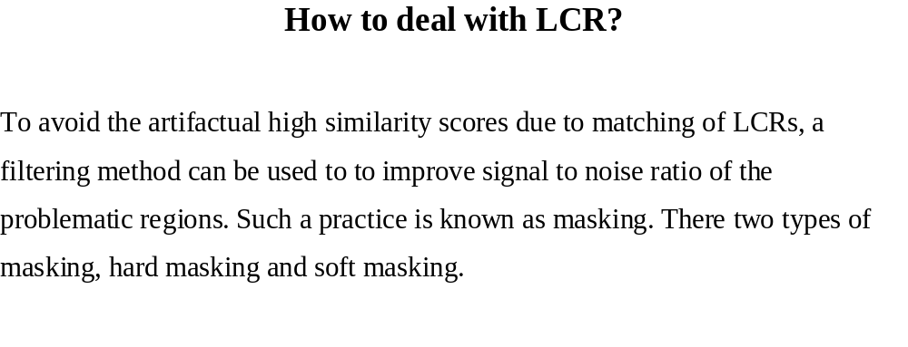

Slide 38
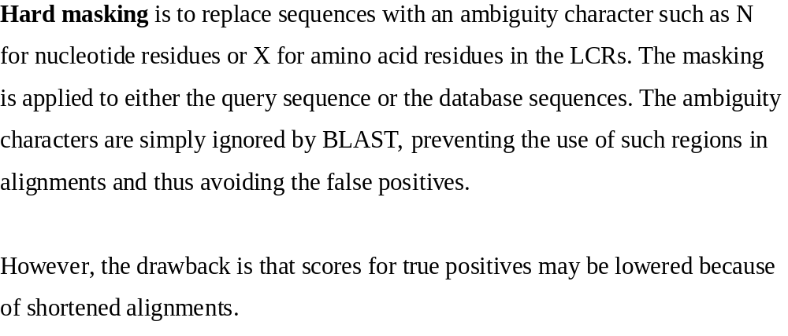
Hard masking

Slide 39
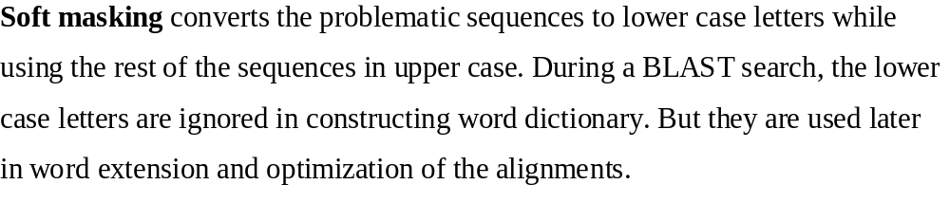
Soft masking

Slide 40
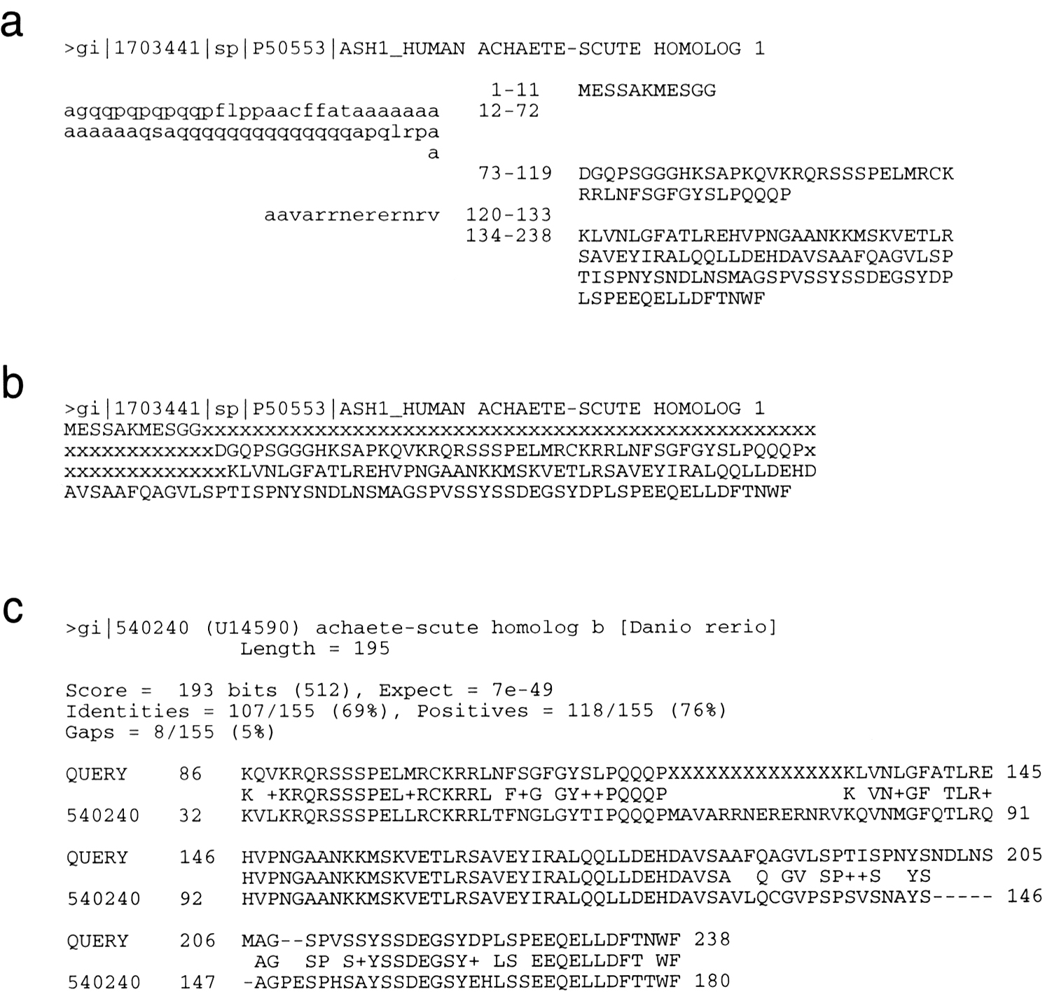

Slide 41
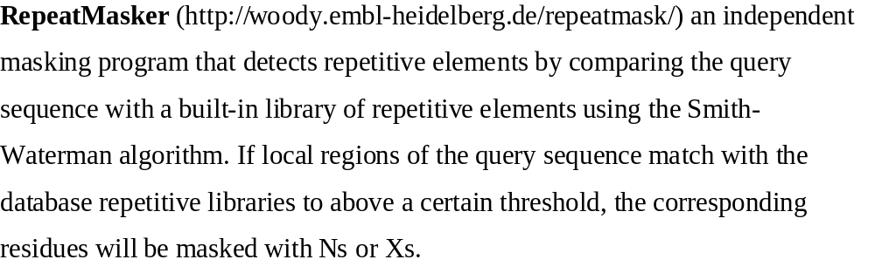
RepeatMasker

Slide 42
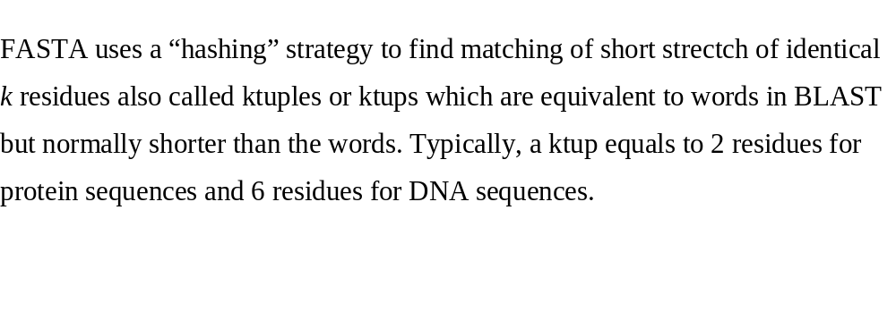
FASTA (not required)

Slide 43
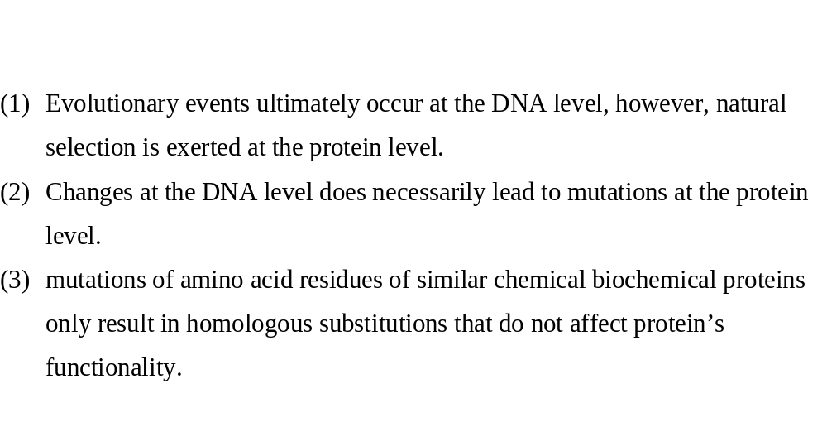
Should I query DNA sequences or protein sequences?

Slide 44
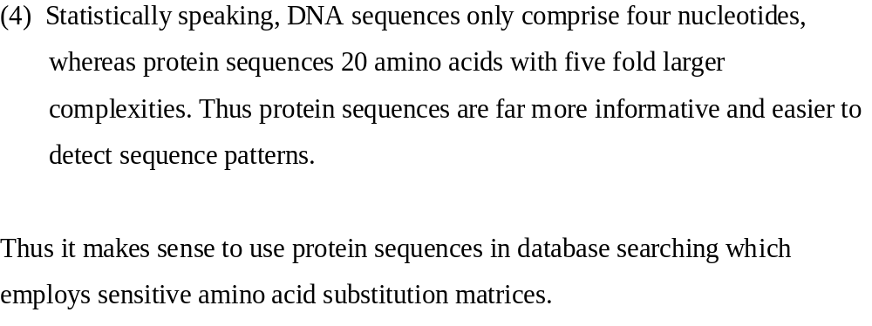

Slide 45
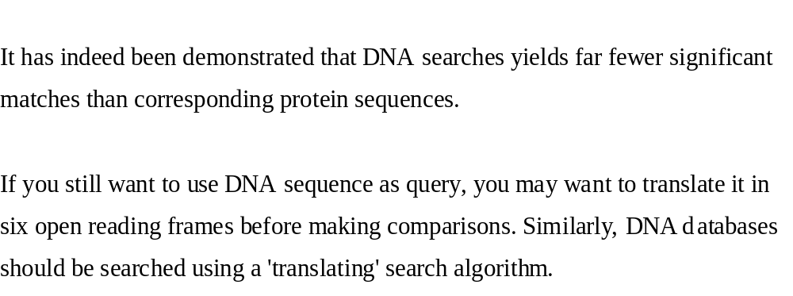

Slide 46
Summary
BLAST
  S (Score) and E-value
  Word
  HSP
  Effect of database
  Low-complexity filter (hard and soft masking)
  Choice of blast programs
  Choice of substitution matrices
How does BLAST shrink its search space?
  WORD

Slide 47
Reading Assignment
Chapter 4, Xiong Book
A web tutorial on sequence alignment by dynamic programming at http://www.sbc.su.se/~pjk/molbioinfo2001/dynprog/dynamic.html

