Slide 1
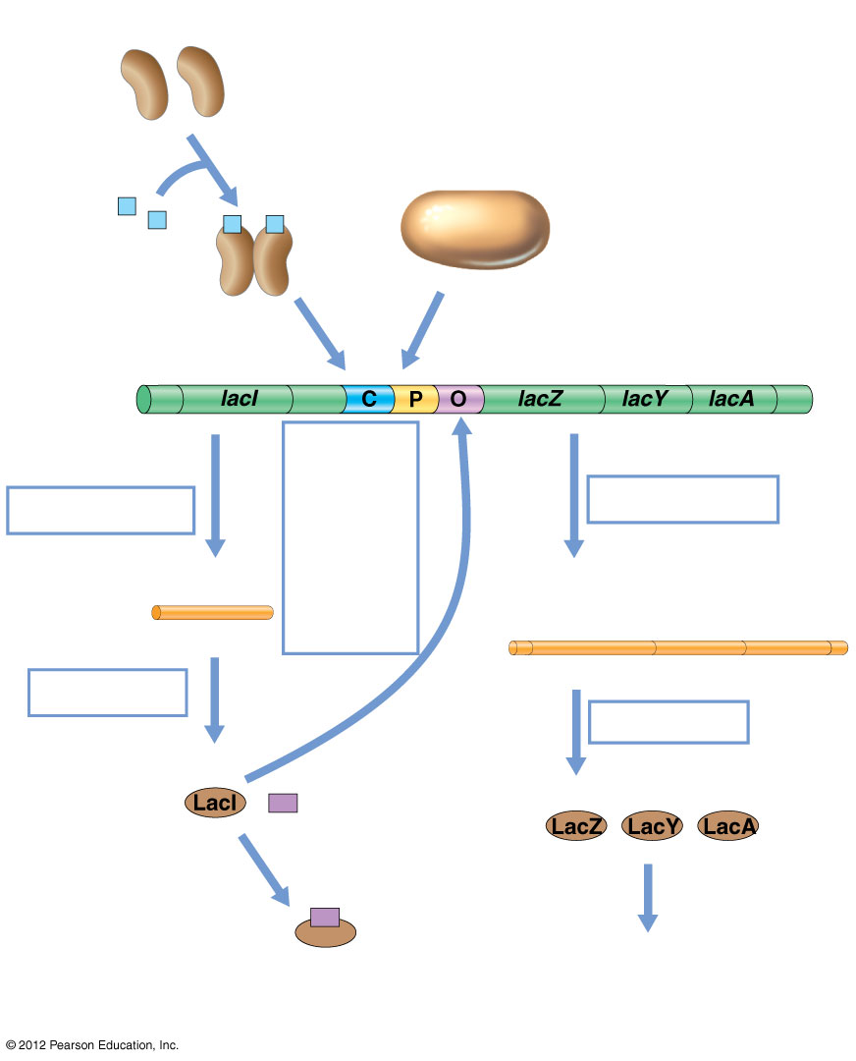
CRP protein
cAMP
RNA polymerase
lac Structural genes
DNA
Active repressor binds to operator and blocks tran- scription
Transcription
Transcription
mRNA
lacI
mRNA
lacZ
lacY
lacA
Translation
Translation
Inducer
Active repressor
Lactose catabolism
Inactive repressor
© 2012 Pearson Education, Inc.
Notes:
Figure 8.14 Overall regulation of the lac system.

Slide 2
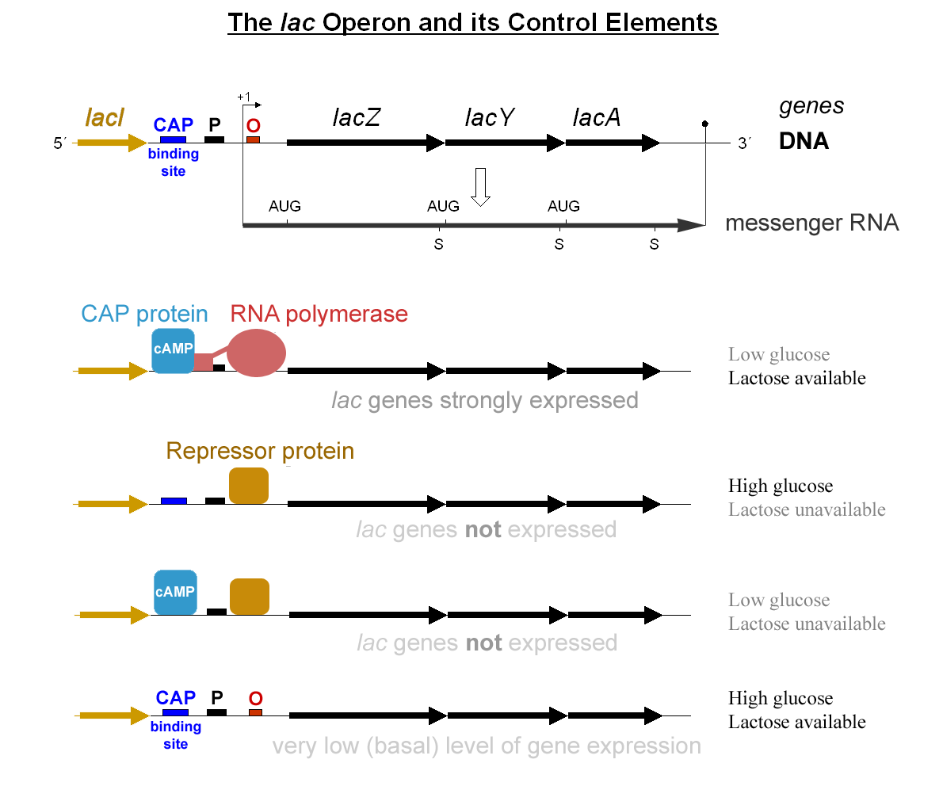

Slide 3
