Slide 1
Differences in FAP and HNPCC: genetic defect, oncogenesis and genetic instabilities
(MIN vs. CIN)
normal
colon
HNPCC
FAP
Genes that are important for DNA mismatch repair, MMR
APC tumor suppressor gene
genetic defect
loss of function
K-Ras
early
TGFβ−RΙΙ
DDC
Smad2/4
intermediate
MSH3
MSH6
BAX
oncogenesis
IGFII_{R}
E2F4
p53
advanced
Diploid tumor with
microsatellite instability
(MIN)
Aneuploid tumor with
chromosomal instability
(CIN)
genetic instabilities
cancer
http://www.hosppract.com/genetics/9711gen.htm
and Duval et al. 2002. Annales de Genetique
Notes:
Much longer list now. See Duval et al. 2002. Annales de Genetique
ACTRII Growth factor receptor
AIM2 Interferon inducible protein
APAF1 Pro-apoptotic factor
AXIN2 Wnt signalling
Bax Pro-apoptotic factor
BCL10 Pro-apoptotic factor
BLM Response to cellular DNA damage
Caspase-5 Pro-apoptotic factor
CDX2 Homeobox transcription factor
CHK1 Response to cellular DNA damage
FAS Pro-apoptotic factor
GRB14 Growth factor receptor bound proteins
hG4-1 Cell cycle protein
IGFIIR Growth factor receptor
KIAA0977 Homologue of mouse cordon-bleu protein
MBD4 DNA glycosylase and methyl CpG binding protein
MLH3 DNA MMR
MSH3 DNA MMR
MSH6 DNA MMR
NADH-UOB NADH ubiquinone oxireductase
OGT O-linked GlcNAc transferase
PTEN Cell cycle protein
RAD50 Response to cellular DNA damage
RHAMM Cellular motility and HA binding
RIZ Cell cycle and apoptotic protein
SEC63 ER membrane protein
SLC23AI Nucleobase transporter
TCF4 Transcription factor (Wnt pathway)
TGF_RII Inhibitor of cellular growth
WISP-3 Growth factor (Wnt pathway)

Slide 2
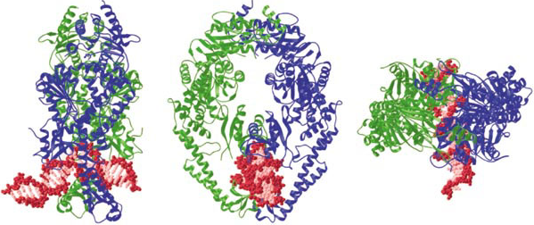
What effect might the single amino acid change have on the structure and function of the Msh2 protein?
Crystal Structure of MutS homodimer
Obmolova et al. (2000) Nature 407:703
Lamers et al. (2000) Nature 407:711
Image from Obmolova et al. (2000) Nature 407:703

Slide 3
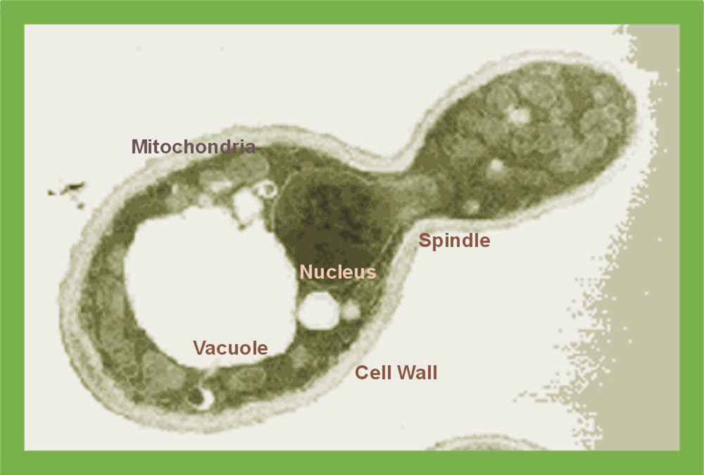
Yeasts as a model
Unicellular, Eukaryotic organism
Multiply by budding or direct division (fission) or sexual reproduction (fusion)
Used as a powerful model because:
  Mechanisms of replication, recombination, cell division and metabolism are CONSERVED between yeast and larger eukaryotes
  Their genome is completely sequenced

Slide 4
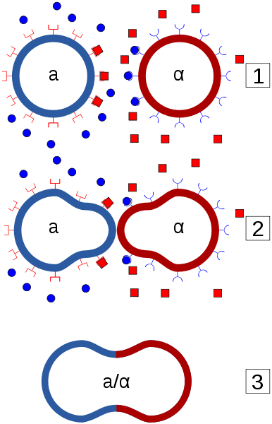
a and α yeast mating types
Haploid cells can mate with other haploid cells of the opposite mating type (an a cell can only mate with an α cell, and vice versa) to produce a stable diploid cell.
a cells produce ‘a-factor’, a mating pheromone to attract α cells.
a cells respond to α-factor by growing projection (a shmoo) towards the source of α-factor.
α cells produce α-factor and respond to a-factor by growing a projection towards the source of the pheromone.
The response only to the mating pheromones of the opposite mating type allows mating between a and α cells, but not between cells of the same mating type.

Slide 5
Yeast cont’
Can exist in haploid or diploid form
Which one would be easier to manipulate?
Disruption or deletion of a gene results in “Knock out” strain
Resulting Mutant can be studied to determine cellular effects of the mutation
Can we introduce a gene into yeast? How would we do that?
- Plasmid can be introduced as a separate replicating molecule or integrated into the genome

Slide 6
Genetic Nomenclature
Dominant alleles are denoted by italicized upper case letters ARG2
Recessive alleles by lowercase letters (e.g. arginine auxotroph) arg2
Wild-type genes are designated with a superscript "plus“ Arg2⁺, sup6⁺
Symbol Definition
ARG⁺ wild-type, arginine requirement
ARG2 dominant allele
arg2 recessive allele
arg2⁻ recessive arg2 allele, with arginine required
in media
ARG2p protein encoded by ARG2
independence and requirement for arginine - denoted by Arg⁺ and Arg⁻, respectively

Slide 7
Transformation
Introduction into cells of exogenously added DNA and subsequent inheritance and expression of that DNA.
Wide range of vectors are available:
  All contain selectable antibiotic markers (Amp^{R} or Tet^{R})
  Markers that allow for selection of transformants containing desired plasmid. Markers include: URA3, HIS3, TRP1 etc, which complement autotrophic mutations in yeast.
  Positive selection – HIS3 restores the yeast strain ability to grow on media without histidine.
  Negative selection – based on specific inhibitors such as 5-fluoro-orotic acid (FOA) that prevent the growth of yeast strain, e.g. URA3 metabolizes FOA to 5-FU which is toxic to the cells.

Slide 8


What is a Leu⁻ mutant?
Leu⁻
Leu synthesis gene
Leu synthesis gene
Leucine making enzyme
Leucine making enzyme
Can make an enzyme to produce Leu in absence of the amino acid.
Can NOT make an enzyme to produce Leu in absence of the amino acid
WT GROWS on Leu deficient plate
Mutant DOES NOT GROW on Leu deficient plate

Slide 9
Plasmid to the rescue!
Leu synthesis gene
Leu⁻
Plasmid
Leu synthesis gene
Plasmid
Can make an enzyme to produce Leu in absence of the amino acid.
RESCUED Mutant
GROWS on Leu deficient plate

Slide 10
What if we only had an empty vector?
Leu⁻
Empty Vector
Leu synthesis gene
Plasmid
STILL CANNOT make an enzyme to produce Leu in absence of the amino acid.
Mutant Will Not
GROW on Leu deficient plate

Slide 11
Chart of Research Project
DISEASE (HNPCC)
MOLECULAR GENETICS
MSH2 GENE
CLONING INTO EXPRESSION VECTOR (E coli)
SITE DIRECTED MUTATION OF MSH2 GENE
CLONING OF MUTANT INTO EXPRESSION VECTOR (E coli)
Transformation into Yeast Cells
FUNCTIONAL ANALYSIS EXPRESSIONAL ANALYSIS

Slide 12
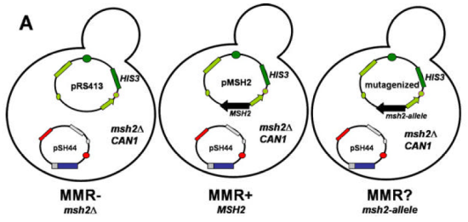
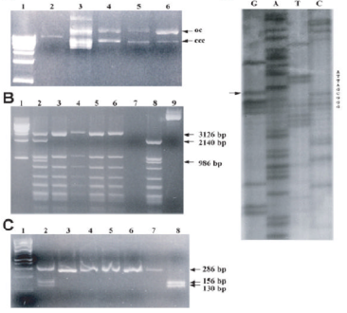
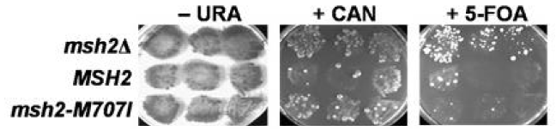
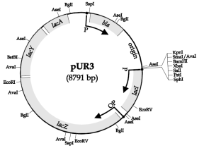
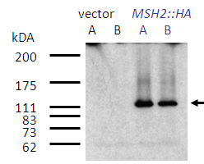
PCR
and
Plasmid Constructs
CEN/ARS
Molecular Biology
Genomics
β-lactamase
amp^{r}
HIS
ColE1 ori
pMSH2
9325 bp
F1(+)
MSH2::HA
lacZ
MSH2 Gene
Plasmid Constructs

Slide 13
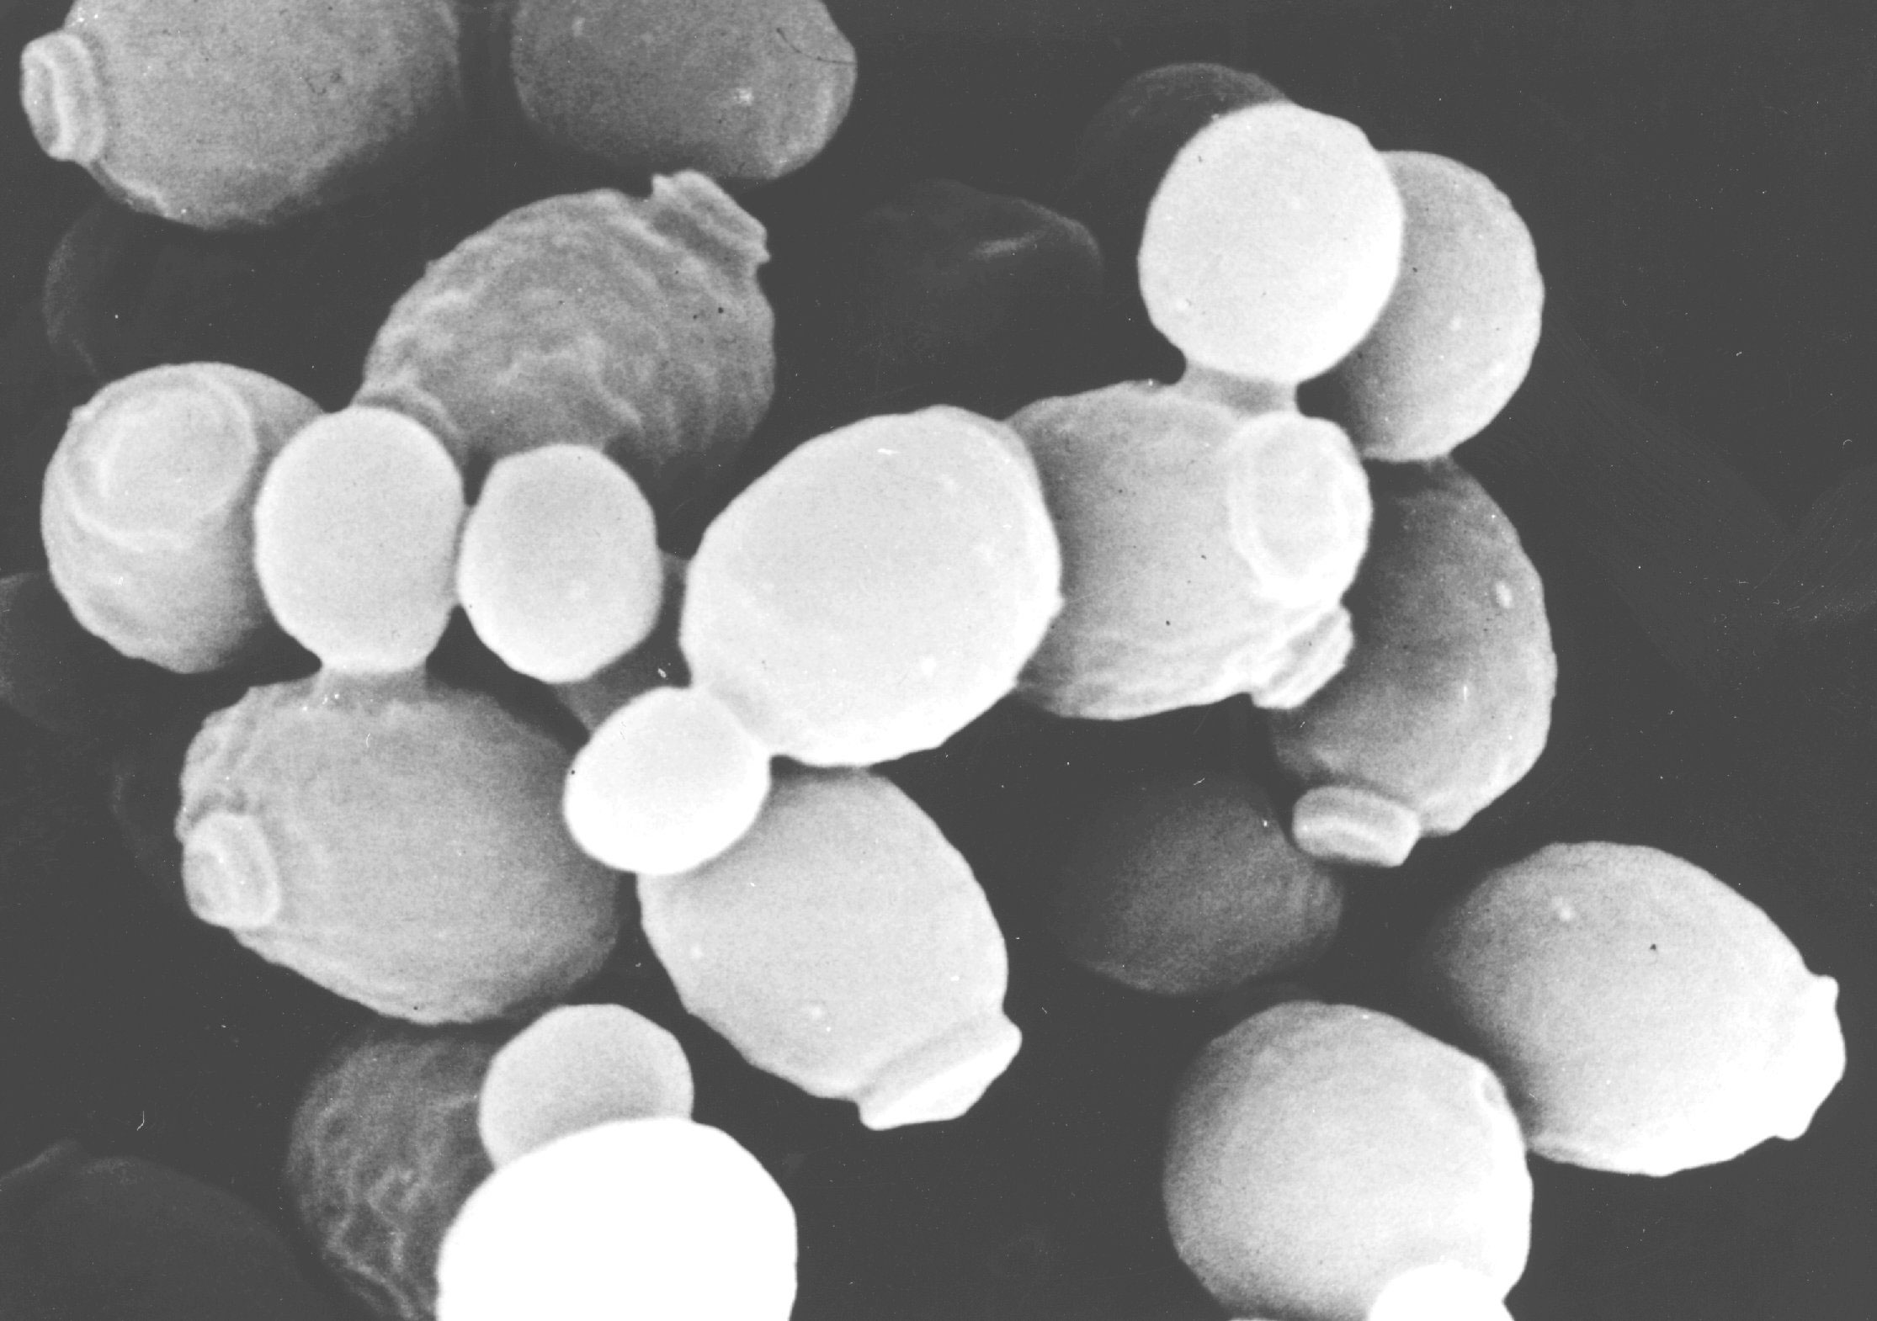
Yeast transformations to initiate the functional tests
introducing the mutagenized miniprep DNA and the controls into the Saccharomyces cerevisiae reporter strain
Saccharomyces cerevisiae
CEN/ARS
HIS3
miniprep
msh2-allele
image from Tufts and Dunn (University of Kent)

Slide 14
Genetic complementation in yeast
MSH2
Nuclear copy
Single copy of functional gene is sufficient in a haploid strain to support WT phenotype
wildtype growth phenotype

Slide 15
Genetic complementation in yeast
msh2
Nuclear copy
Gene deletion in a haploid strain results in a knockout mutant that displays a corresponding mutant phenotype!
mutant phenotype

Slide 16
Genetic complementation in yeast
msh2
Nuclear copy
MSH2
Plasmid copy
Reintroduction of the gene on a plasmid may rescue or complement the mutant phenotype
Rescue mutant phenotype?

Slide 17
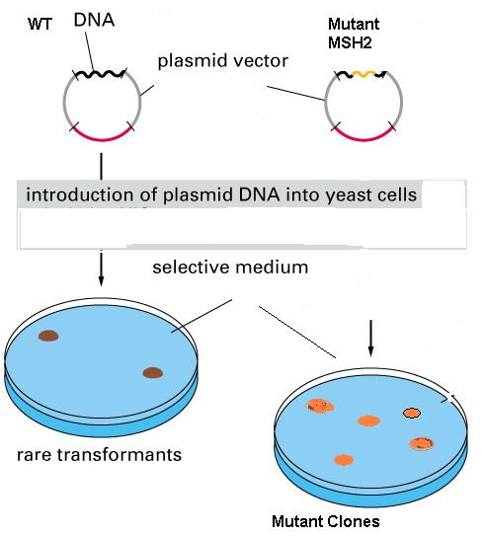
Can we use any random
Strain of YEAST?
and
Why do we need selective
Media?

Slide 18
Genotype of the yeast strain used for the functional assays
his3-11,15 allows for selection of the mutagenized MSH2 plasmids (HIS3)
trp1-1 allows for selection of the reporter construct (pSH44)
ura3-1 allows for assaying the URA3 gene product from the reporter construct
msh2Δ
the strain must be lacking the wild-type MSH2 gene; the strain must be Leu⁺, to allow for activation of the reporter gene promoter
MSH2
MSH2 (wild-type locus) MSH2⁺
msh2Δ (msh2 deletion) msh2⁻
This strain of yeast DOES NOT HAVE MSH2 gene
and
cannot grow without the media being supplemented with His and Trp.

Slide 19
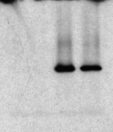
Taking a closer look at our plasmid, pMSH2
MSH2 construct for mutagenesis and functional assays
CEN/ARS
amp^{r}
HIS3
pMSH2
9325 bp
ColE1 ori
lacZ
MSH2::HA
hemagglutinin epitope in the MSH2 coding region
-produces a protein product of the expected molecular weight
vector
MSH2::HA
kDA
A
B
A
B
200
175
111
Msh2 “HA-tagged”
83
73
62
-complements msh2Δ defects, therefore the construct is functional

Slide 20
Haploid yeast strain for the functional assays
pSH44 is the reporter construct for
di-nucleotide stability assay
chromosome:
msh2Δ
trp1-1
his3-11,15
allows for selection
and replication of
the plasmid
pSH44
TRP1
pSH44
P_{LEU2}
CEN11
allows for the stable segregation of plasmid
(GT)_{16.5}-URA3
reporter = in frame fusion between a GT tract and the URA3 gene
leucine responsive promoter (activated when cells grown in media lacking leucine and threonine)

Slide 21
Yeast transformation
Appropriate Conditions for Transformation
HIS3
mutagenized
*
msh2-allele
chromosome: msh2Δ
trp1-1
his3-11,15
TRP1/ARS
pSH44
P_{LEU2}
CEN11
(GT)_{16.5}-URA3

Slide 22
How will we know that both plasmids are in the yeast?
chromosome:
msh2Δ
trp1-1
his3-11,15
Yeast will grow without His in media
pMSH2
MSH2
pSH44
Yeast will grow without Trp in media

Slide 23
MMR Assay in Yeast: Complementation of haploid msh2 test strain
+ pMSH2 + (WT)
Restored WT MSH2 function
msh2
+ pRS413 (vector)
Nuclear copy
No MSH2 function
MSH2
Plasmid copy
+ pMSH2 Mut (?)
MSH2 function ???
We transformed the msh2 test strain with one of the following:
pMSH2 (+)
pRS413 (-)
Mutagenized plasmid (?)
What is the rescue MMR- phenotype?

Slide 24


The haploid yeast strains for the functional assays
LEU2
msh2Δ::LEU2 (msh2 deletion)
vector
msh2Δ
pMSH2
LEU2
mutagenized
pSH44
MSH2
*
msh2Δ
msh2-allele
LEU2
msh2Δ
pSH44
LEU2
pSH44
MutSα/β
NO MutSα/β
altered MutSα/β
MMR +
MMR -
MMR ??

Slide 25

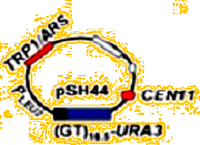
msh2
CEN/ARS
Recombinant
pRS413 plasmid
HIS3
msh2-allele
5-FU toxic to yeasts
5-FOA
REDUCED or NO
YEAST GROWTH
5-FU

Slide 26
Hmmm…what about the my mutant MSH2?
WT MSH2 gene was introduced
Into yeast
Vector was introduced
Into yeast
Fixes problems in microsatelite DNA in reporter construct
Microsatelite DNA errors occur in reporter construct
Reporter URA3 gene can be expressed
Reporter URA3 gene CANNOT be expressed
URA3 metabolizes FOA to
5-FU
FOA is NOT metabolized to
5-FU
5-FU is TOXIC TO THE CELLS
YEAST LIVE
YEAST DIE

Slide 27
Transformation and Functional Test Controls
pMSH2
pRS413
mutant
control for functional tests
+
-
??
control for transformation
+
+
+

Slide 28
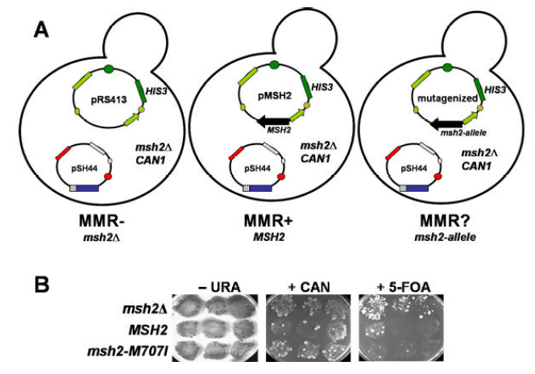
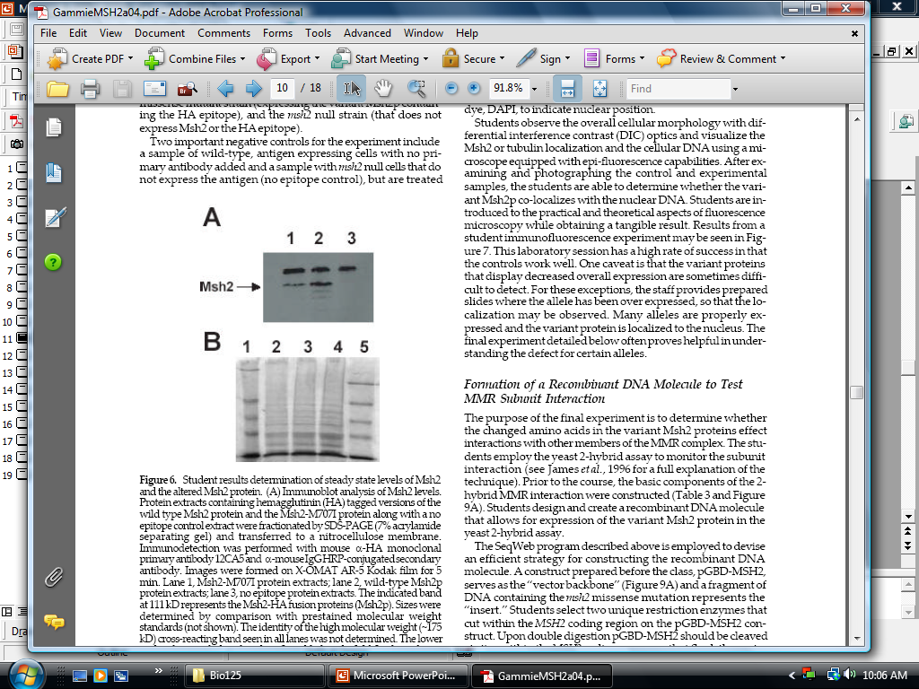
Transformation
Mismatch Repair Functional Assay
No MSH2 gene
Wild Type MSH2
msh2 Mutant
C
Steady State Levels MSH2 Proteins
Modified from Gammie, 2004

Slide 29
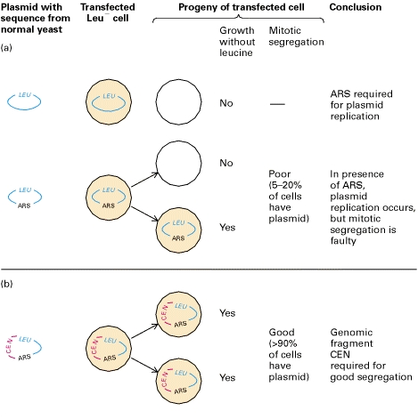

ARS – Autonomously Replicating sequence (Yeast start of replication)
CEN – centromer from yeast chromosomes. Improves the segregation of the plasmid into progeny

