Slide 1


Slide 2
Northern Blot
Western Blot
Eastern Blot
Southern Blot

Slide 3
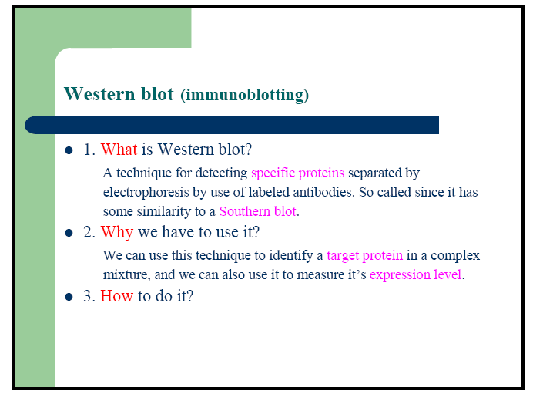

Slide 4
Protein Gel Electrophoresis
Separation of proteins is done using a gel made of polyacrylamide (polyacrylamide gel electrophoresis = PAGE)
  Treat proteins to denature subunits with detergent such as SDS
    SDS coats polypeptides with negative charges so all move to anode
    Masks natural charges of protein subunits so all move relative to mass not charge
  As with DNA, smaller proteins move faster toward the anode
5-<number>

Slide 5
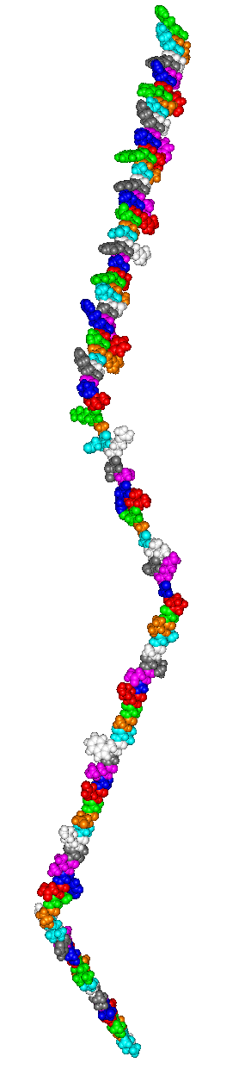
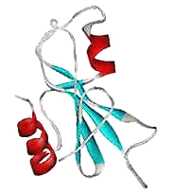
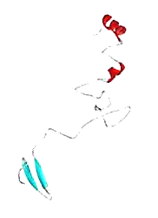
Protein Denaturation
denature: loss of structure due to protein unfolding
unfolding leads to loss of function
Folded
Unfolded

Slide 6
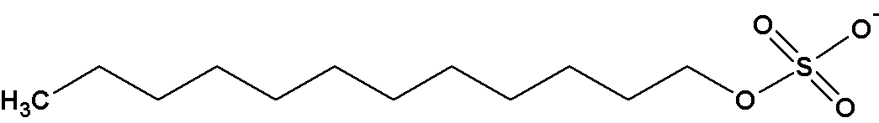
Sodium Dodecyl Sulfate (SDS)
strongly denaturing detergent
  disrupts 2º, 3º, and 4º structures
binds and confers negative charge to protein
  charge is proportional to mass

Slide 7
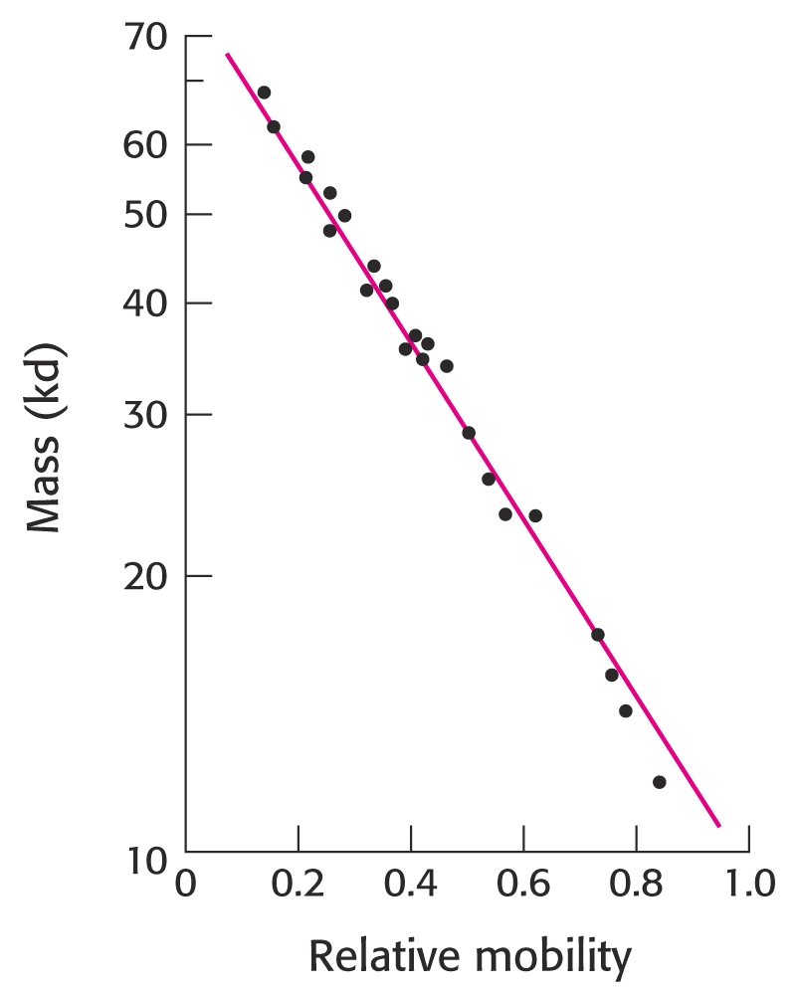
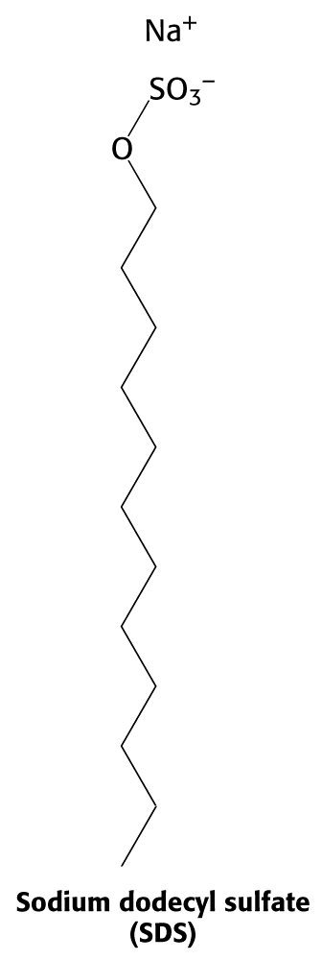
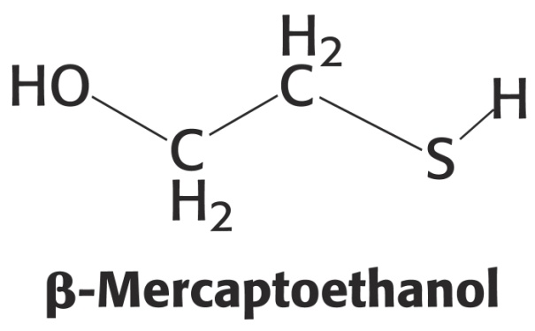
Polyacrylamide gel electrophoresis can occur under both denaturing and reducing conditions

Slide 8
SDS-PAGE
Sodium Dodecyl Sulfate - Polyacrylamide Gel Electrophoresis
developed by Laemmli (1970)
Denatured Gel
SDS is a negatively charge detergent which
DENATURES the protein (what does this mean?)
and gives all proteins a uniform charge SHOW FIGURE 6
This gel separates based on MW
no interference from 3D structure or charge
Smaller proteins move faster and further
Smaller the proteins being separated --Higher % of acrylamide

Slide 9
Reducing Agents
DDT dithiothreitol
BME B-mercaptoethanol
Break disulfide bonds
Completely disrupt the 3D structure of proteins

Slide 10
Electrophoresis
Separate proteins based on
  Size (Molecular Weight - MW)
    SDS PAGE
  Isoelectric Point
    Isoelectric focusing
Allows us to
  characterize (degradation, MW)
  quantify
  determine purity of sample
  compare proteins from different sources
  step in Western blot

Slide 11
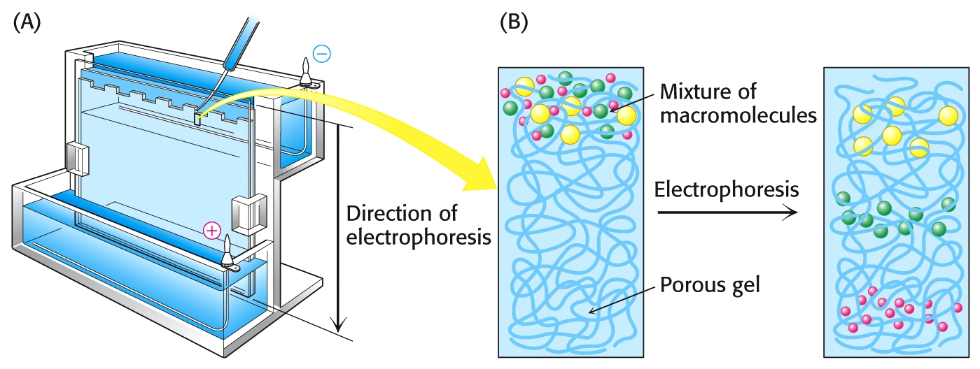
Polyacrylamide Gel Electrophoresis (PAGE)
Molecules are separated by size in an electric field
Smaller molecules migrate more rapidly through porous gel matrix

Slide 12
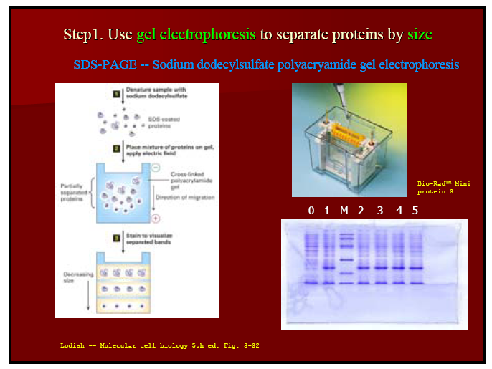

Slide 13
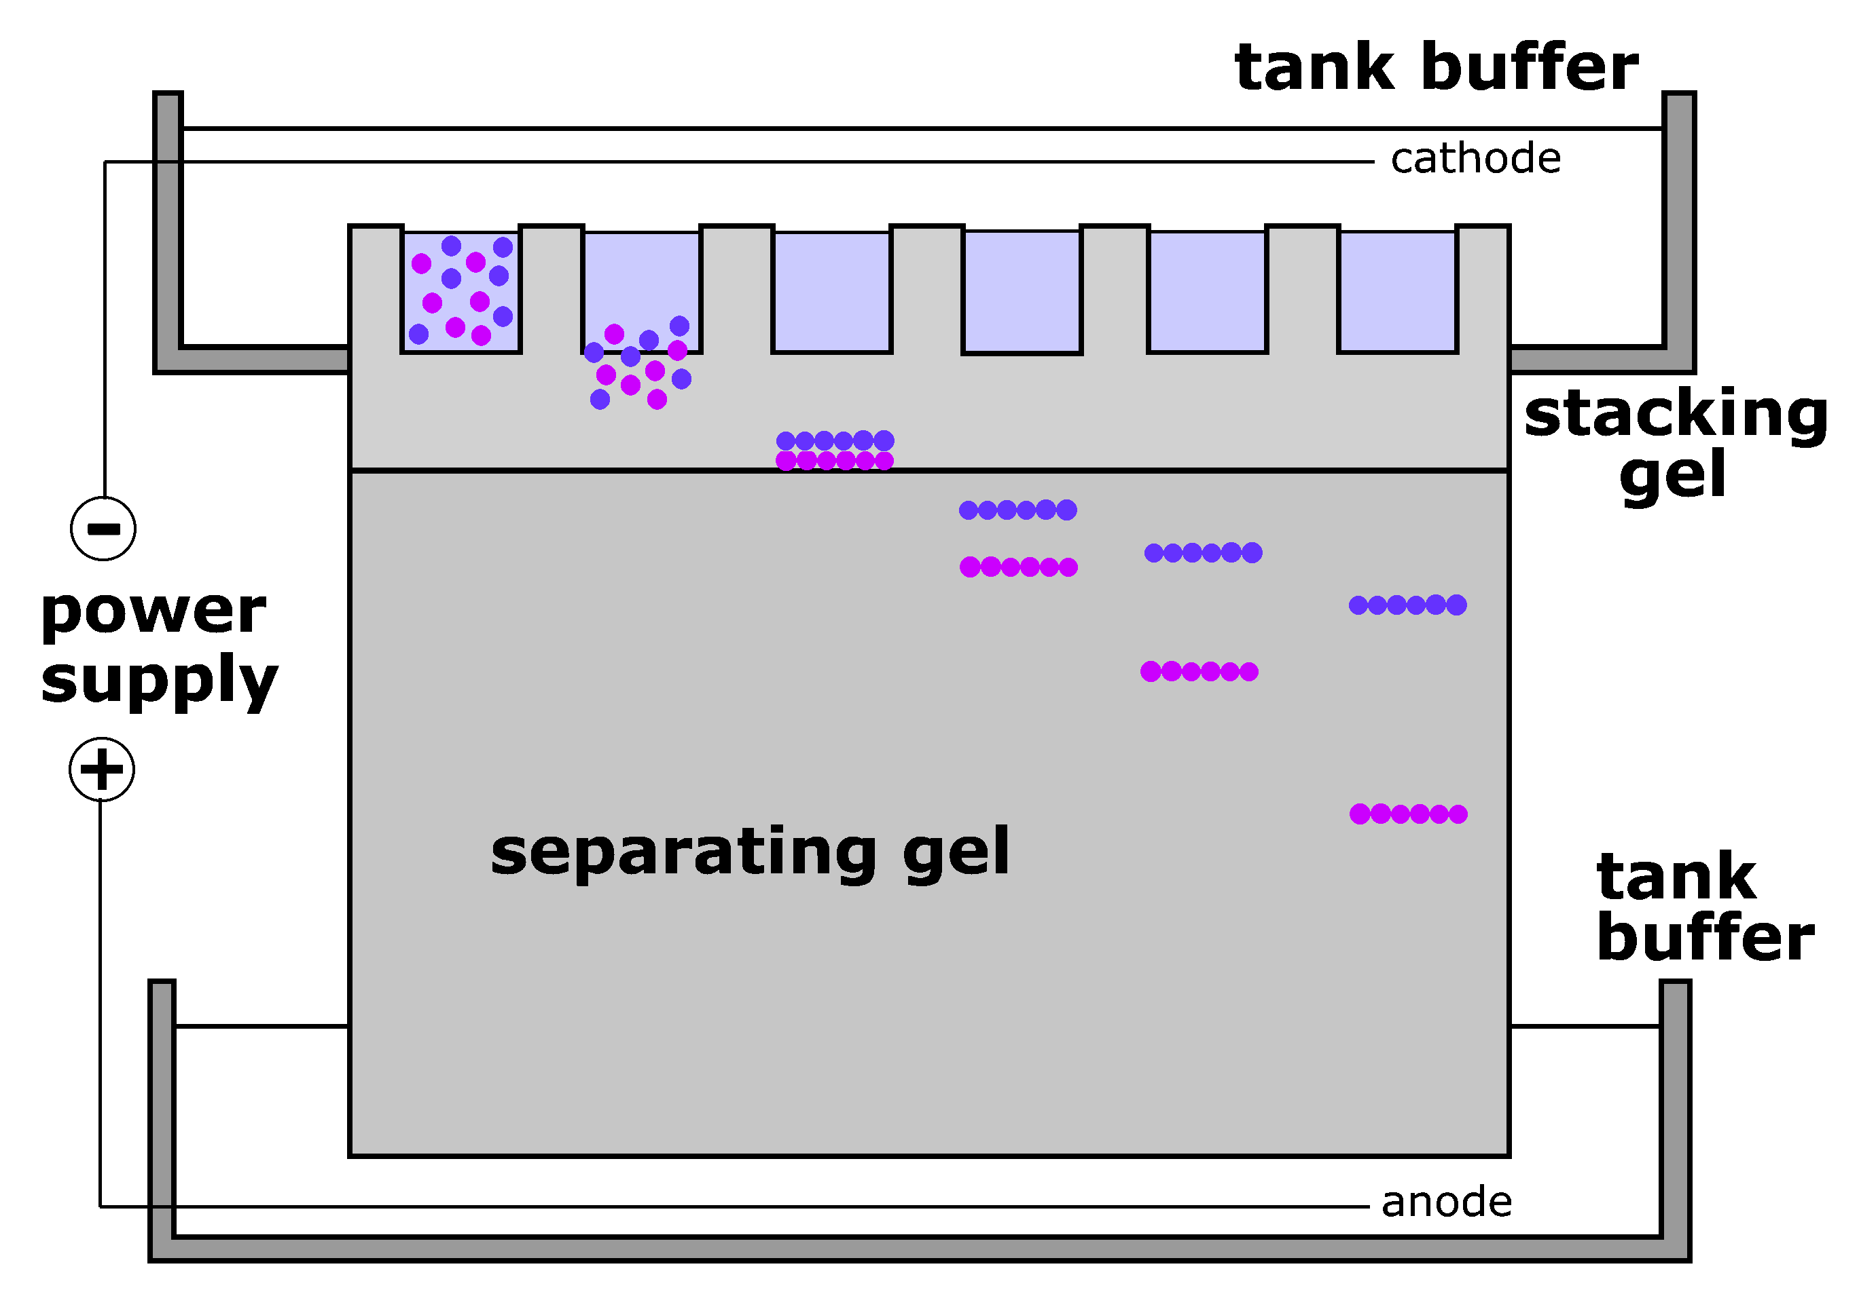

Slide 14
How to Detect Proteins?
Coomassie Blue (0.1 ug)
Silver Staining (2 ng)
How to Quantify Proteins
Desitometry

Slide 15
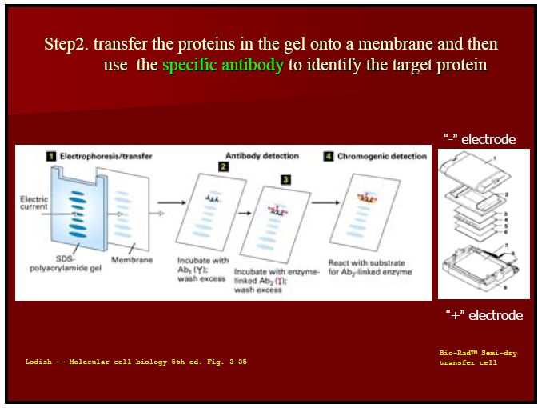
Primary antibody against MSH2
Add developing solution
Secondary
Antibody

