Slide 1
Some more slides on SDS-PAGE and probing for protein

Slide 2
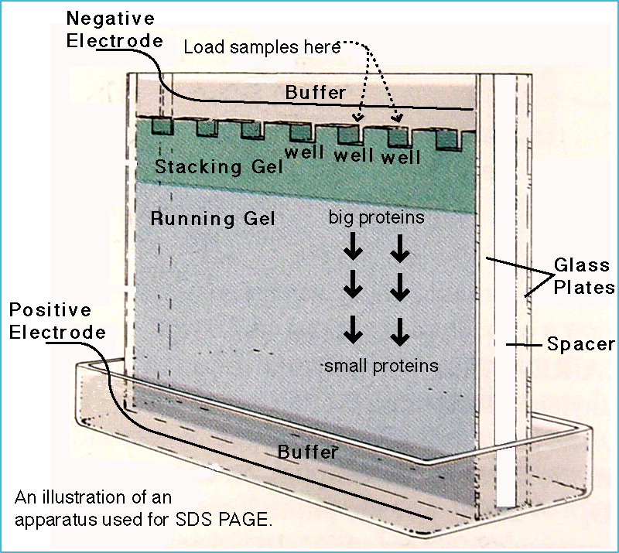
SDS PAGE
Sodium dodecyl sulfate (SDS) is an amphipathic detergent. It has an anionic headgroup and a lipophilic tail. It binds non-covalently to proteins, with a stoichiometry of around one SDS molecule per two amino acids.
SDS causes proteins to denature and dissassociate from each other (excluding covalent cross-linking). It also confers negative charge. In the presence of SDS, the intrinsic charge of a protein is masked.
During SDS PAGE, all proteins migrate toward the anode (the positively charged electrode). SDS-treated proteins have very similar charge-to-mass ratios, and similar shapes. During PAGE, the rate of migration of SDS-treated proteins is effectively determined by molecular weight.

Slide 3
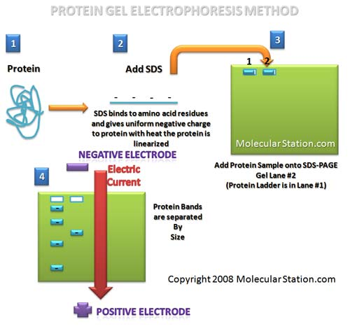

Slide 4
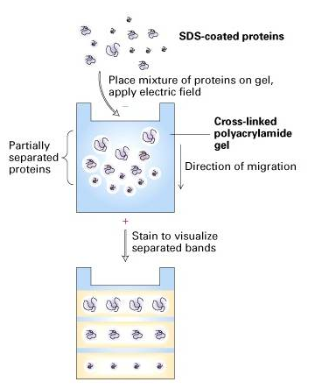
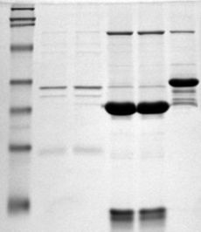

Slide 5
