Slide 1
Lecture 12: Phylogeny and the beginning of linkage analysis

Slide 2
Which sequences to use?
Genomic DNA.
  Fastest evolution
    Most sensitive to establishing order of closely related taxa
    Not so good for distant relationships
  Non-uniform mutation rates. Use noncoding regions?
mRNA.
  Medium distances. Can model non-uniformity by codon
Protein sequences.
  Long distances. More character states, good models of mutation rates exist

Slide 3
16S ribosomal trees
Pioneered by Woese
  Archaeal kingdom hypothesis came from 16S tree!
Exist in all organisms, highly conserved
Suitable for very broad phylogenies
Sequenced in tens of thousands of organisms
Not appropriate for close relatives...

Slide 4
Whole genome trees
Characteristics over entire genomes
  Presence/absence of homologous genes
  Chromosomal rearrangements (inversions, translocations)
Good for distant taxa
Mostly practical for microbes, since relatively few completely sequenced genomes of metazoa yet.

Slide 5
Multiple hit correction
A site can change and then change back to where it was during the course of evolution.
Poisson correction: assume that changes after time t are independent of ones before t.
D(i,j) = - ½ log [1- h(i,j)]
Other models are possible as well...

Slide 6
Ultrametric trees
In addition to the additive tree criterion, require that all distances to the root be equal
Idea is that differences in sequence should be proportional to the evolutionary time since divergence
Assumes that DNA evolves at a constant rate across lineages.

Slide 7
The Molecular Clock
Are mutation rates constant? If so, sequence distance = evolutionary time distance
Why not?
  Selective pressure. E.g. in coding regions, mutations that disrupt function will occur less often than neutral mutations
  Punctuated equilibrium. E.g. causative factors in mutation rates (e.g. UV light exposure) vary over evolutionary time
  Random changes in mutation rate (can model these!)
Apparently not true in general, but perhaps...
  Over relatively short intervals? In certain regions?

Slide 8
Sequence issues
Ortholog vs. Paralog
  Ortholog is gene with similar sequence in different organism, paralog is gene with similar sequence in the same species.
  Paralogs arise from gene duplications
  Paralogs are not appropriate for phylogeny. How to exclude?
Homoplasy
  Sequence similarity NOT due to shared ancestry
    Convergent or parallel evolution
    Horizontal transmission

Slide 9
Comparing distance to state methods
Distance methods are suitable for continuous characters. For sequences, we need to define a distance function.
MP doesn't provide branch lengths.
Speed: distance < MP << MLE

Slide 10
Tree merging
Consensus trees
  Multiple trees constructed from same data to evaluate robustness
Supertrees
  Trees constructed on overlapping sets of taxa and then combined to form larger trees without considering across-subtree interactions

Slide 11
Consensus trees
When many different trees have similar scores, look to see where they are identical
Various consensus criteria
  Unanimous, majority, 2/3, score-weighted voting
Bootstrapping
  Resample characters (sequences) from inferred tree
  Compute new tree from resampled data
  Report on consensus between original and resampled data.

Slide 12
Supertrees
Compute trees from overlapping taxa
Only way to create very large trees
Each tree needs significant overlap (and consensus) with at least one other tree.
Warnow's DCM algorithm

Slide 13
When to use which...
Continuous characters, lots of data, computational constraints: Neighbor Joining
Discrete characters, moderate data, no homoplasy: maximum parsimony
Discrete characters, limited sequence lengths, some homoplasy: maximum likelihood
Many taxa: supertrees
Complete genomes: whole genome methods

Slide 14
Resources
PAUP* the most popular (but for pay) phylogeny inference program
PHYLIP the second most popular and open source phylogeny inference program

Slide 15
Linkage Analysis
Genes near each other on a chromosome tend to be inherited together, that is, they are linked.
Linkage analysis are the techniques used to identify such linkages among genes
Key piece of human disease gene identification.

Slide 16
Finding genes for human disease
Positional cloning. Find a location in the genome that is inherited with a disease
Basic concepts:
  Polymorphism
    A region of genome that varies across individuals
    SNP: single nucleotide polymorphism (say “snip”)
  Haplotype: a set of closely linked polymorphisms (usually SNPs) that are inherited as a unit
  Linkage analysis: Use “markers” (genetic regions with widely distributed polymorphisms) to identify chromosomal regions that are inherited (“cosegregate”) with the disease.

Slide 17
Mendelian Inheritance
Each sexually reproducing organism has two alleles for each gene, one from each parent
  If the two alleles are the same, the phenotype reflects it. These organisms are called homozygotic for that allele.
  If the two alleles are different, the phenotype reflects the dominant allele. These organisms are heterozygotic.
  The allele that is not dominant is called recessive.
Recessive alleles are reflected in the phenotype only when they are homozygotic.

Slide 18
Linkage
Mendel showed that alleles segregate independently. Then he tested genes
Sometimes inheritance of two genes are independent of another, that is phenotype ratios are 9:3:3:1
Sometimes inheritance of two genes are linked together, showing a ratio of 3:0:0:1
Linkage can vary continuously from perfectly correlated to uncorrelated.

Slide 19
Why genes are linked
Alleles are arranged linearly
Each parent passes only one of its two chromosomes to an offspring.
Recombination periodically switches which chromosome in the parent is passed along
Alleles near each other are more likely to be passed along than ones further apart
Alleles on different chromosomes are always inherited independently.

Slide 20
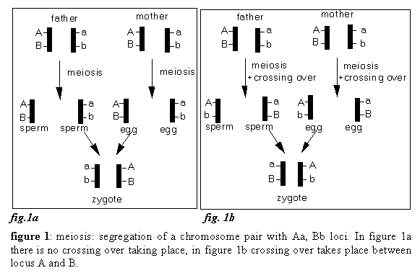
Recombination picture
Crossover is the alternation of allele generating chromatid (half of chromosome)

Slide 21
Finding disease genes
Create collections of easily detectable polymorphisms with known chromosomal position (markers). Genome Maps
Assemble families with affected members.
Look for patterns of markers that correlate with disease incidence
Place disease gene in ordering relationship with markers. If markers are close together, we know where the gene is (or is likely to be)

Slide 22
Linkage analysis process
Find sets of related patients
Assemble patients into pedigrees (family genologies)
Genotype patients and other family members for polymorphic markers
Look for markers that are inherited with the disease; these are said to cosegregate.
Identify the chromosomal region(s) where they are (or are not) located

Slide 23
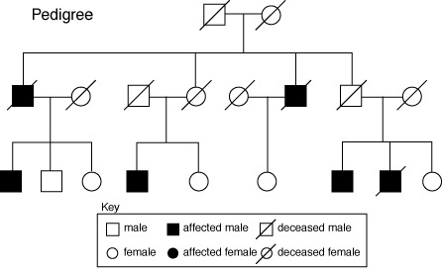
Pedigrees
A pedigree is a tabulation of the appearance of a trait (disease or marker) in an extended family, along with the family's mating history.

Slide 24
Some assumptions
Start by looking for a single gene with Mendelian inheritance, but...
  Quantitative traits are polygenic
  Most widespread inherited diseases are polygenic
  Incomplete penetrance
Kinds of pedigrees:
  Large, extended families (but few of them)
    Best for single gene, Mendelian inheritance
  Sib-pairs (but a lot of them)
    Best for complex traits, incomplete penetrance.

Slide 25
Recombination
Individual i is recombinant with respect to a parent p if i inherits the A allele from one chromatid of p and B from the other.
Recombination fraction θ_{AB} = probability that a child is recombinant
Linkage between A and B ≡ low θ_{AB}

Slide 26
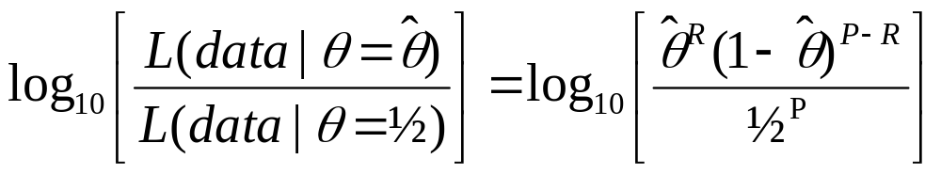
LOD Scores (simple model)
Let R ≡ number of recombinant offspring,
P ≡ total offspring
Model: Likelihood of the data = θ^{R}(1- θ)^{P-R}
Maximum likelihood estimate of θ = R/P
LOD score for linkage in a pedigree is
^

Slide 27
Two point parametric linkage analysis
Two point because we look at the disease versus a marker (one marker at a time)
Parametric because we are making a distributional assumption to get the likelihood of the data given θ, R and P
For a set of markers covering a whole genome at moderate spacing, calculate LOD scores.
LODs > 3 (1000:1) give a general sense of where the disease gene is likely to be (>5 very strong)

Slide 28
Some complications
Which loci are recombinant? Need to know genotypes of parents and phase.
Other parameterized models of non-Mendelian inheritance
Non-parametric models
Linkage disequilibrium

Slide 29
Phase
If disease gene D/d is linked to marker A/a, the disease could segregate either with A or a.
  We can't tell who is recombinant and who isn't unless we know whether the mother or father donated the allele
  Phase I (D|a): d|a (R), D|a (N), D|a (N), d|A (N), d|A (N)
  Phase II (D|A): d|a (N), D|a (R), D|a (R), d|A (R), d|A (R)
Can average over phases (losing power)
Aa
AA
Aa
Aa
Aa
AA
AA

Slide 30
Informativeness of family data
Sometimes, the addition of one more family member can dramatically improve results
  E.g. allowing inference of phase
Sometimes, an additional family member doesn't provide any new information
  Second parent when are both homozygous for the marker allele.
Can estimate the expected informativeness of various kinds of additional data...

Slide 31
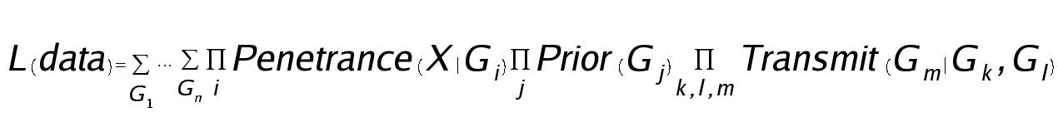
Realistic models
Most genetics is not Mendelian. Relationship between genotype and phenotype complex.
  Most general form for likelihood function:
  where Penetrance(X|G) is the likelihood of observing the trait X given the genotype G, Prior(G) is the probability of observing the genotype spontaneously in member j, and Transmit(G_{m}|G_{k},G_{l}) is the probability that an offspring will have genotype Gm given that the parents had genotypes G_{k} and G_{l}, parameterized by θ (and a mapping function).
Easy to write, hard to compute MLE.

Slide 32
LOD graph
Can look at LOD score over a range of θ's, not just MLE.
Usual assumption is LOD > 3 is evidence for linkage, LOD < -2 is evidence for exclusion
LOD
3
2
1
0
.1
.2
.3
.4
.5

-1
-2
-3

Slide 33
Readings & Assignment
Next time: Finding disease genes
  Campbell & Heyer, Chapter 3
  Web articles:
    Robert Elston’s Overview of linkage and association analysis
    Gil McVean’s first lecture in the 2002 Oxford population genetics course (slides and notes)

