Slide 1
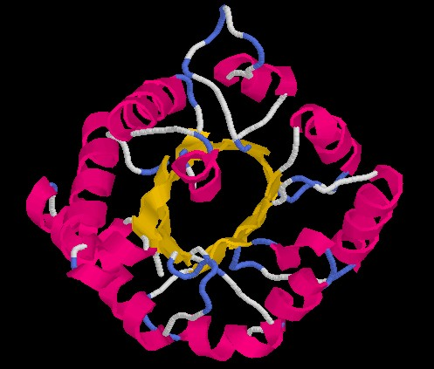
Introduction to protein structure
Hong Qin
ARMS annex B, Phone 8731
1TIM

Slide 2
Overview
Introduction to proteins structures
Protein secondary structure prediction

Slide 3
AMINO ACIDS
AMINOACIDS: There are 20 amino acids:
Alanine (A), Cysteine (C), Aspartic Acid (D),
Glutamic Acid (E), Phenylalanine (F), Glycine (G),
Histidine (H), Isoleucine (I),Lysine (K), Leucine (L),
Methionine (M), AsparagiNe (N), Proline (P),
Glutamine (Q), ARginine (R), Serine (S),
Threonine (T), Valine (V),Tryptophan (W),
TYrosine (Y)
AMINO ACIDS SYMBOLS: A,C,D,E,F,G,H,I,J,K,L,M,N,P,Q,R,S.T,V,W,Y

Slide 4
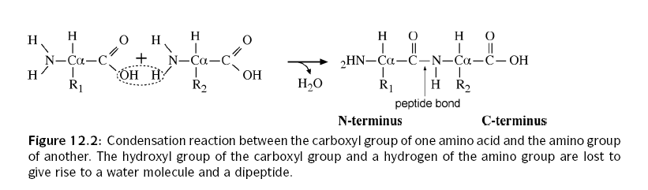
From amino acids to peptides

Slide 5
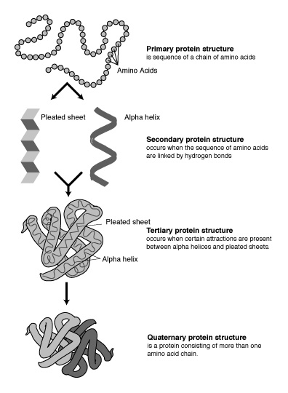
Four levels of protein structure

Slide 6
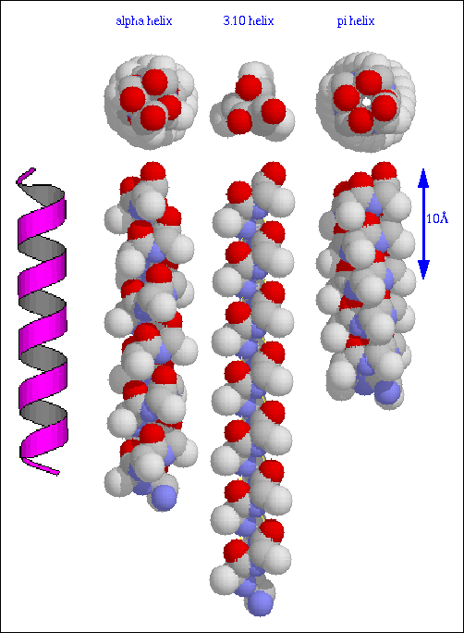
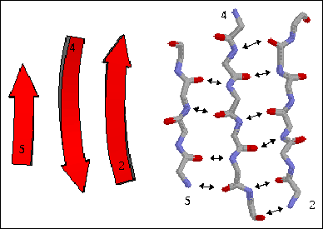
Secondary Structure
H: α - helix
E: β - strand
C: coil
T: β- turn

Slide 7
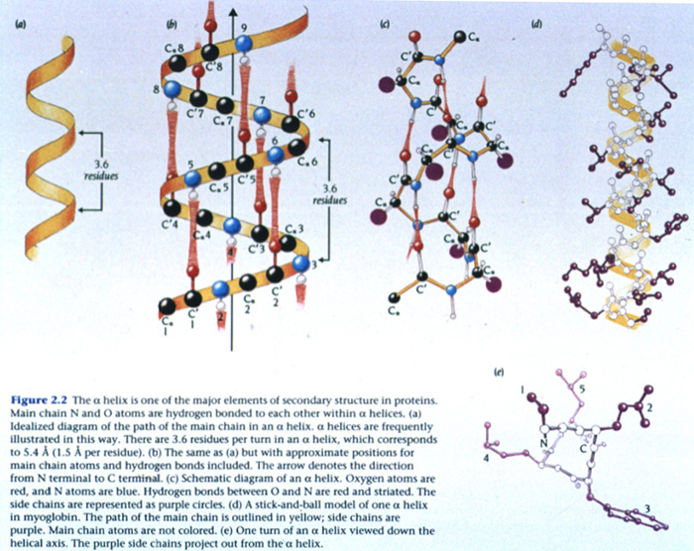
Backbone Hydrogen-bonds within alpha-helices
Notes:
Most importantly, the N-H group of an amino acid forms a hydrogen bond with the C = O group of the amino acid four residues earlier; this repeated hydrogen bonding defines an α-helix.

Slide 8
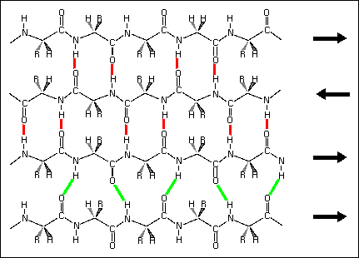
Backbone hydrogen-bonds between beta-strands

Slide 9
Three basic secondary structure states
H (helix), E (strands) and C (coil)

Slide 10
Tertiary structure
The tertiary structure of a protein is the arrangement in space of all its atoms
For a given protein we can experimentally determine its tertiary structure by X-rays or NMR
Given the tertiary structure of a protein we can know its secondary structure.

Slide 11

Quaternary Structure
Many globular proteins are made up of several polypeptide chains called sub-units, stuck to each other by a variety of attractive forces but rarely by covalent bonds. Protein chemists describe this as quaternary structure.

Slide 12
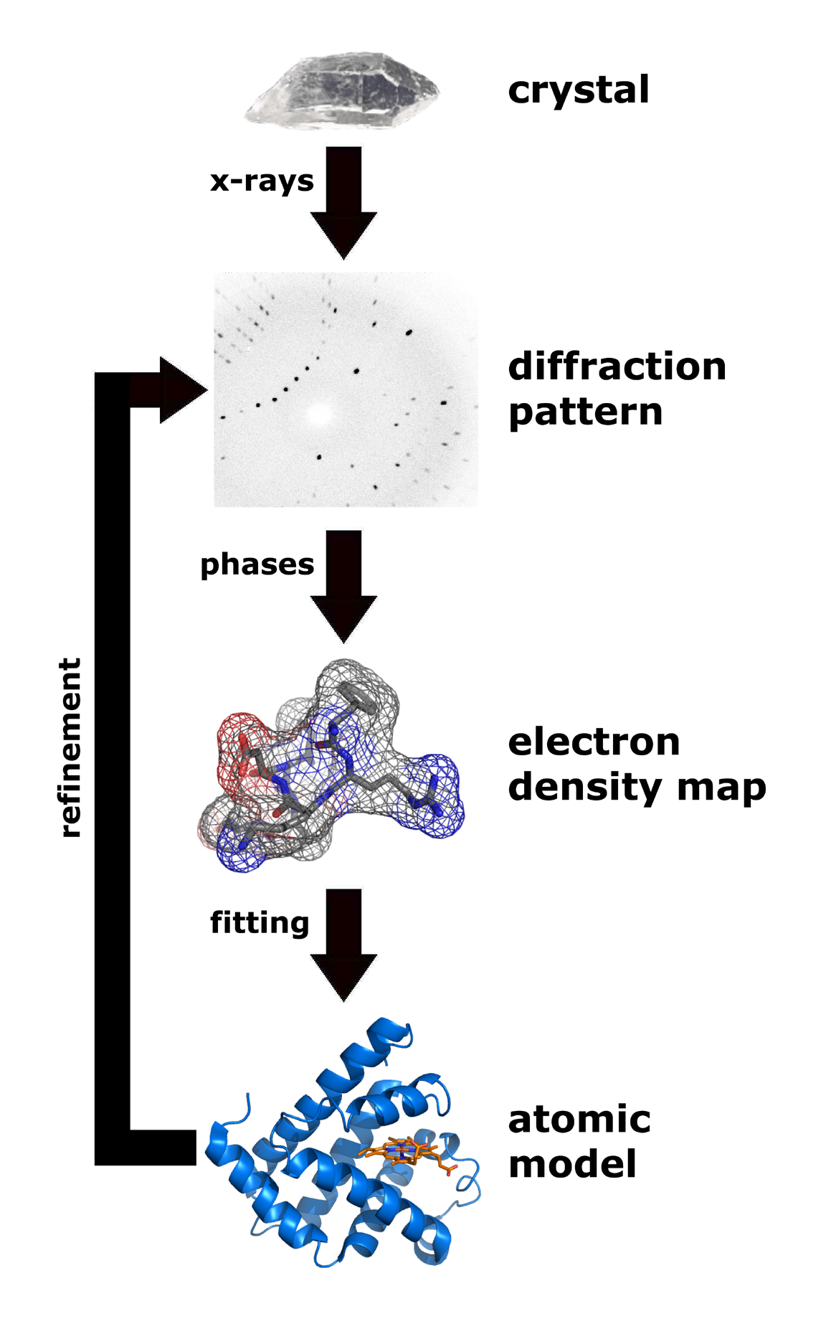
Protein structures can be determined by x-ray crystallography.

Slide 13
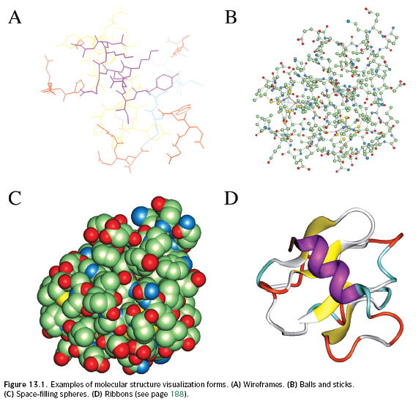
Visualization of protein structures

Slide 14
Why prediction of protein secondary structure?
We can infer the protein functions from their structures
  For example, globular or membrane proteins?
Experimental determinations of protein structures are often difficult and expensive, so we need simple and fast methods to glean some clues.
We can model their tertiary structures based on secondary structures.

Slide 15
Secondary Structure Prediction
Given a protein sequence a₁a₂…a_{N}, secondary structure prediction aims at defining the state of each amino acid a_{i} as being either H (helix), E (extended=strand), or C (coils).
The quality of secondary structure prediction is measured with a “3-state accuracy” score, or Q₃. Q₃ is the percent of residues that match “reality” (X-ray structure).

Slide 16
Early methods for Secondary Structure Prediction
Chou and Fasman
(Chou and Fasman. Prediction of protein conformation. Biochemistry, 13: 211-245, 1974)
GOR
(Garnier, Osguthorpe and Robson. Analysis of the accuracy and implications of simple methods for predicting the secondary structure of globular proteins. J. Mol. Biol., 120:97- 120, 1978)
GOR method is based on Chou-Fasman method.

Slide 17
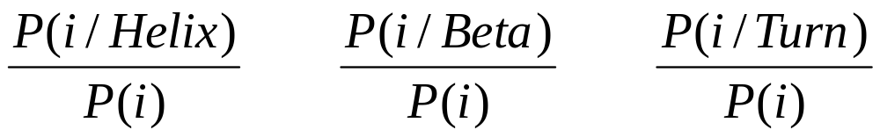
Chou and Fasman
Start by computing amino acids propensities to belong to a given type of secondary structure:
Propensities > 1 mean that the residue type I is likely to be found in the
Corresponding secondary structure type.

Slide 18
Chou and Fasman
Amino Acid α-Helix β-Sheet Turn
Ala 1.29 0.90 0.78
Cys 1.11 0.74 0.80
Leu 1.30 1.02 0.59
Met 1.47 0.97 0.39
Glu 1.44 0.75 1.00
Gln 1.27 0.80 0.97
His 1.22 1.08 0.69
Lys 1.23 0.77 0.96
Val 0.91 1.49 0.47
Ile 0.97 1.45 0.51
Phe 1.07 1.32 0.58
Tyr 0.72 1.25 1.05
Trp 0.99 1.14 0.75
Thr 0.82 1.21 1.03
Gly 0.56 0.92 1.64
Ser 0.82 0.95 1.33
Asp 1.04 0.72 1.41
Asn 0.90 0.76 1.23
Pro 0.52 0.64 1.91
Arg 0.96 0.99 0.88
Favors
α-Helix
Favors
β-strand
Favors
turn

Slide 19
Chou and Fasman
Predicting helices:
- find nucleation site: 4 out of 6 contiguous residues with P(α)>1
- extension: extend helix in both directions until a set of 4 contiguous
residues has an average P(α) < 1 (breaker)
- if average P(α) over whole region is >1, it is predicted to be helical
Predicting strands:
- find nucleation site: 3 out of 5 contiguous residues with P(β)>1
- extension: extend strand in both directions until a set of 4 contiguous
residues has an average P(β) < 1 (breaker)
- if average P(β) over whole region is >1, it is predicted to be a strand

Slide 20
Evaluation of a 2nd structure prediction
-- The Q3 score
ALHEASGPSVILFGSDVTVPPASNAEQAK
hhhhhcccceeeeccceeeccccchhhhh
chhhcccceeeeccccceeeccchhhhhh
hhhhhcccchhhhccchhhccccchhhhh
Amino acid sequence
Actual Secondary Structure
Q3=22/29=76%
(useful prediction)
Q3=22/29=76%
(terrible prediction)
Q3 for random prediction is 33%
Secondary structure assignment in real proteins is uncertain to about 10%;
Therefore, a “perfect” prediction would have Q3=90%.

Slide 21
The GOR method
1) Based on Chou-Fasman method.
2) Takes neighbouring effect of residues into consideration.
3) More accurate than Chou-Fasman method.

Slide 22
The GOR method
Position-dependent propensities for helix, sheet or turn is calculated for each amino acid. For each position j in the sequence, eight residues on either side are considered.
A helix propensity table contains information about propensity for residues at 17 positions when the conformation of residue j is helical. The helix propensity tables have 20 x 17 entries.
Build similar tables for strands and turns.
j

Slide 23
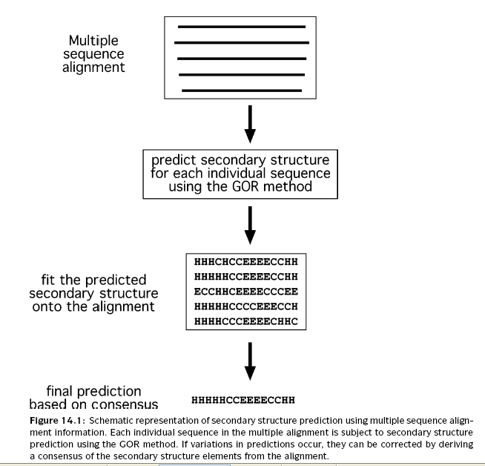
GOR method (continued)

Slide 24
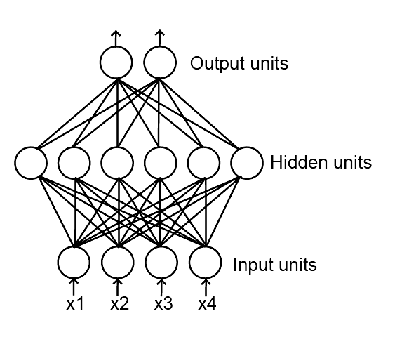
Neural Network
Machine learning component
inspired by the neuron network
In the brain.
Neural networks have to be trained using known data sets.
In general, neural network methods are considered to be the best methods
for 2nd structure prediction.

Slide 29
Neural networks and Secondary Structure prediction
Experience from Chou and Fasman and GOR has shown that:
  In predicting the conformation of a residue, it is important to consider a window around it.
  Helices and strands occur in stretches
  It is important to consider multiple sequences

Slide 30
Accuracy
Both Chou and Fasman and GOR have been assessed and their accuracy is estimated to be Q3=60-65%.
(initially, higher scores were reported, but the experiments set to measure Q3 were flawed, as the test cases included proteins used to derive the propensities!)

Slide 31
The GOR method
Position-dependent propensities for helix, sheet or turn is calculated for each amino acid. For each position j in the sequence, eight residues on either side are considered.
A helix propensity table contains information about propensity for residues at 17 positions when the conformation of residue j is helical. The helix propensity tables have 20 x 17 entries.
Build similar tables for strands and turns.
GOR simplification:
The predicted state of AAj is calculated as the sum of the position-dependent propensities of all residues around AAj.
GOR can be used at : http://abs.cit.nih.gov/gor/ (current version is GOR IV)
j

Slide 32
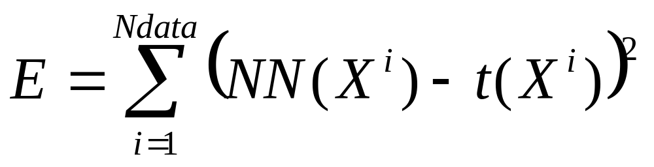
Neural Network
A complete neural network
is a set of perceptrons
interconnected such that
the outputs of some units
becomes the inputs of other
units. Many topologies are
possible!
Neural networks are trained just like perceptron, by minimizing an error function:

Slide 33
Neural networks and Secondary Structure prediction
Experience from Chou and Fasman and GOR has shown that:
  In predicting the conformation of a residue, it is important to consider a window around it.
  Helices and strands occur in stretches
  It is important to consider multiple sequences

Slide 34
Quality of Secondary Structure Prediction
Determine Secondary Structure positions in known protein
structures using DSSP or STRIDE:
Kabsch and Sander. Dictionary of Secondary Structure in Proteins: pattern
recognition of hydrogen-bonded and geometrical features.
Biopolymer 22: 2571-2637 (1983) (DSSP)
Frischman and Argos. Knowledge-based secondary structure assignments.
Proteins, 23:566-571 (1995) (STRIDE)

Slide 35
Limitations of Q₃
ALHEASGPSVILFGSDVTVPPASNAEQAK
hhhhhooooeeeeoooeeeooooohhhhh
ohhhooooeeeeoooooeeeooohhhhhh
hhhhhoooohhhhooohhhooooohhhhh
Amino acid sequence
Actual Secondary Structure
Q3=22/29=76%
(useful prediction)
Q3=22/29=76%
(terrible prediction)
Q3 for random prediction is 33%
Secondary structure assignment in real proteins is uncertain to about 10%;
Therefore, a “perfect” prediction would have Q3=90%.

Slide 36
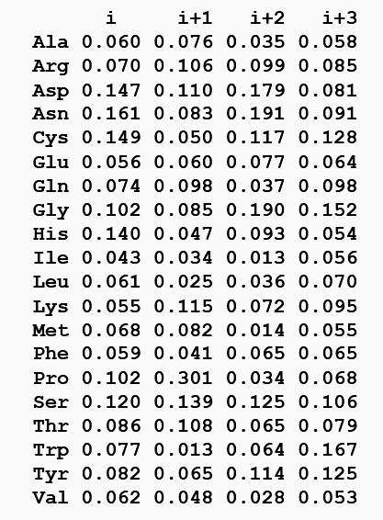
Chou and Fasman
f(i) f(i+1) f(i+2) f(i+3)
Position-specific parameters
for turn:
Each position has distinct
amino acid preferences.
Examples:
At position 2, Pro is highly
preferred; Trp is disfavored
At position 3, Asp, Asn and Gly
are preferred
At position 4, Trp, Gly and Cys
preferred

Slide 37
Chou and Fasman
Predicting turns:
- for each tetrapeptide starting at residue i, compute:
- P_{Turn} (average propensity over all 4 residues)
- F = f(i)*f(i+1)*f(i+2)*f(i+3)
- if P_{Turn} > Pα and P_{Turn} > Pβ and P_{Turn} > 1 and F>0.000075
tetrapeptide is considered a turn.
Chou and Fasman prediction:
http://fasta.bioch.virginia.edu/fasta_www/chofas.htm

Slide 38
Neural networks
The most successful methods for predicting secondary structure
are based on neural networks. The overall idea is that neural
networks can be trained to recognize amino acid patterns in
known secondary structure units, and to use these patterns to
distinguish between the different types of secondary structure.
Neural networks classify “input vectors” or “examples” into
categories (2 or more).
They are loosely based on biological neurons.

Slide 39
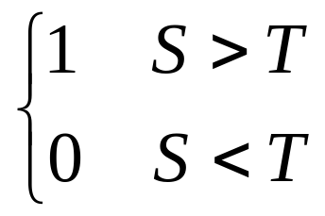
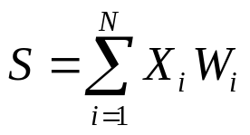
The perceptron
X1
w1
T
X2
w2
wN
XN
Input
Threshold Unit
Output
The perceptron classifies the input vector X into two categories.
If the weights and threshold T are not known in advance, the perceptron
must be trained. Ideally, the perceptron must be trained to return the correct
answer on all training examples, and perform well on examples it has never seen.
The training set must contain both type of data (i.e. with “1” and “0” output).

Slide 40
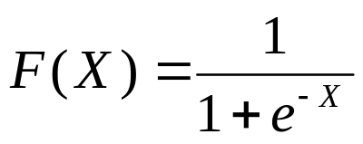
The perceptron
Notes:
- The input is a vector X and the weights can be stored in another
vector W.
- the perceptron computes the dot product S = X.W
- the output F is a function of S: it is often set discrete (i.e. 1 or
0), in which case the function is the step function.
For continuous output, often use a sigmoid:
1
1/2
0
0
- Not all perceptrons can be trained ! (famous example: XOR)

Slide 41
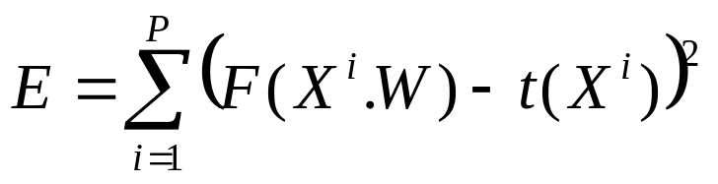
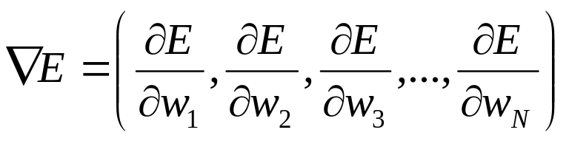
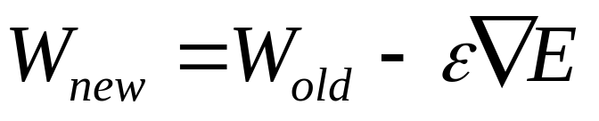
The perceptron
Training a perceptron:
Find the weights W that minimizes the error function:
P: number of training data
X^{i}: training vectors
F(W.X^{i}): output of the perceptron
t(X^{i}) : target value for X^{i}
Use steepest descent:
- compute gradient:
- update weight vector:
- iterate
(e: learning rate)

Slide 42
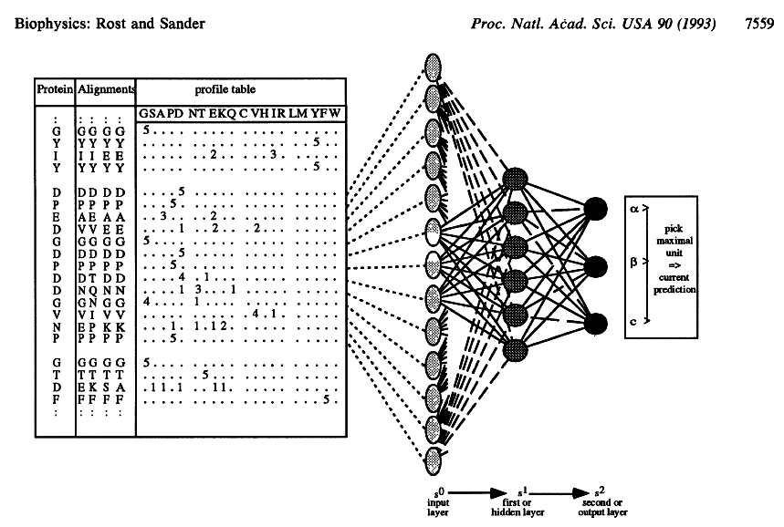
PHD: Secondary structure prediction using NN

Slide 43
PHD: Input
For each residue, consider
a window of size 13:
13x20=260 values

Slide 44
PHD: Network 1
Sequence Structure
13x20 values
3 values
Network1
Pα(i) Pβ(i) Pc(i)

Slide 45
PHD: Network 2
Structure Structure
For each residue, consider
a window of size 17:
3 values
3 values
17x3=51 values
Network2
Pα(i) Pβ(i) Pc(i)
Pα(i) Pβ(i) Pc(i)

Slide 46
PHD
Sequence-Structure network: for each amino acid aj, a window of 13 residues aj-6…aj…aj+6 is considered. The corresponding rows of the sequence profile are fed into the neural network, and the output is 3 probabilities for aj: P(aj,alpha), P(aj, beta) and P(aj,other)
Structure-Structure network: For each aj, PHD considers now a window of 17 residues; the probabilities P(ak,alpha), P(ak,beta) and P(ak,other) for k in [j-8,j+8] are fed into the second layer neural network, which again produces probabilities that residue aj is in each of the 3 possible conformation
Jury system: PHD has trained several neural networks with different training sets; all neural networks are applied to the test sequence, and results are averaged
Prediction: For each position, the secondary structure with the highest average score is output as the prediction

Slide 47
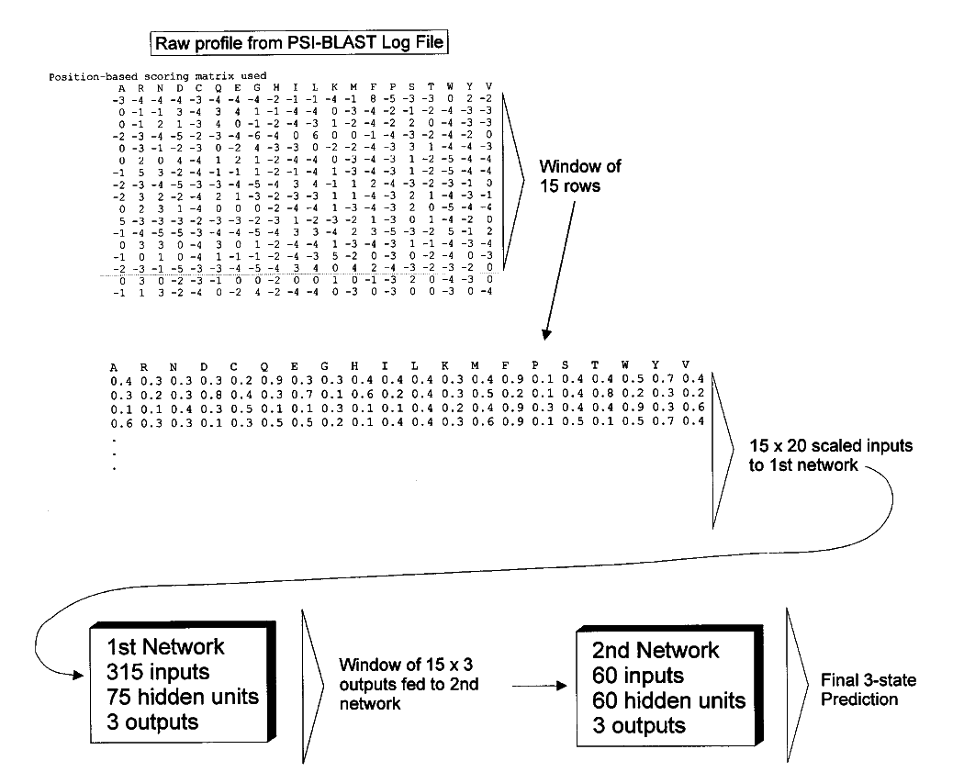
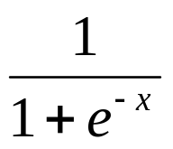
PSIPRED
Jones. Protein secondary
structure prediction based
on position specific scoring
matrices. J. Mol. Biol.
292: 195-202 (1999)
Convert to [0-1]
Using:
Add one value per row
to indicate if Nter of Cter

Slide 48
Performances
(monitored at CASP)
CASP | YEAR | # of Targets | <Q3> | Group
CASP1 | 1994 | 6 | 63 | Rost and Sander
CASP2 | 1996 | 24 | 70 | Rost
CASP3 | 1998 | 18 | 75 | Jones
CASP4 | 2000 | 28 | 80 | Jones

Slide 49
Secondary Structure Prediction
Available servers:
- JPRED : http://www.compbio.dundee.ac.uk/~www-jpred/
- PHD: http://cubic.bioc.columbia.edu/predictprotein/
- PSIPRED: http://bioinf.cs.ucl.ac.uk/psipred/
- NNPREDICT: http://www.cmpharm.ucsf.edu/~nomi/nnpredict.html
- Chou and Fassman: http://fasta.bioch.virginia.edu/fasta_www/chofas.htm
Interesting paper:
- Rost and Eyrich. EVA: Large-scale analysis of secondary structure
prediction. Proteins 5:192-199 (2001)

Slide 50
Proteins
Protein: from the Greek word PROTEUO which means "to be first (in rank or influence)"
Why are proteins important to us:
  Proteins make up about 15% of the mass of the average person
  Enzyme – acts as a biological catalyst
  Storage and transport – Haemoglobin
  Antibodies
  Hormones – Insulin
Notes:
Antibody - a protein molecule made by the human body's immune system to destroy invading substances like viruses, bacteria or their toxins
Enzyme - a particular type of protein that acts as a catalyst for chemical reactions in living cells
Catalyst - a substance that speeds up a chemical reaction without being used up
protein, α-keratin, as one of their components

Slide 51
Proteins
Why are proteins important to us (c.d.):
    Ligaments and arteries (mainly former by elastin protein)
    Muscle – Proteins in the muscle respond to nerve impulses by changing the packing of their molecules
    Hair, nails and skins: protein α-keratin as main component
    And more ……
Notes:
Antibody - a protein molecule made by the human body's immune system to destroy invading substances like viruses, bacteria or their toxins
Enzyme - a particular type of protein that acts as a catalyst for chemical reactions in living cells
Catalyst - a substance that speeds up a chemical reaction without being used up
protein, α-keratin, as one of their components

