Slide 1
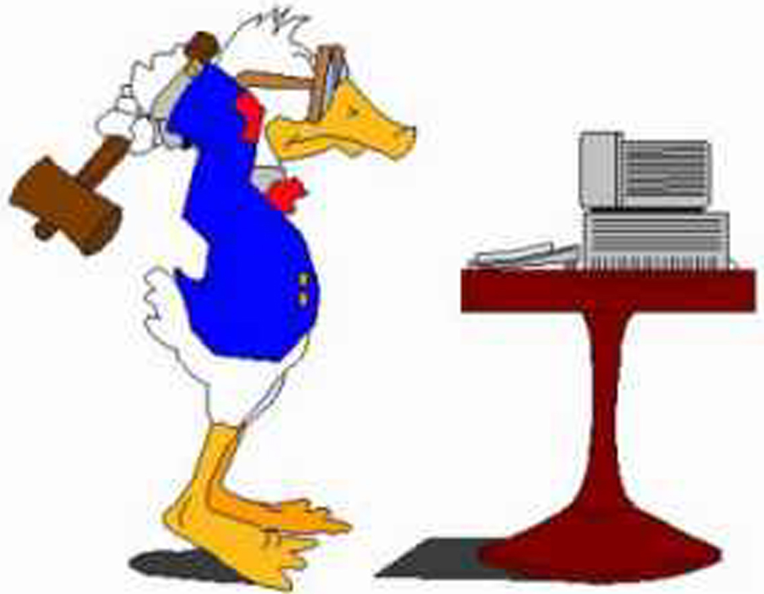
Computer Basics
Hong Qin

Slide 2
Computer lab policy
Sign and return them.

Slide 3
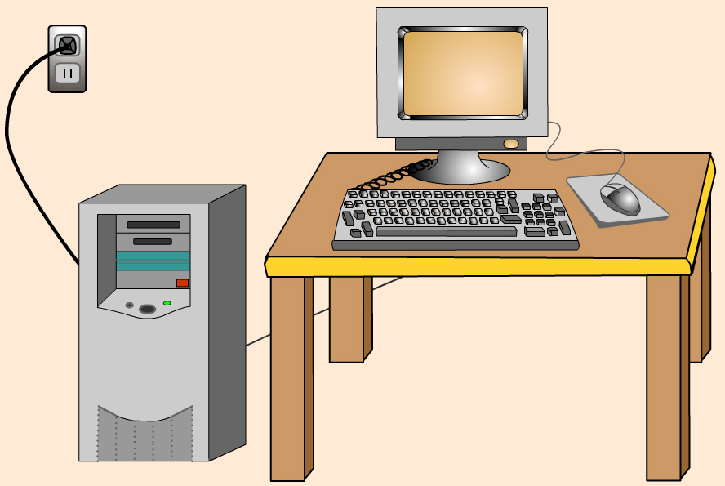
What is a computer?
An programmable device (hardware) that can store, retrieve and process data. It is a machine that executes commands (software) to perform mathematical and logical operations.

Slide 4
What is a computer?
Hardware
  “The stuff that you can build”.
  CPU
  Memory (RAM)
  Storage (hard drive)
  Monitor, keyboard, mouse, cables, etc.
Software
  “The stuff that you can write.”
  The abstract components of the computer that controls the hardware by executing commands and processing data.
  Software are stored physical media (such as hard drive).

Slide 5
What is a computer?
Customize a DELL computer on its website.
Customize a Gateway computer on its website.

Slide 6
Software
System software
  Manages and controls hardware.
  Examples: operating systems likes Windows, Linux, and Mac OSX.
Application software
  Programs are supposed to help human to do their jobs.
  Examples: Microsoft Word, Powerpoint, Excel, Firefox.

Slide 7
Programming Languages
An artificial language to control the behavior of a machine.
It has own syntax and semantic rules, just like human languages.
Different languages for different kind of tasks
  PERL for text management.
  R, S-PLUS, SAS, or Matlab for math/statistics.
  C++, JAVA, C# for software engineering.

Slide 8


Bioinformatics research and open-source software
Proprietary software
Windows – consumer oriented.
Open-source software
  Linux – research oriented.

Slide 9
Open-source software
Most bioinformatics software are open-source, including many that are considered to be the best ones.
The open source definition
  http://www.opensource.org/docs/osd
Open-source vs. free software

Slide 10
Problems related to computers
Computer security problems
  Computer viruses and other malicious software
    Always back your data.
    Counter with antivirus software.
  Spyware.
    Counter with spyware scanners.
  Intrusions
    Counter with firewalls.
Occupational hazard
  Carpal tunnel syndrome.
    Counter with ergonomic solutions.
  Lower back pain.
    Proper posture.
  Dry eyes.
  Compulsive email checking.

Slide 11
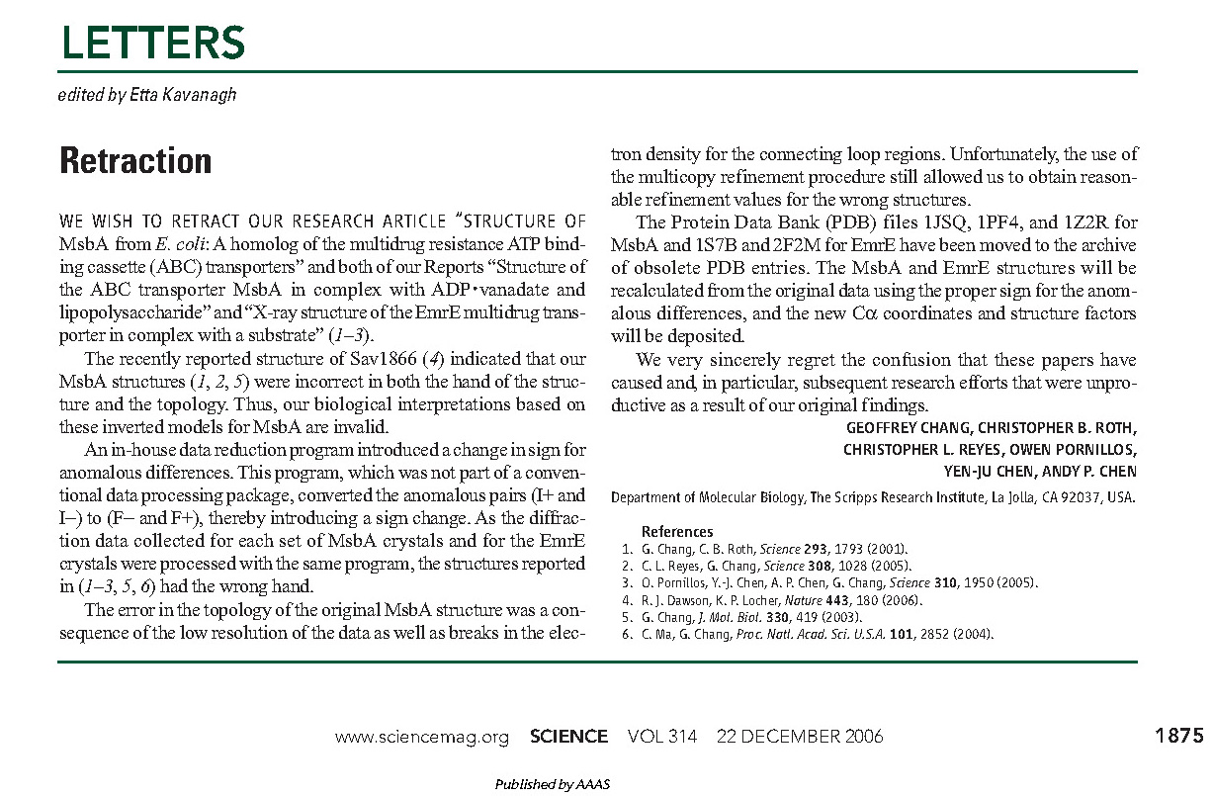
When software goes wrong, it can be a monumental blunder.

Slide 12
Files
Test Files and Binary Files are mis-leading names.
  See “Text File” in Wikipedia.
  All data in computer are stored in binary codes (0,1)
Text Files
  Files contain only characters (often in ASCII format)
  ASCII, American Standard Code for Information Interchange
  Commonly used in bioinformatics. For example, sequence files are often stored in FASTA format in text files.
  Can be edited by text editors
Binary Files
  Files contain data that cannot be interpreted as text.
  For example, *.doc *.exe

Slide 13
View text file under Linux
View text files:
  “cat”
  “more”
  “less”
  “head”
  “tail”
Edit text files:
  “nano“

Slide 14
FASTA sequence file
>This is a fasta header
ATGCGTTGCAAAATTTNATG

Slide 15
Test text files under cygwin
Optional

Slide 16
Test your ID and password

Slide 17
Test some software
Swiss PDB Viewer
MEGA 4

Slide 18
Notes:
Todo:
What are the basic bioinformatics skills?

