Slide 1
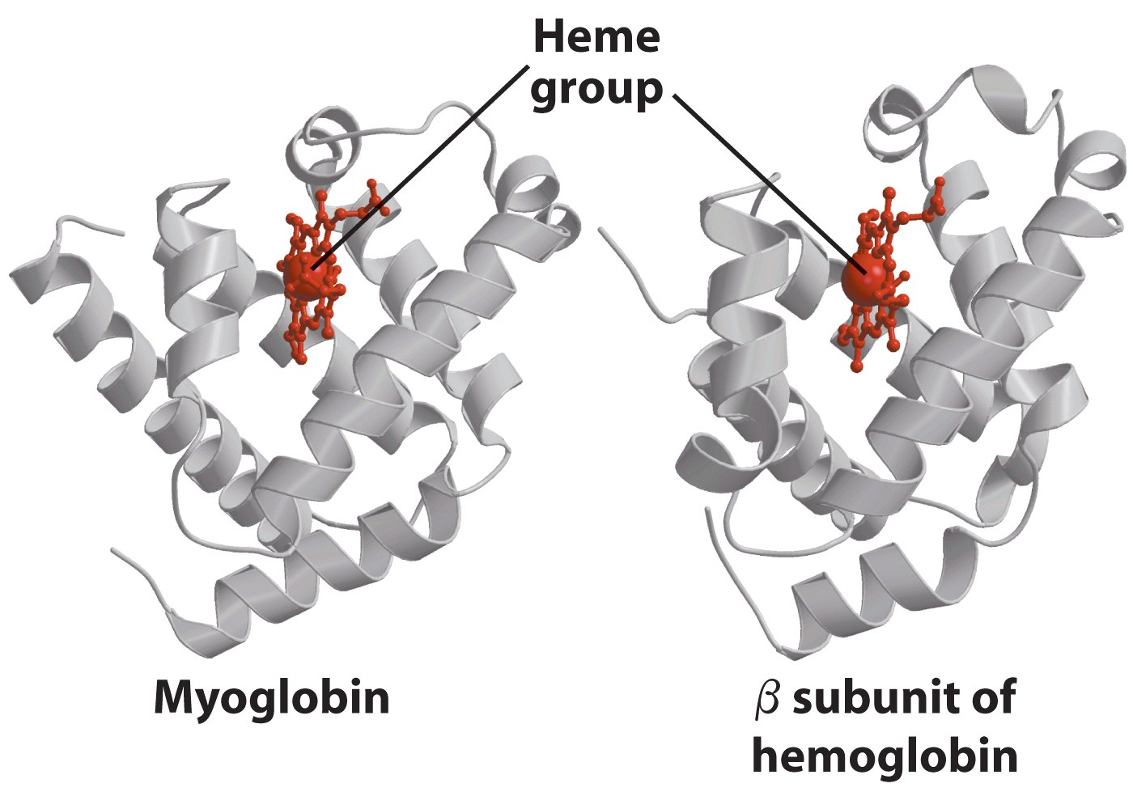
Introduction to protein structure (2)
Hong Qin
ARMS annex B, Phone 8731

Slide 2
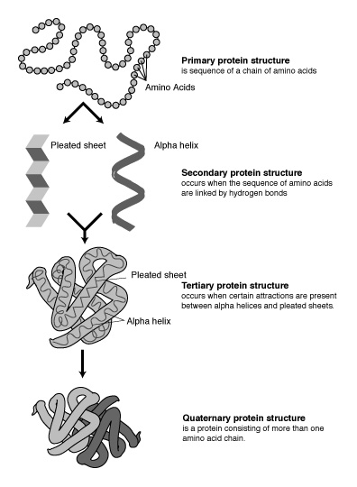
Four levels of protein structure

Slide 3
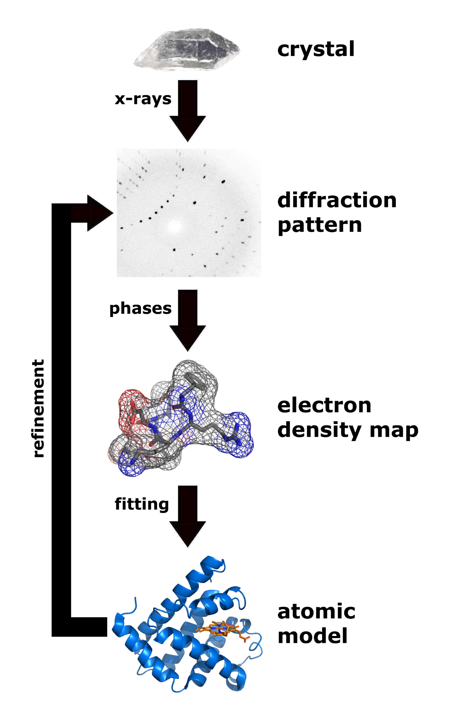
Protein structures can be determined by x-ray crystallography.

Slide 4
PDB– The file format for protein structures
A text file.
80 characters per line.

Slide 5
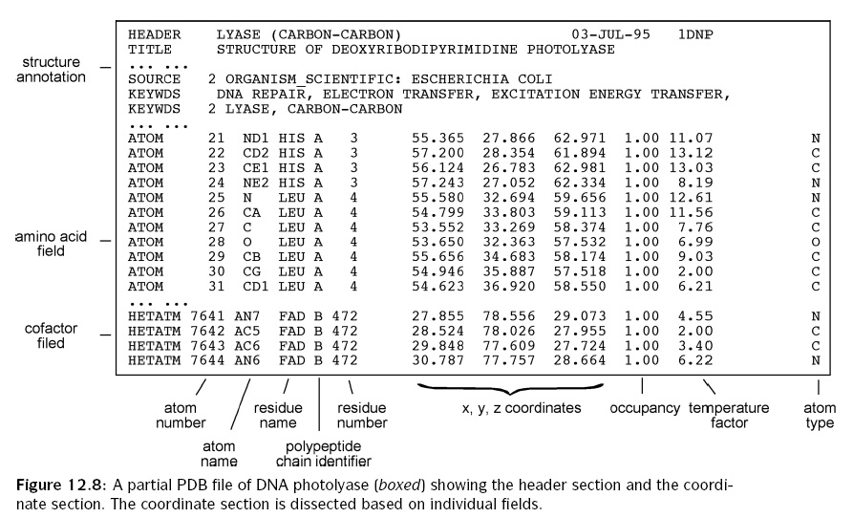
PDB file format
Notes:
Coordinates are given in anstrongs.

Slide 6
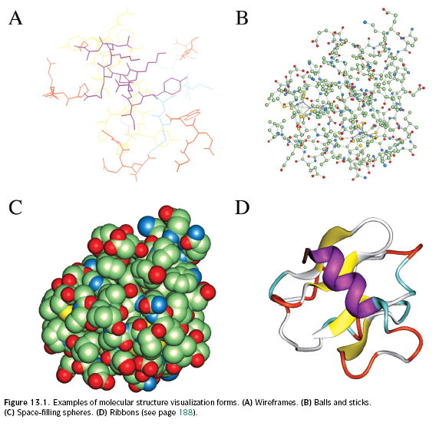
Visualization of protein structures

Slide 7
Objective: Learn to analyze protein structure using a software “Swiss PDB Viewer”
What can SPDBV do?
  Display protein structure in various modes.
  Analyze protein secondary structures.
  Analyze hydrogen-bonds etc.
  Generate figures
  Mutation of amino acid residues
  Model protein tertiary structures
  And many more features.

Slide 8
Why SPDBV?
It is free, powerful, and user-friendly.
It runs on Windows and Apple computers.
It comes with on-line tutorials and manuals.

Slide 9
SPDBV usages
On line user manual:
  http://expasy.org/spdbv/text/main.htm

Slide 10
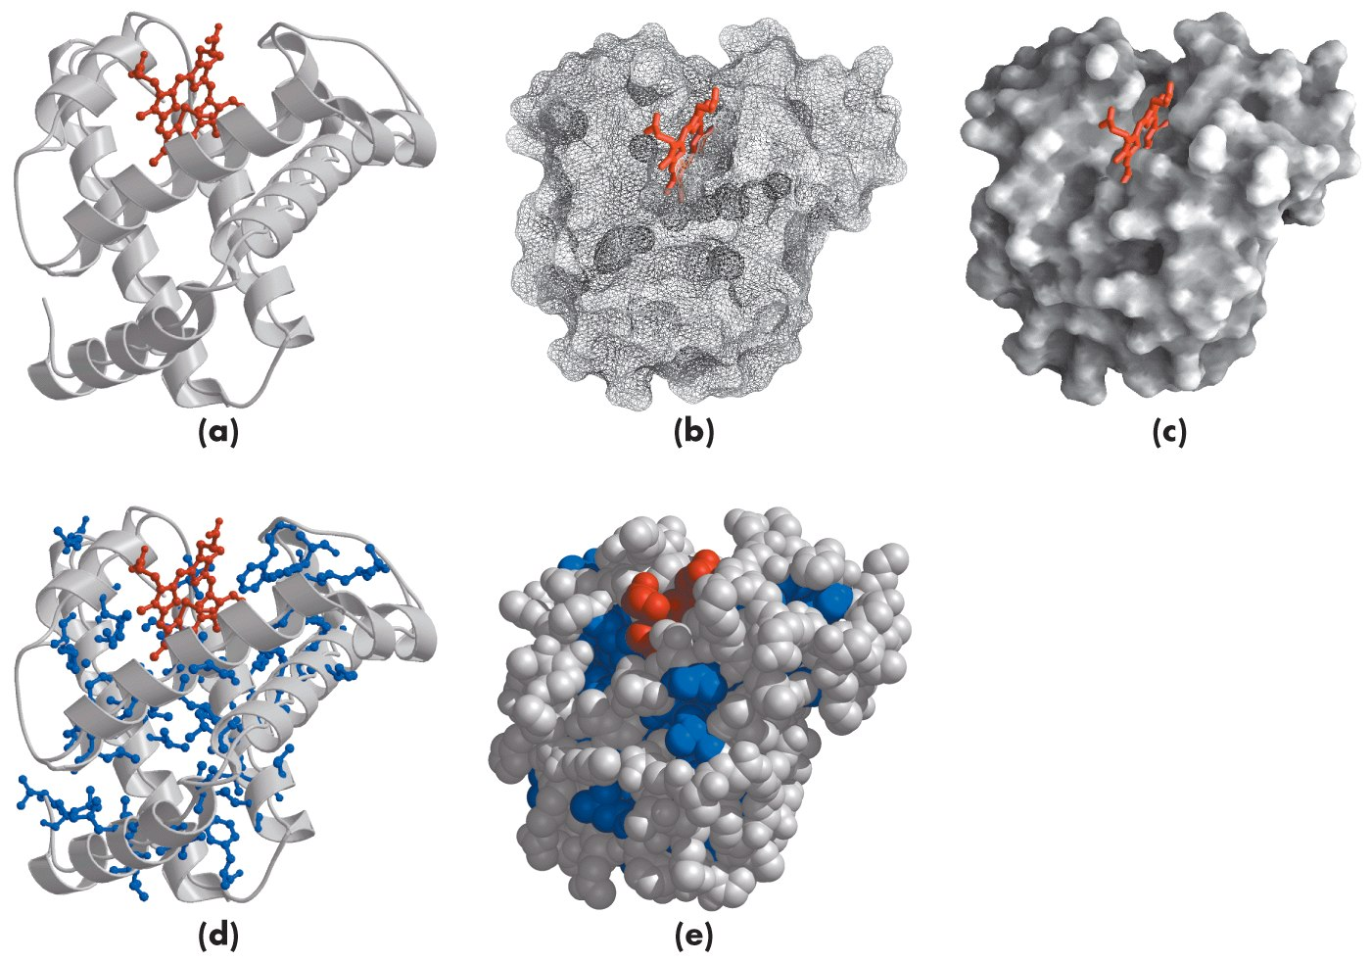
Myoglobin? (Leningher, Fig4-16)

Slide 12
Myoglobin, hemglobin (Leningher, Fig 5-6)

Slide 13
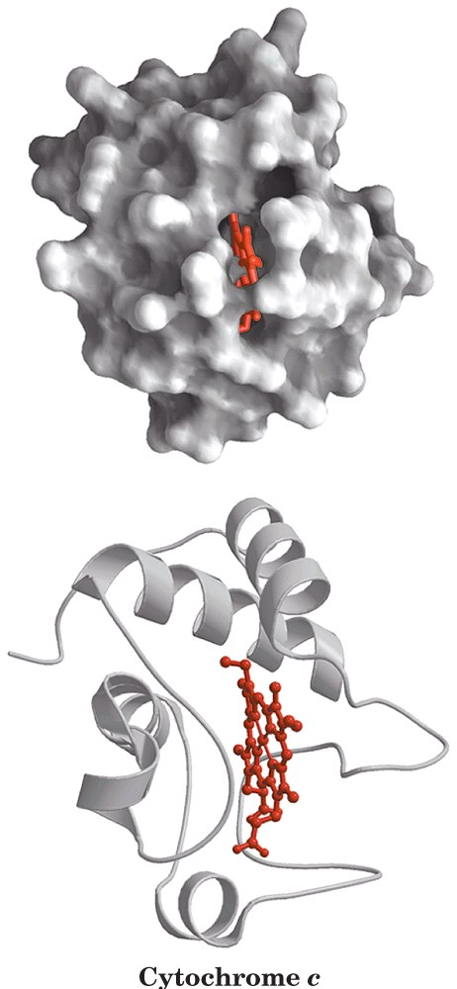
Cytochrome c (Leningher, Fig 4-18a)

Slide 17
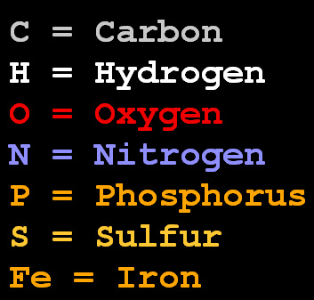
CPK color scheme
CPK =
Corey, Pauling, Kultin.
Notes:
The atoms are colored in CPK scheme as:
C--> white O --> red N --> blue S --> yellow P --> orange H --> cyan other --> gray.

