Slide 1
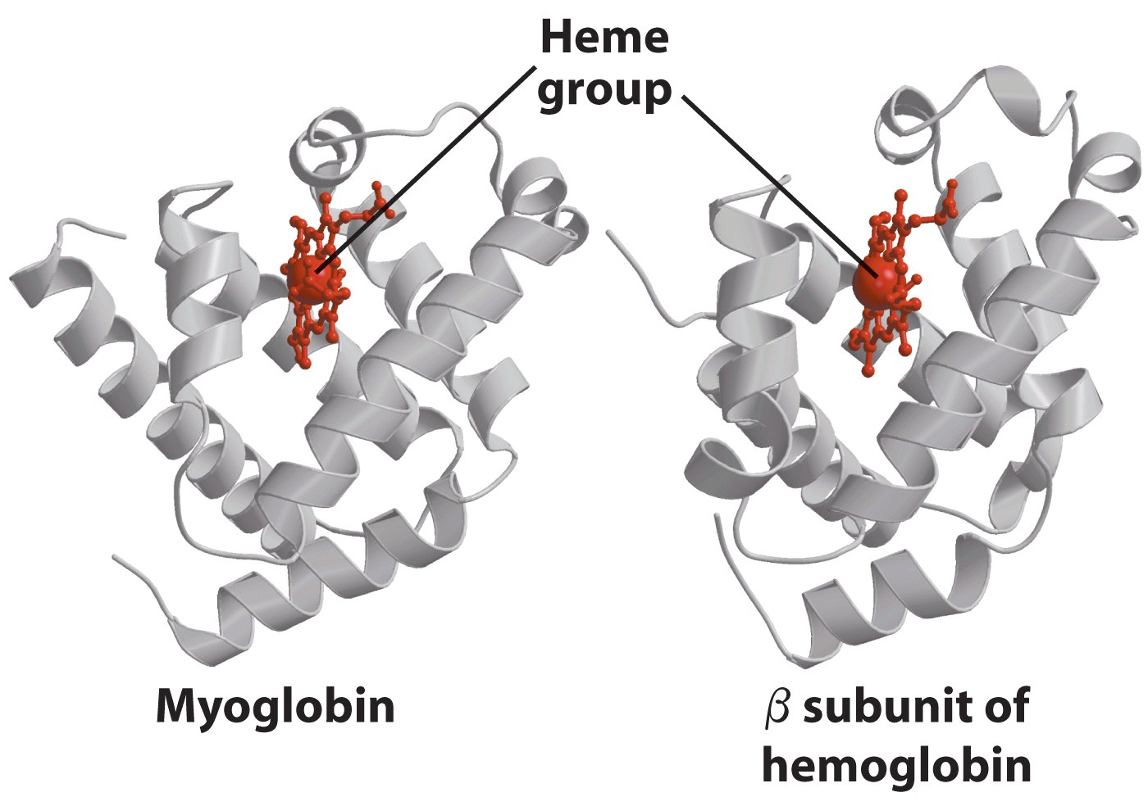
Myoglobin and Hemoglobin

Slide 2
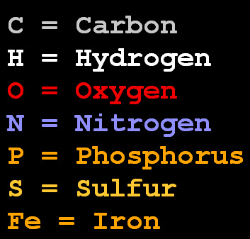
CPK color scheme
CPK =
Corey, Pauling, Kultin.
Notes:
The atoms are colored in CPK scheme as:
C--> white O --> red N --> blue S --> yellow P --> orange H --> cyan other --> gray.

