Slide 1
Study the Link between Oxidative Stress and the Aging Process in Yeast
Aliman Caliman

Slide 2
Reactive Oxygen Species is a hypothesized cause of aging
Oxidative stress in involved in heart failure, Parkinson’s disease, Alzheimer’s disease and chronic fatigue syndrome
Oxidative stress is also known to be involved with aging, through the production of Reactive Oxygen Species
Build-up of Free Radicals
Oxidative Stress
Apoptosis
Inflammation
ADHD
Cancer
Heart Disease
Parkinson’s
Alzheimer's
Aging

Slide 3
Oxidative stress and ROS
Oxidative stress is an imbalance between production and detoxification of oxidative substances (Schafer & Buettner 2001)
A buildup of these free radicals can lead to damage in parts of the cell
Reactive Oxygen Species are reactive oxygen molecules with unpaired valence shell electrons
They are known to be involved in Redox Signaling, which act as messengers
With environmental stress, ROS levels can rise, which can damage macromolecules, including DNA, RNA and proteins
Notes:
Reactive Oxidative Species

Slide 4
Yeast is a model for cellular aging
Yeast are used as a model organism because they are easy to grow and have a simple cell cycle, recombination and metabolism process
These processes are conserved in larger eukaryotes
The lifespan of Yeast can be measured using two mechanisms
Replicative Life Span is the number of times one cell can divide before is senesce (Fabrizio & Longo 2003)
Chronological life span is how long a cell can live without dividing, (Lai & Jazwinski 2002)
Notes:
(Yeast as Model to study cellular aging in oxidative stress)

Slide 5
Hypothesis
?
Lifespan
Life-history traits
Resistance to oxidative stress
Is there a correlation between resistance to oxidative stress and life span or life-history traits?

Slide 6
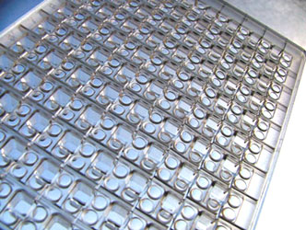

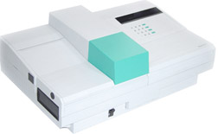
Experimental Design
Yeast Plate
Yeast
Add Hydrogen Peroxide
Measure amount of Damage
in Plate using Ruler
Measure Oxidative Stress
Using Linear Regression Analysis
Notes:
Use 12 strains of yeast whose life span have been characterized in details (Qin & Lu 2006, Qin, Lu & Goldfarb 2008)

Slide 7
Resistances to H2O2 in strains
 | Inner Circle at 15% (cm) | Inner Circle at 30% (cm) | Outer Circle at 15% (cm) | Outer Circle at 30% (cm) | Death H202 %
M5* | 0.5 | 0.7 | 2.1 | 2.6 | 5
M32* | 0.6 | 1.8 | 0.5 | 1.7 | 10
YPS163 | 1.0 | 1.0 | 2.8 | 2.9 | 2.5
M1-2* | 0.5 | 0.6 | 2.0 | 2.6 | 5
M2-8* | 0.5 | 0.7 | 2.0 | 2.7 | 5
M22 | n/a | n/a | 3.5 | 4.5 | 2.5
YPS128 | 1.0 | 1.0 | 2.3 | 2.5 | 5
M34* | 0.5 | 0.9 | 2.2 | 2.7 | 5
M8* | 1.0 | 0.8 | 2.5 | 2.6 | 5
101s* | 0.8 | 0.9 | 3.0 | 3.0 | 5
M13* | 1.9 | 1.2 | 2.5 | 2.7 | 5
M14 | n/a | n/a | 3.0 | 4.1 | 2.5

Slide 8
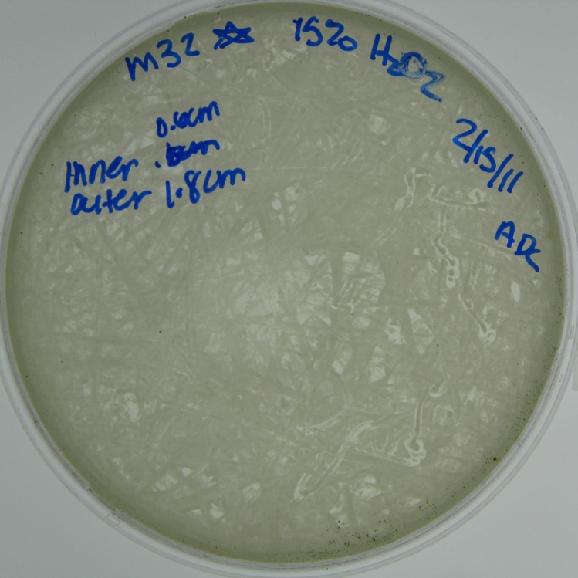
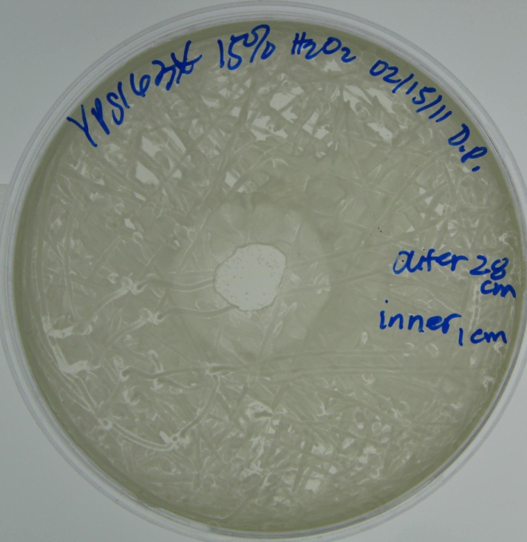
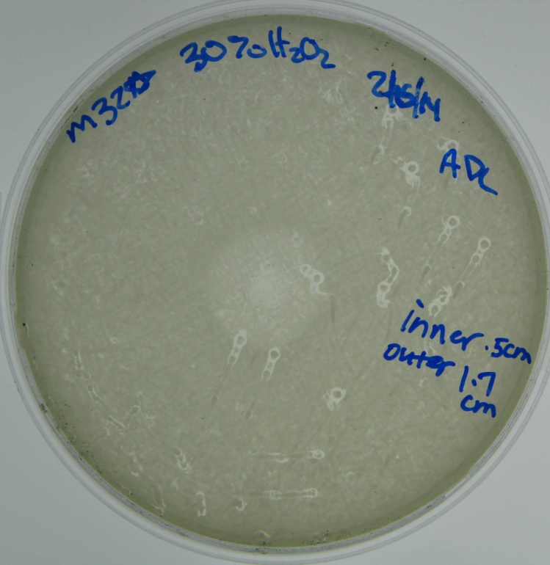
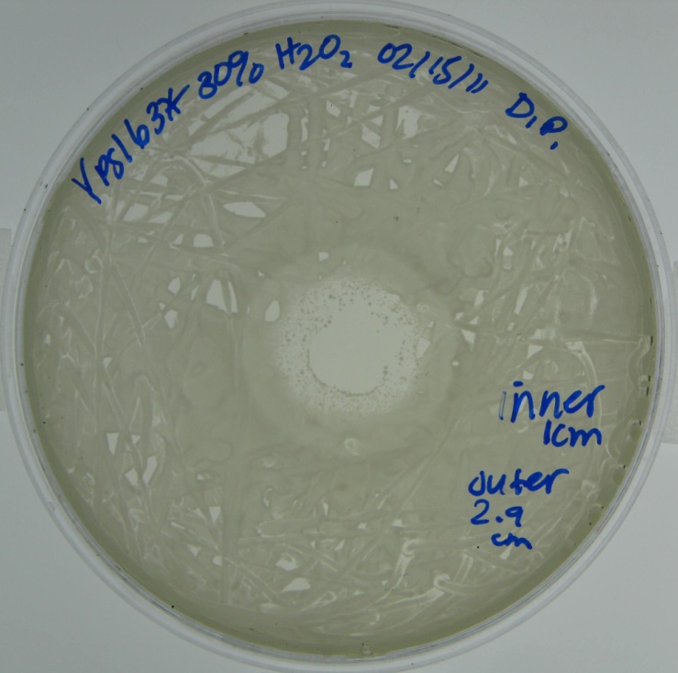
Sensitive and resistant strains by halo assay
Resistant
Senstive
With an increase in Hydrogen Peroxide Concentration, there is an increase in oxidative damage
Notes:
Arrow

Slide 9
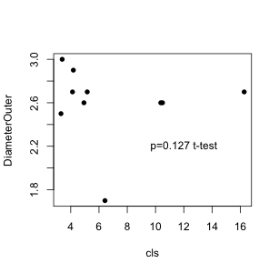
Chronological life span vs. Outer Diameter

Slide 10
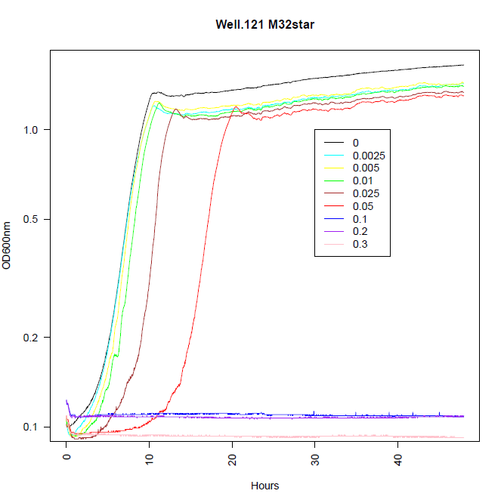
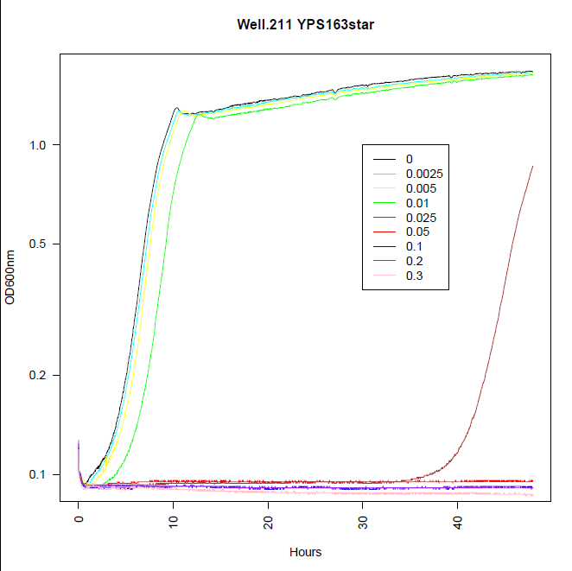
Measure of H2O2 tolerance by growth curves

Slide 11
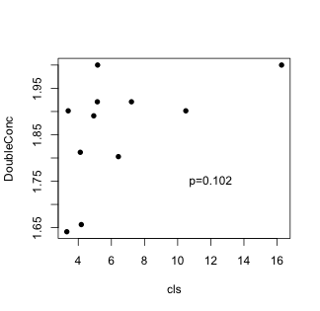
Chronological life span vs. H2O2

Slide 12
Summary
There are substantial variation in oxidative stress tolerance in yeast wild isolates.
There is a possible positive correlation between the chronological life span and the resistance to oxidative stress, support by both halo-assay and growth curve measures.

Slide 13
(Future Directions)
The specific mechanism of Cellular Aging has yet to be discovered
SIR2, TOR1 and SCH9 are known to be involved in aging
Sir2 is involved in an organisms' response to stress (Kaeberlein & Guarente 1998)
TOR1 controls growth by regulating transcription and translation (Zheng & Schreiber 1997, Beck & Hall, 1999)
SCH9 is involved in the G1 phase (Toda 1988, Crauwels 1997)
Notes:
correlated

Slide 14
Acknowledgement
NSF award 1022294
Spelman RISE

