Slide 1
Chronological Lifespan Assay in Yeasts
Meng Lu
3/16/05

Slide 2
Experiments
Chronological Lifespan (CLS): length of viable cells at stationary phase
Studying CLS of natural isolates:
M5 M2-8 M32 M34 YPS128 YPS163 101S
and BY4743 (control)
Studying CLS of M5 & M34 MET15+/-
Notes:
Natural variation of CLS in a collection of natural yeast isolates.

Slide 3
Brief Procedures
Grow yeasts in 10mL rich media (YPD) O/N
Wash with H2O to remove YPD
Resuspend in 5ml H2O to start from time = 0
Sonicate, Plate ~ 300 cells on YPD plates
Count the cell # /mL and colonies # for analysis.
Notes:
The reason that we chose to study CLS in water is that natural isolates have different growth rates. Therefore, when studying CLS in either YPD or SCD, they may enter stationary phases at different time points. Using water, we may be able to synchronize the entry time to stationary phase.

Slide 4
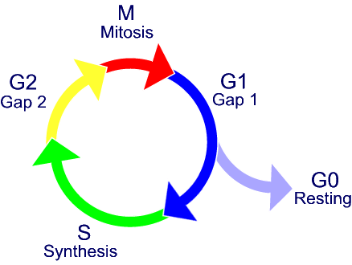
Cell cycle
Cells that can not exit G0 == Dead
Cells that can exit G0 == Alive
Notes:
G0 is the stationary phase.

Slide 5
Results (cell #)
Notes:
Basically, cell numbers do not fluctuate dramatically over time, in comparison to vitality.

Slide 6
Results (Colony #)
Notes:
here, we measure the ability of yeast cells to exit stationary phase and restart growing.
Cell

Slide 7
Results (cell #)

Slide 8
Results (Colony #)

Slide 9
Log phase
Notes:
Significant increase of M5 from time 160 hours to 300 hours.

Slide 10
Comparison

Slide 11
Comparison

Slide 12
Conclusions
Cell # no significant changes
Colonies sizes differ
Data not consistent

Slide 13
Concerns
YPD or SCD ?
Cells from semi-log phase (cells with buds)?
Sources of errors (counting, pipetting, plating)

