Slide 2
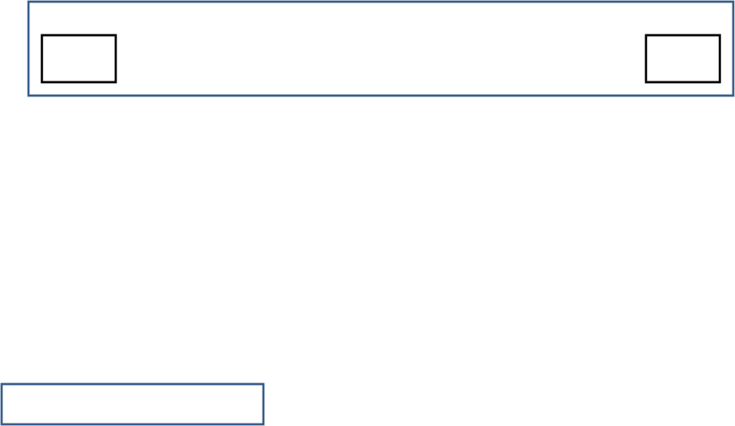
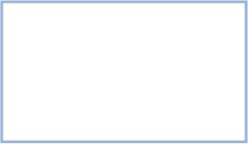
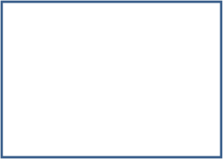
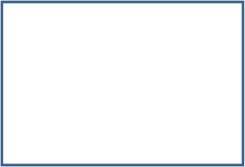

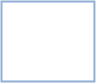
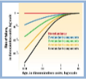

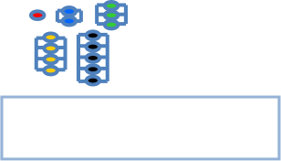
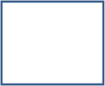

Reliability Model Shows Heterogeneity Key Factor of Biological Aging
Erika Dommond
Dr. Hong Qin, Dr. Nagambal Shah
Spelman Logo
HHMILogo
Introduction
Aging is defined by the increasing risk of failure with time. In terms of organisms, this increased risk of failure can lead to sickness and ultimately death. Therefore, deciphering the mechanisms by which cell components of a biological system age is of great interest. In terms of the aforementioned systems, components are configured in a functionally redundant manner. It follows that the failure of one component does not lead to the death of the entire system . A system fails (dies) when all of its components fail; which can take place at homogeneous (constant) failure rates or non-homogeneous rates. It is this accumulation of damage to the components which in turn leads to the aging of the system. When modeling the failure rate of a biological system…
Objectives
  Utilize R (statistical programming package) to create a reliability model which simulates the application of non-constant failure rates to the components of a system.
  Determine whether the application on heterogeneous failure rates gives rise to a Gompertz Model.
Summary
Materials/Methods
Conclusion
Explanation of difference between Weibull and Gompertz (power function vs. exponential function)
Results
Works Cited
Insert graph of results with non constant rate
Insert graph of results with non constant rate
Acknowledgements
The left diagram illustrates subsystems composed of a various number of components. As the graph shows, early age failure rates decrease with an increase in components.

Slide 3
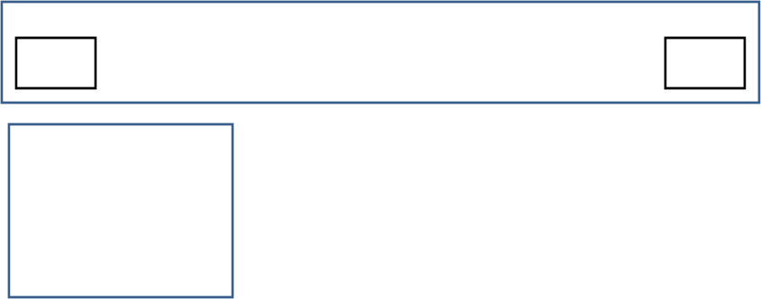


Reliability Model Shows Heterogeneity Key Factor of Biological Agingig
Erika Dommond
Dr. Hong Qin, Dr. Nagambal Shah
Spelman Logo
HHMILogo
Objectives
Introduction
Summary
Materials/Methods
Insert graph of Weibull Model example
Insert graph of Gompertz Model example
Conclusion
Results
Explanation of difference between Weibull and Gompertz (power function vs. exponential function)
Picture of parallel and series components
Graph showing relationship b/w redundancy and failure rate
Works Cited
Insert graph of results with non constant rate
Insert graph of results with non constant rate
Acknowledgements
Explanation of difference between Weibull and Gompertz (power function vs. exponential function)

