Slide 1
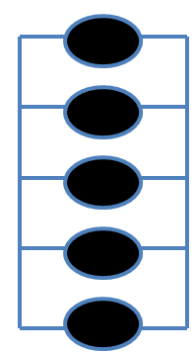
From previous study…
Our initial goal is to add to the original code in order to represent multiple systems
In further research we want to change the code to correct for failed components…
…And then apply the code to multiple systems with random failed components in each system.

