Slide 1



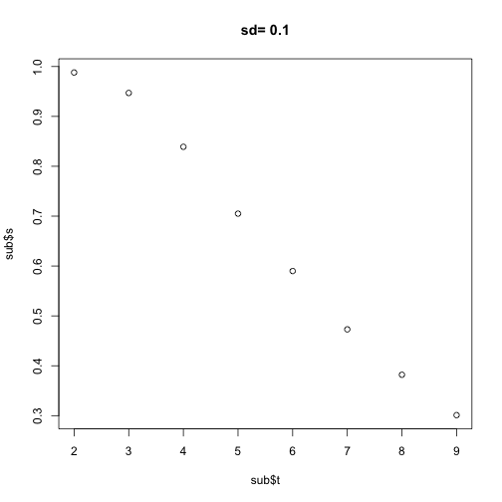
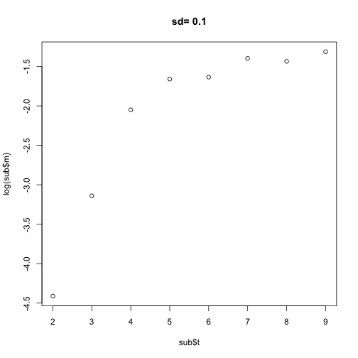
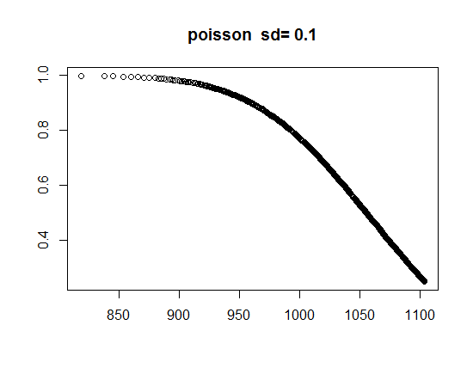
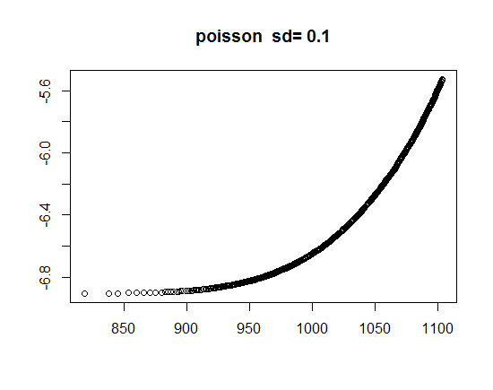
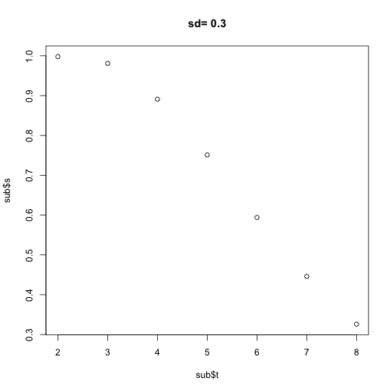
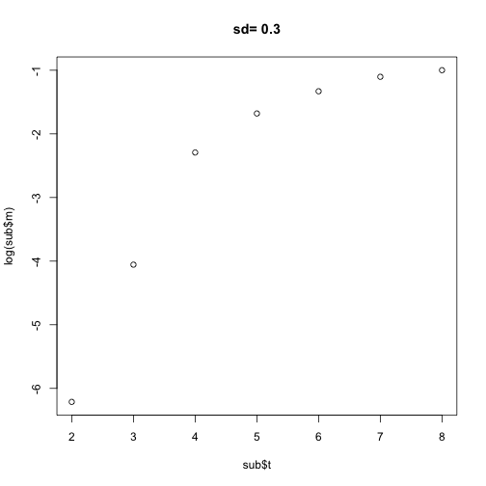
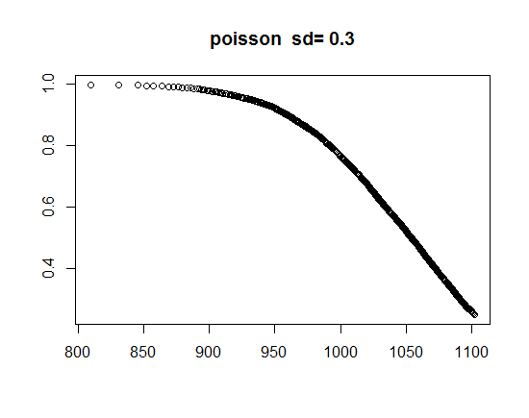
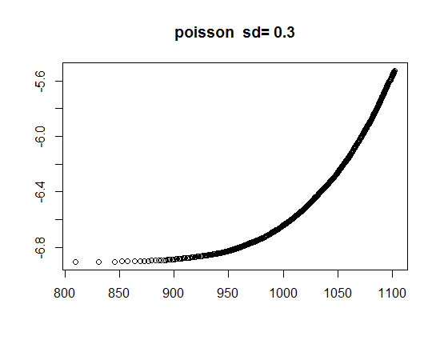
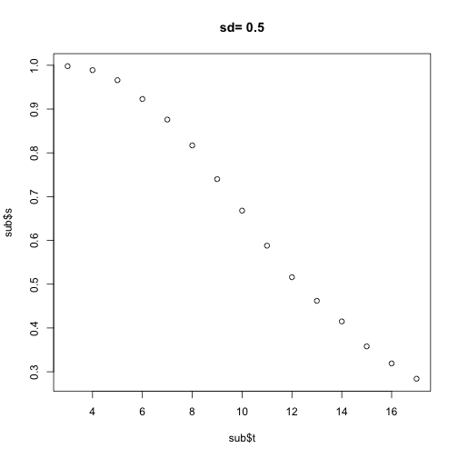
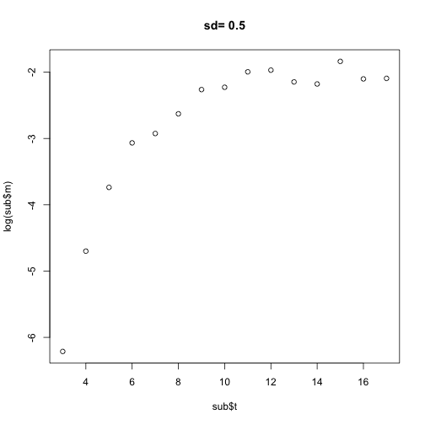


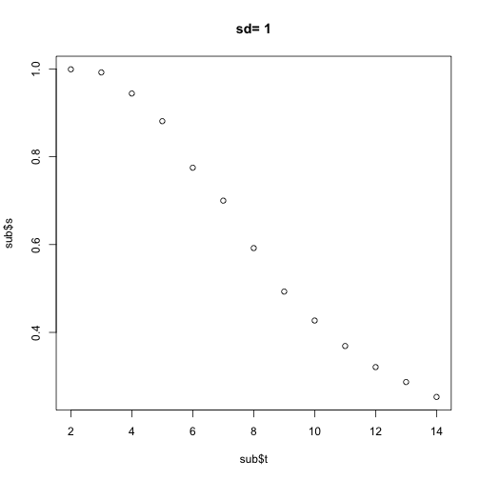
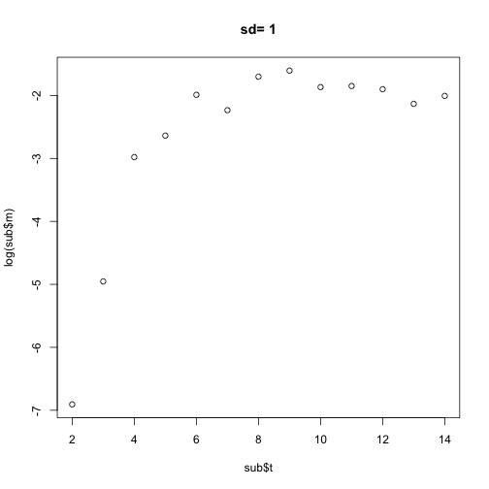
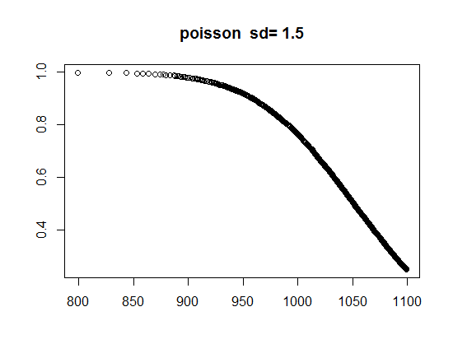

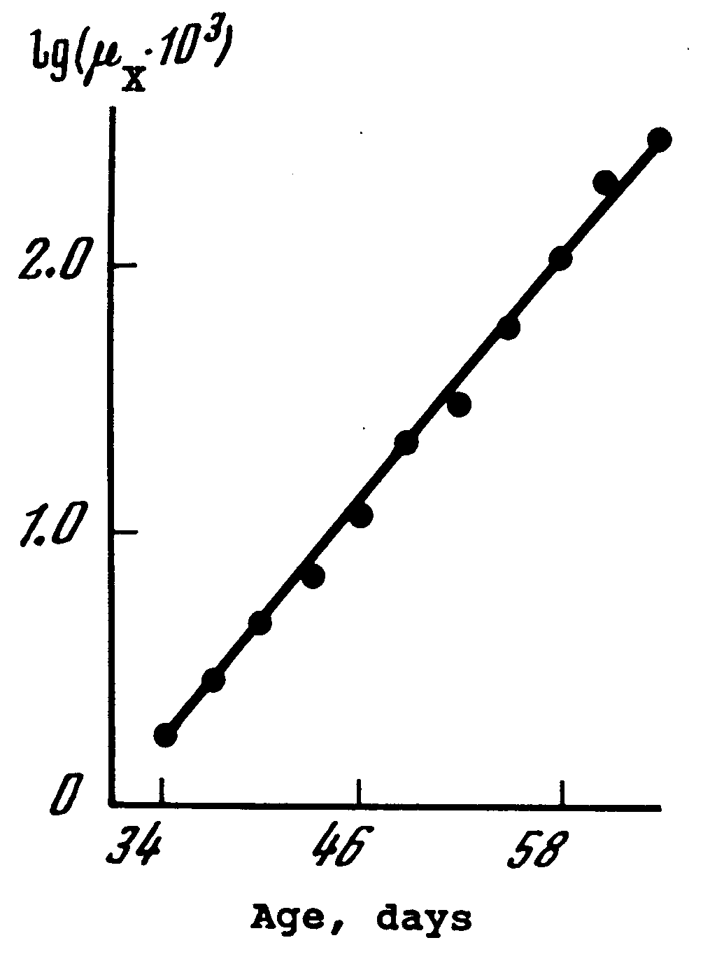
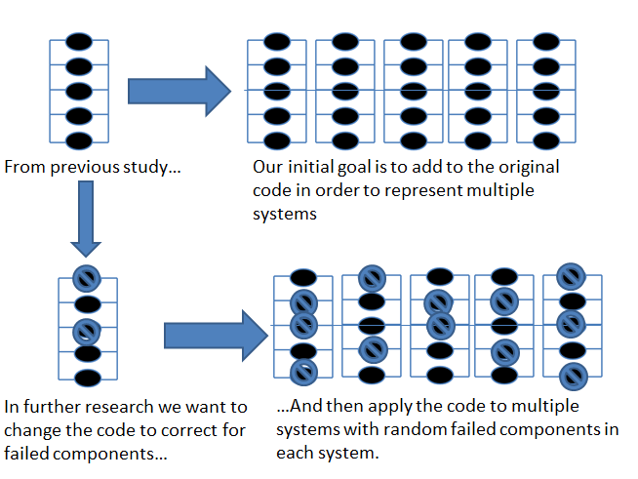
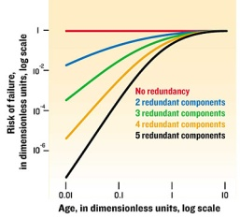
Extending the Reliability Model of Cellular Aging Jessica Christopher, Jessika Williams, Erika Dommond, Dr. Hong Qin, Ph.D., Biology Department
Introduction
Aging is defined as the increasing chance of failure with time. For biological organisms, increasing risk of functional failure can lead to sickness and ultimately death. Thus, discovering the manner by which cell components of a biological system age is an important question. In the reliability model of cellular aging, components are considered functionally redundant, if one dies, the entire system does not fail, because the components are connected in parallel. The system will only fail when all of the components fail. In the human body, the cells that make up organs represent the components, and the organs represent the system. The individual components can either have the same failure rate (homogeneous) or different failure rates (heterogeneous). Biological aging can be characterized by the Gompertz model that indicates an exponential increase of mortality rate. Previous findings demonstrate a system with a random number of redundant components with constant failure rates. We found that heterogeneous components can also give rise to biological aging as described by the Gompertz model. We are also studying the impact of varying functional modules and heterogeneous components on the emergence of biological aging characteristics, using R studio. R studio is software for statistical computing and graphics.
Fixed Configuration
Variable Configuration
Viabilty
Failure rate
Low Heterogeneity
Viabilty
Failure rate
Low Heterogeneity
Time
Time
Time
Time
Viabilty
Failure rate
Viabilty
Failure rate
Time
Time
Time
Time
Viabilty
Failure rate
Viabilty
Failure rate
Time
Time
Time
Time
Viabilty
Failure rate
High Heterogeneity
Viabilty
Failure rate
Gompertz Law of Mortality
Left graph shows the general behavior exhibited by the Gompertz Model with the logarithm of the failure rate versus time. One expects the shown linear trend.
Time
Time
Time
Time
High Heterogeneity
Log of Failure Rate
Method & Results
Utilize R studio (statistical programming package) to create a reliability model which simulates the application of non-constant failure rates to the random redundant components of a system.
The codes used exhibited the method by which the lifespan of 15 systems, with an original 50 components (can be altered in the code) was simulated with exponential failure rates applied. Further, the life span of the entire system, was simulated for the total number of systems.
Conclusion
Simulations have shown that heterogeneity can reproduce the exponentially increasing failure rates as dictated by the Gompertz Law of Mortality; the key biological feature of aging. Previous results show a correlation between standard deviation and the rate of aging. However, in recent experiments, the effect is not seen because majority of fluctuation comes from poisson model. Noise added is too small.
Future Work
Lower the poisson mean and increase standard deviation noise level of decay rate.
Time
The left diagram illustrates subsystems (e.g. organs) composed of a various number of components. In the bottom half, there are a random number of failed components. The graph on the right shows, early age failure rates decrease with an increase in components.
References
Gavrilov, Leonid., Gavrilova, Natalia., (2001). The Reliability Theory of Aging and Longevity. 528-536
Gavrilov, Leonid., Gavrilova, Natalia. (2006). Models of Systems Failure in Aging. 47-51, 57-60.
Gavrilov, Leonid., Gavrilova, Natalia. (2003). The Quest for a General Theory of Aging and Longevity. 2-7.
Hellemans, Alexander, Mullins, Justin, Lal, Amit. “Why We Fall Apart”. IEEE Spectrum, Vol. 41, no. 9. September 2004, p. 3.
Objective
Determine after performing simulations whether the application of heterogeneous failure rates gives rise to a Gompertz Model, the key biological feature of aging.
Acknowledgements
ED thanks the Howard Hughes Medical Institute at Spelman College (52006134) . HQ acknowledges NSF Award #1022294.
Notes:
Don’t see effect because majority of fluctuation comes from poisson model. Noise added is too small. Future: lower poisson mean, increase standard deviation noise level of decay rate
Side by side comparison to Dommond research

Slide 2
Comments from Qin
The simulation results seem to show that change of sd have no effect in poisson-based reliability model?!.
I do not see how the following conclusion is reached: “There is non-linear correlation between the heterogeneity measured in variance and Gompertzian rate of aging.” Quantitative analysis should be provided.

