Slide 1

Effect of Network Configuration on the Aging Process in the Reliability Model of Cellular Aging
Palpasa Manandhar
April 19th ,2013

Slide 2
Outline
Aging: Study Aging

Slide 3
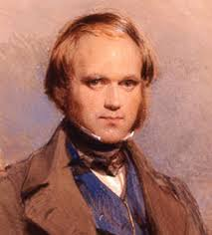
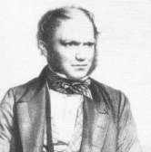
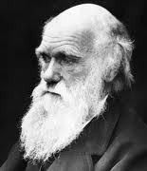




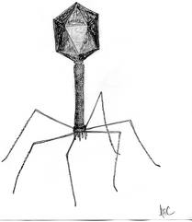

Question: What is it?
Answer: Aging
Humans do it
Birds do It
Bees do It
Add a picture of RBC
Red blood cells do it
Boeing airplanes do it
Computers do it
Viruses do NOT do it.
Radioactive isotopes do NOT do it.

Slide 4
The quantitative definition of aging
Aging = mortality rate increase over time
m: mortality rate
s: viability or survivorship
Notes:
Gompertz mortality model (constant hazard model)
Mortality Rate: m = - (ds/dt)(1/s) = I₀ e^{Gt}
Viability: s = exp[ (I₀ /G) ( 1 - e^{Gt}) ]

Slide 5
Need a title here
Virus Aging (Radioactive Isotope Decay)
Machine Aging (Weibull Model)
Biological Aging (Gompertz Model)
where ‘m(t)’ is the mortality rate, and ‘t’ is time, c, , , R₀ , G are constants. Mortality rate increases as a power function in machine aging versus a exponential function in biological aging. (Garilov & Gavilova 2001)

Slide 6
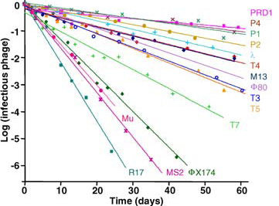
Non-aging systems
where ‘s’ is the viability
De Paepe & Taddei, 2006, Plos Biology

Slide 7
Derivation of :
When
Using differential equations
Initial Conditions
We get:
can be anything
Thus,
Notes:
INTEGRATE from 0 to t

Slide 8
Gompertz definition of biological aging
Mortality rate
Viability
Aging is modeled as exponential increase of mortality rate over time.
m₀ : initial mortality rate, innate susceptibility to dying, lifespan potential at birth.
G: an coefficient for mortality rate acceleration (rate of aging)
Notes:
Gompertz mortality model (constant hazard model)
Mortality Rate: m = - (ds/dt)(1/s) = I₀ e^{Gt}
Viability: s = exp[ (I₀ /G) ( 1 - e^{Gt}) ]

Slide 9
Example: Red Blood Cell (RBC)
Due to the absence of nucleus, no regeneration.
Photohemolysis in RBCs follows Gompertz model of aging:
where H is the percentage of hemolysis during the lysis time ‘t’ (the time measured from start of rupturing the RBCs at dark incubation), H0 the initial maximum number of cells, normalized to one, ‘a’ is a fractional hemolysis ratio, and b is the rate of fractional hemo- lysis change.
Med Bio Eng Comput (2006) 44:703–710
Notes:
Explain Photohemolysis

Slide 10
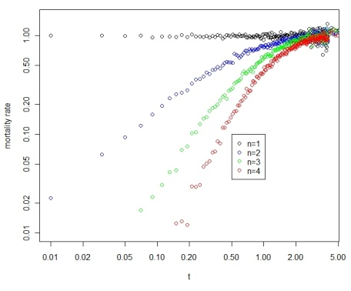
Aging can arise from systems with non-aging components
In essence, characteristics of aging of a system can arise from interactions of non-aging components, i.e., aging is an emergent property.
Notes:
Fig 1. Increase of mortality rate over time, a characteristic of aging, can arise in systems with parallel non-aging components. (A) A system with 4 parallel components (n=4). (B) Simulation of parallel systems with 1,2,3, and 4 non-aging components (constant aging rates).

Slide 11



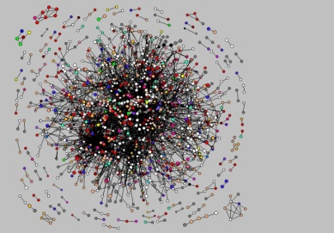

Redundancy increases the latency of failure.
Robustness

Slide 12
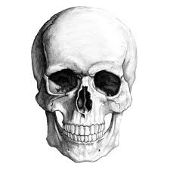
A gene/protein network model of cellular aging
Essential Node
Non-essential Nodes
An essential gene
with four connections
A reliability model
with four parallel pathways

Slide 13
Network with modules
Weibull model of Machine Aging
A network with two
essential modules
Assumption: Links between
modules do not affect aging.
A reliability model
with two modules

Slide 14
Modular network with stochastic links
Cell-1
Rationale for stochastic links
Cellular process is a dynamic process
Limited number of protein molecules and the stereo-hindrance effect.
Spatial restrictions
Random choices
Cell-2
Cell-3

Slide 15
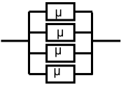
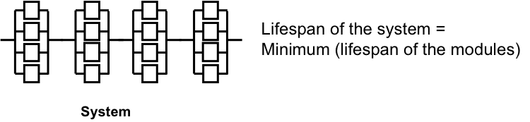
Pathway based reliability model with non-aging components
akweekl
Viability, , for each i
Lifespan of each module block = Maximum ( )

Slide 16
SIMULATION

Slide 18
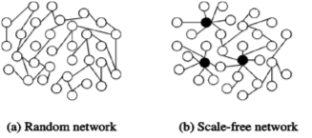
Power Law Network
Heterogeneity plays a key role in biological aging.
Key source of heterogeneity: Power law

Slide 19
Modular network with power-law links

Slide 20
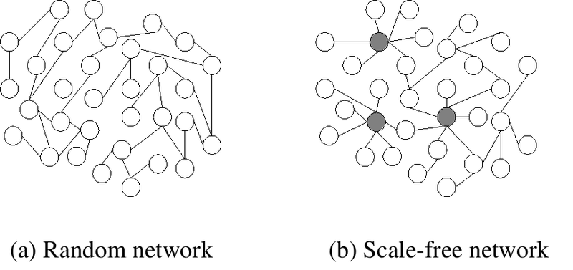

Slide 21
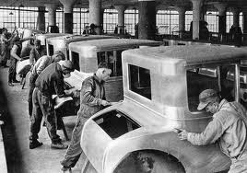
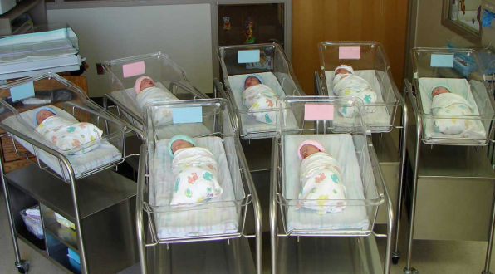
What is the difference between mass-produced machines and the thousands of babies born on one day?
Homogeneous
Systems
Heterogeneous
Systems
Thus, Heterogeneity plays a key role in biological aging.
Key source of heterogeneity: Power law

Slide 22
Modular network with stochastic links
Gompertz Aging, i.e. Biological Aging
?
?
?
?
Modular network with
stochastic links
?
?
?
?
?
?
A reliability model
with defects
?
?
?
?
?
?
m: the number of modules
n: the number of links per essential gene (essential module)
k: exponential decay rate (constant aging rate)
q: the chance of a link to be functional ( q = avg func links/ n)
c: a normalization constant

Slide 23
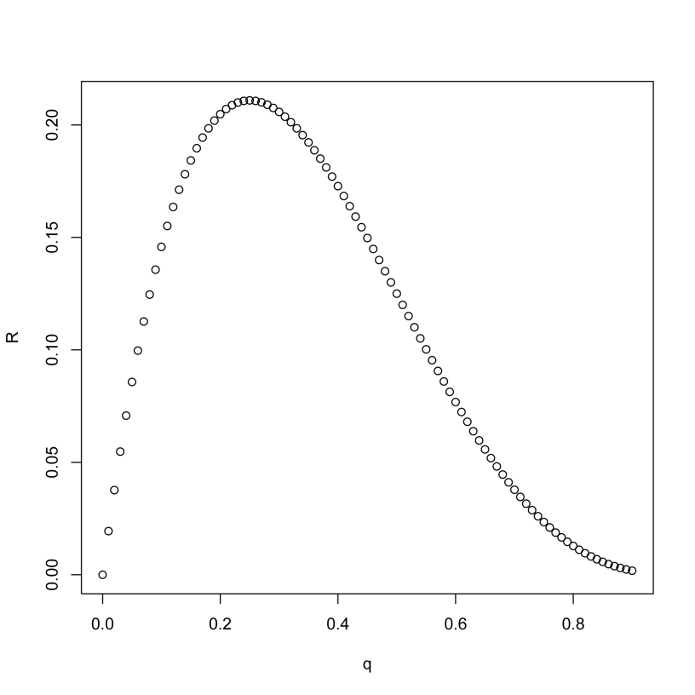
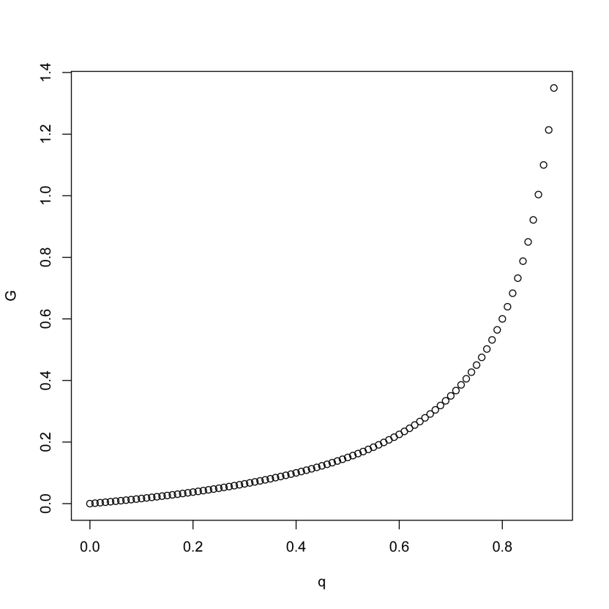
Robustness on R₀ and G
Notes:
For my Tg/C results, R0 is negatively correlated. But G is not significantly correlated in partial regression. I need more data. So Kaberlein’s data is really a geneous gift to me. I can measure the oxidative tolerance of these strains, or mutational tolerance Tg/Tc of these strains.

Slide 24
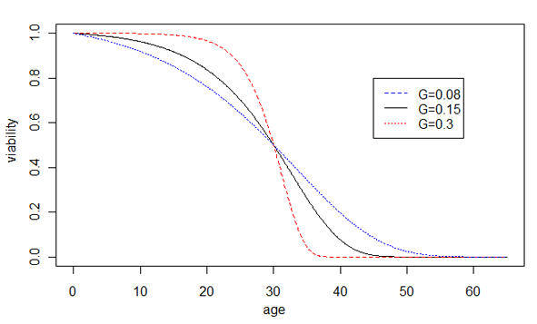
Prediction of the network model of cellular aging
Increased robustness
Decreased robustness
Notes:
Prediction of our hypothesis, the effect of network robustness on the rate of aging G, is shown by changes of the Gompertz survival curves. Increased robustness leads to larger G and faster aging, shown by the sharper transition of the dying off phase, whereas decreased robustness leads to smaller G and slower aging, shown by the slower dying off phase. For illustration purposes, the average life spans are unchanged.

Slide 25
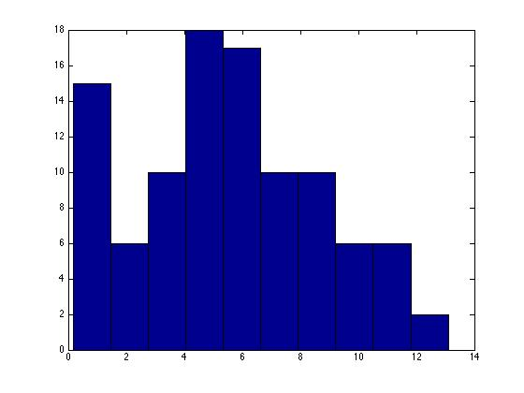
CV of Poisson

Slide 26
Conclusion

Slide 28
Biological aging versus Machine Aging
Machine Aging
Biological Aging
where m(t) is the mortality rate, s is viability, and t is time. C1, C2, R₀, G are constants. Mortality rate increase as a power function in machine aging versus a exponential function in biological aging .
(Garilov & Gavilova 2001)

Slide 29
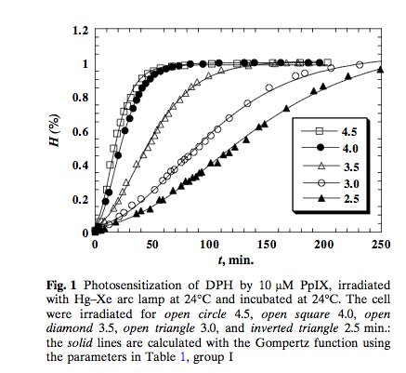

Slide 30
GRAPH of RBC following Gompertz model
Move the end for Q&A

Slide 32
A general theoretic framework for cellular aging
Cellular aging is an emergent property of gene/protein networks

Slide 33


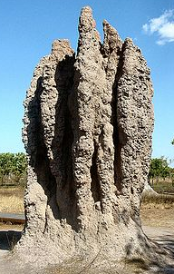
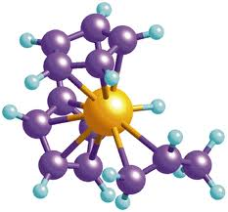
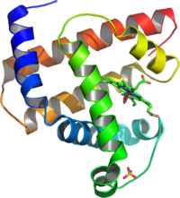
What is an emergent property?
Often loosely refers to the property arising at higher levels as a result of interaction at a low level.
A still debatable concept.
Many examples
Notes:
http://en.wikipedia.org/wiki/Emergent_property
Termite castle
Shoal of fishes

Slide 34
A gene/protein network model of cellular aging
An essential gene
with four connections
A reliability model
with four parallel pathways

Slide 35
The reliability theory of aging
Aging systems (Machines):
Age-dependent increase of risk to die
Non-aging systems (Radioactive isotopes) :
Age-independent increase of risk to die
Parallel connection of non-aging components can lead to aging systems.
Gavrilov & Gavrilova, 2001 JTB
Notes:
Move to Q&A

Slide 36
The key of modeling in biology is how to model the phenotype. The key phenotype for modeling aging is death.
How can we model aging using networks?

