Slide 1
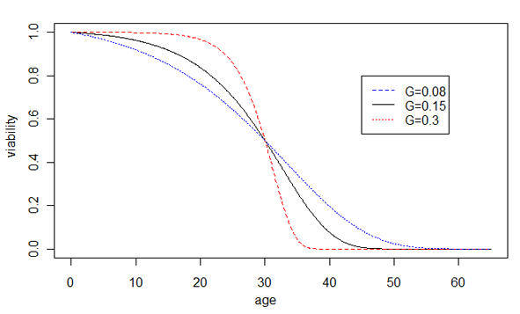
Prediction of the network model of cellular aging
Increased
Robustness
Decreased
Robustness
Notes:
Prediction of our hypothesis, the effect of network robustness on the rate of aging G, is shown by changes of the Gompertz survival curves. Increased robustness leads to larger G and faster aging, shown by the sharper transition of the dying off phase, whereas decreased robustness leads to smaller G and slower aging, shown by the slower dying off phase. For illustration purposes, the average life spans are unchanged.

