Slide 1
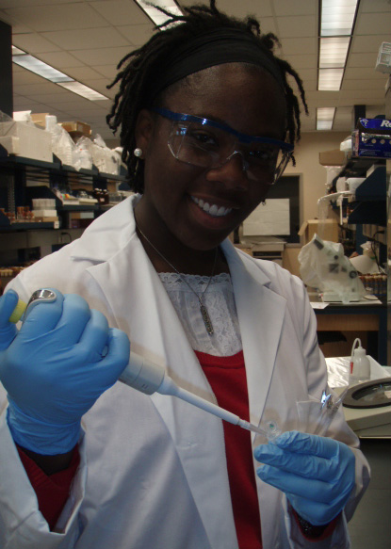
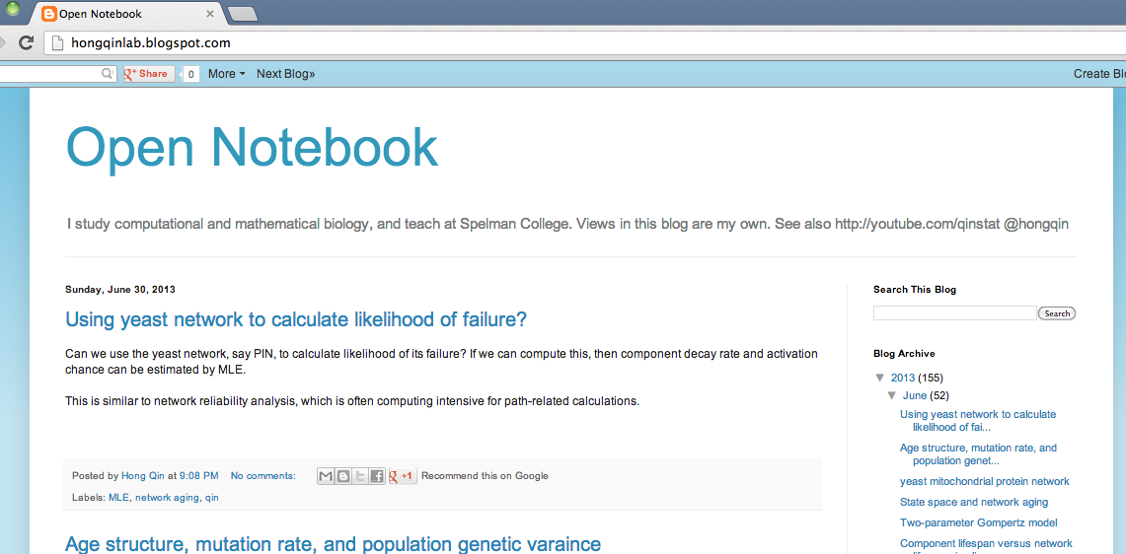
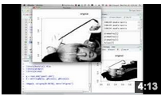
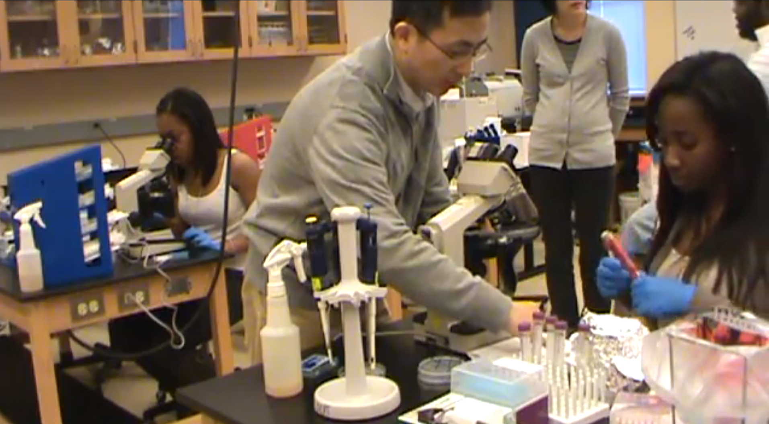
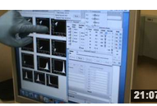
Other Educational Activities
Research Activities
Courses
Student Independent Studies
Mathematical modeling
Systems biology
A new course
Open Projects
github.com/hongqin
Network simulations
BIO386 Bioinfor & Genomics, R projects
Open Notebook
hongqinlab.blogspot.com/
Natural variations
Minor, Bioinformatics & Systems Biology
Yeast networks analysis
CIS115
Python projects
Video Tutorials
youtube.com/qinstat
Genome association study
BIO125 Mol Biol & Genomics
SIAM Chapter
Yeast aging experiments
Workshops
Mini proposals on
yeast aging
BIO233
Microbiology
Software Carpentry Boot Camps

Slide 2
Other Educational Activities
Research Activities
Courses
Student Independent Studies
Mathematical modeling
Systems biology
A new course
Open Projects
github.com/hongqin
Network simulations
BIO386 Bioinfor & Genomics, R projects
Open Notebook
hongqinlab.blogspot.com/
Natural variations
Minor, Bioinfor & Systems Biol
Yeast networks analysis
CIS115
Python projects
Video Tutorials
youtube.com/qinstat
Genome association study
BIO125 Mol Biol & Genomics
SIAM Chapter
Yeast aging experiments
Workshops
Mini proposals on
yeast aging
BIO233
Microbiology
Software Carpentry boot camps

Slide 3
Other Educational Activities
Research Activities
Courses
Student Independent Studies
Mathematical modeling
Systems biology
A new course
Open Projects
github.com/hongqin
Network simulations
BIO386 Bioinfor & Genomics, R projects
Open Notebook
hongqinlab.blogspot.com/
Natural variations
Minor, bioinfor & systems biol
Yeast networks analysis
CIS115
Python projects
Video Tutorials
youtube.com/qinstat
Genome association study
BIO125 Mol Biol & Genomics
SIAM Chapter
Yeast aging experiments
Workshops
Mini proposals on
yeast aging
BIO233 Microbiology
Software Carpentry boot camps

Slide 4
1.Theoretical Component
BIO386
(Upper classes)
2.2 Limiting modules
2.3 Natural variations
BIO233
(Juniors)
CIS115
(Freshmen)
2.1 Robustness proxies
2.4 Experimental genomics
BIO125
(Sophomores)
Systems biology
(Upper classes)
2.5 ODE model of ROS
Computing culture and community:
FYE, minor, student club, faculty workshop, outreach

Slide 5
BIO125
1.Theoretical Component
1.1Power-law
1.2 Synthetic lethality
1.3 Renweals/repairs
1.4 Quantitative genetics
BIO233
FYE
Independent studies
BIO386
2. Empirical Component
2.1 Robustness proxies
2.2 Limiting modules
2.3 Natural variations
2.4 Experimental genomics
2.5 ODE model
CIS115
Faculty workshop
Student club
Outreach
Systems biology

