Slide 1
Evolution of the yeast protein interaction network
Hong Qin
Department of Ecology and Evolution
University of Chicago
July 2003

Slide 2
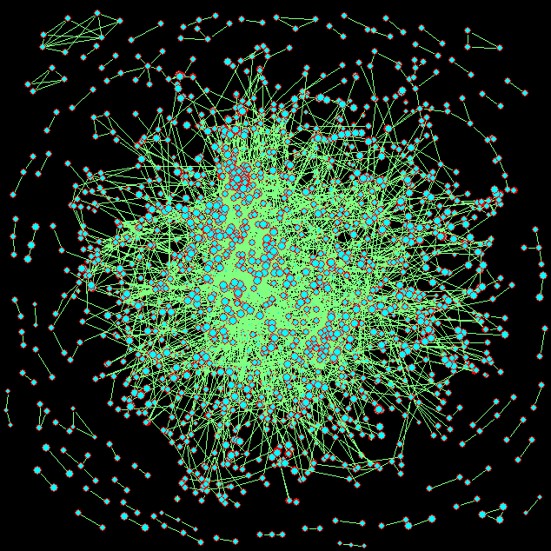
The yeast protein interaction network
Notes:
This is a snapshot of the yeast protein-to-protein interaction network. The data are collected by highthroughput methods and curation of the published data. Each circle represents a protein. Each straight line represents a physical interaction between a pair of proteins.
This network contain 6600 interaction and over 2000 yeast proteins.

Slide 3
Data for yeast protein interactions
Yeast two-hybrid assay
Bait-prey → pairwise interaction
Mass spectrometry of purified complexes
A set of proteins
Statistical analysis of highthroughput data
Overlapping; Correlation
Manual curation of literatures

Slide 4
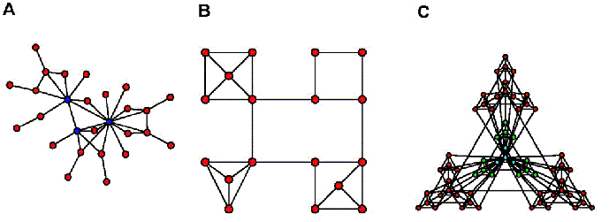
Biological networks: Scale-free and modular organization
Ravasz et al, 2002 Science

Slide 5
Studying network evolution can help us understand the configuration and organization of biological networks.

Slide 6
The yeast protein interaction network is one of the best annotated biological networks.

Slide 7
What are the interaction patterns during the network expansion?
new
recent
recent
?
?
new
old
old
Hello

Slide 8
Q: How can we reconstruct the evolutionary path from the extant network?
A: An isotemporal approach
Notes:
->8 min

Slide 9
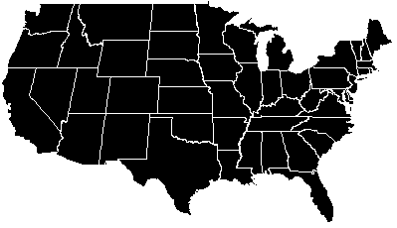
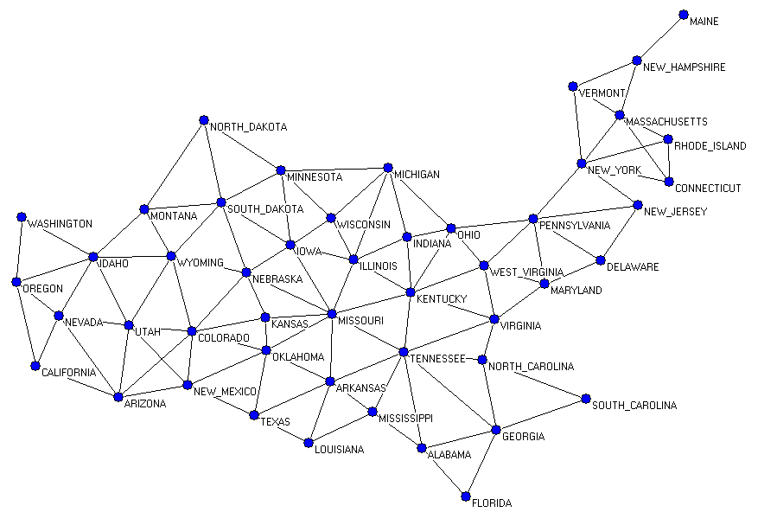
A familiar example
- The historical growth of the continental U.S.
Notes:
The developmental process of the continental states in the U.S.. I first convert this map into a network. Each state is a node. An edge represents that two states directly border each other. In this case, the histories of the nodes are well documented.

Slide 10
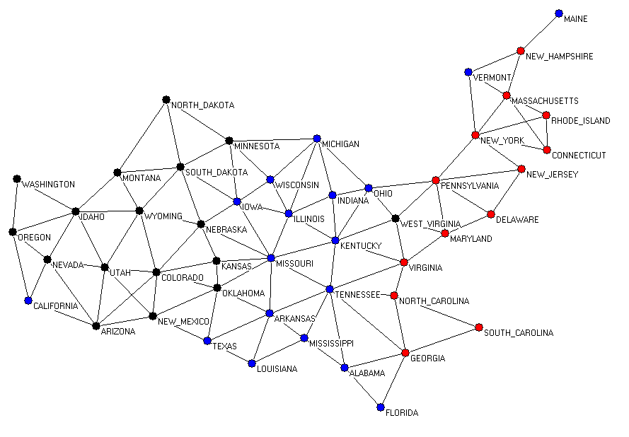
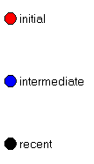
Three temporal categories of the continental states
Notes:
Here I classify all the states into three isotemporal categories based on the official dates of admission to statehood. Statehood before 1780 are classified as "initial"; statehood before the mid-19th century are classified as "intermediate"; statehood after the mid-19th century are classified as "recent".
Each isotemporal category are color-coded. By visual examination, we can tell all the three categories form clusters. I will show you the quantitative way to analyze this pattern.
1780 initial
1850 intermediate
2002 recent

Slide 11
Goal: To reconstruct the growth history of the U.S. from today’s borders between states.

Slide 12
First, a statistical analysis of the bordering patterns of the three temporal categories.

Slide 13
Assessing the bordering patterns of the three temporal categories
-
Observed borders between/within temporal categories
Random Expectation
Z =
Standard deviation
+
Higher than random expectation
-
Lower than random expectation
Notes:
Z score is a statistical number to measure how an observation deviates from the random expectation.
+ : higher than average - : lower than average
the absolute value of Z indicates the significance of the observation
The random expectation is calculated by randomly picking pairs of proteins from the network.

Slide 14
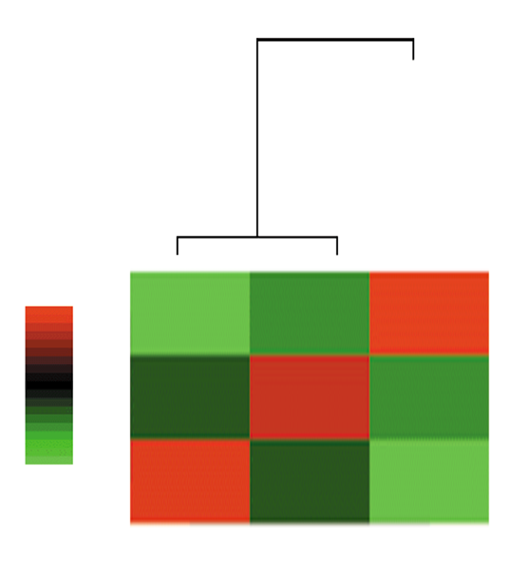
From bordering patterns to growth path
+
recent
Z
-
intermediate
initial
initial
recent
intermediate
Notes:
Here are the quantitative analysis of interaction tendencies among the three isotemporal categories of the continental states.
The Z-scores between all pairs are presented in the two-dimensional matrices. Rows and columns corresponds to the three isotemporal categories. Rows and columns are arranged in the same order.The two color matrices are identical. They are presented twice because the two kinds of statistical methods
are used to analyze the Z-score matrix.
On the left side, is the interaction significance analysis. The intensity of the red corresponds to the value of the positive Z-scores. The diagonal pattern
of the red cells indicates that all three categories tend to interact among themselves. The interaction tendencies among the categories can be quantitatively shown the P-value tree. For positive Z-score, the P-value represents interaction significance. The interaction significance tree shows that "initial" states tend to interact with "intermediate" states.

Slide 15
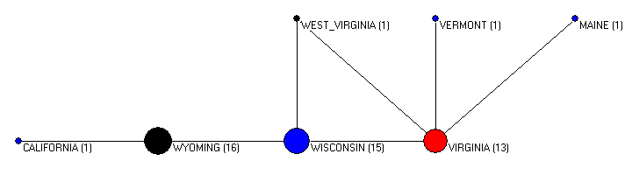
Isotemporal clusters in the continental U.S.
Notes:
-> 15min
To intuitively understand the analysis, we can further decompose the continental states by the isotemporal categories. Shown here is the result after the clustering. The size of the circles are proportional to the number of states within them.
The 13 initial states all collapse into one cluster at the east coast. The "intermediate" states forms another cluster. So do the "recent" states. Irregular states are California, West Virginia, Vermont and Maine.
In short, I used the example of the US continental states to test my programs and algorithms. However, to apply the method to the yeast protein interaction network, I need to know the history of every protein. The histories of every protein in the yeast genome is estimated based on the evolution theory.

Slide 16
Isotemporal analysis for growing networks
Temporal histories of the nodes
Interaction patterns of the isotemporal groups
Reconstruction of the evolutionary path

Slide 17
To apply this isotemporal approach, we need to know the temporal histories of all the yeast proteins.

Slide 18
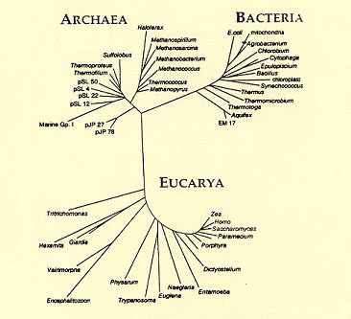
The universal tree
Euryarchaeota
Euryarchaeota
Crenarchaeota
hyperthermophiles
Notes:
In his book, "The origin of species", Charles Darwin proposed, "a great Tree of Life". He stated, the "connexion of the former and present buds by ramifying branches may well represent the classification of all extinct and living species in groups subordinate to groups."
The current universal tree is largely inferred by Carl Woese, using small subunit ribosomal RNA.
I pick six clades from the universal tree in my analysis: eubacteria, hyperthermophilic bacteria, crenarcheota, Euryarchaeota, eukayota, and fungi.
Discussion of Phylogenetic Relationship
Two alternative views on the relationship of the major lineages (omitting viruses) are shown below The "archaea tree":
,=============== Eubacteria | | ,== Euryarchaeota =====| ,=Archaea=| `==| `== Crenarchaeota-Eocytes | `============ Eukaryotes The "eocyte tree": ,======== Eubacteria | | ,===== Euryarchaeota =====| | `==| ,== Crenarchaeota-Eocytes `==| `== Eukaryotes

Slide 19
Binary coding scheme based on the universal tree
-- an isotemporal approach
1 | 1 | 0 | 0 | 1 | 1
Eubac | Hyper | Eury-arch | Cren-arch | Euk | Fungi
=51(10)
COGs
NCBI
Universal Tree
EMBL
?
1: presence of orthologous hits
0: absence of orthologous hits
Notes:
The classification of each yeast protein is based on the orthologous hit in the six clades. Yeast genome itself is excluded from the fungi clade. 1 indicates the presence of orthologous hits in that clade. 0 represents the absence of orthologous hit in that clade. This method gives a binary coding scheme of the evolutionary categories.
Mathematically, 6 clades give 64 different categories. Because of biological constrains, the yeast genome contain only 42 categories. The available protein interaction data contain 39 categories.
The binary coded categories can also be presented in the more familiar decimal format.

Slide 20
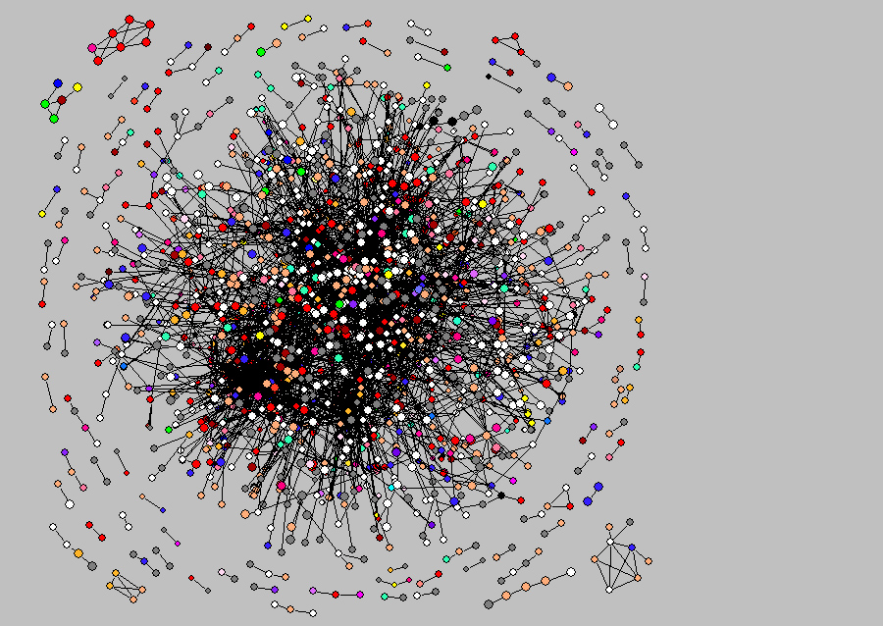
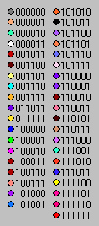
Protein interaction network after the isotemporal classification
Notes:
Here, I color-code all 39 categories in the yeast protein interaction network. I then analyzed the interaction tendencies among the categories.

Slide 21
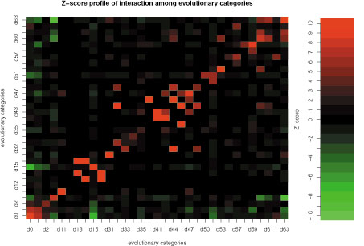
Interaction patterns of the categories
Evolutionary categories
Z
Evolutionary categories
Notes:
Here is the color-matrix presentation of the Z-score evaluation of the interaction significance. The significance is compared to the random expectation. The row and column are the evolutionary categories. The categories are in decimal format and in the same order along the x-axis and the y-axis.
Positive Z-scores, shown in various shades of red, indicate the interaction frequency is higher than the random expectation. The diagonal arrangement of the red cells indicates that most categories tend to interact among them selves and closely related categories.
Negative Z-scores, shown in various shade of green, indicate the interaction frequencies are lower than the random expectation.

Slide 22
Random expectation:
Maslov-Sneppen null model
Maslov & Sneppen Science 2002

Slide 23
Can we use another method to confirm the interaction patterns?

Slide 24
The shortest path in the protein interaction network

Slide 25
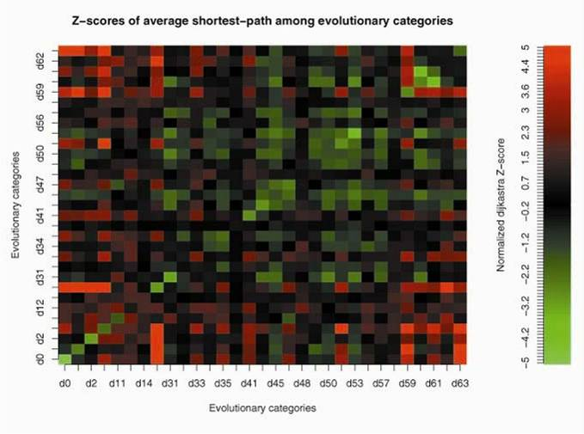
Traversal patterns of the categories

Slide 26
Random expectation:
Isomorphic MS02 null model
Hello

Slide 27
To reconstruct the evolutionary path, we need to convert Z-scores to distance measurements.

Slide 28
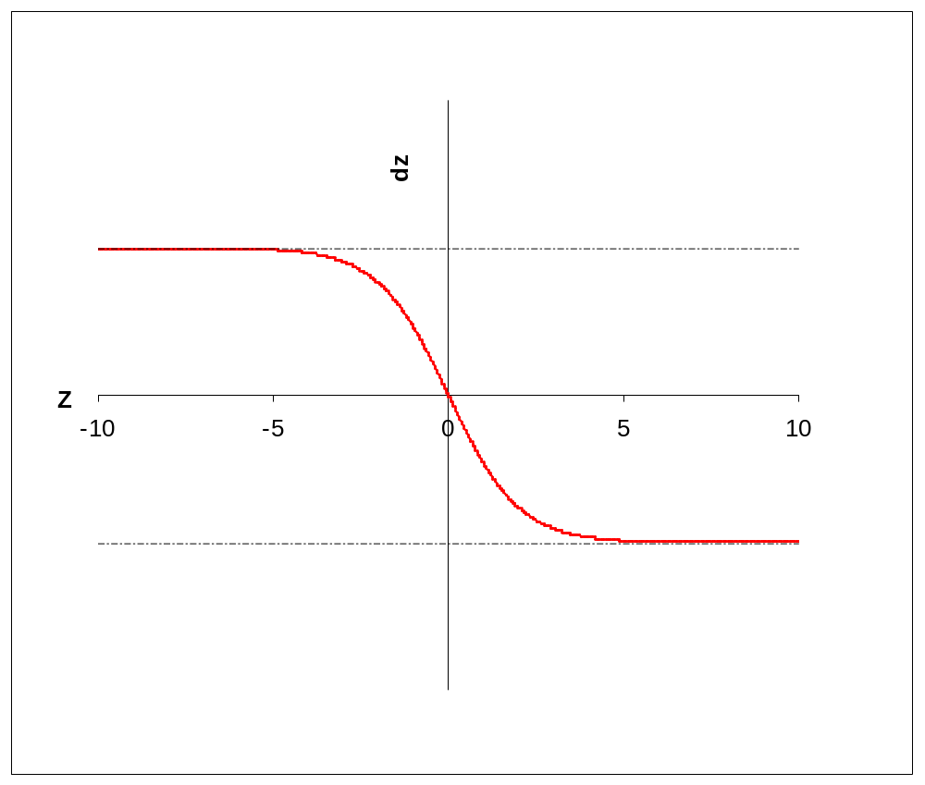
Interaction tendencies (Z-score) to distance measurement (d_{z})
1
1
Logit-like Transformation
d_{z} = 1/(1+e^{Z})
0.5
0
0

Slide 29
Reconstruction of the evolutionary path
000001
000000
000000
000001
Eukaryotic
expansion
000011
000011
110011
Endosymbiotic
expansion
110011
001111
001111
Ancient core
111111
0.1
111111
0.1
Based on interaction Z-scores
Based on traversal Z-scores

Slide 30
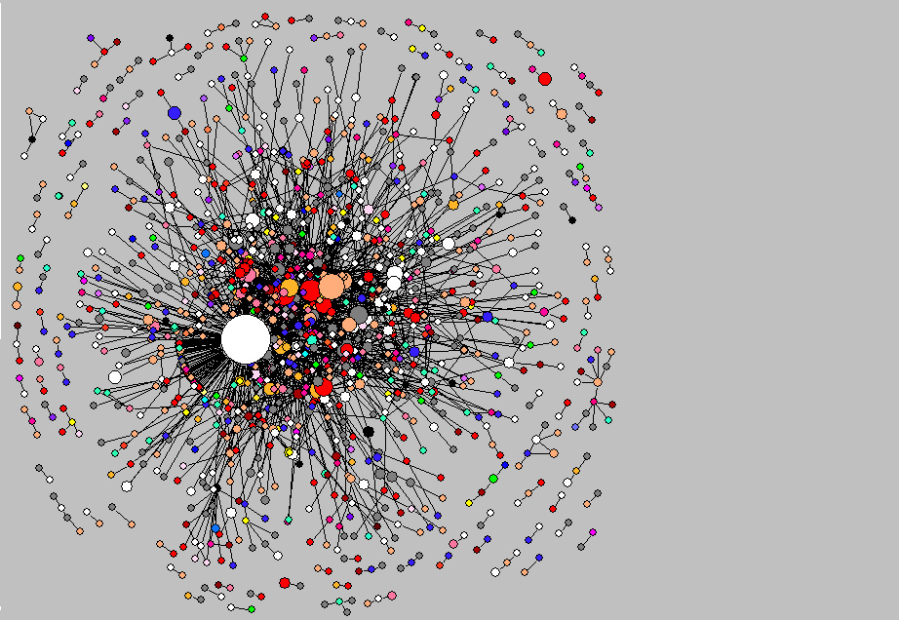
Isotemporal clusters in the yeast network
Notes:
Shown here is the isotemporal decomposition of the yeast protein interaction network. The size of each circle is proportional the number of proteins in them. Each categories are color-coded.
Apparently, the network contains many isotemporal clusters.

Slide 31
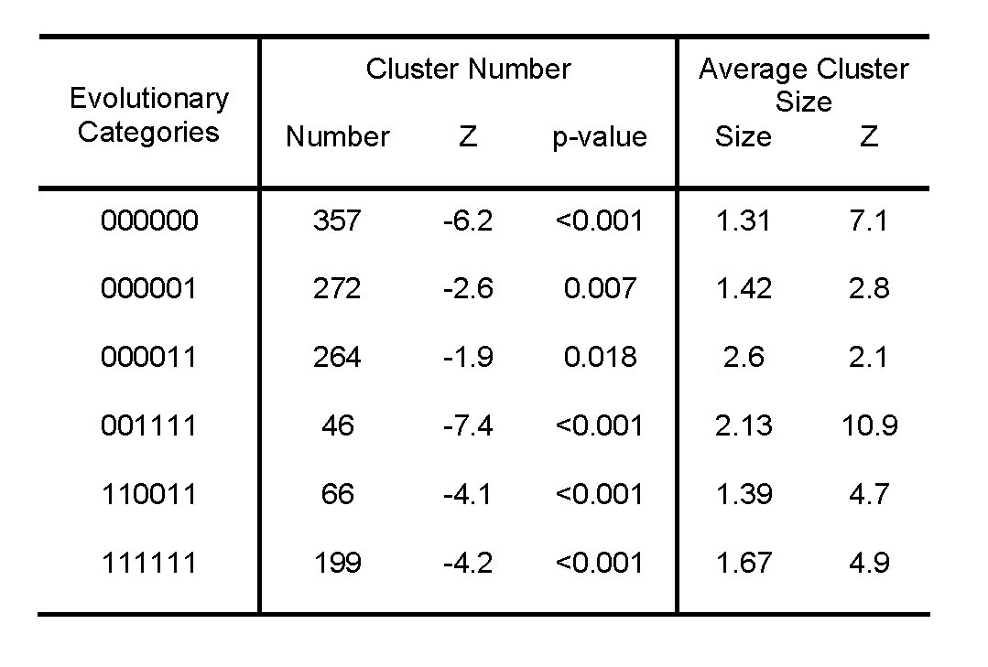
Significant clustering within categories of yeast proteins

Slide 32
Synergistic selection of new proteins
new
new
new
recent
recent
new
old
old
Hello

Slide 33
A possible scenario

Slide 34
Remarks
Isotemporal clusters ≈ modularity
Network evolution ≈ universal tree of life.
Network evolution is constrained.
Notes:
-> 35 min
Finally, I conclude here,

Slide 35
Acknowledgements
Wen-Hsiung Li E&E UC
Henry Lu NCTU Taiwan
Weibiao Wu Statistics UC
Bill Martin U of Düsseldorf
Maximino Aldana Physics UC
Xun Gu Iowa State U
Leo Kadanoff Physics UC
Natalia Maltsev Argon National Lab
Leigh Van Valen E&E UC
Joel Bader Curagen
Peter Bouman Statistics UC
Tom Nagylaki E&E UC
Janice Spofford E&E UC
Manyuan Long E&E UC
Martin Kreitman E&E UC
Joy Bergelson E&E UC
Rick Blocker E&E UC
Kevin Thornton E&E UC
Jianming Zhang E&E UC
John Choy Stanford
Brian Tobe MGCB UC
The Li-lab (past and present):
Kateryna Makova Penn State
Todd Oakley UCSB
Anton Nekrutenko Penn State
Henrik Kaessmann Max Planck Inst
Arthur Shi Academia Sinica, Taiwan
Robert Friedman Nat Hist Museum,UK
Zhenglong Gu , Geoffrey Morris
Chien Hsien Kuo, Runsun Pan
Shin-Han Shiu, Liqing Zhang,
Yun-Huei Tzeng, Ning Yu, Soojin Yi
Nathaniel Dominy, Peng Zhang
Tyrone Summers, Jing Yang
Dayi Wang, Shiaowei Huang
Martin Feder EEFG
Notes:
-> 40 min

