Slide 2
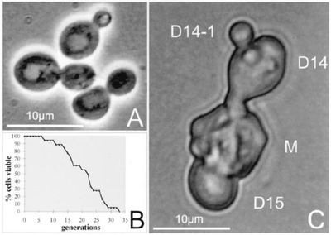
http://schaechter.asmblog.org/schaechter/2010/02/mothers-love.html

