Slide 1




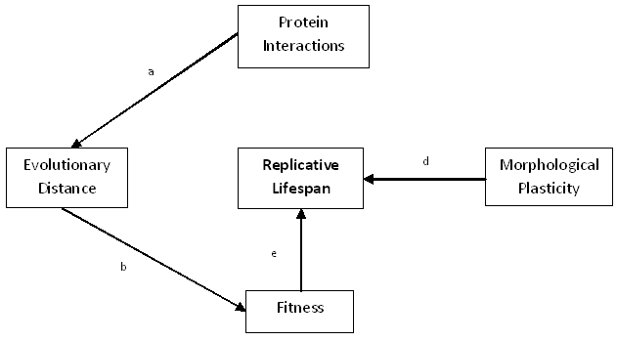
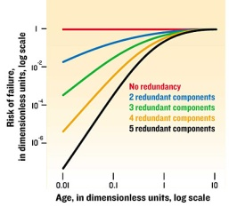
The interconnection of molecular evolution, gene network, and cellular aging Alice Story, Charita Montgomery, and Hong Qin Biology Department, Spelman College, Atlanta, Georgia 30314
Abstract
Pleiotropic traits, such as cellular aging, are shaped by gene networks which channeled the molecular evolution of individual genes into phenotypic manifestations. We recently proposed a mathematical model and demonstrated that cellular aging is an emergent property of gene networks and the characteristics of the aging process are linked to network robustness and gene interaction patterns. In this study, we aim to dissect the interconnection of molecular evolution, interaction pattern, robustness, and life-history traits in Saccharomyces cerevisiae. We evaluated the causal relationship of these factors with life span using partial regressions and extracted principal components from interacting factors. We found that molecular evolution influence life span through growth fitness.
Method & Results
Summary
Figure 1: YPD vs. Lifespan
Introduction
To understand the mechanisms of aging we used the model organism Saccharomyces cerevisiae. S. cerevisiae was used because the organelles and mechanisms of the cells are similar to higher organisms. Aging in S. cerevisiae is referred to as replicative life span (RLS). RLS is defined by the number of cell divisions that occurred prior to senescence or when diploid cells can no longer divide. We studied the effect of robustness on cellular aging in yeast S. cerevisiae. Prior research implies that protein robustness (cell being able to maintain homeostasis) contributes to lifespan by increasing existence. We hypothesized that robustness would have a significant effect on replicative lifespan. The robust factors analyzed for this study were growth fitness (ability for yeast to prosper in selected medium), morphological plasticity, and evolutionary rate. The significance of studying aspects related to aging such as replicative lifespan, morphological plasticity, and evolutionary rate is to assist in identifying the direct causes of cellular aging.
Figure 2: YPE vs. Lifespan
Conclusions
1. There is significant positive association between growth fitness and RLS, which suggests that faster cell division leads to increase in both lifespan and growth fitness.
2. Morphological Plasticity robustness is negatively correlated to RLS. Change in cell morphology leads to shorter lifespan.
3. Growth fitness is correlated with both molecular evolution rates and life span.
Figure 3: Morphological Plasticity Robustness vs. RLS
Acknowledgements
I would like to extend a sincere thank you to the Spelman College RIMI for seed grant and NSF award #1022294 and the Minority Biomedical Research Support-Research Initiative for Scientific Enhancement (MBRS-RISE) for support. In addition, I would like to thank my advisor Dr. Hong Qin.
p-value = 1.349 e-05 R-squared = 0.03253
Figure 4: Evolutionary Distance Robustness vs. RLS
References
Crow J.F. and William F.D., Anecdotal, Historical, and Critical Commentaries on Genetics. Genetics Society of America. 2000. 156: 927–931.
Gavrilov L.A. and Gavrilov N.S., Evolutionary Theories of Aging and Longevity. The Scientific World Journal. 2002. 2: 339-356
Goldsmith, T. The Evolution of Aging, 2nd ed, ISBN 0-978-87090-5, 2006
Mahler J.F., Mutant Models of Prolonged Life Span. Society of Toxicologic Pathology. 2001. 29: 673
p-value = 0.3758
R-squared = -0.0007506
The left diagram illustrates subsystems composed of a various number of components. As the graph shows, early age failure rates decrease with an increase in components.

