Slide 1
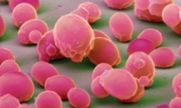

A Gene/Protein Network Model for Cellular Aging
Hong Qin
November 15, 2010

Slide 2
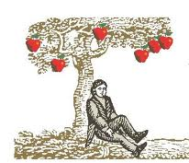
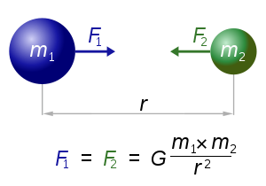
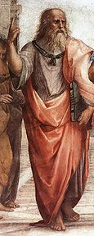
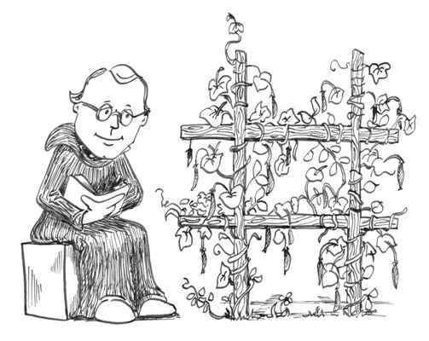
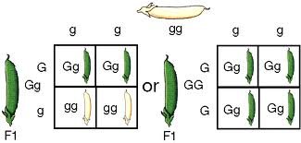
The Search for General Theories and Mechanistic Models

Slide 3
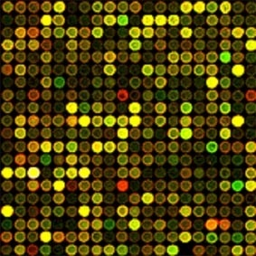
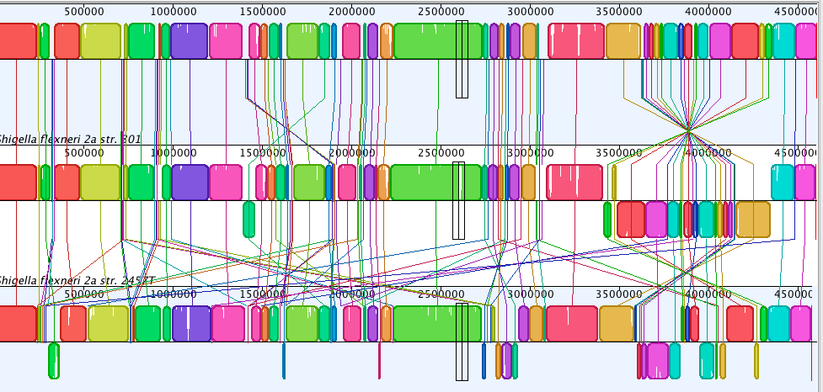
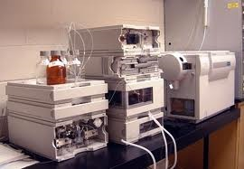
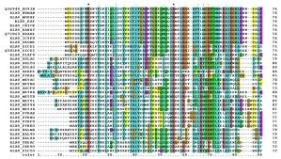
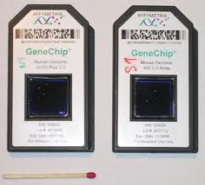
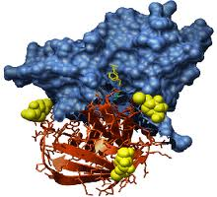
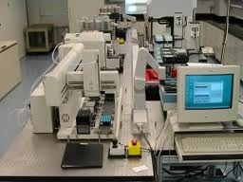
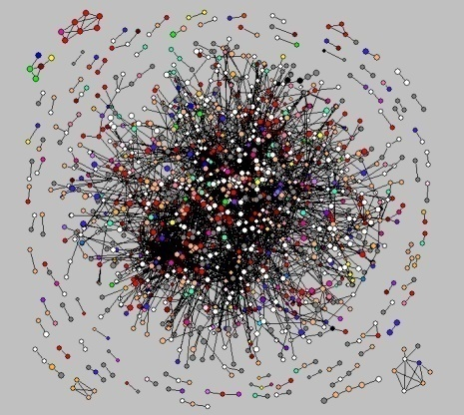
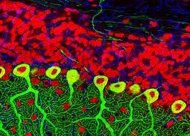
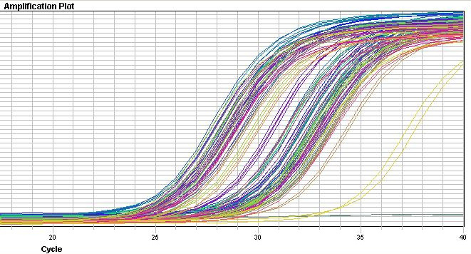
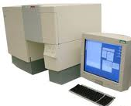
Modern biology is rich in data but poor in mechanistic models.

Slide 4
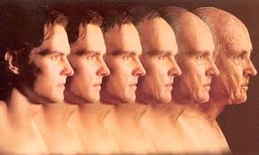
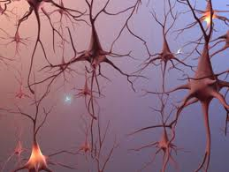
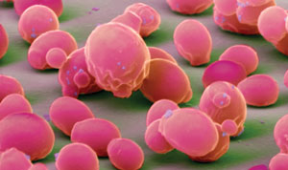
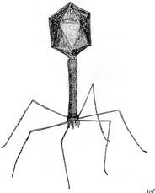
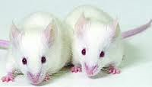
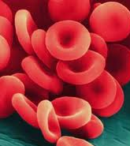
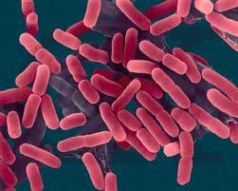

Aging is a fundamental question in biology, yet its mechanism remains elusive.

Slide 5
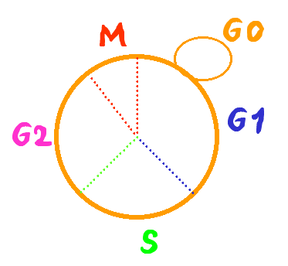
The life span of the budding yeast S. cerevisiae
Replicative life span
  The average number of offsprings of single mother cells
  dividing cells
Chronological life span
  The duration of cells in stationary phase
  non-dividing cells
Notes:
As a cellular organism, the life span of yeast can be measured in two different ways. The RLS and the CLS.
How to assay RLS?
S. cerevisize grow by budding out new cells. The new cells are smaller than the old mother cells. This enable us to identify the mother and daughter cells under microscope and separate them by by micro dissection.

Slide 6
Assay of replicative life span in yeast
new bud
remove bud with micro-manipulator
90 min @ 30 ˚C
repeat until cells no longer reproduce

Slide 7
Assay of chronological life span in yeast
t=0
t=1day
t=5 days

Slide 8
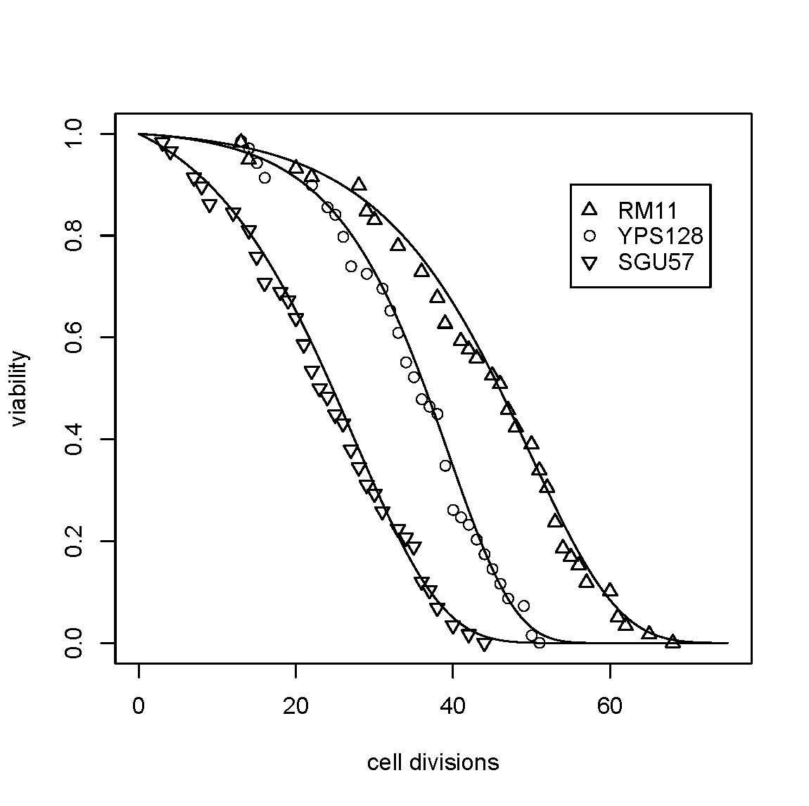
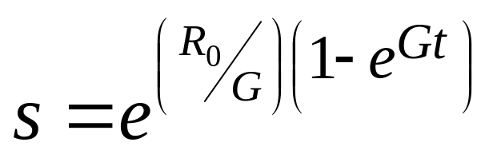
Replicative life spans of yeast isolates
Qin and Lu, 06
Exp Gerontology
Notes:
Regression of avg with group + strain

Slide 9
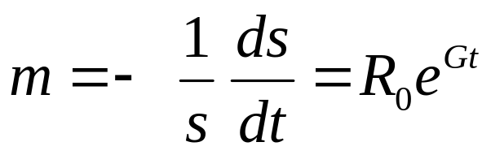
Gompertz model of aging (A descriptive model)
  Aging is modeled as exponential increase of mortality rate over time.
  R₀ : initial mortality rate, innate susceptibility to dying, lifespan potential at birth.
  G: an coefficient for mortality rate acceleration (rate of aging)
Notes:
Gompertz mortality model (constant hazard model)
Mortality Rate: m = - (ds/dt)(1/s) = I₀ e^{Gt}
Viability: s = exp[ (I₀ /G) ( 1 - e^{Gt}) ]

Slide 10
A working definition of (cellular) aging.
Gompertz model

Slide 11
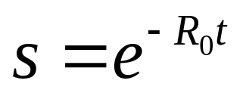
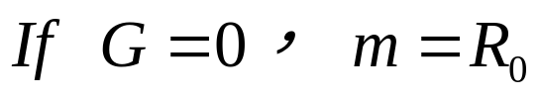
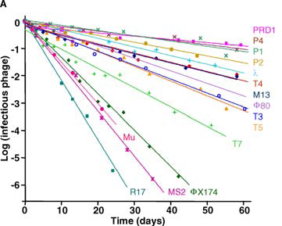
Non-aging systems
De Paepe & Taddei, 2006, Plos Biology

Slide 12
A paradox in yeast aging
Genes with known effect on life span show no molecular mechanisms that are directly linked to aging.
SIR2
  How does ERC affect aging?
TOR1/2
  ?
Sch9
  ?
Notes:
Longo’s sir2 role cell paper: sir2D sch9D -> extremely long cls (However, Fig1D shows that sir2D actually has larger variance, median seems to be similar to WT in haploid background.)

Slide 13
It seems that once we delve into the molecular mechanism of aging, we lose the biology of aging.
Why?

Slide 14
Another paradox in yeast aging
There exist universal demographic characteristics of aging despite the diverse genetic and environmental factors involved.
This universality suggests a common random process.

Slide 15
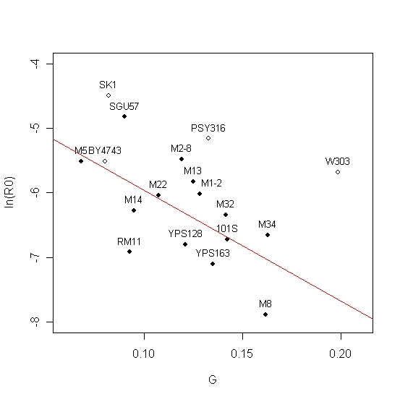
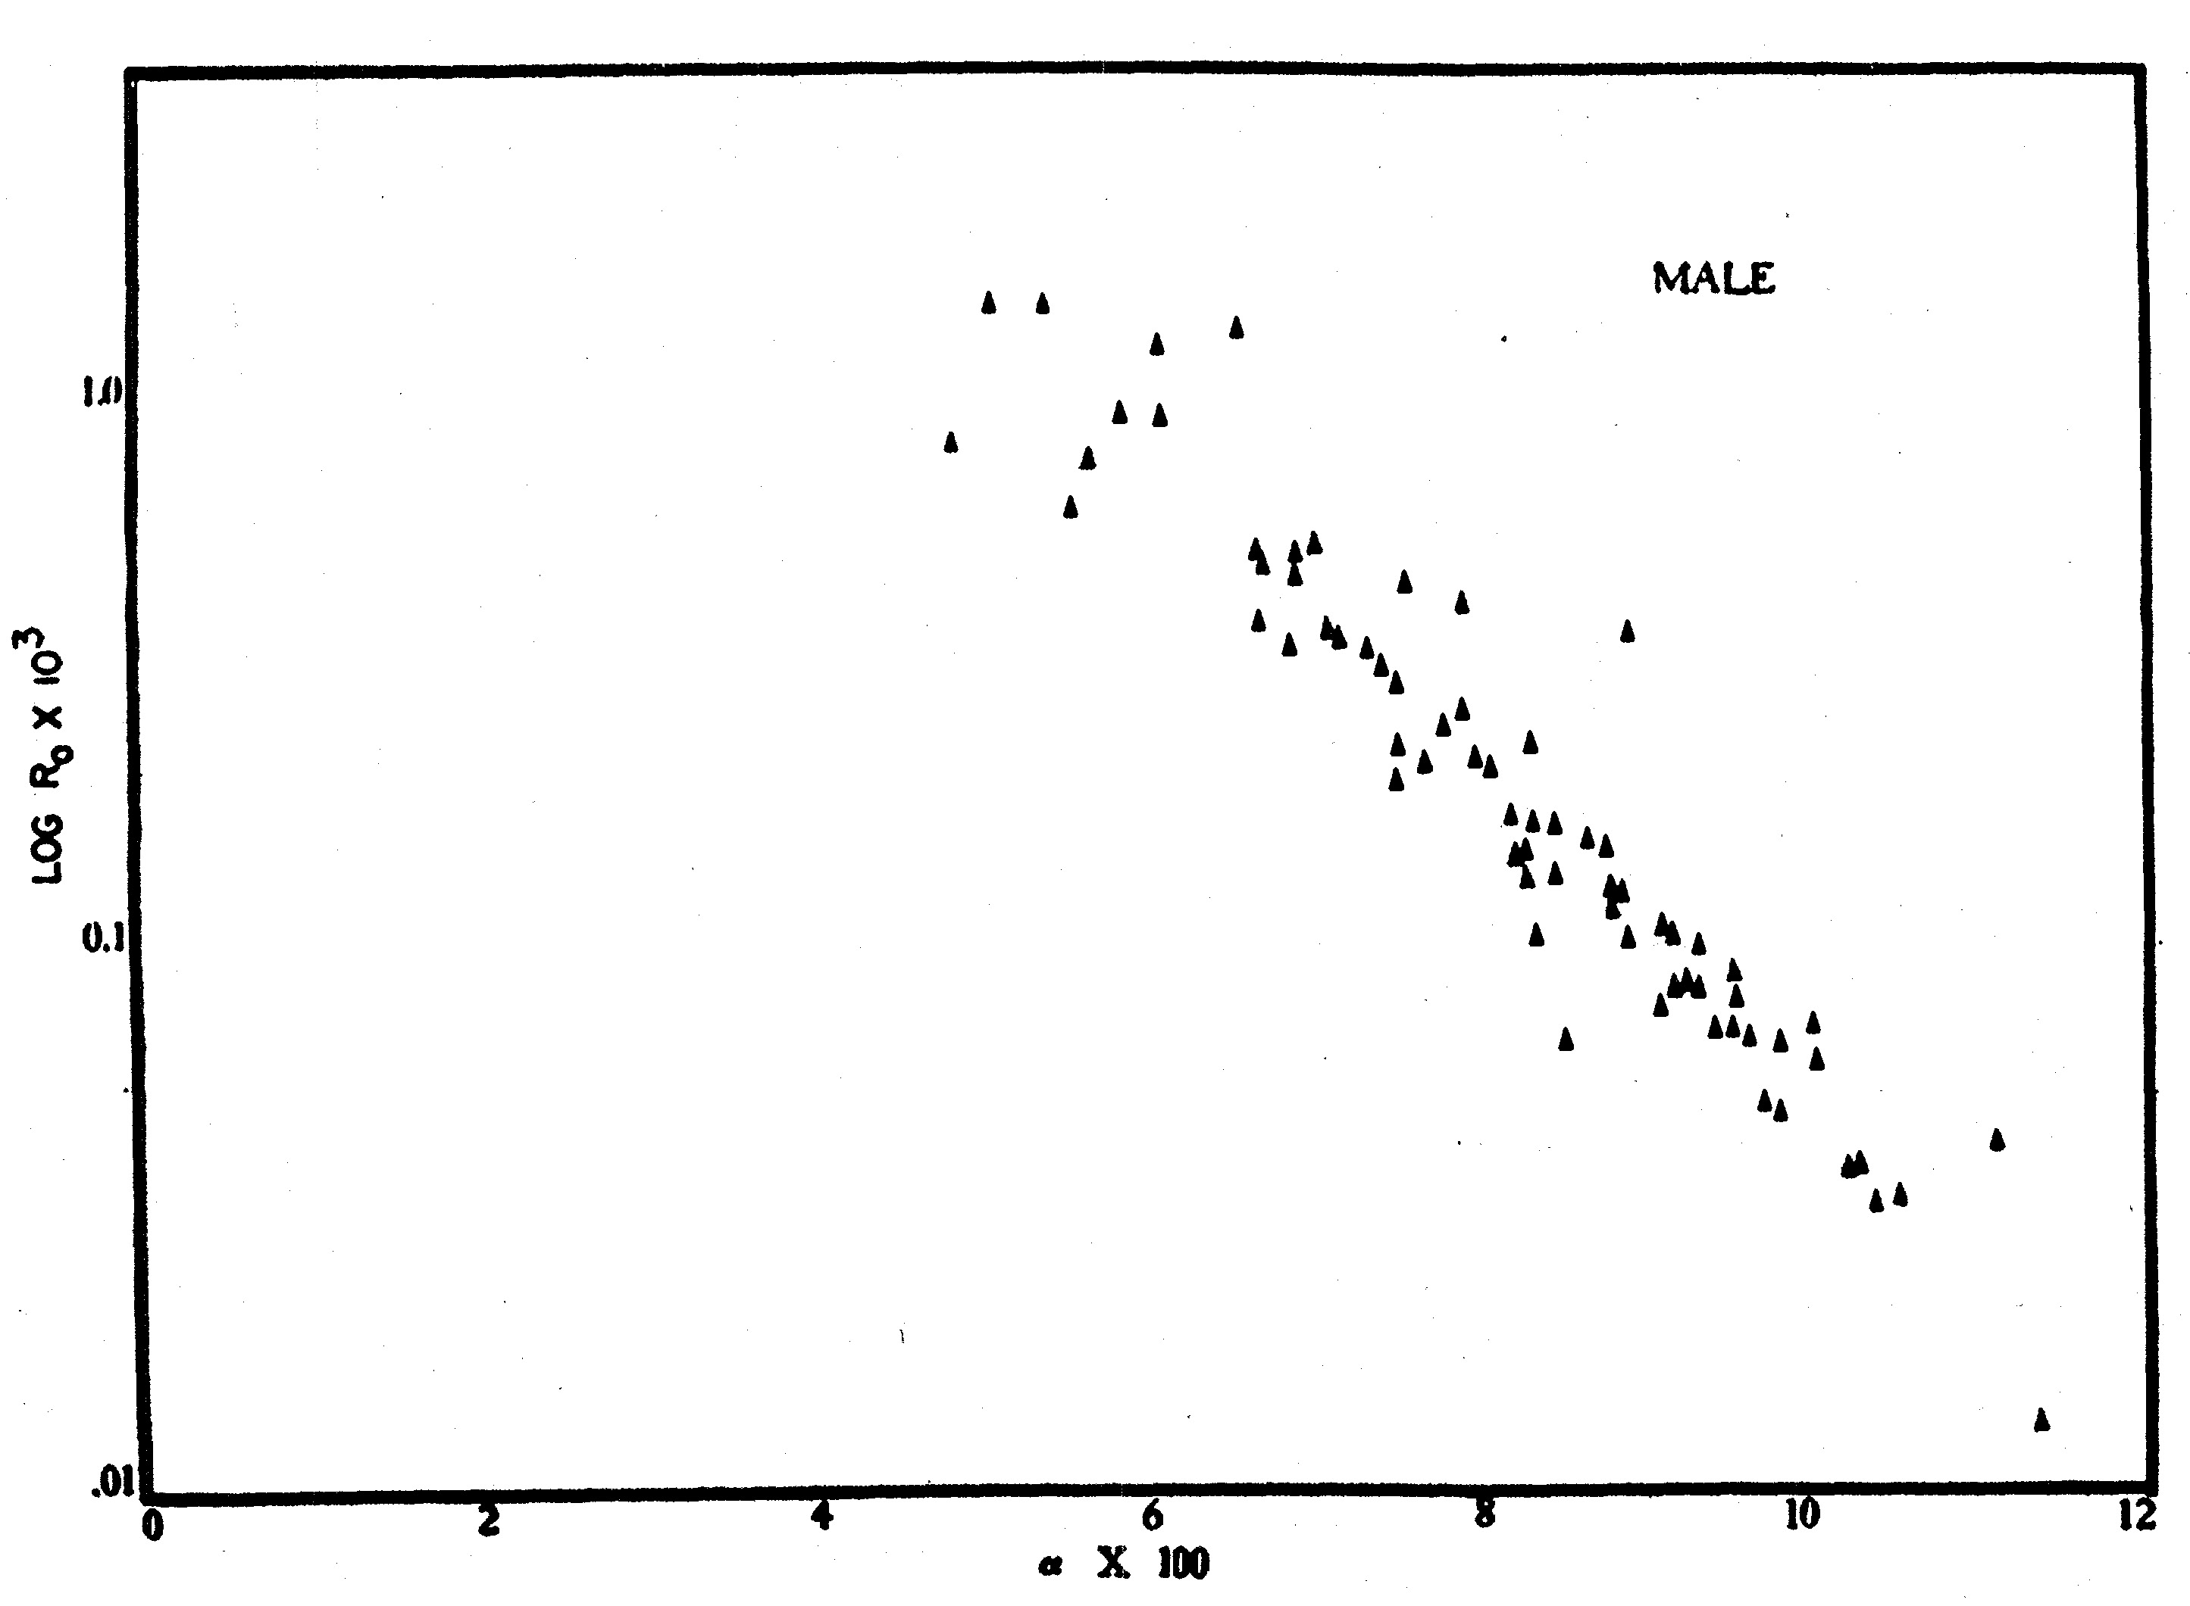
Yeast aging is similar to mammalian aging at the demographic level.
Yeast
Human
Ln(R0)
G
Qin & Lu, 2006 Exp Gerontology
Strehler & Mildvan, 1960 Science
Notes:
Regression is only done to the natural isolates (solid black dots).

Slide 16
Yeast aging is a stochastic process to a large extent.
Model 1: AGE_{ijk} ~ u + STRAIN_{i} + GROUP_{j} + PLATE_{ij} + e_{ijk}
Model 2: AGE_{ijk} ~ u + STRAIN_{i} +ζ_{j} + e_{ijk}
Model 3: AGE_{ijk} ~ u + STRAIN_{i} + e_{ijk}
Conclusion: Genotypic variation accounts for 22% of
RLS variation among individual cells.
Qin and Lu, 06
Exp Gerontology
Qin and Lu, 2006

Slide 17
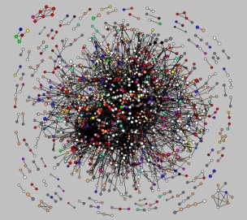
A general theoretic framework for cellular aging
Cellular aging is an emergent property of gene/protein networks

Slide 18


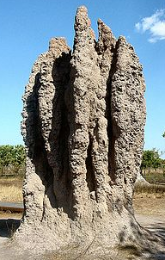
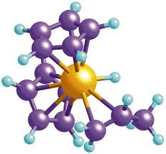
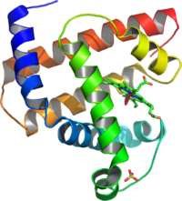
What is an emergent property?
Often loosely refers to the property arising at higher levels as a result of interaction at a low level.
A still debatable concept.
Many examples
Notes:
http://en.wikipedia.org/wiki/Emergent_property
Termite castle
Shoal of fishes

Slide 19
The reliability theory of aging
Aging systems (Machines):
  Age-dependent increase of risk to die
Non-aging systems (Radioactive isotopes) :
  Age-independent increase of risk to die
Parallel connection of non-aging components can lead to aging systems.
Gavrilov & Gavrilova, 2001 JTB

Slide 20
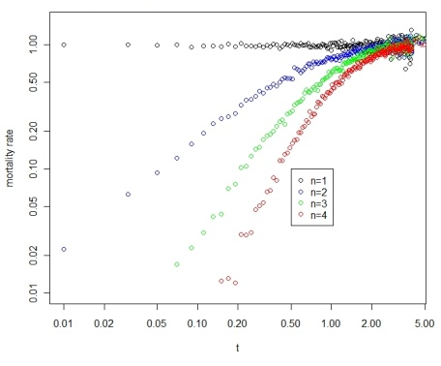
Aging can arise from systems with non-aging components
In essence, characteristics of aging of a system can arise from interactions of non-aging components, i.e., aging is an emergent property.
Notes:
Fig 1. Increase of mortality rate over time, a characteristic of aging, can arise in systems with parallel non-aging components. (A) A system with 4 parallel components (n=4). (B) Simulation of parallel systems with 1,2,3, and 4 non-aging components (constant aging rates).

Slide 21
A gene/protein network model of cellular aging
An essential gene
with four connections
A reliability model
with four parallel pathways

Slide 22
Network with modules
Weibull model of Cellular Aging
A network with two
essential modules
Assumption: Links between
modules do not affect aging.
A reliability model
with two modules

Slide 23
Modular network with stochastic links
Cell-1
Rationale for stochastic links
Cellular process is a dynamic process
Limited number of protein molecules and the stereo-hindrance effect.
Spatial restrictions
Random choices
Cell-2
Cell-3

Slide 24
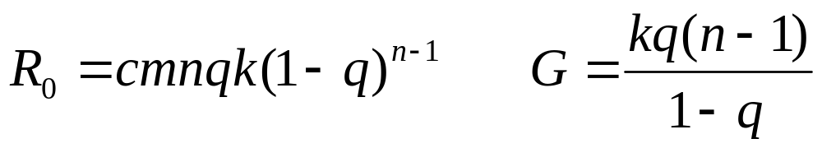
Modular network with stochastic links
Gompertz Aging, i.e. Biological Aging
?
?
?
?
Modular network with
stochastic links
?
?
?
?
?
?
A reliability model
with defects
?
?
?
?
?
?
m: the number of modules
n: the number of links per essential gene (essential module)
k: exponential decay rate (constant aging rate)
q: the chance of a link to be functional ( q = avg func links/ n)
c: a normalization constant

Slide 25
Some implications of cellular aging as an emergent property of networks.
Trade off between R0 and G (negative correlation between lnR0 and G).
There is no real “aging” genes.
  Ageing is influenced but not controlled by genes, Kirkwood &Finch 2002, Nature.
We should pay more attention to gene interactions and their temporal dynamics.
Can a gene’s effect on the Gompertzian parameters be predicted by its network-related features?
  Number of links of essential modules → rate of aging ?
  Genes with overall effect on network → initial mortality rate.
Notes:
How about SIR2, shc9, ros1, hxk, fob1?
Laboratory strain BY4743 show smaller Gompertz coefficient than wild isolates, especially for CLS.

Slide 26
Antagonistic pleiotropy theory of aging
Network-based models will put pleiotropy model on a mechanistic foundation.
Williams 1957
Trade-off
  Early benefits and late costs
Pleiotropy
  Gene interactions
  Influenced by network temporal dynamics

Slide 27
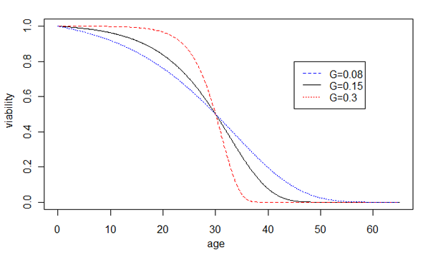
Prediction of the network model of cellular aging
Increased robustness
Decreased robustness
Notes:
Prediction of our hypothesis, the effect of network robustness on the rate of aging G, is shown by changes of the Gompertz survival curves. Increased robustness leads to larger G and faster aging, shown by the sharper transition of the dying off phase, whereas decreased robustness leads to smaller G and slower aging, shown by the slower dying off phase. For illustration purposes, the average life spans are unchanged.

Slide 28
Testing the model:
Diploid cells age faster than haploid cells
Table Aging rate is faster in diploid BY4743 than in haploid strains based on nest model tests.
Models | lnL
H0 I_{BY4741} = I_{BY4742} = I_{BY4743}, G_{BY4741}= G_{BY4742}= G_{BY4743} | -952.7
H1_{g2} I_{BY4741} = I_{BY4742} = I_{BY4743}, G_{BY4741}= G_{BY4742}≠G_{BY4743} | -946.1
H1_{i2} I_{BY4741} = I_{BY4742} ≠I_{BY4743}, G_{BY4741}= G_{BY4742} = G_{BY4743} | -939.4
H2_{ig2} I_{BY4741} = I_{BY4742} ≠ I_{BY4743}, G_{BY4741}= G_{BY4742}≠G_{BY4743} | -937.2
H3_{i3ig2} I_{BY4741}≠ I_{BY4742}≠ I_{BY4743}, G_{BY4741}= G_{BY4742}≠G_{BY4743} | -929.3 | Best parsimonious model p-value=3.6x10⁻¹⁰ (chi-square, df=3) G_{BY4741}= G_{BY4742} = 0.0653 G_{BY4743} = 0.0786
H6 I_{BY4741}≠I_{BY4742}≠I_{BY4743}, G_{BY4741}≠G_{BY4742}≠G_{BY4743} | -929.3

Slide 29
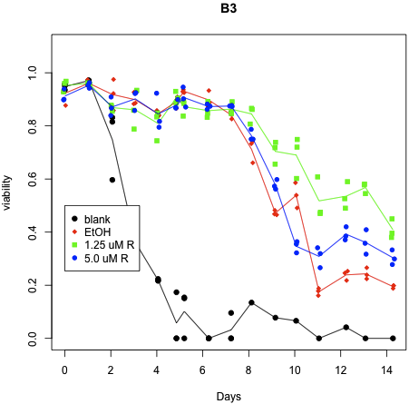
Testing the model:
The effect of radicicol on chronological aging
P-value = 0.027

Slide 30
Implications of the network aging model
Theoretic perspectives
Based on yeast gene/protein networks
Connection between aging and genetic capacitors
Mutation and selection on gene interaction, fitness and aging.
Lethality due to multiple interactions
Power-law networks versus random networks
Heterogeneous rates of exponential decays
Empirical perspectives
G as a proxy of robustness (a phenotypic measure)
Provides a new perspective to interpret experimental data

Slide 31
Summary
A gene/protein network model of cellular aging ― a general theoretic framework. Cellular aging = network emergent property Aging = emergent property of complexity

Slide 32





Thanks

