Slide 1

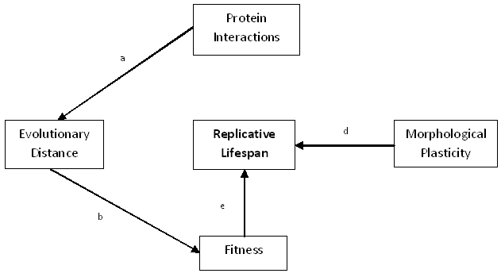
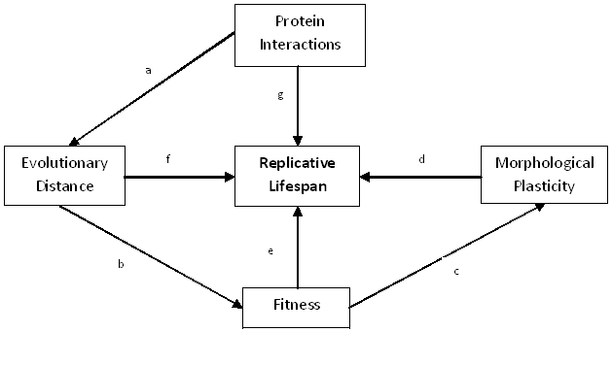
The interconnection of molecular evolution, gene network,
and cellular aging Alice Story, Charita Montgomery,Hong Qin,
Biology Department, Spelman College, Atlanta, GA 30314
Spelman College
ABSTRACT:
Alice Story, Charita Montgomery, and Hong Qin
Biology Department, Spelman College, Atlanta, Georgia 30314
Pleiotropic traits, such as cellular aging, are shaped by gene networks which channeled the molecular evolution of individual genes into phenotypic manifestations. We recently proposed a mathematical model and demonstrated that cellular aging is an emergent property of gene networks and the characteristics of the aging process are linked to network robustness and gene interaction patterns. In this study, we aim to dissect the interconnection of molecular evolution, interaction pattern, robustness, and life-history traits in Saccharomyces cerevisiae. We evaluated the causal relationship of these factors with life span using partial regressions and extracted principal components from interacting factors. We found that molecular evolution influence life span through growth fitness.
In this study the relationship between RLS and robustness of the protein networks in the yeast S. cerevisiae were examined . We hypothesized that the robustness of the protein networks will be directly proportional to the RLS of S. cerevisiae. The factors used in this study were: number of protein interactions, evolutionary distance, fitness and morphological plasticity. To test this hypothesis computational biology was used. We performed linear regression tests to compare the protein robust factors to cellular aging. These results were each plotted for further analysis. The results showed that the protein robust factors: number or protein interactions, evolutionary distance and protein fitness directly affect celluar aging in S. Cerevisiae proteins.
INTRODUCTION:
Cellular aging has been a highly biologically debated topic for decades. It has been suggested that the evolution of prokaryotes and eukaryotes is the cause for the initiation of aging in asymmetric dividing cells. Earlier research studies have shown that the yeast Saccharomyces cerevisiae is the best model to use when testing cellular aging. Yeast aging can be measured in two ways: replicative life span (RLS) and chronological life span (CLS)(Qin, 2010). Previous research conducted by Dr. Hong Qin has provided the evidence that phenotypic capacitors influence network robustness suggesting that protein network robustness is a contributing factor for cellular aging. Robustness is the ability of a cell to maintain homeostasis throughout environmental changes and mutations, such as temperature, time, and cellular damage.
RESULTS:
SUMMARY:
Figure 5: Our results revealed that the correct hypotheses were hypotheses 1, 2 and 3.
CONCLUSION:
Based on our results, we were able to conclude that:
The number of protein interactions is directly related to evolutionary distance which is directly related to fitness,
fitness is directly related to Replicative Lifespan and
the robustness of fitness and morphological plasticity directly affect the Replicative Lifespan
in S. cerevisiae proteins.
Figure 1: The Alternative Hypothesis Model for the tested protein robust factors to Replicative Lifespan. The hypotheses are as follows: (1) arrows a, b and e, (2) arrow d, (3) arrow e, (4) arrow f, (5) arrow g, and (6) arrows a,b, c, and d.
Figure 2: Fitness is directly related to the Replicative lifespan in the yeast S. cerevisiae (p<0.01).
Figure 3: Replicative Lifespan is negatively related to morphological plasticity robustness (p<0.01).
Figure 4: Fitness is negatively related to fitness robustness (p<0.01).
MATERIALS & METHODS:
Computational biology was used.
We performed a regression analysis to compare the protein robust factors to cellular
aging. These results were each plotted for further analysis.
The p and Q values were obtained to determine which mutants were false positive.
To calculate protein robustness, the standard deviation of the robust factors were
calculated.
All of the regression test and plots were conducted using the computer program R
2.10.1.
The p and R squared values were analyzed to determine the relationships.
ACKNOWLEDGEMENTS:
We would like to thank NIH and Dr. Hong Qin.
REFERENCES:
Fraser, H.B., A.E. Hirsh, L.M. Steinmetz, C. Scharfeand and M.W. Feldman.2002. Science Magazine, 296:750-752.
Fu, X., F. Meng, Y. Hu, and J. Zhou. 2008. Aging Cell, 7(5): 746-757.
Notes:
Changes to be made:
Correct grammar errors in abstract and introduction.
Remove inappropriate statements in abstract.
Conflicted conclusions are found in abstract and Fig 5.
Introduction contain inappropriate statements, wrong citations. The Intro is not smooth.
M & M:
The statement about comp biology is trivial and meaningless.
Statements on p and q are incorrect
Robustness calculation calculation is inappropriate
Figure 1 is incomplete. Fig2, 3,4 lacks R-squared. Fig 3 lacks regression. Regression lines in figures are colored inconsistently.
Figure 5 legend is inappropriate.
Conclusions: Grammar errors, font, and format issues
Inconsistency between morphology robustness to the title of protein network robustness
Ack is inappropriate.
Reference misquoted and inconsistent with the body of the poster.
Need to add a R logo.
Need to add a Spelman CHDRE logo.

Slide 2
Shorten abstract, emphasize conclusions and main findings.

