Slide 1
Reliability Theory of Aging and Longevity
Dr. Leonid A. Gavrilov, Ph.D.
Dr. Natalia S. Gavrilova, Ph.D.
Center on Aging
NORC and The University of Chicago
Chicago, Illinois, USA

Slide 2

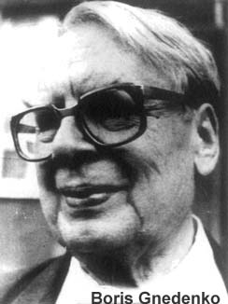
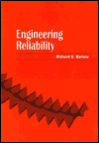

What Is Reliability Theory?
Reliability theory is a general theory of systems failure developed by mathematicians:

Slide 3



Reliability theory was historically developed to describe failure and aging of complex electronic (military) equipment, but the theory itself is a very general theory based on probability theory and systems approach.

Slide 4
Why Do We Need
Reliability-Theory Approach?
Because it provides a common scientific language (general paradigm) for scientists working in different areas of aging research.
Reliability theory helps to overcome disruptive specialization and it allows researchers to understand each other.
May be useful for integrative studies of aging.
Provides useful mathematical models allowing to explain and interpret the observed data and findings.

Slide 5
Some Representative Publications on Reliability-Theory Approach to Aging

Slide 6
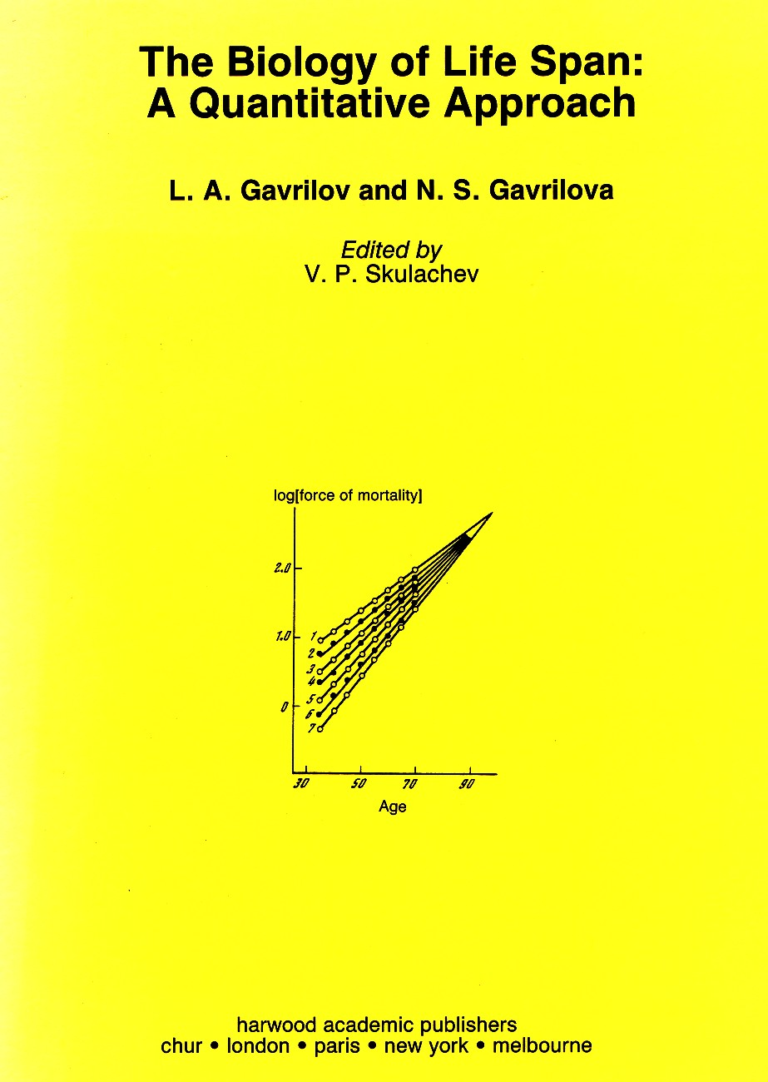

Slide 7

Gavrilov, L., Gavrilova, N. Reliability theory of aging and longevity. In: Handbook of the Biology of Aging. Academic Press, 6th edition, 2006, pp.3-42.

Slide 8

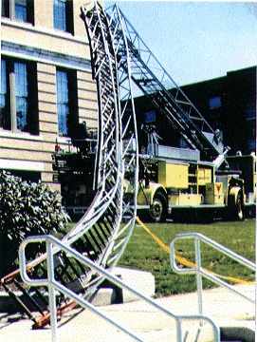
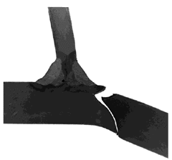
The Concept of System’s Failure
In reliability theory failure is defined as the event when a required function is terminated.

Slide 9


Failures are often classified into two groups:
degradation failures, where the system or component no longer functions properly
catastrophic or fatal failures - the end of system's or component's life

Slide 10
Definition of aging and non-aging systems in reliability theory
Aging: increasing risk of failure with the passage of time (age).
No aging: 'old is as good as new' (risk of failure is not increasing with age)
Increase in the calendar age of a system is irrelevant.

Slide 11


Aging and non-aging systems
Progressively failing clocks are aging (although their 'biomarkers' of age at the clock face may stop at 'forever young' date)
Perfect clocks having an ideal marker of their increasing age (time readings) are not aging

Slide 12
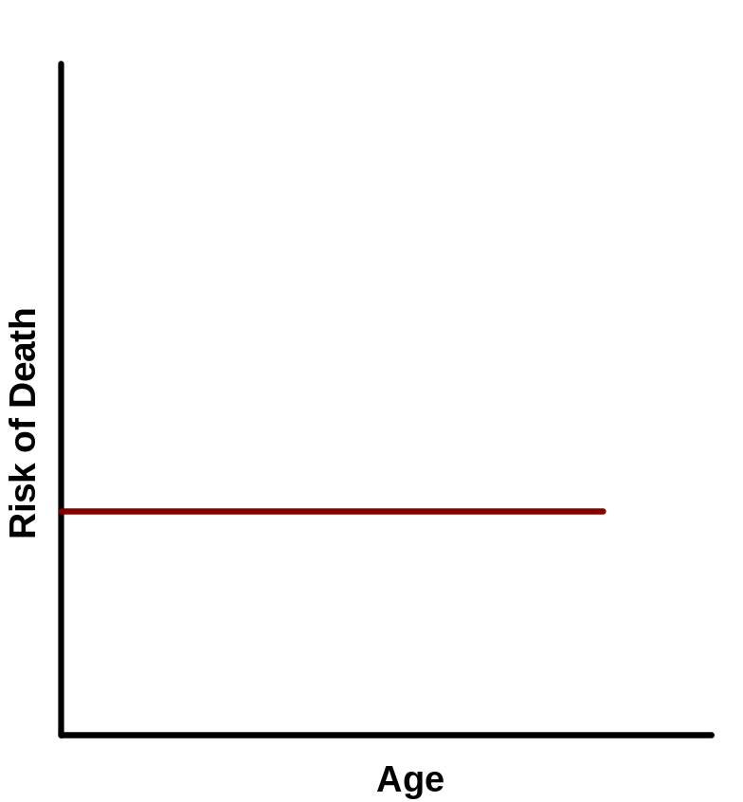
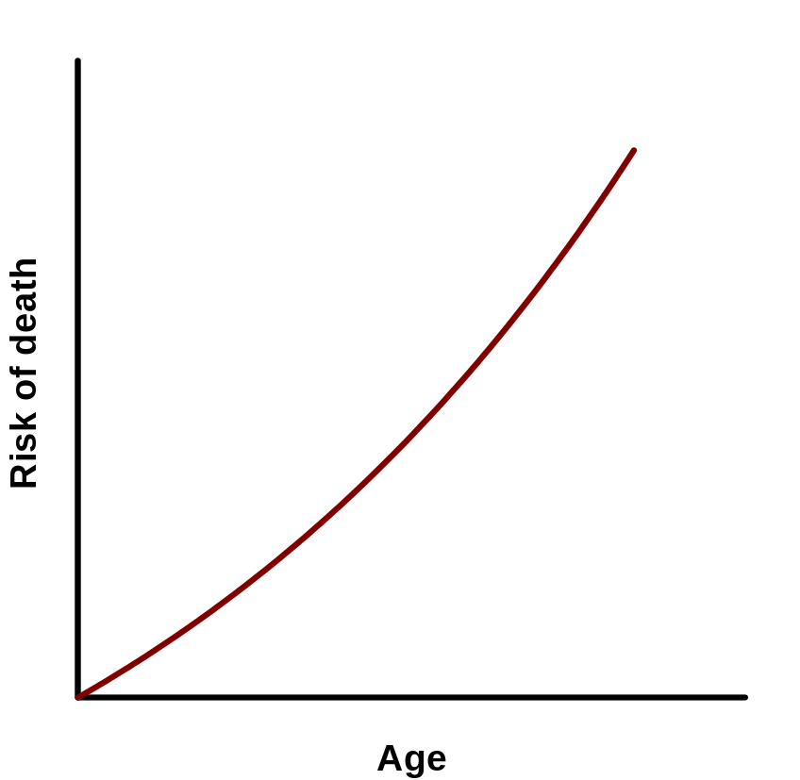
Mortality in Aging and Non-aging Systems
non-aging system
aging system
Example: radioactive decay

Slide 13
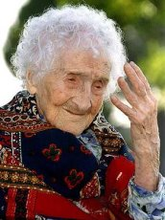
According to Reliability Theory:
Aging is NOT just growing old
Instead
Aging is a degradation to failure: becoming sick, frail and dead
'Healthy aging' is an oxymoron like a healthy dying or a healthy disease
More accurate terms instead of 'healthy aging' would be a delayed aging, postponed aging, slow aging, or negligible aging (senescence)

Slide 14
According to Reliability Theory:
Onset of disease or disability is a perfect example of organism's failure
When the risk of such failure outcomes increases with age -- this is an aging by definition

Slide 15
Implications
Diseases are an integral part (outcomes) of the aging process
Aging without diseases is just as inconceivable as dying without death
Not every disease is related to aging, but every progression of disease with age has relevance to aging: Aging is a 'maturation' of diseases with age
Aging is the many-headed monster with many different types of failure (disease outcomes). Aging is, therefore, a summary term for many different processes.

Slide 16





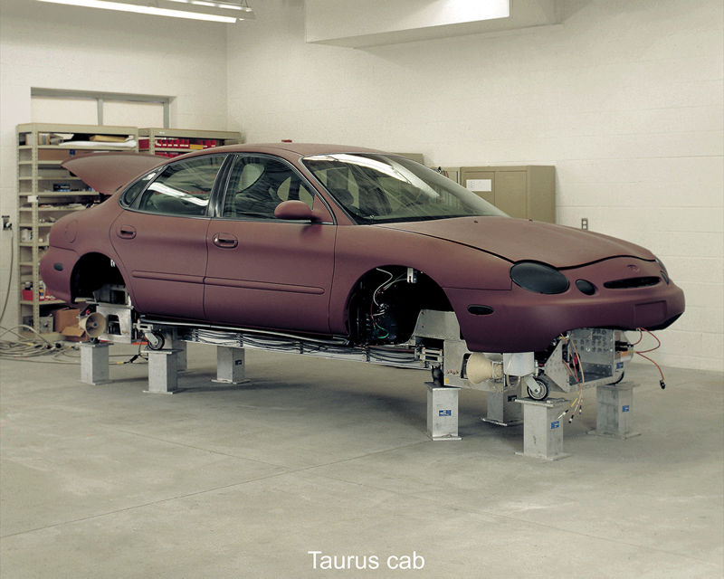
Aging is a Very General Phenomenon!

Slide 17
Particular mechanisms of aging may be very different even across biological species (salmon vs humans)
BUT
General Principles of Systems Failure and Aging May Exist
(as we will show in this presentation)

Slide 18
Further plan of presentation
Empirical laws of failure and aging
Explanations by reliability theory
Links between reliability theory and evolutionary theory

Slide 19
Empirical Laws of Systems Failure and Aging

Slide 20
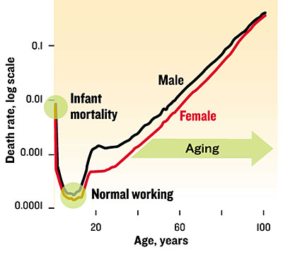
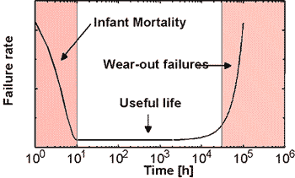
Stages of Life in Machines and Humans
Bathtub curve for human mortality as seen in the U.S. population in 1999 has the same shape as the curve for failure rates of many machines.
The so-called bathtub curve for technical systems

Slide 21
Failure (Mortality) Laws
Gompertz-Makeham law of mortality
Compensation law of mortality
Late-life mortality deceleration

Slide 22
The Gompertz-Makeham Law
Death rate is a sum of age-independent component (Makeham term) and age-dependent component (Gompertz function), which increases exponentially with age.
μ(x) = A + R e ^{αx}
A – Makeham term or background mortality
R e ^{αx} – age-dependent mortality; x - age
risk of death
Non-aging
component
Aging
component

Slide 23
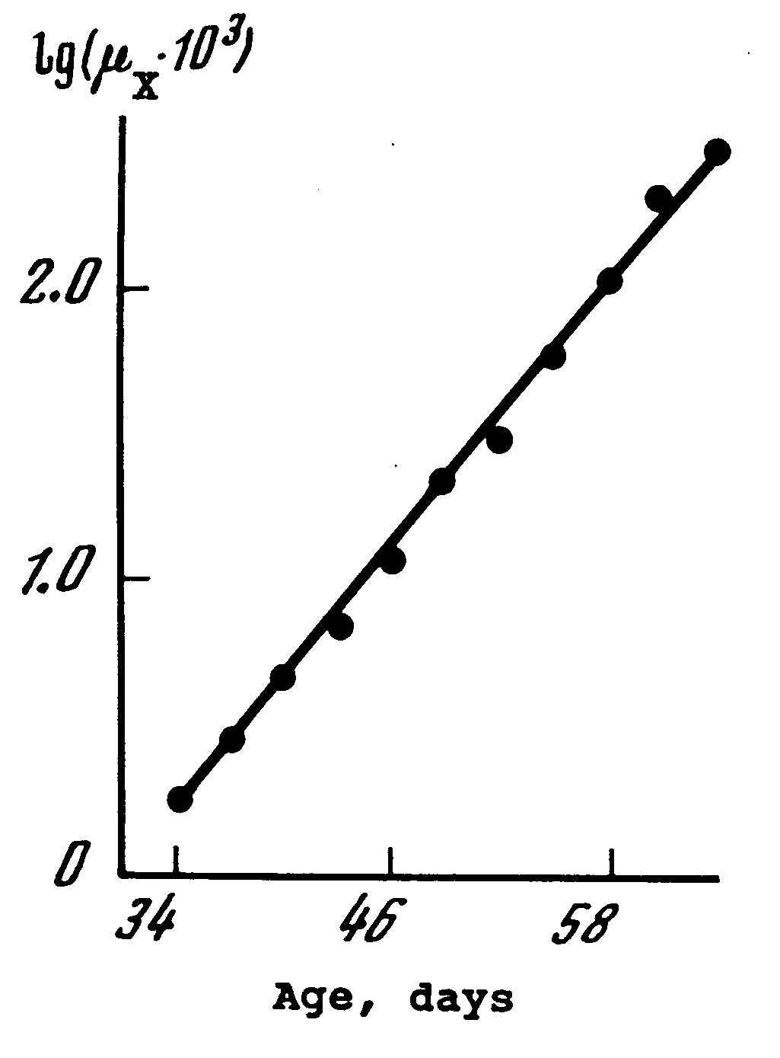

Gompertz Law of Mortality in Fruit Flies
Based on the life table for 2400 females of Drosophila melanogaster published by Hall (1969).
Source: Gavrilov, Gavrilova, “The Biology of Life Span” 1991

Slide 24
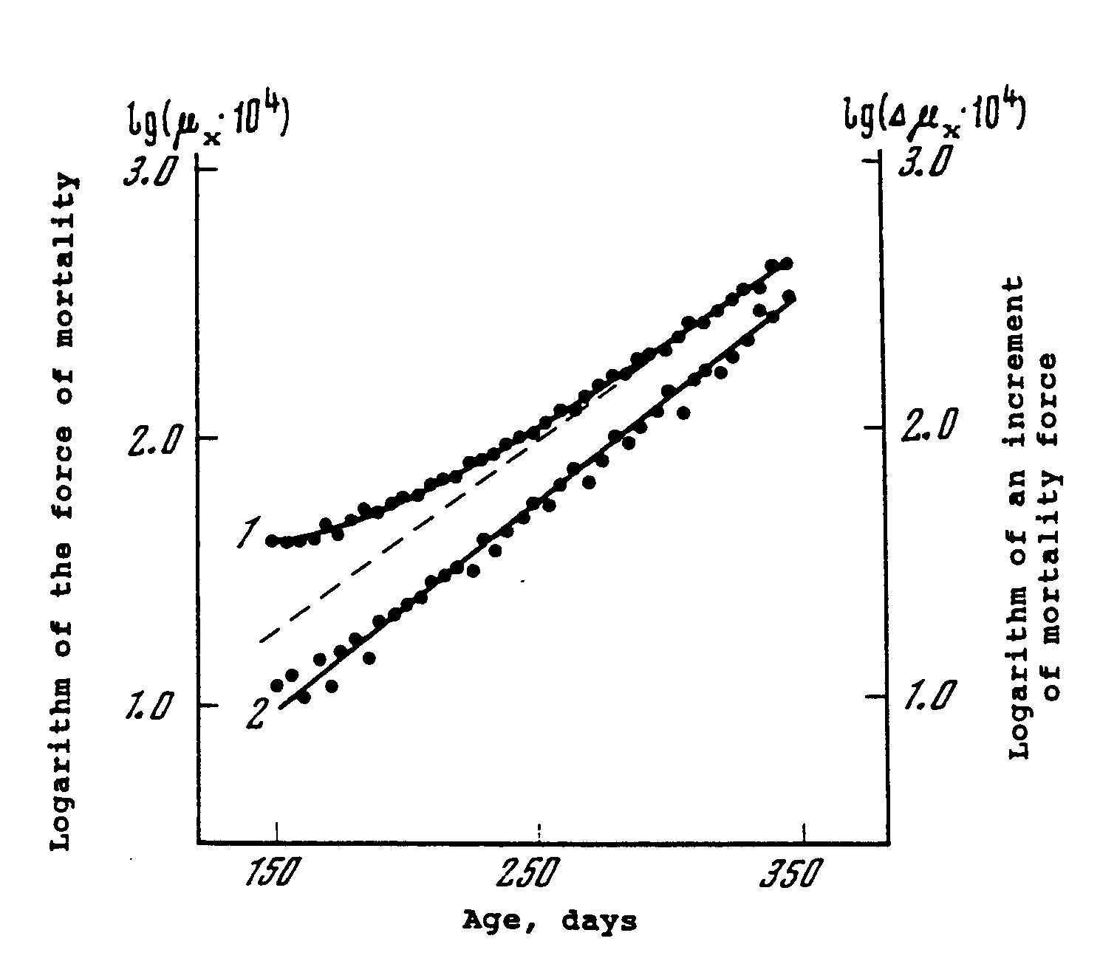

Gompertz-Makeham Law of Mortality in Flour Beetles
Based on the life table for 400 female flour beetles (Tribolium confusum Duval). published by Pearl and Miner (1941).
Source: Gavrilov, Gavrilova, “The Biology of Life Span” 1991

Slide 25
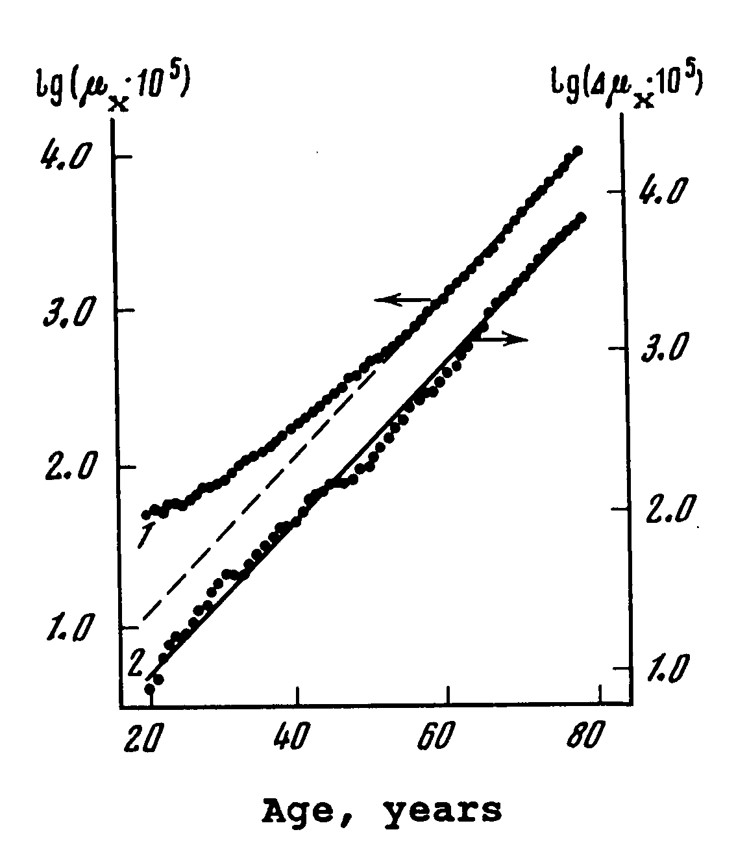
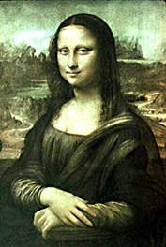
Gompertz-Makeham Law of Mortality in Italian Women
Based on the official Italian period life table for 1964-1967.
Source: Gavrilov, Gavrilova, “The Biology of Life Span” 1991

Slide 26
Compensation Law of Mortality
(late-life mortality convergence)
Relative differences in death rates are decreasing with age, because the lower initial death rates are compensated by higher slope of mortality growth with age (actuarial aging rate)

Slide 27
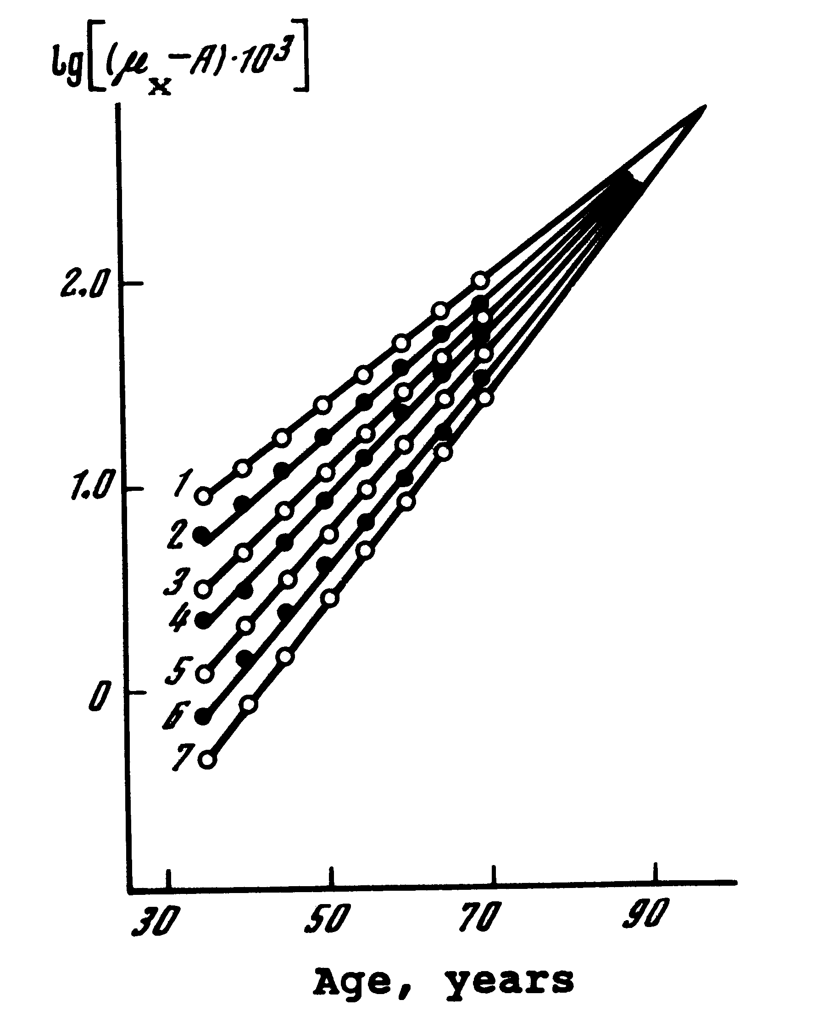
Compensation Law of Mortality
Convergence of Mortality Rates with Age
1 – India, 1941-1950, males
2 – Turkey, 1950-1951, males
3 – Kenya, 1969, males
4 - Northern Ireland, 1950-1952, males
5 - England and Wales, 1930-1932, females
6 - Austria, 1959-1961, females
7 - Norway, 1956-1960, females
Source: Gavrilov, Gavrilova,
“The Biology of Life Span” 1991

Slide 28
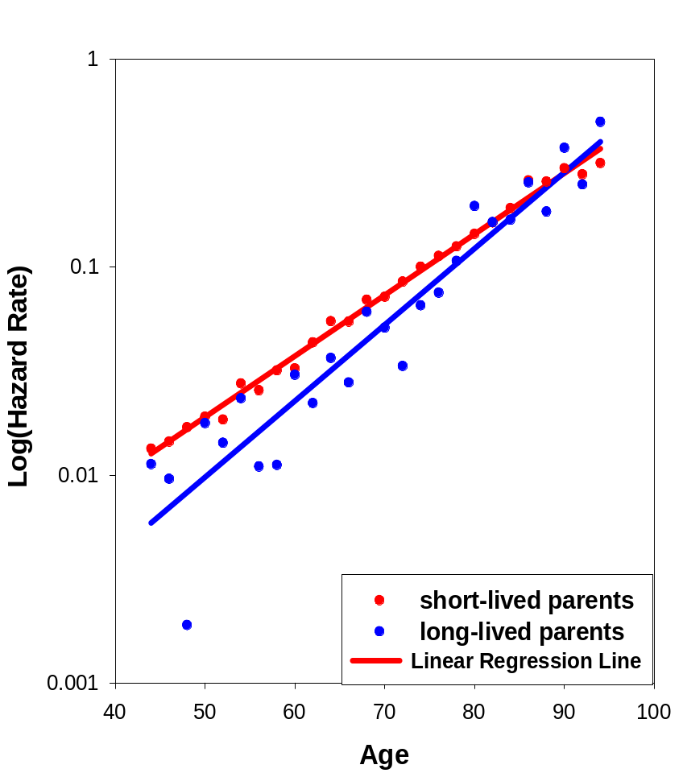
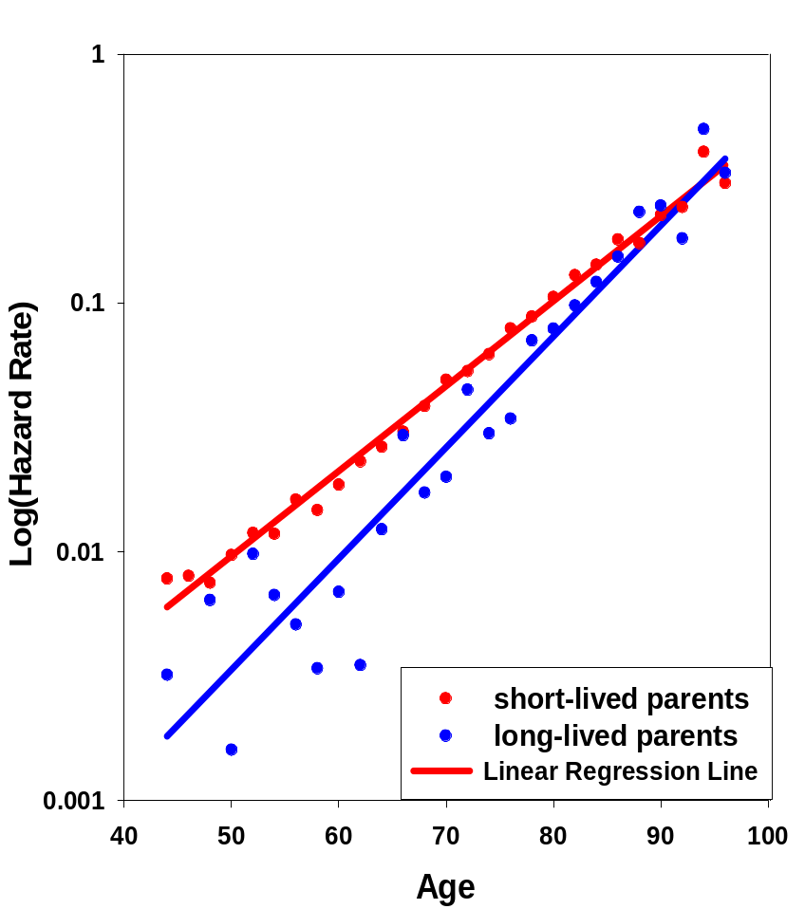
Compensation Law of Mortality (Parental Longevity Effects)
Mortality Kinetics for Progeny Born to Long-Lived (80+) vs Short-Lived Parents
Sons
Daughters

Slide 29
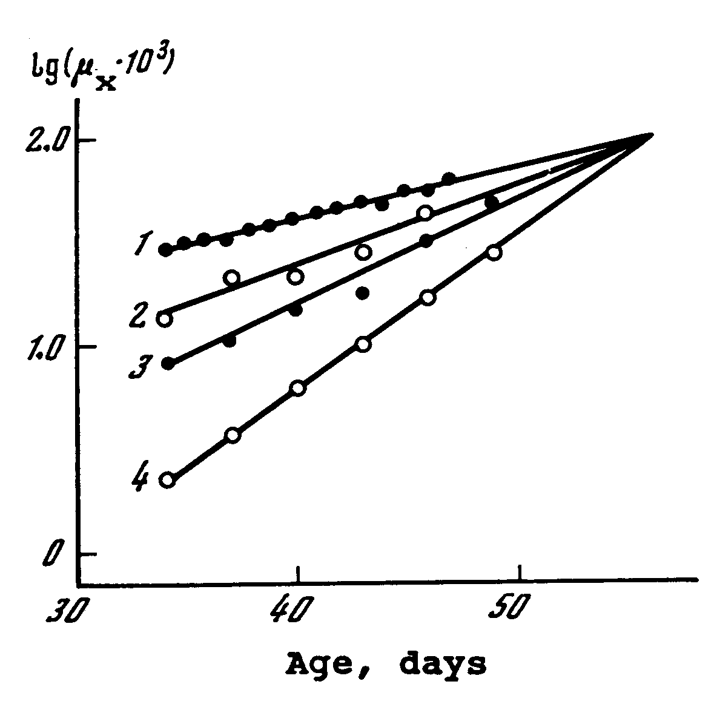
Compensation Law of Mortality in Laboratory Drosophila
1 – drosophila of the Old Falmouth, New Falmouth, Sepia and Eagle Point strains (1,000 virgin females)
2 – drosophila of the Canton-S strain (1,200 males)
3 – drosophila of the Canton-S strain (1,200 females)
4 - drosophila of the Canton-S strain (2,400 virgin females)
Mortality force was calculated for 6-day age intervals.
Source: Gavrilov, Gavrilova,
“The Biology of Life Span” 1991

Slide 30
Implications
Be prepared to a paradox that higher actuarial aging rates may be associated with higher life expectancy in compared populations (e.g., males vs females)
Be prepared to violation of the proportionality assumption used in hazard models (Cox proportional hazard models)
Relative effects of risk factors are age-dependent and tend to decrease with age

Slide 31
The Late-Life Mortality Deceleration (Mortality Leveling-off, Mortality Plateaus)
The late-life mortality deceleration law states that death rates stop to increase exponentially at advanced ages and level-off to the late-life mortality plateau.

Slide 32
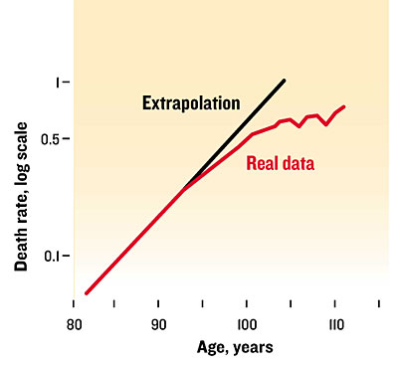
Mortality deceleration at advanced ages.
After age 95, the observed risk of death [red line] deviates from the value predicted by an early model, the Gompertz law [black line].
Mortality of Swedish women for the period of 1990-2000 from the Kannisto-Thatcher Database on Old Age Mortality
Source: Gavrilov, Gavrilova, “Why we fall apart. Engineering’s reliability theory explains human aging”. IEEE Spectrum. 2004.

Slide 33
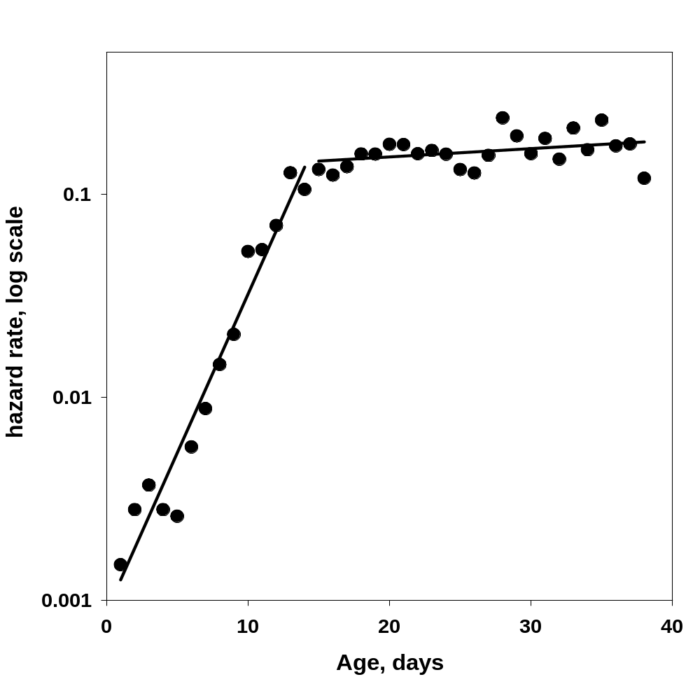

Mortality Leveling-Off in House Fly
Musca domestica
Our analysis of the life table for 4,650 male house flies published by Rockstein & Lieberman, 1959.
Source:
Gavrilov & Gavrilova. Handbook of the Biology of Aging, Academic Press, 2006, pp.3-42.

Slide 34
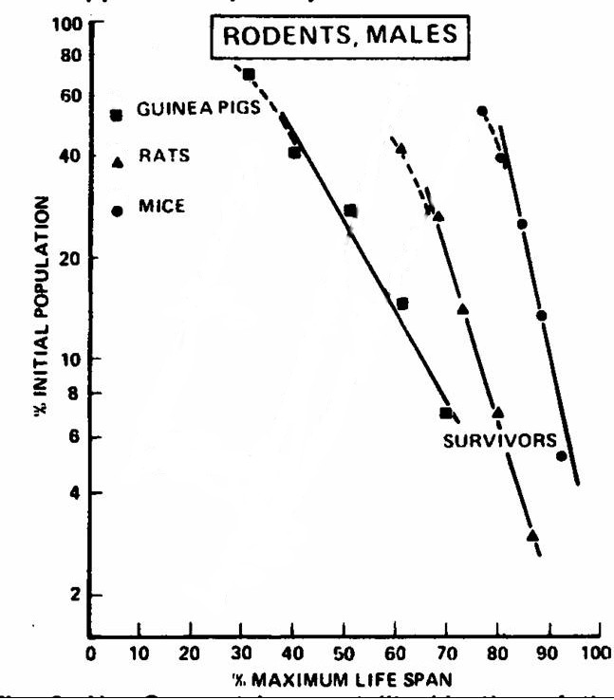
Non-Aging Mortality Kinetics in Later Life
If mortality is constant then log(survival) declines with age as a linear function
Source:
Economos, A. (1979).
A non-Gompertzian paradigm for mortality kinetics of metazoan animals and failure kinetics of manufactured products.
AGE, 2: 74-76.

Slide 35
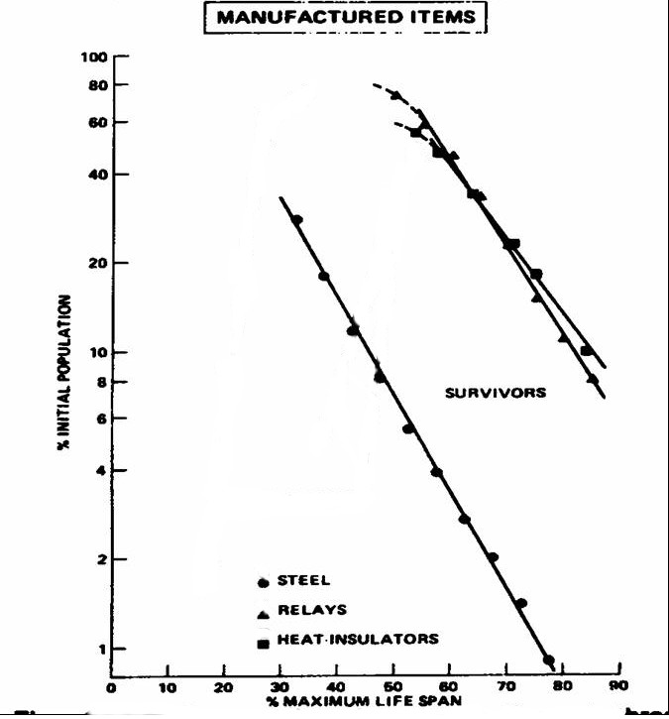
Non-Aging Failure Kinetics of Industrial Materials in ‘Later Life’
(steel, relays, heat insulators)
Source:
Economos, A. (1979).
A non-Gompertzian paradigm for mortality kinetics of metazoan animals and failure kinetics of manufactured products.
AGE, 2: 74-76.

Slide 36
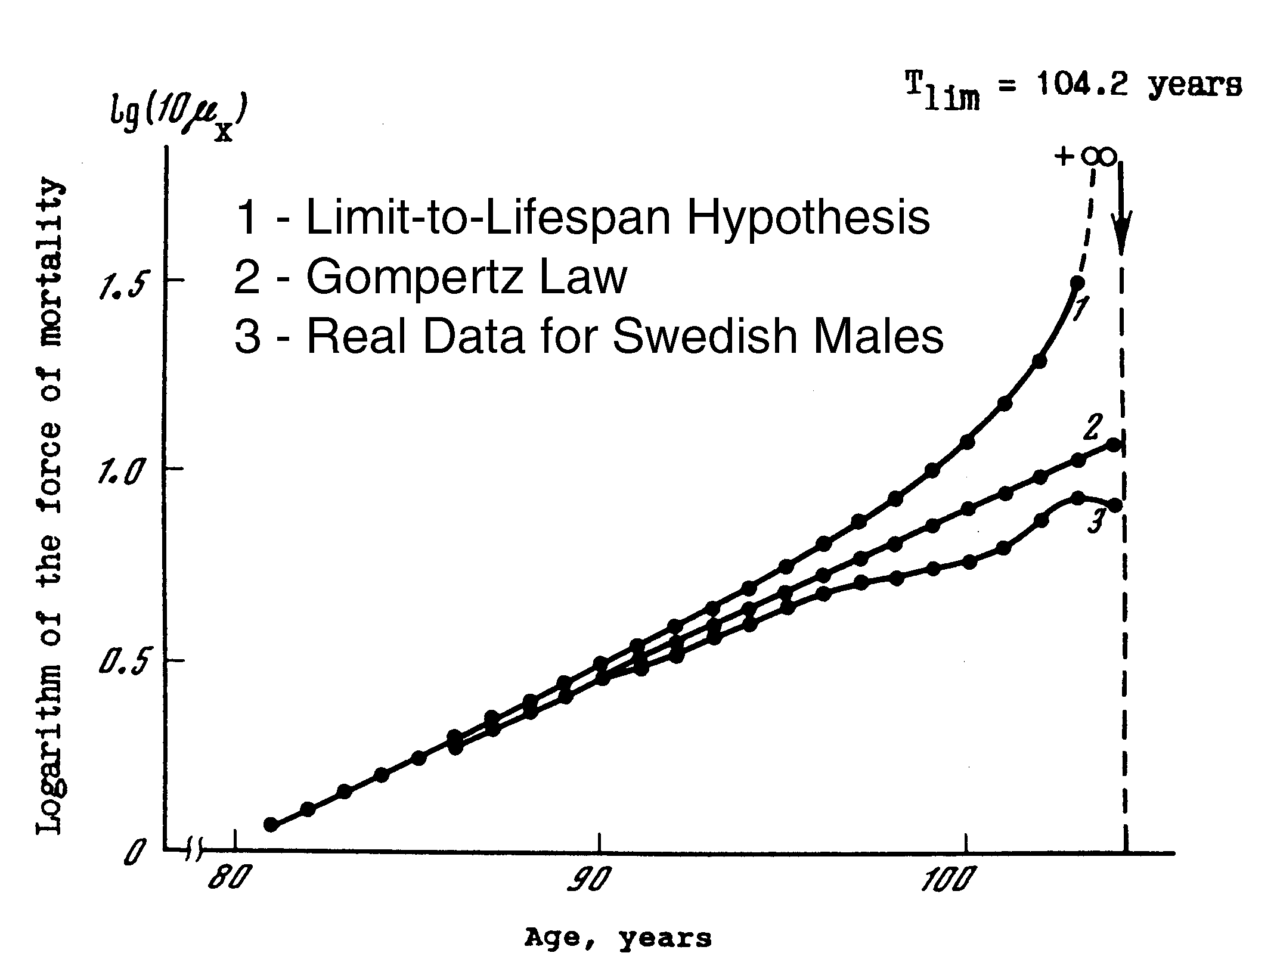
Testing the “Limit-to-Lifespan” Hypothesis
Source: Gavrilov L.A., Gavrilova N.S. 1991. The Biology of Life Span

Slide 37
Implications
There is no fixed upper limit to human longevity - there is no special fixed number, which separates possible and impossible values of lifespan.
This conclusion is important, because it challenges the common belief in existence of a fixed maximal human life span.

Slide 38
Additional Empirical Observation:
Many age changes can be explained by cumulative effects of cell loss over time
Atherosclerotic inflammation - exhaustion of progenitor cells responsible for arterial repair (Goldschmidt-Clermont, 2003; Libby, 2003; Rauscher et al., 2003).
Decline in cardiac function - failure of cardiac stem cells to replace dying myocytes (Capogrossi, 2004).
Incontinence - loss of striated muscle cells in rhabdosphincter (Strasser et al., 2000).

Slide 39
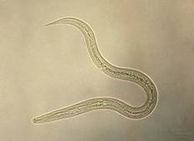
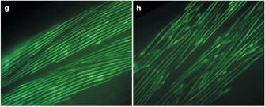
Like humans, nematode
C. elegans experience muscle loss
Herndon et al. 2002. Stochastic and genetic factors influence tissue-specific decline in ageing C. elegans. Nature 419, 808 - 814.
“…many additional cell types (such as hypodermis and intestine) … exhibit age-related deterioration.”
Body wall muscle sarcomeres
Left - age 4 days. Right - age 18 days

Slide 40
What Should the Aging Theory Explain
Why do most biological species including humans deteriorate with age?
The Gompertz law of mortality
Mortality deceleration and leveling-off at advanced ages
Compensation law of mortality

Slide 41
The Concept of Reliability Structure
The arrangement of components that are important for system reliability is called reliability structure and is graphically represented by a schema of logical connectivity

Slide 42
Two major types of system’s logical connectivity
Components connected in series
Components connected in parallel
Fails when the first component fails
P_{s} = p₁ p₂ p_{3 …} p_{n} = p^{n}
Fails when all components fail
Q_{s} = q₁ q₂ q₃ … q_{n} = q^{n}
Combination of two types – Series-parallel system

Slide 43
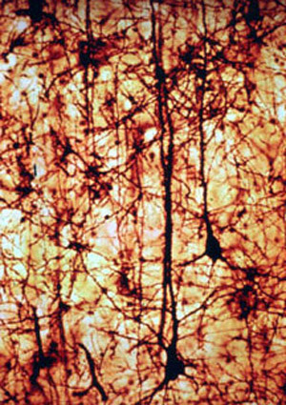
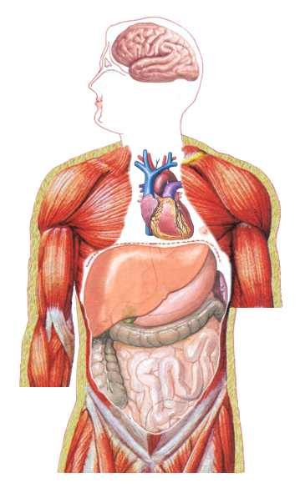
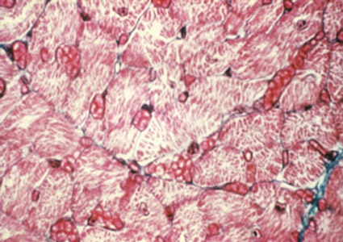
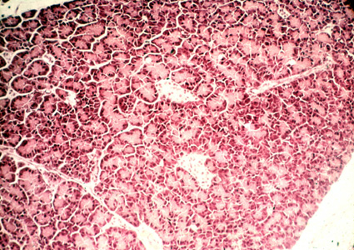
Series-parallel Structure of Human Body
Vital organs are connected in series
Cells in vital organs are connected in parallel

Slide 44
Redundancy Creates Both Damage Tolerance and Damage Accumulation (Aging)
System without redundancy dies after the first random damage (no aging)
System with redundancy accumulates damage (aging)

Slide 45
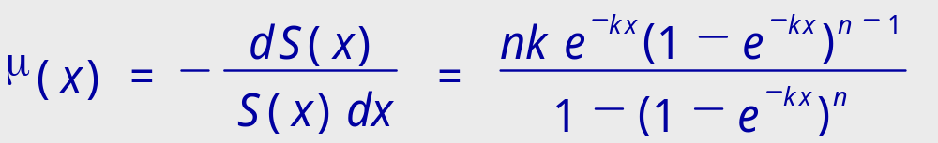
Reliability Model of a Simple Parallel System
Failure rate of the system:
Elements fail randomly and independently with a constant failure rate, k
n – initial number of elements
≈ nk^{n}x^{n-1} early-life period approximation, when 1-e^{-kx} ≈ kx
≈ k late-life period approximation, when 1-e^{-kx} ≈ 1
Source: Gavrilov L.A., Gavrilova N.S. 1991. The Biology of Life Span

Slide 46
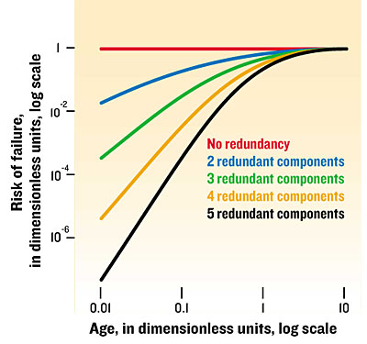
Failure Rate as a Function of Age in Systems with Different Redundancy Levels
Failure of elements is random
Source: Gavrilov, Gavrilova, IEEE Spectrum. 2004.

Slide 47
Standard Reliability Models Explain
Mortality deceleration and leveling-off at advanced ages
Compensation law of mortality

Slide 48
Standard Reliability Models
Do Not Explain
The Gompertz law of mortality observed in biological systems
Instead they produce Weibull (power) law of mortality growth with age:
μ(x) = a x^{b}

Slide 49
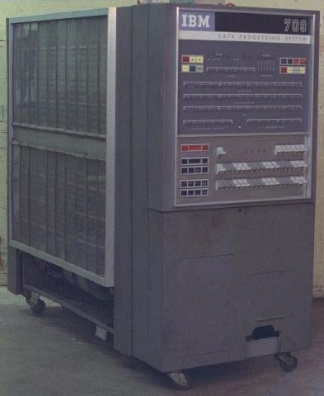
An Insight Came To Us While Working With Dilapidated Mainframe Computer
The complex unpredictable behavior of this computer could only be described by resorting to such 'human' concepts as character, personality, and change of mood.

Slide 50
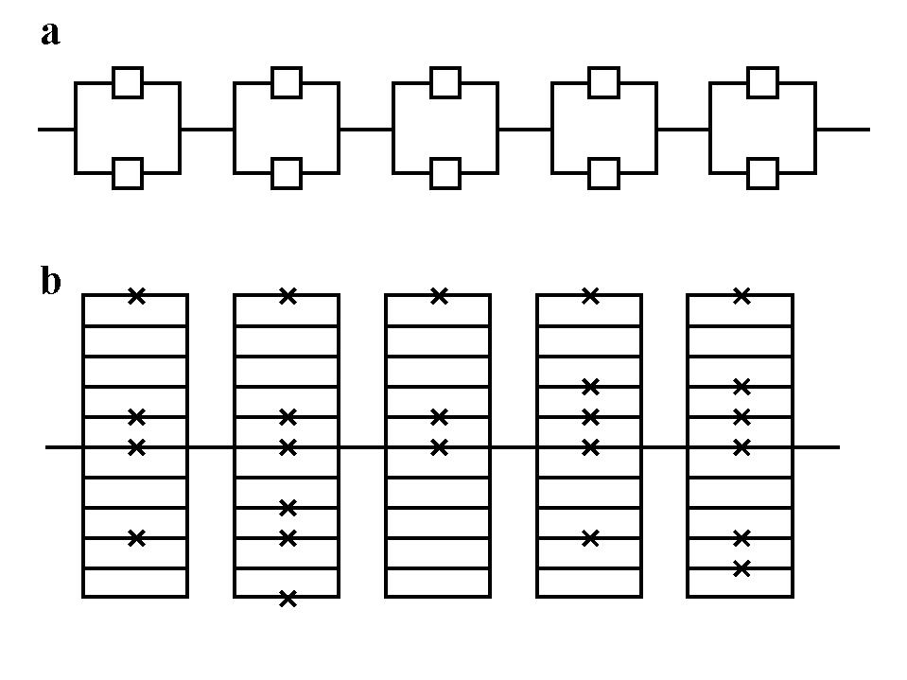
Reliability structure of
(a) technical devices and (b) biological systems
Low redundancy
Low damage load
Fault avoidance
High redundancy
High damage load
Fault tolerance
X - defect

Slide 51
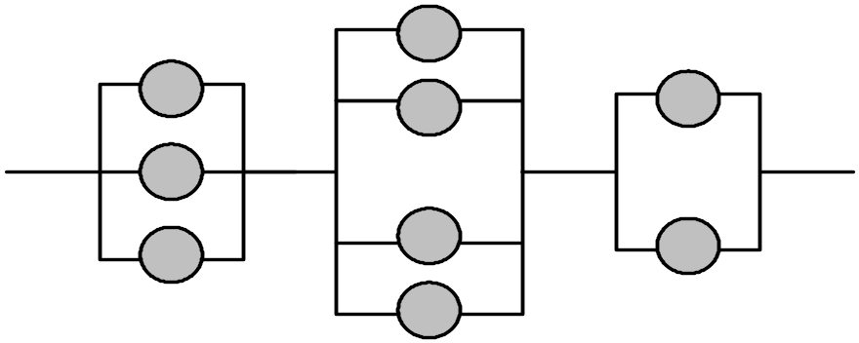
Models of systems with distributed redundancy
Organism can be presented as a system constructed of m series-connected blocks with binomially distributed elements within block (Gavrilov, Gavrilova, 1991, 2001)

Slide 52
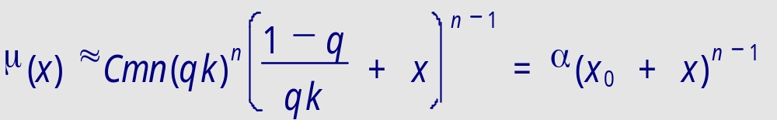
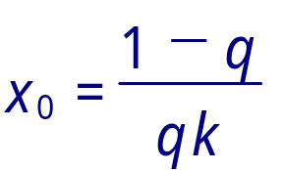
Model of organism with initial damage load
Failure rate of a system with binomially distributed redundancy (approximation for initial period of life):
Binomial law of mortality
where
- the initial virtual age of the system
The initial virtual age of a system defines the law of system’s mortality:
x₀ = 0 - ideal system, Weibull law of mortality
x₀ >> 0 - highly damaged system, Gompertz law of mortality
Source: Gavrilov L.A., Gavrilova N.S. 1991. The Biology of Life Span

Slide 53
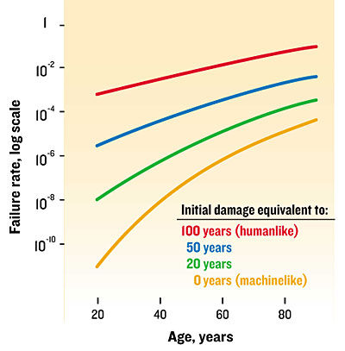
People age more like machines built with lots of faulty parts than like ones built with pristine parts.
As the number of bad components, the initial damage load, increases [bottom to top], machine failure rates begin to mimic human death rates.
Source: Gavrilov, Gavrilova, IEEE Spectrum. 2004

Slide 54
Statement of the HIDL hypothesis:
(Idea of High Initial Damage Load )
"Adult organisms already have an exceptionally high load of initial damage, which is comparable with the amount of subsequent aging-related deterioration, accumulated during the rest of the entire adult life."
Source: Gavrilov, L.A. & Gavrilova, N.S. 1991. The Biology of Life Span:
A Quantitative Approach. Harwood Academic Publisher, New York.

Slide 55
Why should we expect high initial damage load in biological systems?
General argument:
-- biological systems are formed by self-assembly without helpful external quality control.
Specific arguments:
Most cell divisions responsible for DNA copy-errors occur in early development leading to clonal expansion of mutations
Loss of telomeres is also particularly high in early-life
Cell cycle checkpoints are disabled in early development

Slide 56
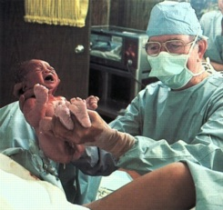
Birth Process is a Potential Source of High Initial Damage
Severe hypoxia and asphyxia just before the birth.
oxidative stress just after the birth because of acute reoxygenation while starting to breathe.
The same mechanisms that produce ischemia-reperfusion injury and the related phenomenon, asphyxia-reventilation injury known in cardiology.

Slide 57
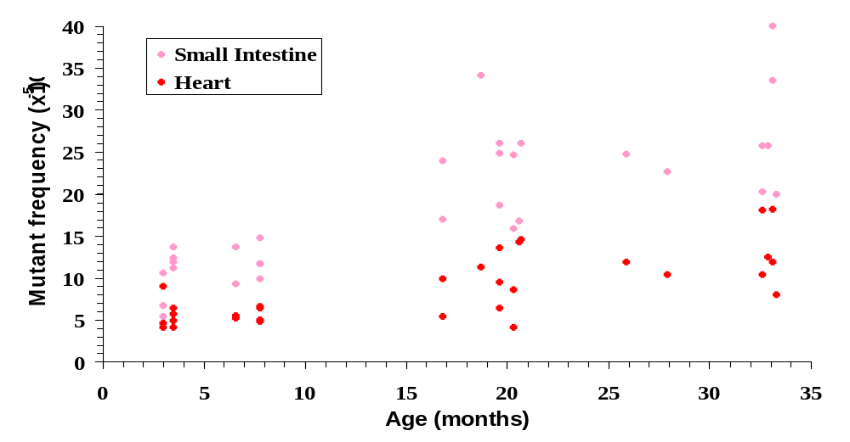
Spontaneous mutant frequencies with age in heart and small intestine
Source: Presentation of Jan Vijg at the IABG Congress, Cambridge, 2003

Slide 58
Practical implications from the HIDL hypothesis:
"Even a small progress in optimizing the early-developmental processes can potentially result in a remarkable prevention of many diseases in later life, postponement of aging-related morbidity and mortality, and significant extension of healthy lifespan."
Source: Gavrilov, L.A. & Gavrilova, N.S. 1991. The Biology of Life Span:
A Quantitative Approach. Harwood Academic Publisher, New York.

Slide 59
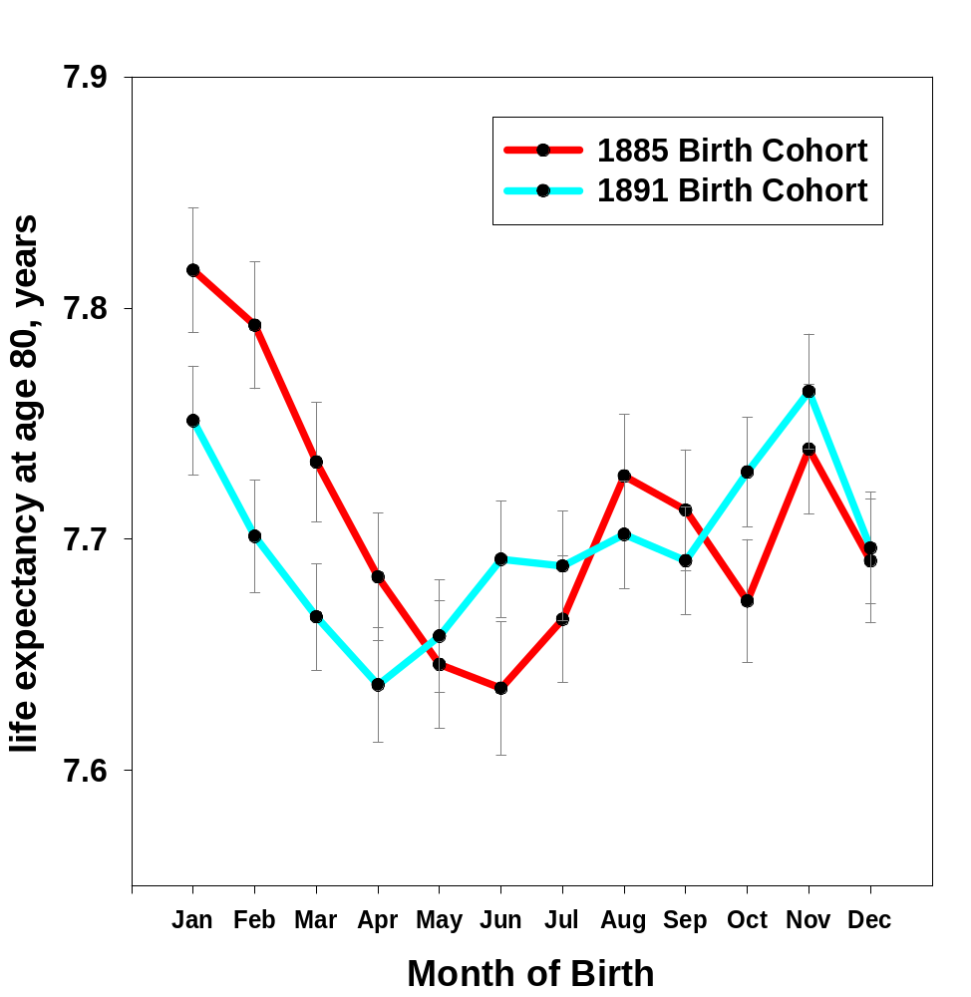
Life Expectancy and Month of Birth
Data source: Social Security Death Master File
Published in:
Gavrilova, N.S., Gavrilov, L.A. Search for Predictors of Exceptional Human Longevity. In: “Living to 100 and Beyond” Monograph. The Society of Actuaries, Schaumburg, Illinois, USA, 2005, pp. 1-49.

Slide 60
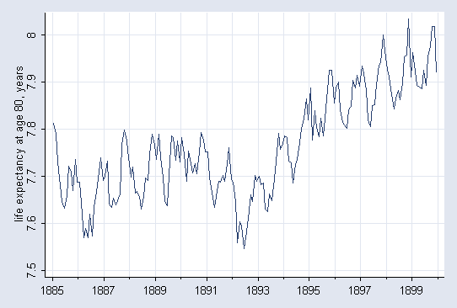

Slide 61
Evolution of Species Reliability
Reliability theory of aging is perfectly compatible with the idea of biological evolution.
Moreover, reliability theory helps evolutionary theories to explain how the age of onset of diseases caused by deleterious mutations could be postponed to later ages during the evolution.

Slide 62
Evolution in the Direction of Low Mortality at Young Ages
This could be easily achieved by simple increase in the initial redundancy levels (e.g., initial cell numbers).
Log risk of death
Age

Slide 63
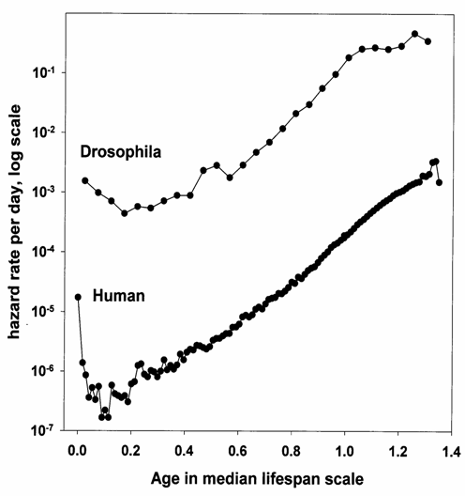
Evolution of species reliability
Fruit flies from the very beginning of their lives have very unreliable design compared to humans.
High late-life mortality of fruit flies compared to humans suggests that fruit flies are made of less reliable components (presumably cells), which have higher failure rates compared to human cells.

Slide 64
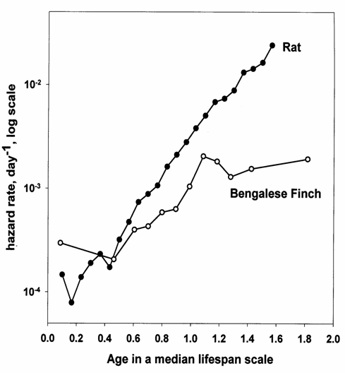



Reliability of Birds vs Mammals
Birds should be very prudent in redundancy of their body structures (because it comes with a heavy cost of additional weight).
Result: high mortality at younger ages.
Flight adaptation should force birds to evolve in a direction of high reliability of their components (cells).
Result: low rate of elements’ (cells’) damage resulting in low mortality at older ages

Slide 65
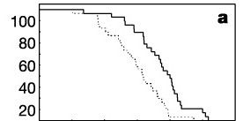

Effect of extrinsic mortality on the evolution of senescence in guppies.
Reznick et al. 2004. Nature 431, 1095 - 1099
Reliability-theory perspective:
Predators ensure selection for better performance and lower initial damage load.
Hence life span would increase in high predator localities.
Solid line – high predator locality
Dotted line –low predator locality

Slide 66
Conclusions (I)
Redundancy is a key notion for understanding aging and the systemic nature of aging in particular. Systems, which are redundant in numbers of irreplaceable elements, do deteriorate (i.e., age) over time, even if they are built of non-aging elements.
An apparent aging rate or expression of aging (measured as age differences in failure rates, including death rates) is higher for systems with higher redundancy levels.

Slide 67
Conclusions (II)
Redundancy exhaustion over the life course explains the observed ‘compensation law of mortality’ (mortality convergence at later life) as well as the observed late-life mortality deceleration, leveling-off, and mortality plateaus.
Living organisms seem to be formed with a high load of initial damage, and therefore their lifespans and aging patterns may be sensitive to early-life conditions that determine this initial damage load during early development. The idea of early-life programming of aging and longevity may have important practical implications for developing early-life interventions promoting health and longevity.

Slide 68
Acknowledgments
This study was made possible thanks to:
generous support from the National Institute on Aging, and
stimulating working environment at the Center on Aging, NORC/University of Chicago

Slide 69
For More Information and Updates Please Visit Our
Scientific and Educational Website on Human Longevity:
http://longevity-science.org

