Slide 1


Effect of Network Configuration on the Reliability Model of Cellular Aging
Palpasa Manandhar
April 19 ,2013
Advisors
Dr. Hong Qin
Dr. Nagambal Shah

Slide 2
Outline
Introduction
  Aging: Different Versions
  Redundancy and Failure
  Reliability Network Model
  Biological vs. Machine Aging
Objective
Methodology
Results and Conclusion

Slide 3
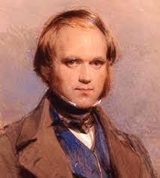
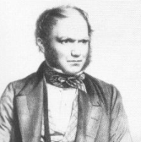
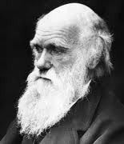





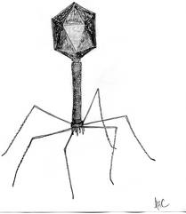

Question: What is it?
Answer: AGING
  Humans do it
  Birds do it
  Bees do it
Red Blood Cells do it
Boeing airplanes do it
Computers do it
Viruses do NOT do it.
Radioactive isotopes do NOT do it.

Slide 4
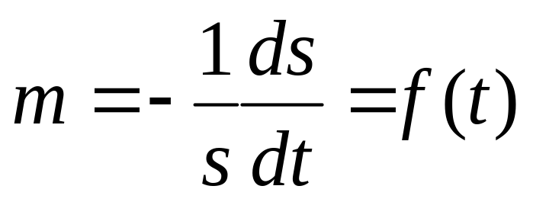
The quantitative definition of aging
Aging = mortality rate increase over time
  m: mortality rate
  s: viability or survivorship
Notes:
Gompertz mortality model (constant hazard model)
Mortality Rate: m = - (ds/dt)(1/s) = I₀ e^{Gt}
Viability: s = exp[ (I₀ /G) ( 1 - e^{Gt}) ]

Slide 5
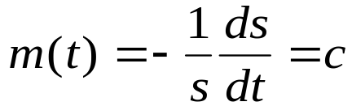
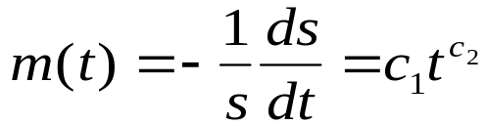


Different versions of aging
Virus/Non Aging (Radioactive Isotope Decay)
Machine Aging (Weibull Model)
Biological Aging (Gompertz Model)
where ‘m(t)’ is the mortality rate, and ‘t’ is time, c, , , R₀ , G are constants. Mortality rate increases as a power function in machine aging versus a exponential function in biological aging. (Gavrilov & Gavrilova 2001)

Slide 6
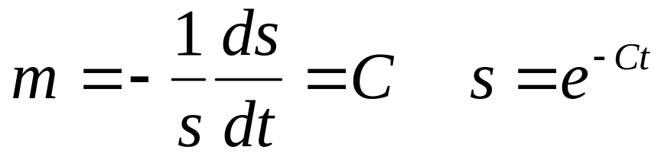
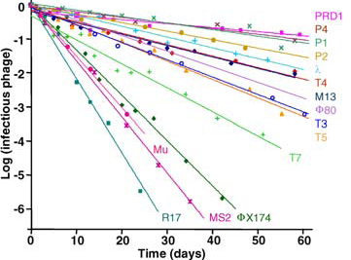
Virus / Non-aging systems
where ‘s’ is the viability
De Paepe & Taddei, 2006, Plos Biology
Notes:
Explain graph?

Slide 7
Gompertz definition of biological aging
  Mortality rate
  Viability
  Aging =exponential increase of mortality rate over time.
  m₀ : initial mortality rate
  G: rate of aging
Notes:
Gompertz mortality model (constant hazard model)
Mortality Rate: m = - (ds/dt)(1/s) = I₀ e^{Gt}
Viability: s = exp[ (I₀ /G) ( 1 - e^{Gt}) ]

Slide 8
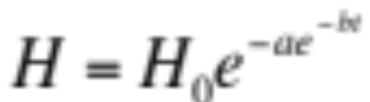
Example: Red Blood Cell (RBC)
Photohemolysis in RBCs follows Gompertz model of aging:
where H is the percentage of hemolysis during the lysis time ‘t’ (the time measured from start of rupturing the RBCs at dark incubation), H0 the initial maximum number of cells, normalized to one, ‘a’ is a fractional hemolysis ratio, and b is the rate of fractional hemo- lysis change.
Med Bio Eng Comput (2006) 44:703–710
Notes:
Explain Photohemolysis

Slide 9
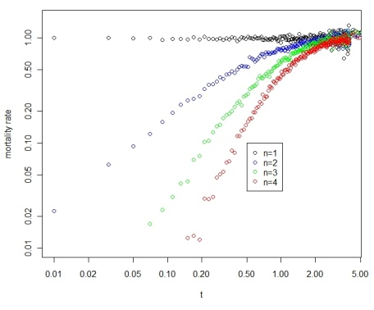
Aging can arise from systems with non-aging components
In essence, characteristics of aging of a system can arise from interactions of non-aging components, i.e., aging is an emergent property
Notes:
Fig 1. Increase of mortality rate over time, a characteristic of aging, can arise in systems with parallel non-aging components. (A) A system with 4 parallel components (n=4). (B) Simulation of parallel systems with 1,2,3, and 4 non-aging components (constant aging rates).
When no of components increases, the mortality rate increase gets more dramatic (faster)

Slide 10



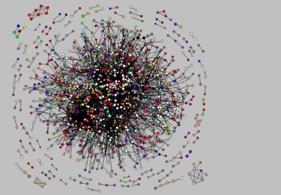

Redundancy increases the latency of failure.
Robustness
Number of components Increase in mortality rate Robustness
Notes:
Explanation?

Slide 11

A gene/protein network model of cellular aging
Essential Node
Non-essential Nodes
An essential gene
with four connections
A reliability model
with four parallel pathways

Slide 12
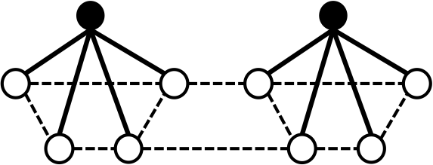
Weibull Model of Machine Aging
A network with two
modules
Assumption: Links between
modules do not affect aging.
A reliability model
with two modules

Slide 13
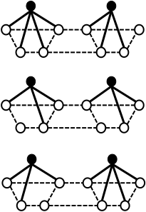
Modular network with Poisson random numbers of links lead to Gompertz model of aging
Cell-1
Rationale for stochastic links
Cellular process is a dynamic process
Limited number of protein molecules and the steric-hindrance effect.
Spatial restrictions
Random choices
Cell-2
Cell-3
Notes:
Gompertz
Each protein species can only interact with a limited number of other protein species.
Steric effects arise from the fact that each atom within a molecule occupies a certain amount of space.

Slide 14
Objective of Study
To study the network configuration effect on lifespan.
  Compare Regular Network Model and Poisson Network Model.

Slide 15
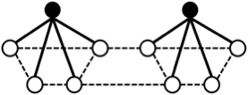
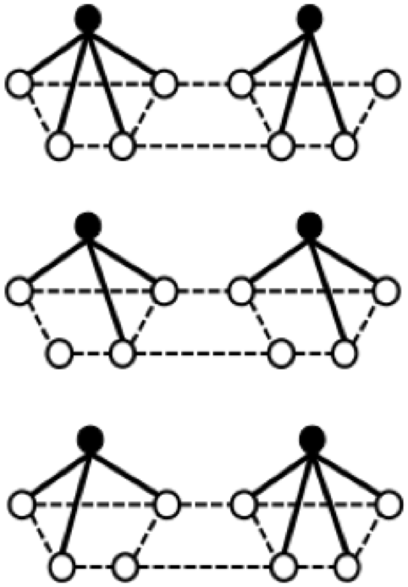
Regular Network Models and Poisson Network Models
Regular Network Model
Constant number of interactions
Poisson Network Model
Number of interactions follows
Poisson Distribution
(p.m.f. = , where = mean)

Slide 16
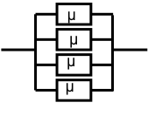

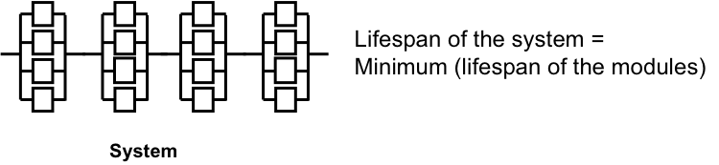
Methodology
Step 1: Simulation
Simulated Regular Network and Poisson Network using Matlab and calculated lifespan using the following:
Viability, , for the i-th element
Lifespan of each module block = Maximum ( )

Slide 17
Methodology
Step 2: Coefficient of Variation
Calculated the Coefficient of Variation (CV) for the Regular and Poisson Networks.
CV = is the normalized measure of dispersion of a
probability distribution.
where is the standard deviation and is the mean.
Higher the CV, more dispersion, more heterogeneous data, less robust.
Notes:
Diagram of CV
Regular : Constant number of interaction
Poisson : No. of interaction between each essential gene follows poisson distribution (pmf)

Slide 18
Results
H0:
  Mean CV of Regular Networks = Mean CV of Poisson Networks
H1:
Mean CV of Poisson Networks > Mean CV of Regular Networks
p-value = 1.6638e-11
Conclusion: H0 is rejected.
Notes:
Add histograms.

Slide 19
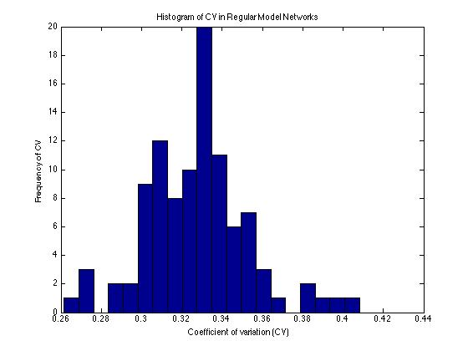
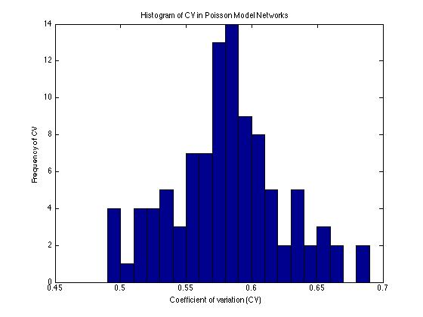
Results
Mean of C.V for Regular Network Model = 0.33 Mean of C.V for Poisson Network Model = 0.58

Slide 20
Conclusion
Poisson network leads to more heterogeneity in life span, and hence is less robust than regular network.

Slide 21
References
Al-Akhras, M. ‘A new application of Gompertz function in photohemolysis: the effect of temperature on red blood cell hemolysis photosensitized by protoporphyrin IX.’ Med Bio Eng Comput (2006) 44:703–710 DOI 10.1007/ s11517-006-0080-y.
Gavrilov and Gavrilova. ‘The Reliability Theory of Aging and Longetivity.’ J. Theor. Biol. (2001) 213, 527-545. doi:10.1006/jtbi.2001.2430.
Hong, Qin. Emergence of Cellular Aging from Gene Networks, Manuscript in preparation.

Slide 22
Acknowledgements
Dr. Hong Qin, Dr. Nagambal Shah
Math RAMP: NSF-DMS #1045557
NSF RUI 1022294
Thank you Audience!

Slide 23
THE END

Slide 29
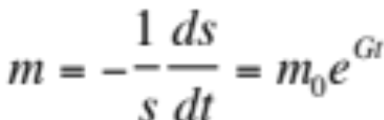
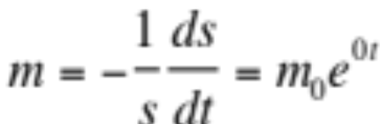


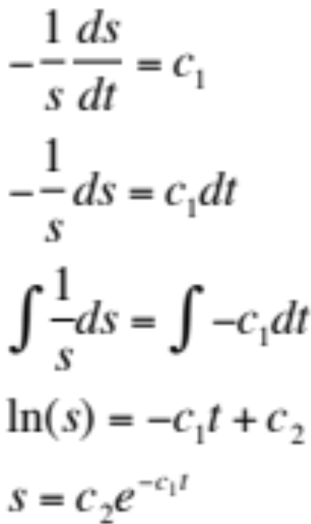
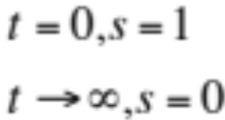
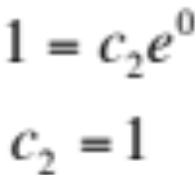
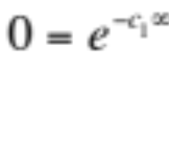


Derivation of :
When
Using differential equations
Initial Conditions
We get:
can be anything
Thus,
Notes:
INTEGRATE from 0 to t

Slide 30
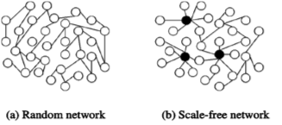
Power Law Network
Heterogeneity plays a key role in biological aging.
Key source of heterogeneity: Power law

Slide 31
Modular network with power-law links

Slide 32
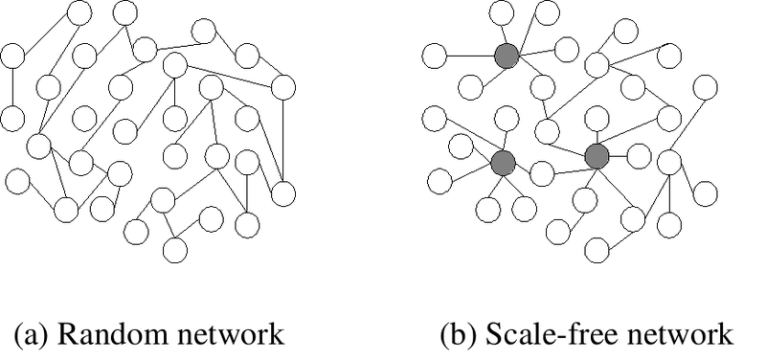

Slide 33
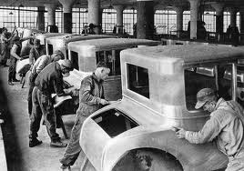
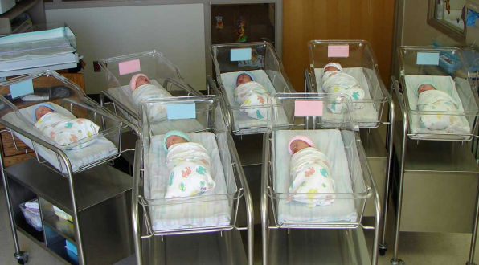
What is the difference between mass-produced machines and the thousands of babies born on one day?
Homogeneous
Systems
Heterogeneous
Systems
Thus, Heterogeneity plays a key role in biological aging.
Key source of heterogeneity: Power law

Slide 34
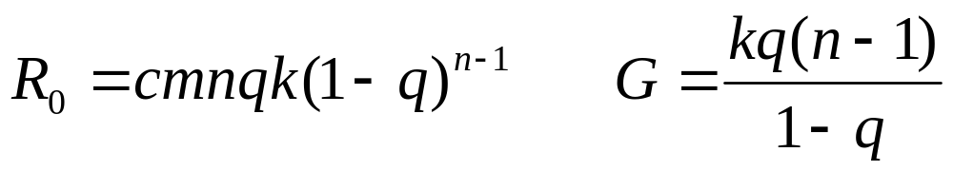
Modular network with stochastic links
Gompertz Aging, i.e. Biological Aging
?
?
?
?
Modular network with
stochastic links
?
?
?
?
?
?
A reliability model
with defects
?
?
?
?
?
?
m: the number of modules
n: the number of links per essential gene (essential module)
k: exponential decay rate (constant aging rate)
q: the chance of a link to be functional ( q = avg func links/ n)
c: a normalization constant

Slide 35
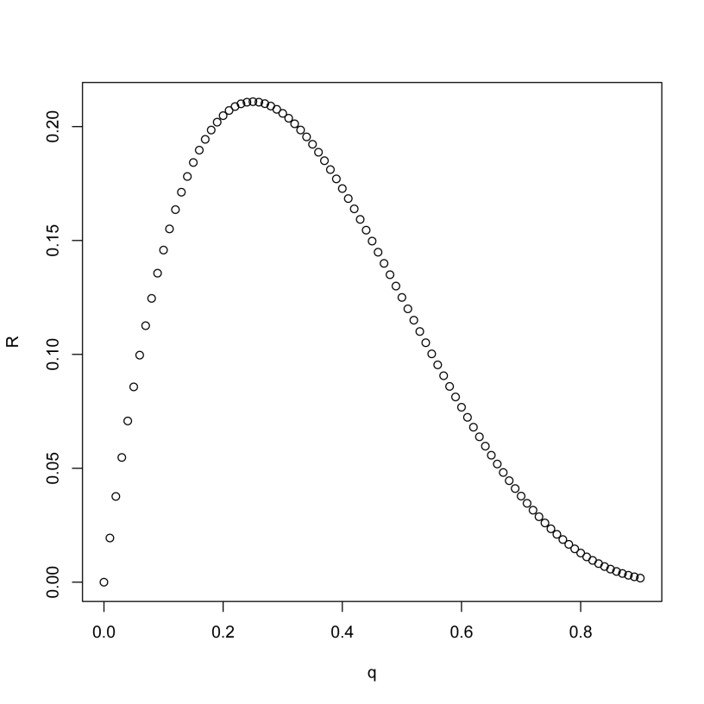
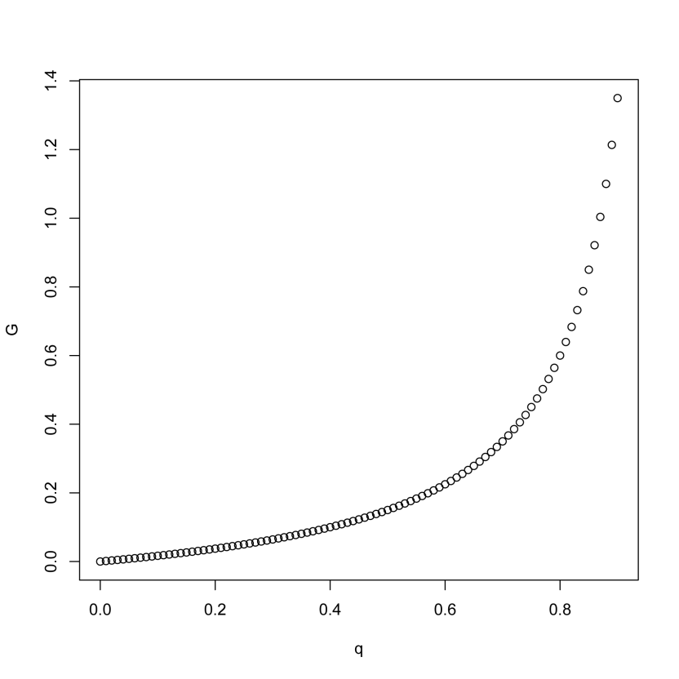
Robustness on R₀ and G
Notes:
For my Tg/C results, R0 is negatively correlated. But G is not significantly correlated in partial regression. I need more data. So Kaberlein’s data is really a geneous gift to me. I can measure the oxidative tolerance of these strains, or mutational tolerance Tg/Tc of these strains.

Slide 36
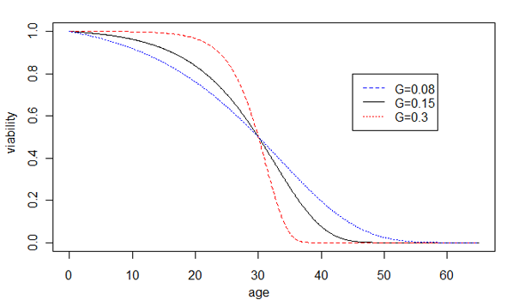
Prediction of the network model of cellular aging
Increased robustness
Decreased robustness
Notes:
Prediction of our hypothesis, the effect of network robustness on the rate of aging G, is shown by changes of the Gompertz survival curves. Increased robustness leads to larger G and faster aging, shown by the sharper transition of the dying off phase, whereas decreased robustness leads to smaller G and slower aging, shown by the slower dying off phase. For illustration purposes, the average life spans are unchanged.

Slide 37
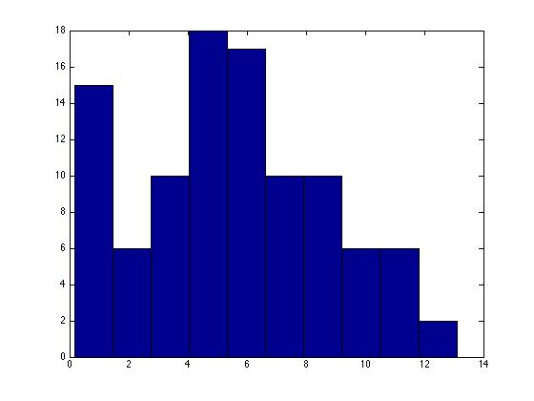
CV of Poisson

Slide 38
Conclusion

Slide 40
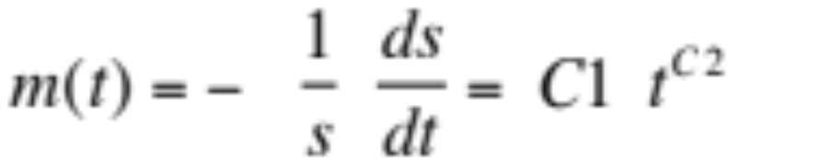
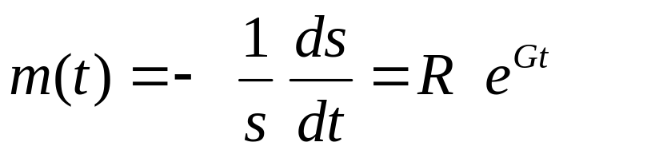
Biological aging versus Machine Aging
Machine Aging
Biological Aging
where m(t) is the mortality rate, s is viability, and t is time. C1, C2, R₀, G are constants. Mortality rate increase as a power function in machine aging versus a exponential function in biological aging .
(Garilov & Gavilova 2001)

Slide 41
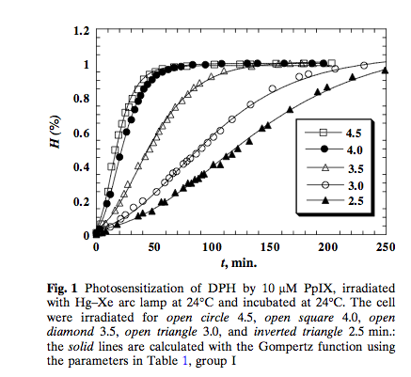

Slide 42
GRAPH of RBC following Gompertz model
Move the end for Q&A

Slide 44
A general theoretic framework for cellular aging
Cellular aging is an emergent property of gene/protein networks

Slide 45


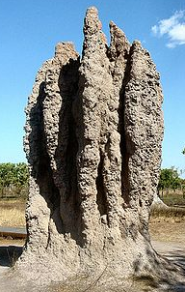
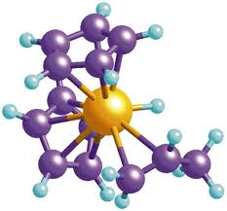
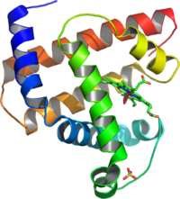
What is an emergent property?
Often loosely refers to the property arising at higher levels as a result of interaction at a low level.
A still debatable concept.
Many examples
Notes:
http://en.wikipedia.org/wiki/Emergent_property
Termite castle
Shoal of fishes

Slide 46
A gene/protein network model of cellular aging
An essential gene
with four connections
A reliability model
with four parallel pathways

Slide 47
The reliability theory of aging
Aging systems (Machines):
  Age-dependent increase of risk to die
Non-aging systems (Radioactive isotopes) :
  Age-independent increase of risk to die
Parallel connection of non-aging components can lead to aging systems.
Gavrilov & Gavrilova, 2001 JTB
Notes:
Move to Q&A

Slide 48
The key of modeling in biology is how to model the phenotype.
The key phenotype for modeling aging is death.
How can we model aging using networks?

Slide 49
