Slide 1




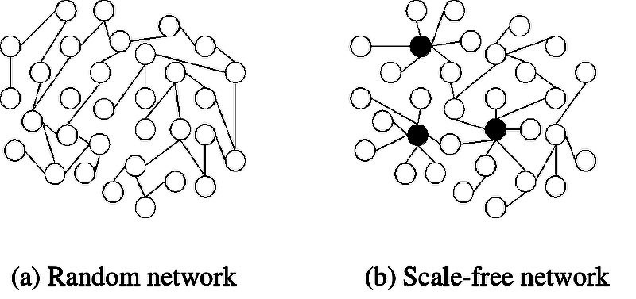
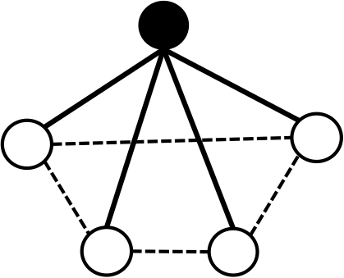
Network configuration and AGING
Palpasa Manandhar, Hong Qin
Mathematics Deparment, Biology Department, Spelman College, Atlanta, GA 30314
Abstract
Aging can be quantitatively defined as the increasing risk of dying over time. A key distinction between biological and non-biological aging is the dynamics of the aging process. Increasing rate of mortality over time follows exponential function in biological aging versus Weibull functions in non-biological aging. Cellular aging can be studied through the reliability framework based on gene networks. Here, we study the influence of network configurations on the dynamics of aging process. We compare three types of networks – networks with degree distributions of constants (lattice network), Poisson distribution and power-law distribution. We then evaluate the heterogeneity of the aging process using the coefficient of variation (CV). Preliminary results show that CV of the aging process in lattice networks with constant connecting degrees is higher than networks with Poisson distributed degrees, suggesting that Poisson networks are more robust for aging than lattice networks. This somewhat counter-intuitive finding suggests an important role of randomness in the emergence of aging from gene networks.
Pathway based reliability model with non-aging components
Power law network
μ
Viability, , for each i
Lifespan of each module block = Maximum ( )
Heterogeneity plays a key role in biological aging.
Key source of heterogeneity: Power law
μ
μ
μ
(Power Law Network)
Assumption: Links between modules do not affect aging
(Modules are independent)
Lifespan of each module = Maximum viability of each gene
Lifespan of the system = Minimum viability of the modules
Lifespan of the system =
Minimum (lifespan of the modules)
System
Biological aging versus Machine Aging
where m(t) is the mortality rate, s is viability, and t is time. C1, C2, R₀, G are constants. Mortality rate increase as a power function in machine aging versus a exponential function in biological aging
(Garilov & Gavilova 2001)
A network with stochastic links in modules
Summary
Cellular aging is an emergent property of the proposed model gene network.
Stochastic heterogeneity of gene networks influences the dynamics of the aging process.
The rate of aging, as measured by the Gompertz coefficient, is proportional to the robustness of gene network.
Virus aging
(Radioactive isotope decay)
Machine Aging
(Weibull Model)
Cell-1
Rationale for stochastic links
Cellular process is a dynamic process
Limited number of protein molecules and the stereo-hindrance effect.
Spatial restrictions
Random choices
Biological Aging
(Gompertz Model)
Cell-2
If Non-Aging
(Exponential Decay)
Cell-3
Acknowledgement
Spelman Math RAMP (Research & Mentoring Program)
NSF Award 1022294
Spelman RIMI Seed grant
FHCRC summer residence support
Gompertzian Aging in a network with stochastic modules
Implication: ➔
Models for aging
Basic Model: Poisson Random Network
Biological Network: Power Law Distribution
?
?
?
?
?
?
?
?
References
L. A. GAVRILOV and N. S. GAVRILOVA. The reliability theory of aging and longevity. Journal of Theoretical Biology, 213(4):527- 545, 2001.
B. Gompertz. On the nature of the function expressive of the law of human mortality and on a new mode of determining life contingencies. Philos. Trans. Roy. Soc. Lond. A, 115:513-585, 1825.
L. M. Leemis. Reliability: Probabilistic models and statistical methods. Lawrence Leemis, 2009.
H. Qin and M. Lu. Natural variation in replicative and chronological life spans of Saccharomyces cerevisiae. Exp. Gerontol.,41:448-456, Apr 2006.
H. Qin, M. Lu, and D. S. Goldfarb. Genomic instability is associated with natural life span variation in Saccharomyces cerevisiae. PLoS ONE, 3:e2670, 2008.
Barchase, Albert, 1999. Science.
Viability of each component is non-aging
No. of components (n 4)
Fit to Gompertz model which represents the cdf
Can use Coefficient of variation, CV =
representing the pdf
m: the number of modules
n: the number of links per essential gene (essential module)
k: exponential decay rate (constant aging rate)
q: the chance of a link to be functional ( q = avg func links/ n)
c: a normalization constant
μ
Essential gene
Large G ➔ Strong robustness ➔
More homogeneity➔
Small spread➔ Small CV
A module
μ
➔
gene
μ
μ
Gene interaction

