Slide 1
Influence of network topology on cellular aging.
Brittany Jackson
Spelman College, Atlanta, GA, U.S.A.
April 11, 2014
Notes:
Goodmorning! I hope everyone is doing well. My name is Lindsay Parnell and my talk focuses on the relationship between oxidative stress and biological aging.

Slide 2
Motivation of the study (background)
Yeast cell of a model for cellular aging.
Gene network and cellular aging.
Human aging and machine aging.

Slide 3
Specific Aim: Compare aging dynamics in random gene works and the original gene network.
A figure here.

Slide 4
Hypothesis and Experimental Design
H₂O₂
We hypothesized that if we can increase ROS than we can increase Loss of Heterozygosity (LOH).
Oxygen
+
Our objective is to compare the H₂O₂ dose-response curves of LOH and viability with the viability change in normal aging.
Inhibition in SOD activity
Respiratory metabolism
Glucose
ROS
DNA
Protein, lipids, organelles
DNA repair mechanism
(Homologous
Recombination)
Increased LOH
Drop in viability

Slide 5
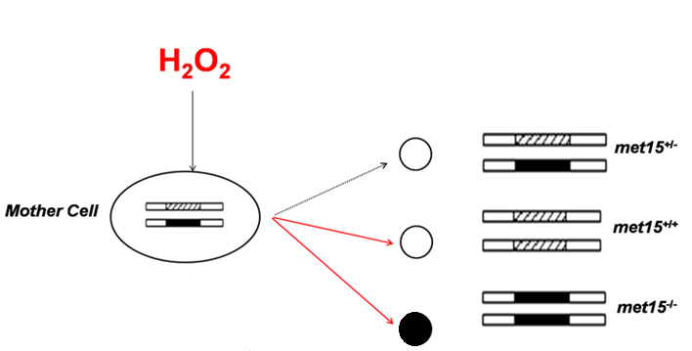
Experimental Design: Using LOH to detect genomic instability
Induces DNA damage
Unchanged genotype
Homozygous dominant genotype
Homozygous recessive genotype
LOH
No LOH
Notes:
Strains use had a heterozygous MET15 locus. When H2O2 was introduced externally, three possible genotypes could have resulted in the mother cell 1) in which the genotype would have remained unchanged from the parental genotype and we would have seen white colonies. A second outcome would involve the alteration of one allele, forming a homozygous dominant genotype. We would have also seen white colonies. 3) an allele would have been altered, forming a homozygous recessive genotype. In which we would have seen black colonies.
Cut off half-black part
*There is no wild-type control because every strain is a mutant. There is parental control.

Slide 6
Experimental Procedure
H₂O₂
Concentration
0%
0.005%
0.01%
0.025%
0.05%
0.075%
0.1%
0.15%
0.2%
0.3%
Pb²⁺containing plates
MET15-/- colonies their black color
Notes:
Cells were cultured and treated with increasing dosages of H2O2. Each H2O2 treated sample were plated in triplicates on Pb2+ contain

Slide 7
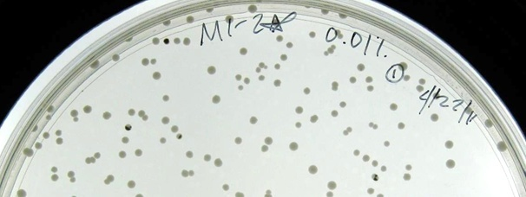
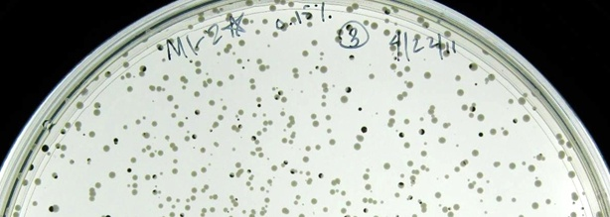
Colonies formed following H₂O₂ treatment on lead-containing MLA plates
M1-2* (0.01% H₂O₂)
Fully black colonies (indicate LOH in mother cells)
M1-2* (0.01% H₂O₂)

Slide 8
Viability and LOH during H₂O₂ treatment.

Slide 9
Contrasting patterns of age and H₂O₂ induced LOH.

Slide 10
Trade-off between RLS and tolerance to H₂O₂ induced genomic instability.

Slide 11
Mitotic asymmetry correlates with H₂O₂ induced genomic instability.
Better
Asymmetry
Poor
Asymmetry

Slide 12
Summary of Major Conclusions
There is a contrasting switching pattern of H₂O₂ and chronological aging on LOH
ROS damage on DNA must be suppressed during normal aging.
Trade off between replicative lifespan and tolerance to H2O2 induced LOH.
There is a significant correlation between RLS and tolerance to H2O2 induced LOH.
Cells with better mitotic asymmetry have a longer lifespan and better H₂O₂ viability tolerance.
Notes:
Suppressed: mechanism to keep ROS from causing substantial damage.

Slide 13
Acknowledgements
Lab Technicians: Erin Jackson, Jenney Rodrigues, Nilin Gupta
Lab Undergraduate: Megan Magee, Meaghan Parker, Brittany Wilson, Dominque Parker, Alisa Caliman
Funding: National Science Foundation (Grant #1022294)

Slide 15
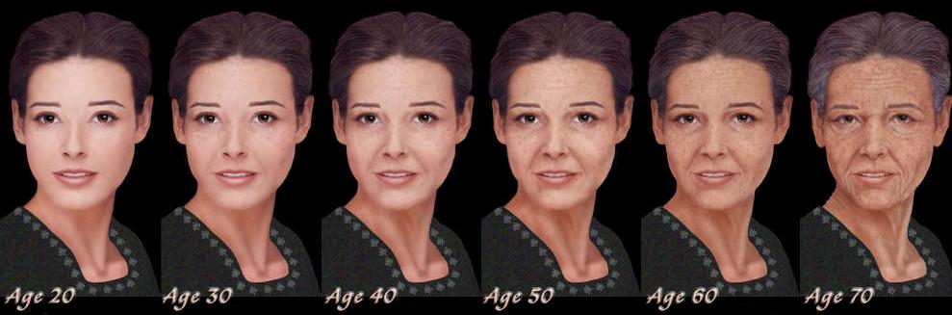
The Concept of Biological Aging
Biological aging can be defined increased chances of dying over time
Consequences of Aging
Decreased fitness and functions and increased chances of diseases
Decreased genome integrity
Cellular aging is the basis of physiological aging.
Saccharomyces cerevisiae is a model for cellular aging
Notes:
Things to add
-at the population level.
-feature exhibited by all eukaryotic organisms

Slide 16
S. cerevisiae is an Ideal Model for Studying Cellular Mechanisms of Human Aging
Aging is a conserved fundamental biological phenomenon
Most of the known genes related to lifespan are conserved in both humans and yeast (ex. Tor1, Sir2)
Calorie restriction (CR) can extend lifespan in yeast, humans, and many other organisms
Caloric intake15% less than average extended lifespan (Wilcox 2004).

Slide 17
Reactive Oxygen Species (ROS) are Accepted Mechanistic Causes of Aging
H₂O₂
Oxygen
+
Superoxide dismutase (SOD)
Food
Respiratory metabolism
ROS
Macromolecule Damage (DNA, Protein, RNA,
AGING
Cancer
Heart Disease
Increase in probability of developing age-related diseases
Alzheimer’s Disease
Based on Weinberger et al. 2010
Notes:
ROS are natural by-products of respiratory metabolic break-down of food. There is an endogenous level of ROS in the cell (point to diagram). Cells naturally convert superoxides to H2O2 as a defense mechanism. Damages cause by ROS can accumulate over time and is considered to be an accepted cause .
*By experimentally raising H2O2 levels we can inhibit SOD (superoxide dimutases) and reverse the flow of that reaction so that ROS levels are increased. This will reduce genome integrity and cell viability.

Slide 18
Previous Results
Age-dependent change of LOH in yeast shows that an increase in genomic instability occurs after a drop in viability (Qin et. al 2008).
Based on the biological survival curve in yeast
Figure Legend
Increase in genomic instability (Tg)
Decrease in viability (Tc)
Notes:
Genomic instability can be measured by loss of heterozygosity on a specific locus. Previous results reported by Qin et. al in 2008 showed that in normal aging, decrease in viability shown by the blue line precedes an increase in genomic instability.
Increase in genome instability (increase in LOH/black colonies) occurs after a drop in viability (measured by CLS)

Slide 19
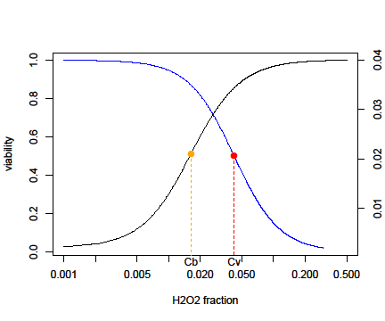
Contrasting Switching Pattern of H₂O₂ and Chronological Aging on LOH
ROS damage on DNA
must be suppressed during normal aging
Notes:
What you see here is a comparison between the biological survival curve represented by the gray bars and the H2O2 dose response curve represented by the black bars. The black bars represent to the Cb/Cv ratio of the H2O2 dose-response curve. Cb represents mid concentration of black colonies; Cv represents the mid viability. A smaller ratio indicates an increase in LOH generally comes before a drop in viability.
In contrast gray bars represent previously reported results that showing that a decline in genomic integrity (increasing LOH) occurs after a drop in viability, in which case we see larger ratios.

Slide 20
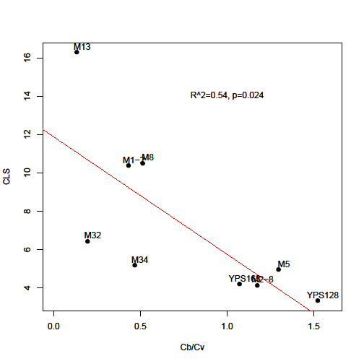
Genome tolerance (C_{b}) and viability tolerance (C_{v}) to H₂O₂ induction co-varies.
Cells with higher tolerance to H₂O₂ have longer CLS

Slide 21
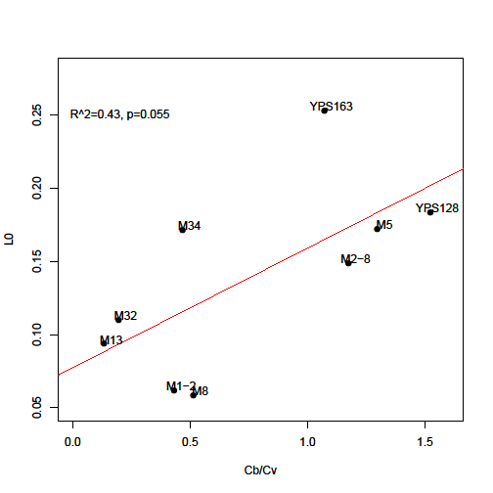
There is a significant correlation between CLS and the relative timing of the H₂O₂ trigger on LOH
Cells with better tolerance to H₂O₂ induced DNA damage have weaker mitotic asymmetry – a tradeoff!
Notes:
Daughter cells have lower LOH, mother cells have higher LOH
Sacrifice taken by the parental generation, if not species couldn’t continue.

Slide 22
Future Directions
Use paraquats or menadione to induce superoxide directly.
Measure hydrogen peroxide and paraquats using fluorescent probe
Compare with CR and Rapamycin treatment.
Test gene deletion mutants with hydrogen peroxide (ex. SOD)
Notes:
(not easy to work with because it is unstable in water)
(hydrophobic)
(measures superoxide levels directly).

Slide 23
References
(1) Yu, S., X. E. Zhang et al. (2011). “Compromised cellular responses to DNA damage accelerate chronological aging by incurring cell wall fragility in Saccharomyces cerevisiae.” Mol Biol Rep 39(4): 3573-3583.
(2) Rahman, K. (2007). “Studies on free radicals, antioxidants, and co-factors.” Clin Interv Aging 2(2): 219–236.
(4) McMurray, M.A., D.E. Gottschling (2004). “Aging and genetic instability in yeast.” Curr Opin Microbiol 7(6): 673-679.
(5) Gravel, S., S.P. Jackson (2003). “Increased genome instability in aging yeast.” Cell 115(1): 1-2.
(3) Qin, H., M. Lu, et al. (2008). “Genomic instability is associated with natural life span variation in Saccharomyces cerevisiae.” PLoS One 3(7): e2670.
(6) Park, P.U. (1998). “DNA repair and Genomic Instability in Aging Yeast.” →Curr Opin Microbiol. 1: 707-711.
(7) Mortimer, R.K. and J.R. Johnston (1959). Lifespan in individual yeast cells. Nature.183: 1751-1752.
(8) Qin H, Lu M (2006) Natural variation in replicative and chronological life spans of Saccharomyces cerevisiae. Exp Gerontol 41: 448–456.
(9) Cost GJ, Boeke JD (1996) A useful colony colour phenotype associated with the yeast selectable/counter-selectable marker MET15. Yeast 12: 939–941.
(10)Wilcox (2004).
(11) Weinberger M, A Mesquita, T Carroll, L Marks, H Yuang, Z Zhang, P Ludovico, W.C. Burhans. (2010) Growth signaling promotes chronological aging in budding yeast by inducing superoxide anions that inhibit quiescence. Aging. 2(10): 709-726.

Slide 24

Notes:
Why use days for tg/tc and H2O2 fraction (on x-axis)?

Slide 26
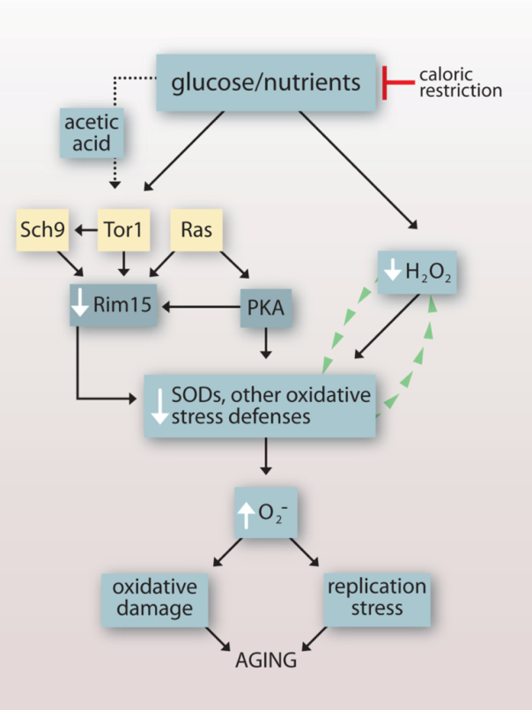
Back-Up Slides for Q&A Session
Mechanism of SOD-catalyzed Dismutation
M^{(n+1)+}-SOD + O₂⁻ → M^{n+}-SOD + O₂
M^{n+}-SOD + O₂⁻ + 2H⁺ → M^{(n+1)+}-SOD + H₂O₂.
Based on Weinberger et al. (2010)
Intracellular level of H₂O₂
already exists in cells.
Treating cells with H₂O₂, quickly
Increases the level of intracellular
H₂O₂
Increasing the level of H₂O₂ will
decrease the activity of SOD.
This decrease increases superoxide
production

Slide 27
Saccharomyces Cerevisiae Strains
Strain | Description | Source
101S* Met15^{+/-} | 101S (Parental Strain ) | Qin et. al 2008
M8* Met15^{+/-} | M8 (Parental Strain) | Qin et. al 2008
M5* Met15^{+/-} | M5 (Parental Strain) | Qin et. al 2008
M34* Met15^{+/-} | M34 (Parental Strain) | Qin et. al 2008
YPS163* Met15^{+/-} | YPS163 (Parental Strain) | Qin et. al 2008
M2-8* Met15^{+/-} | M2-8 (Parental Strain) | Qin et. al 2008
YPS128* Met15^{+/-} | YPS128 (Parental Strain) | Qin et. al 2008
M13* Met15^{+/-} | M13 (Parental Strain) | Qin et. al 2008
M1-2* Met15^{+/-} | M1-2 (Parental Strain) | Qin et. al 2008
M32* Met15^{+/-} | M32 (Parental Strain) | Qin et. al 2008

Slide 28
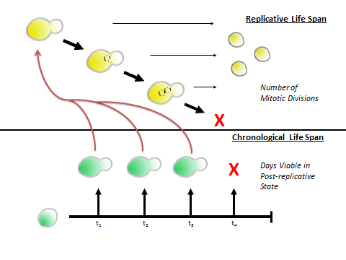
Lifespan in Saccharomyces Cerevisiae
Undergo asexual reproduction via budding.
There are two ways the age is measured in S. cerevisiae
Replicative lifespan
Quantifies the number of times a cell can undergo the cell cycle.
Chronological lifespan
Quantifies amount of time a single mother cell requires to stop replication.
Notes:
Distinguish mother cell and daughter cell.

Slide 29
PB2+-Containing Plates form Black colonies
Excess H₂S was generated as a result of alteration of MET15 locus in response to induced oxidative stress.
The interaction of H₂S with Pb²⁺ on MLA plates formed PbS, which gave colonies their black color.

Slide 30
TOR 1 and SIR2
Back-up
Tor1: nutrient sensing pathways
Sir2: gene silencing and chromatin structure regulation

