Slide 1


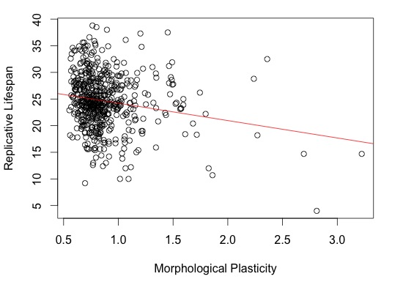
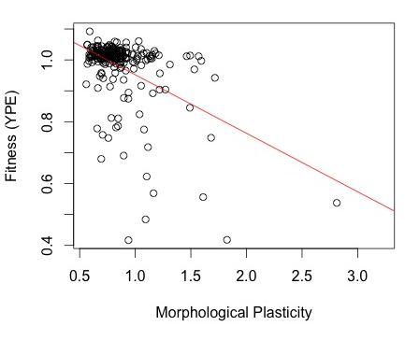
Effect of Network Robustness on Cellular Aging Amanda Alexander, Charita Montgomery and Dr. Hong Qin
Mathematics and Biology Department, Spelman College, Atlanta, GA 30314
ABSTRACT:
This study explored the interconnection between cellular aging and network robustness in yeast Saccharomyces cerevisiae. Replicative lifespan (RLS) served as a measure for yeast aging. We sought to determine the correlation between RLS and several proxies of robustness including: the number of protein interactions, the number of genetic interactions, evolutionary distance, fitness, and morphological plasticity. We hypothesized that a gene’s role in robustness is associated with its role in cellular aging, thus we expected a strong connection between RLS and several proxies of network robustness. Using linear regression analysis it was found that the robustness components (specifically fitness and morphological plasticity) displayed a strong correlation with RLS and thus cellular aging.
INTRODUCTION:
Cellular aging has been a highly biologically debated topic for decades. Previous research has identified the yeast S. cerevisiae as an advantageous model for aging research. Determining causes of cellular aging in yeast is an important topic of study because it can lead directly to identifying the causes of cellular aging in humans and other higher mammals. Yeast aging can be measured by examining replicative life span (RLS). Previous research conducted by Dr. Hong Qin has provided evidence that phenotypic capacitors influence network robustness, suggesting that robustness is a contributing factor for cellular aging. Robustness is the ability of a cell to maintain homeostasis throughout environmental changes and mutations, such as temperature, time, and cellular damage.
RESULTS:
SUMMARY:
CONCLUSION:
Based on our results, we were able to conclude that:
Fitness (YPE) and Morphological Plasticity both have a strong and direct correlation to Replicative Lifespan and to each other.
The number of protein interactions and the number of genetic interactions is directly related to fitness (YPE)
There is a correlation between evolutionary distance and the number of protein interactions
There is a significant correlation between the number of protein interactions and morphological plasticity.
Replicative Lifespan
Figure 1: The Alternative Hypothesis Model for the tested robustness factors to Replicative Lifespan.
Figure 2: Fitness is directly related to the Replicative lifespan in the yeast S. cerevisiae (p=0.0001084).
Protein Interactions
Genetic Interactions
Genetic Interactions
Fitness (YPE)
Morphological Plasticity
Replicative Lifespan
Evolutionary Distance
Replicative Lifespan
Morphological Plasticity
Evolutionary Distance
Protein Interactions
Figure 5: Our results revealed the above correlations between the robustness proxies and replicative lifespan.
Fitness (YPE)
Fitness (YPE)
Figure 3: Replicative Lifespan is negatively related to morphological plasticity robustness (p=1.349x10⁻⁵).
Figure 4: Fitness is negatively related to fitness robustness (p=2.263x10⁻¹³).
Replicative Lifespan
Fitness (YPE)
Morphological Plasticity
Morphological Plasticity
MATERIALS & METHODS:
We performed a regression analysis to compare the different robustness proxies to cellular aging (replicative lifespan). These results were each plotted for further analysis.
The analyzed data for morphological plasticity came from the saccharomyces cerevisiae morphology database (SCMD). RLS data was obtained from the Kaeberlin group.
The standard deviation and coefficient of variation of the morphological plasticity data set were calculated because they are proportional to the robustness of the cell.
All of the regression test and plots were conducted using the computer program R 2.15.1.
The p and R squared values were analyzed to determine the significant relationships.
ACKNOWLEDGEMENTS:
We would like to thank the Spelman College Math RaMP, NSF, and Dr. Hong Qin.
REFERENCES:
Fraser, H.B., A.E. Hirsh, L.M. Steinmetz, C. Scharfeand and M.W. Feldman.2002. Science Magazine, 296:750-752.
Fu, X., F. Meng, Y. Hu, and J. Zhou. 2008. Aging Cell, 7(5): 746-757.
Fabrizio, P., V.D. Longo, Aging Cell, 2(2):73-81
Kaeberlein, M., C.R. Burtner, B.K. Kennedy. PLoS Genet, 3(5):84

