Slide 1

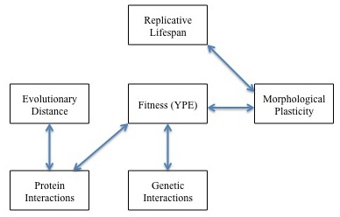
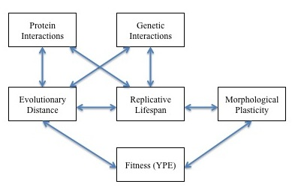
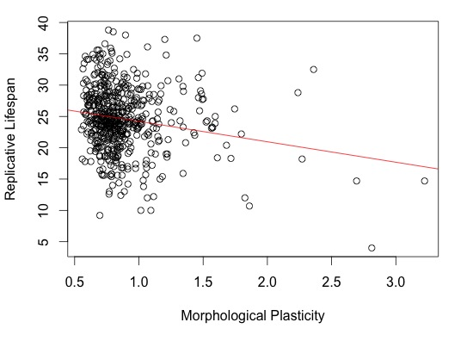
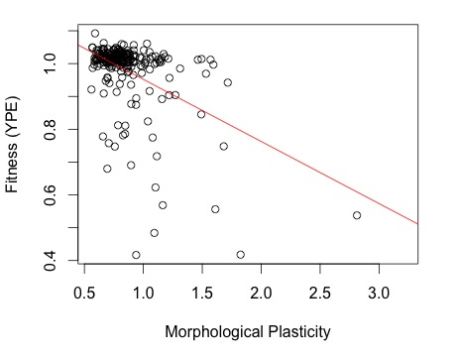
Effect of Network Robustness on Cellular Aging Amanda Alexander, Charita Montgomery and Dr. Hong Qin
Mathematics and Biology Department, Spelman College, Atlanta, GA 30314
Spelman College
ABSTRACT:
In this study the interconnection between cellular aging and network robustness in the yeast S. cerevisiae was examined . We hypothesized that there would be significant correlations between replicative lifespan (RLS) and several proxies of network robustness. We evaluated the causal interactions of network connectivity, coefficient of variations of gene expression, evolutionary distance, fitness, morphological plasticity, and replicative lifespan using linear regression analysis. The results of the partial linear regression tests were plotted for further analysis. The results showed that the robustness factors: number or protein interactions, number of genetic interactions evolutionary distance and protein fitness directly affect celluar aging in S. Cerevisiae proteins.
INTRODUCTION: (revise this!!!)
Cellular aging has been a highly biologically debated topic for decades. It has been suggested that the evolution of prokaryotes and eukaryotes is the cause for the initiation of aging in asymmetric dividing cells. Earlier research studies have shown that the yeast Saccharomyces cerevisiae is the best model to use when testing cellular aging. Yeast aging can be measured in two ways: replicative life span (RLS) and chronological life span (CLS)(Qin, 2010). Previous research conducted by Dr. Hong Qin has provided the evidence that phenotypic capacitors influence network robustness suggesting that protein network robustness is a contributing factor for cellular aging. Robustness is the ability of a cell to maintain homeostasis throughout environmental changes and mutations, such as temperature, time, and cellular damage.
RESULTS:
SUMMARY:
Figure 5: Our results revealed the above correlations between the robustness proxies and replicative lifespan.
CONCLUSION:
Based on our results, we were able to conclude that:
Fitness (YPE) is directly related to Replicative Lifespan
Morphological plasticity directly affects the Replicative Lifespan.
The number of protein interactions and the number of genetic interactions is directly related to fitness (YPE)
There is a correlation between evolutionary distance and the number of protein interactions
Multiple regression analysis showed that evolutionary distance and protein interactions have a strong correlation with fitness.
Figure 1: The Alternative Hypothesis Model for the tested robustness factors to Replicative Lifespan. The hypotheses are as follows:
Figure 2: Fitness is directly related to the Replicative lifespan in the yeast S. cerevisiae (p<0.01).
Figure 3: Replicative Lifespan is negatively related to morphological plasticity robustness (p<0.01).
Figure 4: Fitness is negatively related to fitness robustness (p<0.01).
MATERIALS & METHODS:
We performed a regression analysis to compare the different robustness proxies to cellular aging (replicative lifespan). These results were each plotted for further analysis.
The analyzed data for morphological plasticity came from the saccharomyces cerevisiae morphology database (SCMD). RLS data was obtained from the Kaeberlin group.
The standard deviation and coefficient of variation of the morphological plasticity data set were calculated because they are proportional to the robustness of the cell.
All of the regression test and plots were conducted using the computer program R 2.15.1.
The p and R squared values were analyzed to determine the significant relationships.
ACKNOWLEDGEMENTS:
We would like to thank the Math RaMP, NSF, and Dr. Hong Qin.
REFERENCES:
Fraser, H.B., A.E. Hirsh, L.M. Steinmetz, C. Scharfeand and M.W. Feldman.2002. Science Magazine, 296:750-752.
Fu, X., F. Meng, Y. Hu, and J. Zhou. 2008. Aging Cell, 7(5): 746-757.
Notes:
Changes to be made:
Correct grammar errors in abstract and introduction.
Remove inappropriate statements in abstract.
Conflicted conclusions are found in abstract and Fig 5.
Introduction contain inappropriate statements, wrong citations. The Intro is not smooth.
M & M:
The statement about comp biology is trivial and meaningless.
Statements on p and q are incorrect
Robustness calculation calculation is inappropriate
Figure 1 is incomplete. Fig2, 3,4 lacks R-squared. Fig 3 lacks regression. Regression lines in figures are colored inconsistently.
Figure 5 legend is inappropriate.
Conclusions: Grammar errors, font, and format issues
Inconsistency between morphology robustness to the title of protein network robustness
Ack is inappropriate.
Reference misquoted and inconsistent with the body of the poster.
Need to add a R logo.
Need to add a Spelman CHDRE logo.
Add theory part to introduction about we are doing this. (motivation)

