Slide 1
Studying the Role of Robustness in Cellular Aging
Presented by
Kinnari Matheson & Orrianne Morrison
Biology Department
Spelman College

Slide 2
Overview
Future Directions
Conclusions
Results
Methods
Specific Aims
Hypothesis
Background

Slide 3
Cellular Aging
Aging- the process of progressive deterioration of cellular functions due to modifications of proteins and protein pathways
Reduction in protein activity, specificity, and longevity.
Preliminary research suggests that the rate of cellular aging is proportional to robustness.
Notes:
Cell aging is a product of detrimental protein modifications that lead to consequential inefficiency in associated cellular networks and overall increased sensitivity to stochastic variations.

Slide 4
Robustness
The ability to withstand mutational, environmental or stochastic variation.
Mechanisms of robustness may have developed to protect cells from harmful mutations or environments.
Correlates of robustness – fitness, evolutionary distance, morphological plasticity and degree of protein interactions.

Slide 5


Robustness
Luxury cars provide a much smoother ride that does not make your comfort contingent upon road conditions.
In a vehicle such as a bus, you are totally subject to experience the road as it is- you will be very aware of every pothole you run over.
Notes:
http://classifieds.uplog.org/ads/mercedes-benz-slr-mclaren/
http://www.tirebalancingbeads.com/school-bus-fleet-saves-money-balancing-tires/

Slide 6
Robustness and Cellular Aging
Robustness
Fitness
Degree of protein interactions
Cellular Aging
Replicative lifespan (RLS)
Evolutionary Distance
Morphological plasticity

Slide 7
Gene Networks
Cells have internal networks, gene networks, which allow for the communication of the molecules inside of the cell.
The expression of genes necessary for survival will affect the adaptability of the organism to different environments.
Notes:
Networks regulate the cells response to different environments, which affects the cells ability to adapt.

Slide 8
Hypothesis
Robustness enables cells to withstand environmental, mutational, and stochastic variation and thus will positively correlate with replicative lifespan.

Slide 9
Materials & Methods
Yeast model of cellular aging; clear quantification of aging, easily genetically manipulated.
R statistical programming environment for data analysis.
Linear regression analysis to understand relationships among factors of robustness and replicative lifespan in yeast.
Notes:
Yeast (Kaeberlin 2007)

Slide 10
Significant Relationship between Fitness and Cellular Aging
Comparison |  | Medium | P-value | Multiple R²
RLS | YPD | Dextrose | 0.01499 | 0.02545
RLS | YPDGE | Dextrose + Glucose + Ethanol | 0.01034 | 0.02824
RLS | YPG | Glucose | 0.00366 | 0.03613
RLS | YPE | Ethanol | 0.00011 | 0.06320
RLS | YPL | Lactose | 0.00439 | 0.03474

Slide 11
Significant Relationship between Evolutionary Distance and Cellular Aging
Species 1 | Species 2 | Multiple R² | p - value
S. cerevisiae | S. paradoxus | 0.002773 | 0.3758
S. cerevisiae | S. bayanus | 0.3482 | 0.386

Slide 12
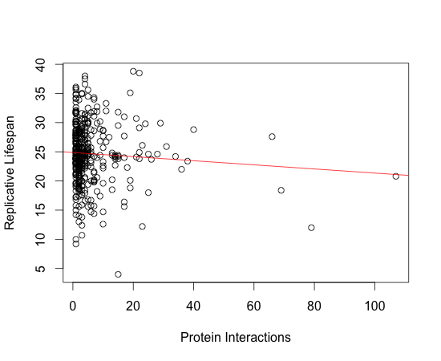
Protein Interactions are not Significantly Correlated with Cellular Aging
p - value =0.1759
R² = 0.004564

Slide 13
Morphological Plasticity : Factored into Cellular Aging and Fitness
Factors in Multiple Regression |  | R² value | P-value
RLS | Morphological Plasticity | 0.03431 | 1.349 x 10⁻⁵
RLS | Evolutionary Distance Fitness Number of Protein Interactions Morphological Plasticity | 0.06907 | 0.2389
Fitness | Number of Protein Interactions Morphological Plasticity Evolutionary Distance | 0.3525 | 2.318 x 10⁻⁷

Slide 14
Summary
The growth fitness in ethanol medium has the strongest correlation with lifespan, suggesting that respiratory metabolism is most informative to lifespan.
There is a significant negative correlation between replicative life span and morphological plasticity, which is inversely correlated with robustness.

Slide 15
A Schematic View
Morphological Plasticity
_
_
+
Robustness
Lifespan
+
Growth Fitness

Slide 16
Conclusion
Significant relationships were established between robustness and replicative lifespan which confirms our hypothesis. Robustness positively correlates with replicative lifespan, suggesting that the robustness increases replicative lifespan.

Slide 17
Future Directions
Perform a permutation analysis of protein deletion mutants to determine the effects on lifespan as a measure the functional similarity between proteins.
Analysis of relationship between robustness and chronological life span

Slide 18
References
Dhami, S. P. S.,N. Mittal, S. C. Janga, and R. Nilanjan, 2011 Comparative analysis of gene expression and regulation of replicative aging associated genes in S. cerevisiae. Molecular BioSystems 7: 403–410.
Nehaniv, C L. Self-replication, evolvability and asynchronicity in stochastic worlds. In Stochastic Algorithms: Foundations and Applications, volume 3777 of Lecture Notes in Computer Science, pages 126–169. Springer, 2005.
Macneil LT, Walhout AJ. Gene regulatory networks and the role of robustness and stochasticity in the control of gene expression. Genome Res. 2011;21:645–657.
Saccharomyces Cerevisiae Morphological Database, 30 Mar. 2005. Web. Apr. 17 2012. http://scmd.gi.k.u-tokyo.ac.jp/datamine/
Gasch AP, Spellman PT, Kao CM. et al. Genomic expression programs in the response of yeast cells to environmental changes. Mol Biol Cell. 2000;11(12):4241–4257.
Costanzo, M., Baryshnikova, A., Bellay, J., et al. The Genetic Landscape of a Cell 22 Jan 2010. Web. 17 Apr 2012. www.sciencemag.org/cgi/content/full/327/5964/425/DC1

Slide 19
Acknowledgements
Dr. Hong Qin, P.I.
Group Members
Robin Levy
Research Day Committee

