Slide 1
Project Review Presentation
Progress as of June 6, 2025
Hongseok Lee

Slide 2
Project Overview
Project Purpose and Objectives
• A static web application for discovering hospitals in Busan.
• Features: dynamic filtering, bilingual support, interactive rating.
• Tech Stack: HTML, CSS, JavaScript (no backend).

Slide 3
System Architecture
High-Level Architecture
• Frontend-only static site.
• Data stored in 'data/hospitals.js' as a JSON-like array.
• Client-side logic in 'script.js' handles filtering, language toggle, and rating functionality.

Slide 4
Code Screenshots
Key Code Sections (Insert screenshots):
• 'script.js': renderCards, event listeners for filters, language toggle, and star-rating logic.
• 'data/hospitals.js': JSON structure for hospital entries with bilingual fields.

Slide 5
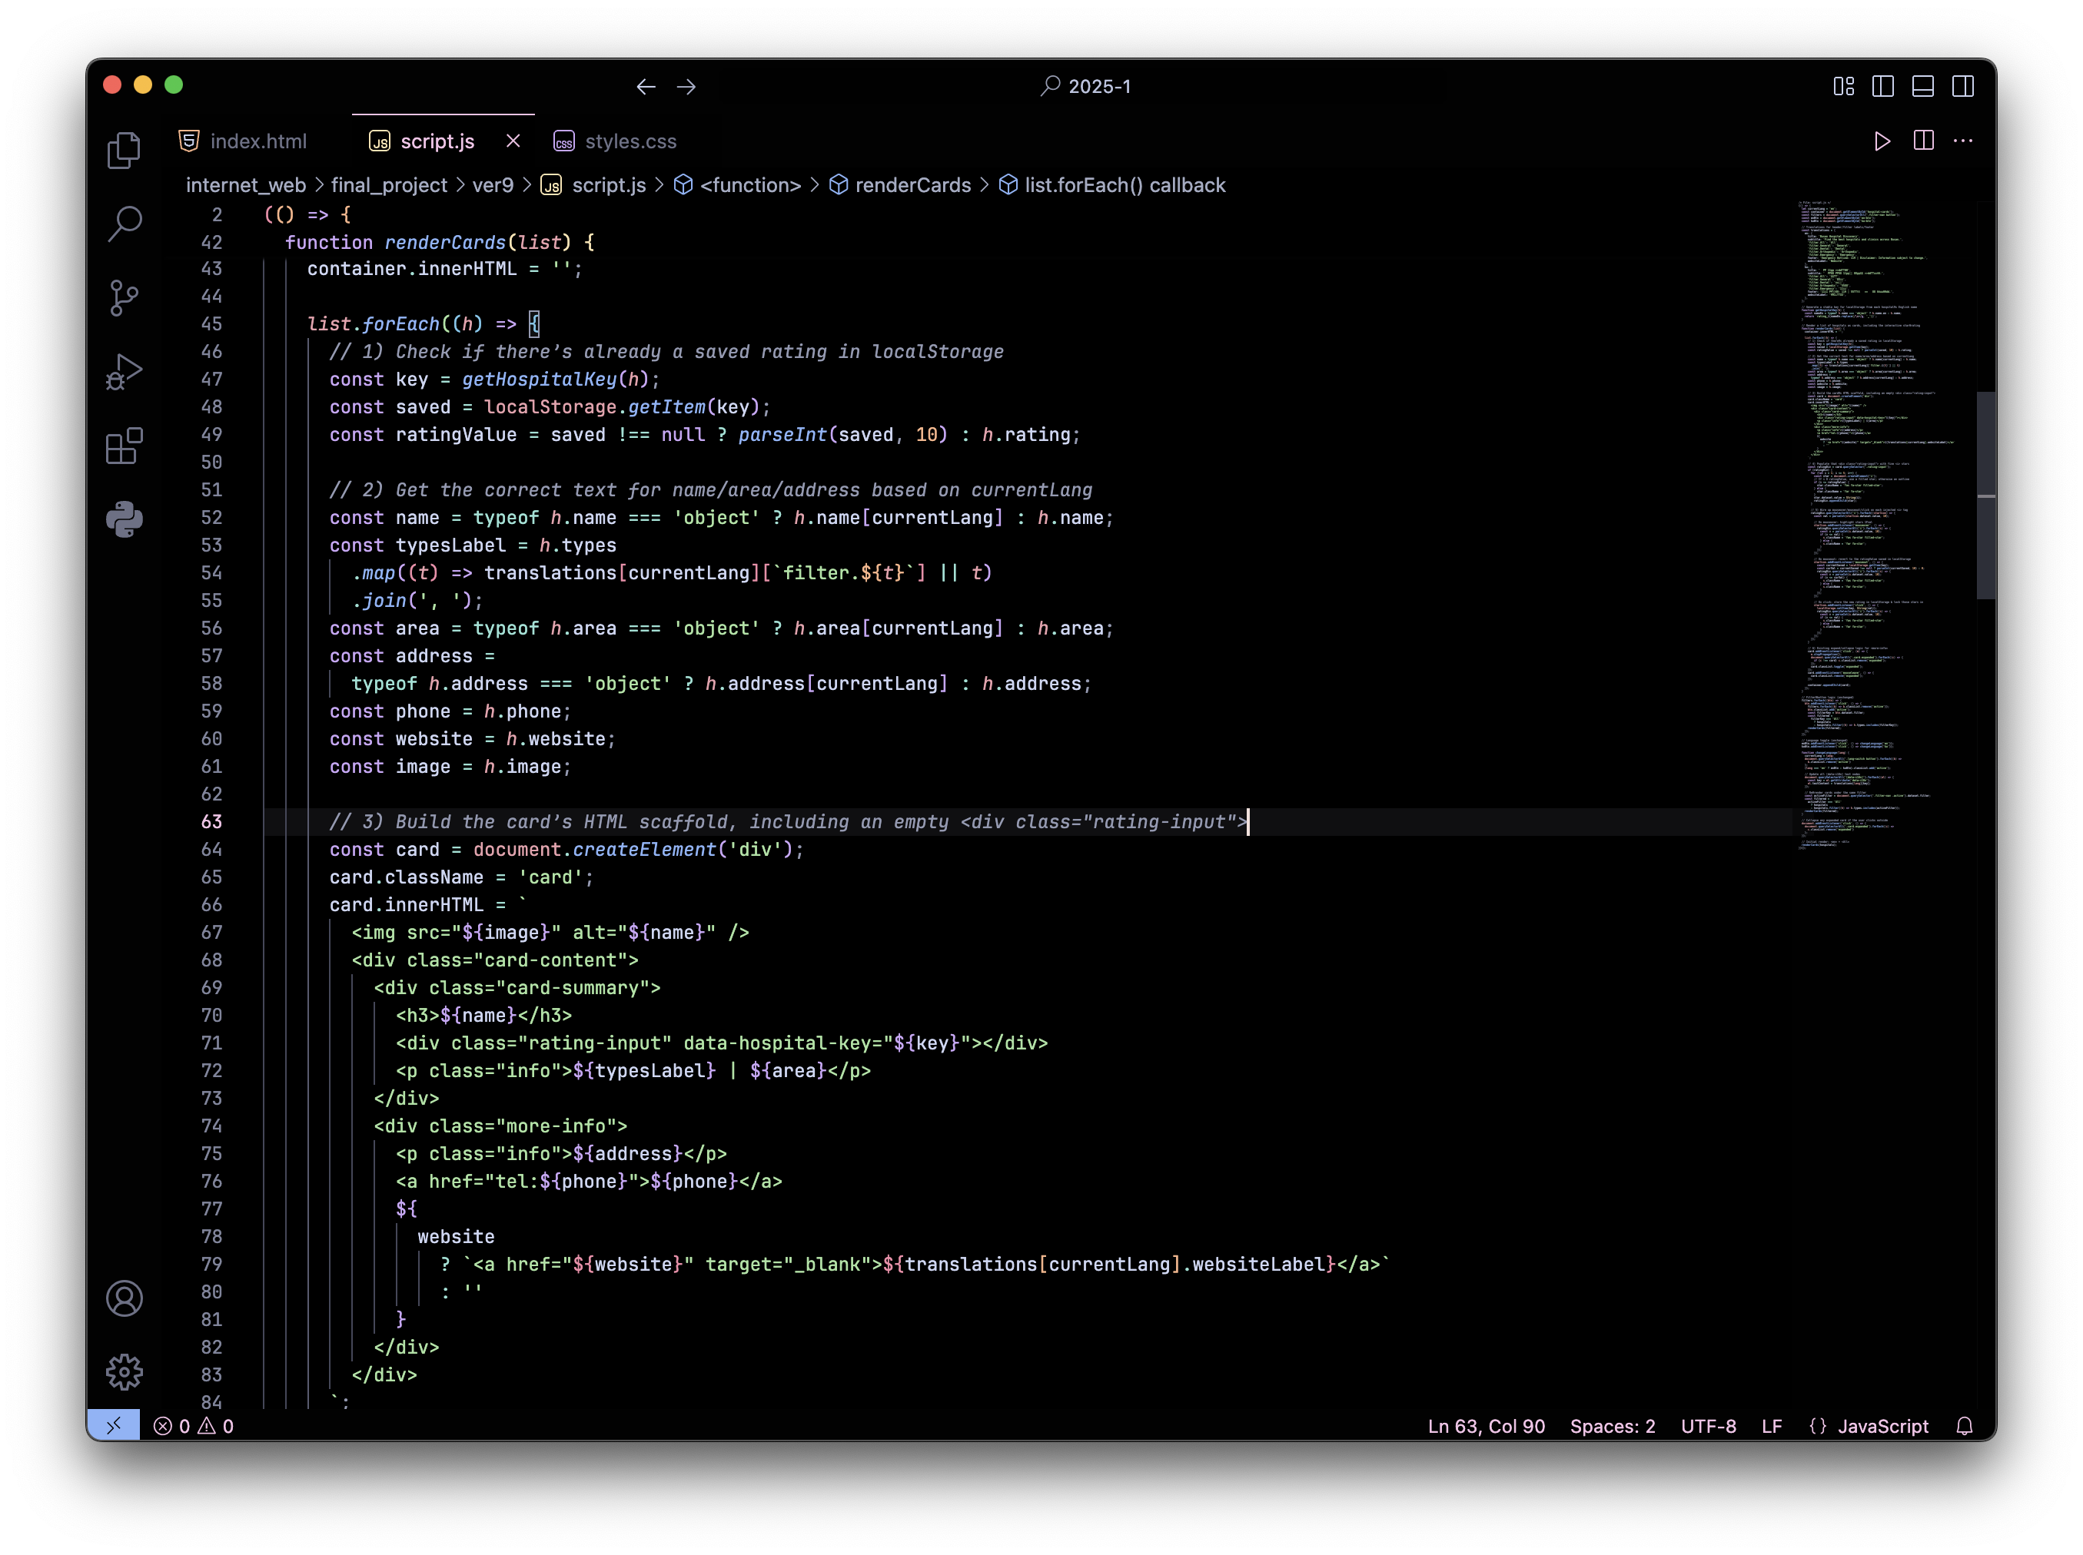
function renderCards

Slide 6
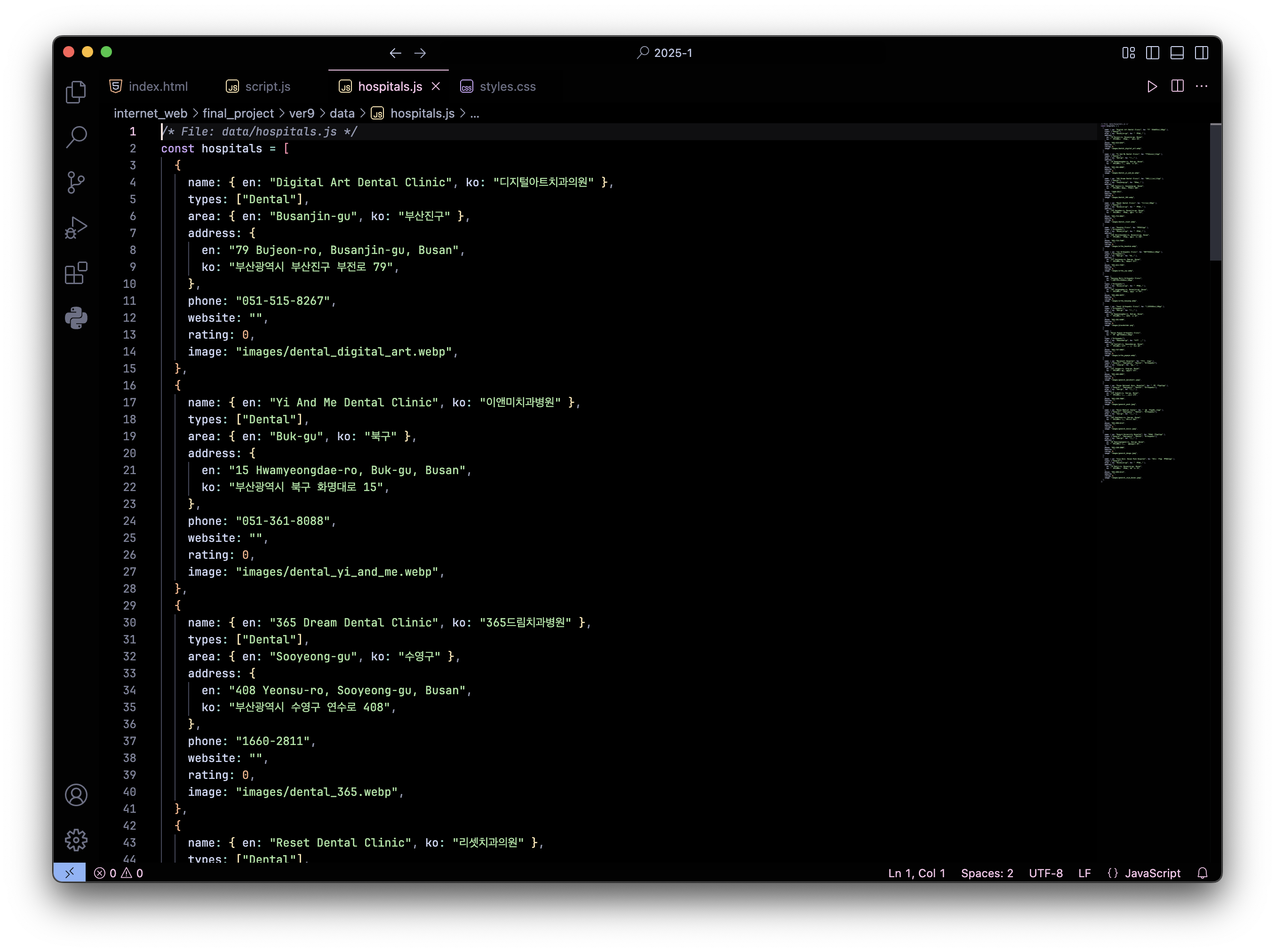
data/hospitals.js

Slide 7
UI Screenshots
User Interface Screenshots (Insert images):
• Homepage with hospital cards grid and filter navigation.
• Expanded card view showing address, phone link, and 'Website' button.

Slide 8
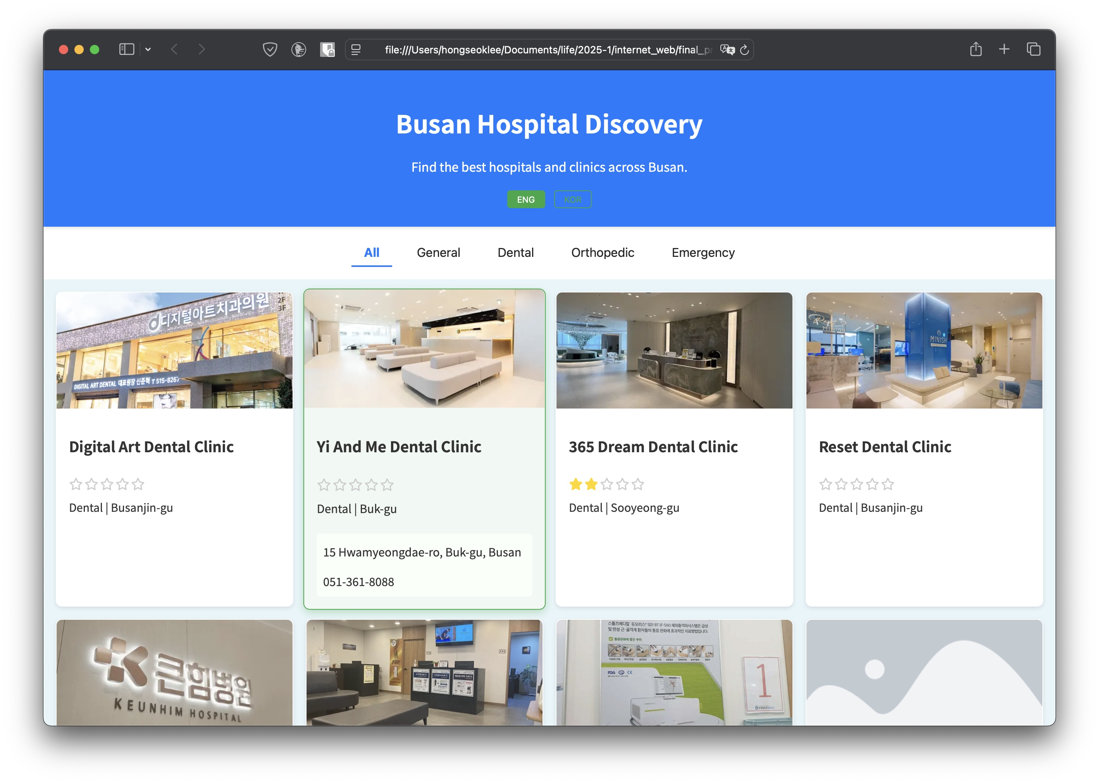
UI Screenshots

Slide 9
Current Progress
Project Completion Status (~75% complete):
• Completed Features:
- Dynamic filtering by hospital type.
- Bilingual support (English/Korean) for UI text.
- Interactive star-rating system using localStorage.
• In-Progress / Remaining:
- Backend integration for persistent ratings.
- Deploy to GitHub Pages or another hosting service.
- Responsive design improvements for mobile.

Slide 10
Technical Challenges & Solutions
Key Challenges Faced
• Implementing interactive star-rating:
- Solution: Dynamically generated <i> elements and mouseover/mouseout event handlers.
• Ensuring bilingual support:
- Solution: Store text fields as objects with 'en' and 'ko' keys and update DOM based on selected language.

Slide 11
Next Steps
Future Work and Enhancements
• Implement backend API for persistent ratings and user data.
• Deploy the application to GitHub Pages or Netlify.
• Improve responsive design for mobile and tablet viewports.

Slide 12
Thank You!
Questions?
Contact: hongseokmlee@pusan.ac.kr

