Slide 1




https://en.wikipedia.org/wiki/Scratch_(programming_language)
What is Scratch?
Scratch is a free visual programming language and online community used by millions of people around the world.
With Scratch, children can create their own interactive stories, then share and discuss their creations with one another. Developed by the Lifelong Kindergarten group at the MIT Media Lab^{[1]} to help children learn to think creatively, reason systematically and work collaboratively.
Scratch is often used in teaching coding, computer science, and computational thinking.
Notes:
Arduino means best friend in italian, In korean best friend is 절친,
Arduino is good platform to learn the programming language and to make some imaginative device.
Arduino is creative tool for making our imagination feasible or to realize.

Slide 2
As of late 2017, there were more than 22 million registered members of the Scratch online community and more than 26 million shared projects, with roughly 25,000 new members and 30,000 new projects every day.
The blocks-based grammar of Scratch has influenced many other programming environments and is now considered a standard for introductory coding experiences for children.
Notes:
Arduino means best friend in italian, In korean best friend is 절친,
Arduino is good platform to learn the programming language and to make some imaginative device.
Arduino is creative tool for making our imagination feasible or to realize.

Slide 3

Origin of name
Scratching is a technique used by disc jockeys to mix music clips together in creative ways and produce different sound effects by manipulating vinyl records on a turntable. Scratch takes its name from this technique, as it lets users mix together different media (including graphics, sound and other programs) in creative ways.
Philosophy
Scratch encourages the sharing, reuse and combination of code. It also gives credit to the participant who built on the original work and to the participant who created the original program.
It is part of a research to design new technologies to enhance learning in after-school centers and other informal education settings, and broaden opportunities for youth from under-represented groups who can become designers and inventors. Scratch was iteratively developed based on ongoing interaction with youth and staff at Computer Clubhouses.
Notes:
Arduino means best friend in italian, In korean best friend is 절친,
Arduino is good platform to learn the programming language and to make some imaginative device.
Arduino is creative tool for making our imagination feasible or to realize.

Slide 4
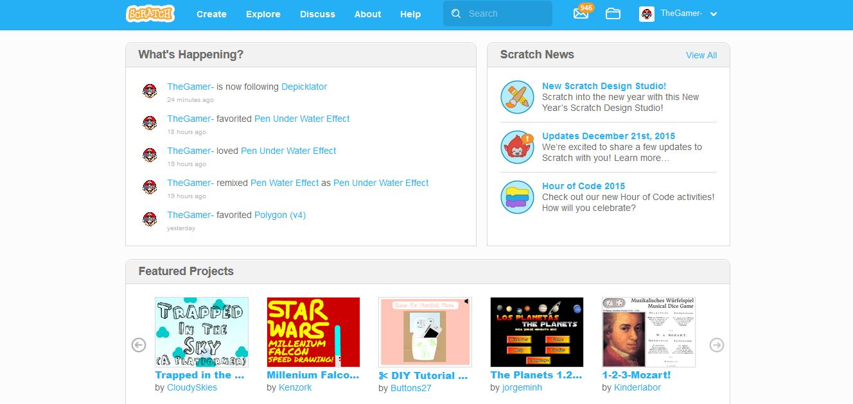
History
The MIT Media Lab's Lifelong Kindergarten group, led by Mitchel Resnick, in partnership with the Montreal-based consulting firm, the Playful Invention Company, co-founded by Brian Silverman and Paula Bonta, together developed the first desktop-only version of Scratch in 2003. Scratch 2 was released on May 9, 2013. With its introduction, custom blocks can be defined within projects. As of 2017, Scratch 2 is available online and as an application for Windows, macOS, Linux (Adobe Air Required).
Notes:
Arduino means best friend in italian, In korean best friend is 절친,
Arduino is good platform to learn the programming language and to make some imaginative device.
Arduino is creative tool for making our imagination feasible or to realize.

Slide 5
https://scratch.mit.edu User interface
From left to right, in the upper left area of the screen, there is a stage area, featuring the results and all sprites thumbnails listed in the bottom area. The stage uses x and y coordinates, with 0, 0 being the stage center. The stage is 480 pixels wide, and 360 pixels tall, x:240 being the far right, x:-240 being the far left, y:180 being the top, and y:-180 being the bottom.
There are many ways to create personal sprites and backgrounds. First, users can draw their own sprite manually with "Paint Editor" provided by Scratch. Second, users can choose a Sprite from the Scratch library that contains default sprite, user's past creations, a picture using a camera, or clip art
Notes:
Arduino means best friend in italian, In korean best friend is 절친,
Arduino is good platform to learn the programming language and to make some imaginative device.
Arduino is creative tool for making our imagination feasible or to realize.

Slide 6
With a sprite selected in the bottom-left area of the screen, blocks of commands can be applied to it by dragging them from the Blocks Palette onto the right area of the screen, containing all the scripts associated with the selected sprite.
Under the Scripts tab, all available blocks are listed and categorized as the Motion, Looks, Sound, Pen, Data, Events, Control, Sensing, Operators, and More Blocks as shown in the table below. Each can also be individually tested under different conditions and parameters via double-click.
Notes:
Arduino means best friend in italian, In korean best friend is 절친,
Arduino is good platform to learn the programming language and to make some imaginative device.
Arduino is creative tool for making our imagination feasible or to realize.

Slide 7
Notes:
Arduino means best friend in italian, In korean best friend is 절친,
Arduino is good platform to learn the programming language and to make some imaginative device.
Arduino is creative tool for making our imagination feasible or to realize.

Slide 8
Besides the Scripts tab, there are two additional tabs, the Costumes tab and the Sounds tab. An expandable bar at the right is Help area.
Next to the Scripts tab, there is the Costumes tab, where users can change the look of the sprite in order to create various effects, including animation. And the last tab is the Sounds tab, where users insert sounds and music to a sprite.
Notes:
Arduino means best friend in italian, In korean best friend is 절친,
Arduino is good platform to learn the programming language and to make some imaginative device.
Arduino is creative tool for making our imagination feasible or to realize.

Slide 9



What is programming?
Make an algorithm to do something in a specific language programming.
● Algorithm: a procedure or formula for solving a problem.
● Programming language: artificial language designed to communicate instructions to a machine.
It also involves the process of designing, writing, testing, debugging, and maintaining the source code of a computer program.
Notes:
At first, Algorithm is very important for making a procedure or formula for solving a problem
Next, we need to know programming. There are so many programming languages such as C, C++, Java, Python, Javascript, PHP, HTML etc.
Of course all programming language has a specific purpose to use it.
As you know, C or C++ are suitable for Engineering Science,
Java is compatible with fields of banking, finance or insurance area,
Javascript is adaptive to the Web browser in helping with NODE.js.
Today, the next 2nd time, I will show you Node.js for Arduino programming through some experiments.

Slide 10



https://github.com/hongsh59/scratch
Notes:
I have a Github accounts as you can see.
There are some Arduino projects.
When you will come back home, If you have any question or need some ideas.
Please contact me,
Email --- hongsh@seoil.ac.kr

Slide 11




Q/A & Have a Good Time!!

Slide 12

References
https://en.wikipedia.org/wiki/Scratch_(programming_language)
https://github.com/hongsh59/scratch
hongsh@seoil.ac.kr

