Slide 1
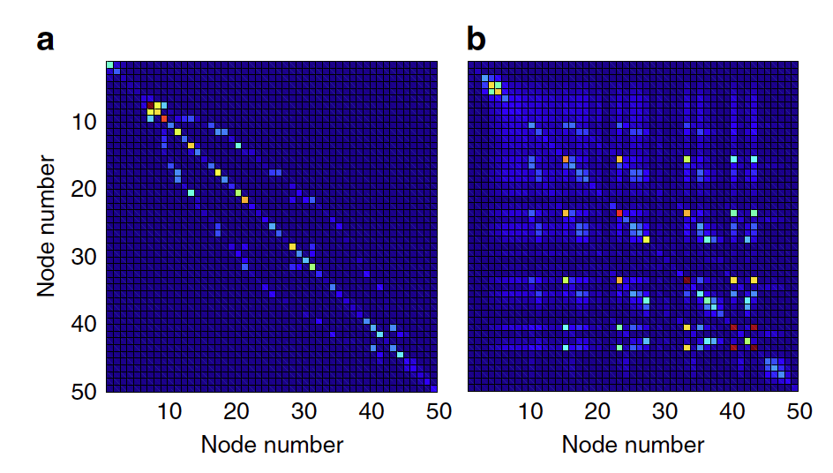
Q_cirt
Q_cirt^-1
Raw
Adjencency Q
Q_cirt
Q_cirt^-1
Recurrent

