Slide 1
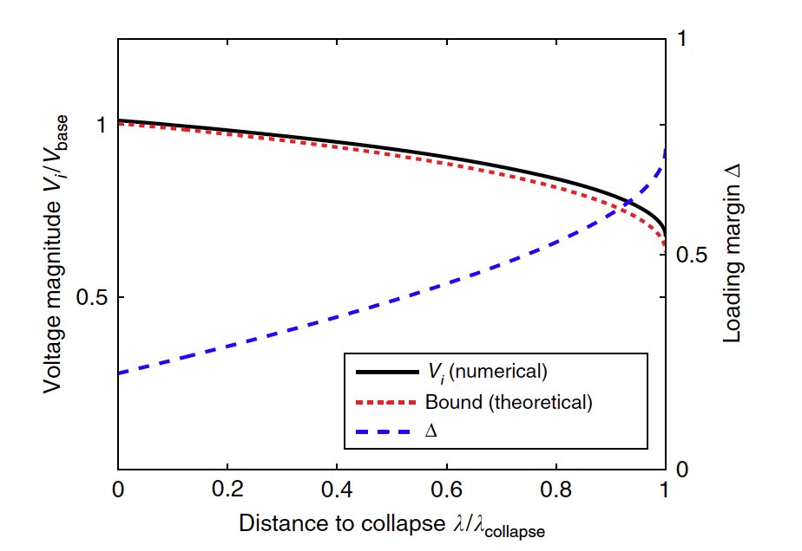
Raw
Recurrent

