Slide 1
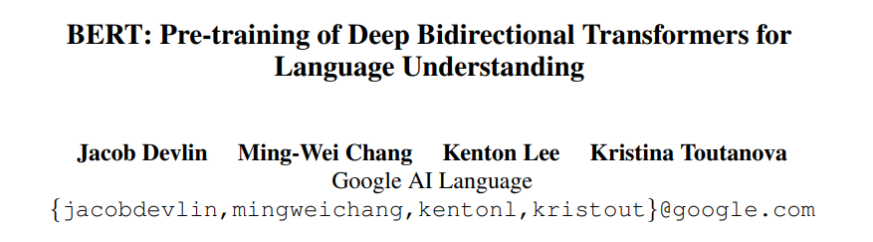
(Bidirectional Encoder Representations from Transformers)
Nilesh Srivastava
KISTI, UST
6th Dec 2022

Slide 2
Contents
Background
Pretraining
Conclusion
Model Details
Finetuning
Experimental Results
Ablation Studies

Slide 3

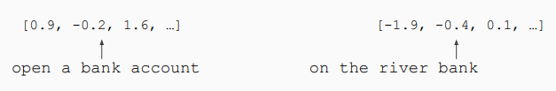
Background
Word embeddings are the basis of deep learning for NLP
Word embeddings (word2vec, GloVe) are often pre-trained on text corpus from co-occurrence statistics
Problem: Word embeddings are applied in a context-free manner
Solution: Train contextual representations on a text corpus

Slide 4
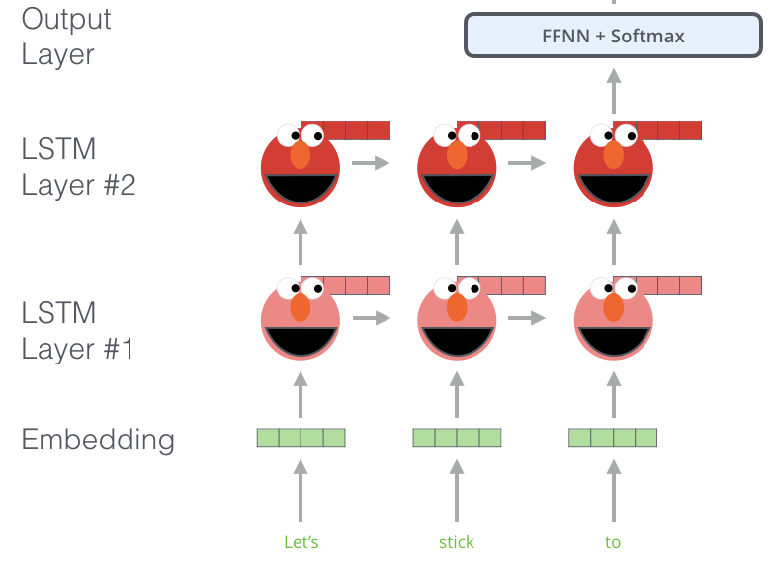
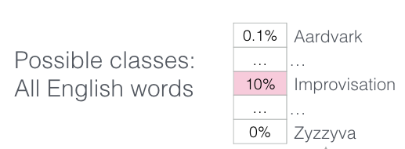
Background – Language Model

Slide 5
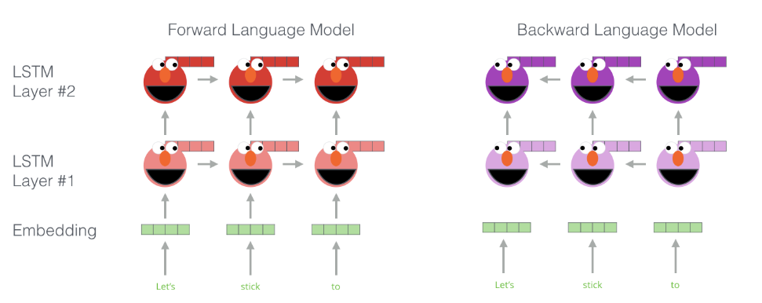
Background - ELMo

Slide 6
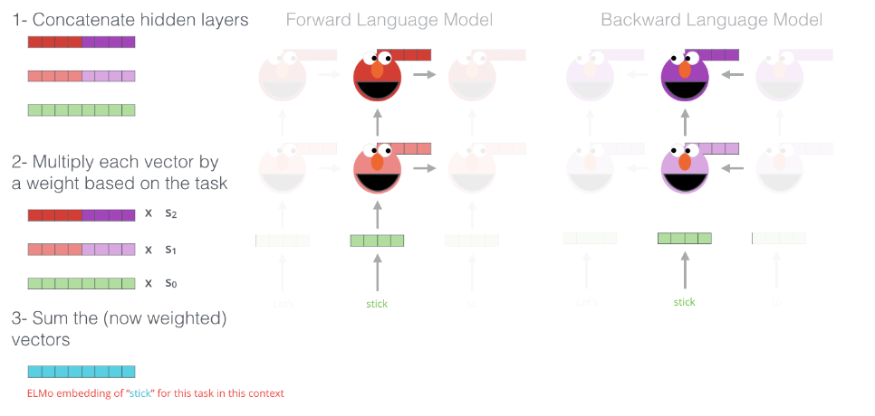
Background - ELMo

Slide 7
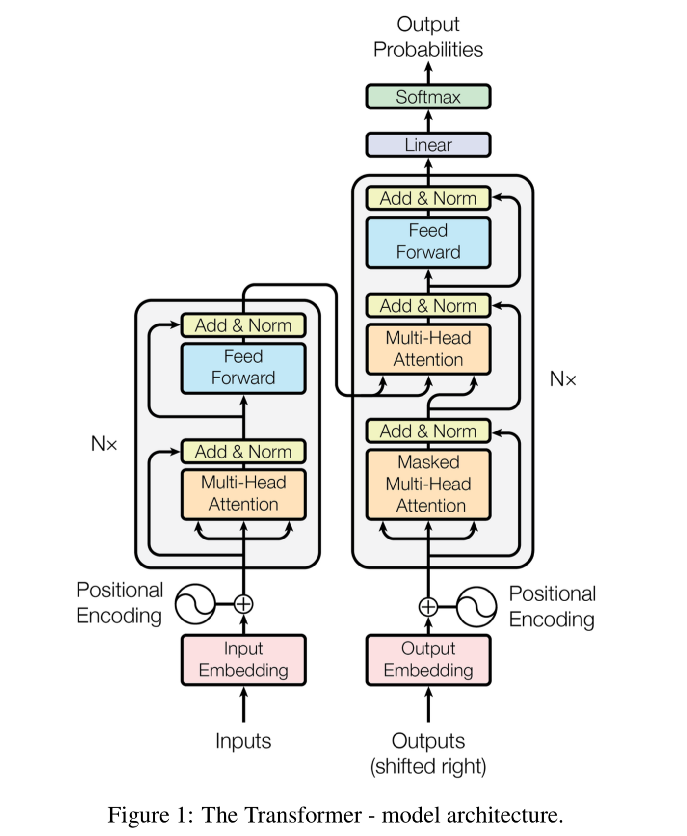
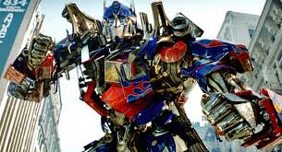
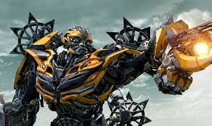
Background - Transformer

Slide 8
Pretraining – Masked LM
Mask out k% of the input words, and then predict the masked words
K = 15% for BERT
store gallon
the man went to the [MASK] to buy a [MASK] of milk
Too little masking: Too expensive to train
Too much masking: Not enough context

Slide 9
Pretraining – Masked LM
Problem: Mask token never seen at fine-tuning
Solution: 15% of the words to predict, but don’t replace with [MASK] 100% of the time. Instead:
80% of the time, replace with [MASK]
went to the store → went to the [MASK]
10% of the time, replace the random word
went to the store → went to the running
10% of the time, keep the same
went to the store → went to the store

Slide 10
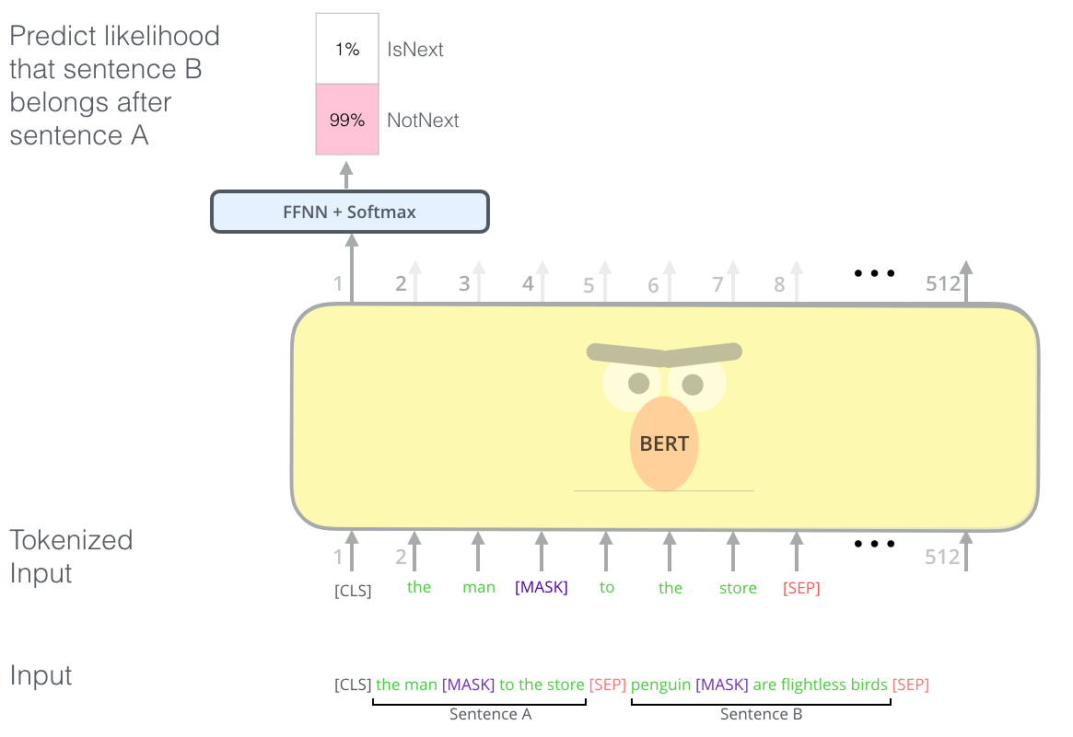
Pretraining – Next Sentence Prediction (NSP)
To learn relationships between sentences

Slide 11
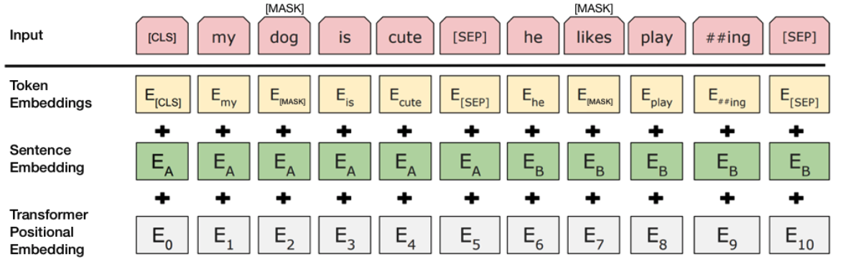
Pretraining - Input Representation
Use 30,000 WordPiece vocabulary on input.
Each token is the sum of three embeddings
Single sequence is much more efficient.

Slide 12
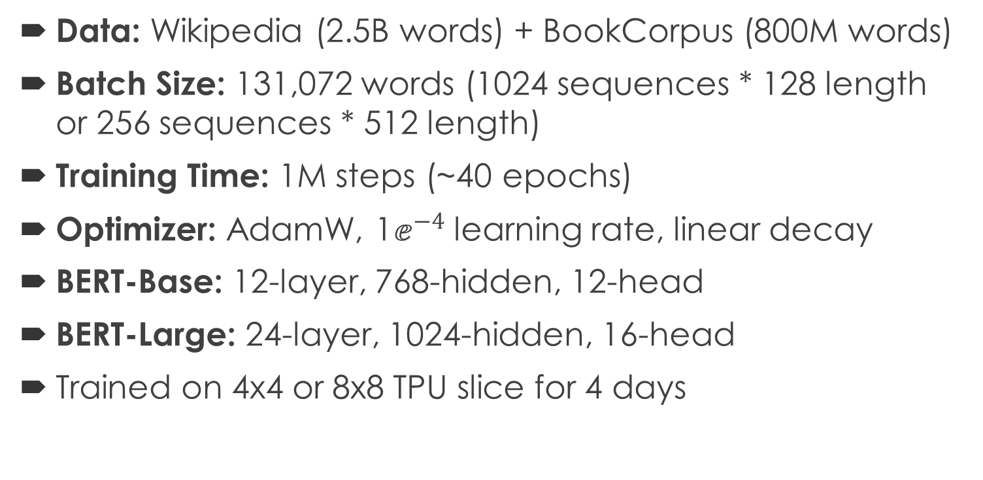
Model Details
Data: Wikipedia (2.5B words) + BookCorpus (800M words)
Batch Size: 131,072 words (1024 sequences * 128 length or 256 sequences * 512 length)
Training Time: 1M steps (~40 epochs)
Optimizer: AdamW, 1$ⅇ^{−4}$ learning rate, linear decay
BERT-Base: 12-layer, 768-hidden, 12-head
BERT-Large: 24-layer, 1024-hidden, 16-head
Trained on 4x4 or 8x8 TPU slice for 4 days

Slide 13
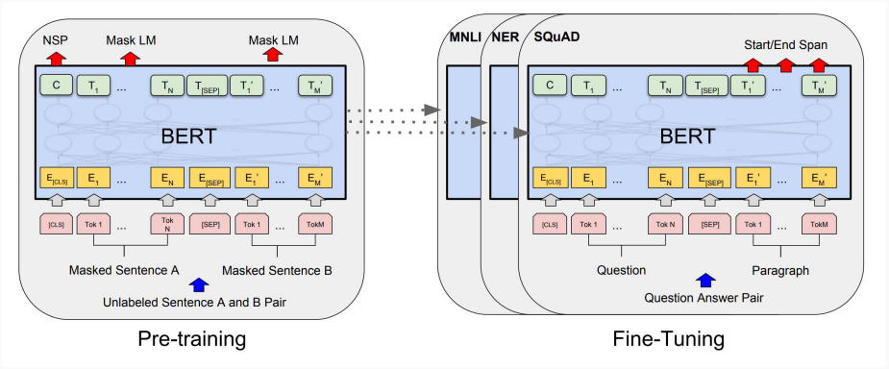
Finetuning

Slide 14
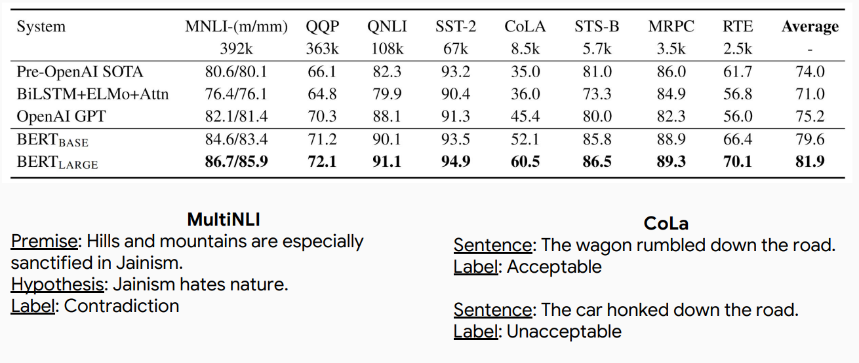
Experimental Results: GLUE

Slide 15
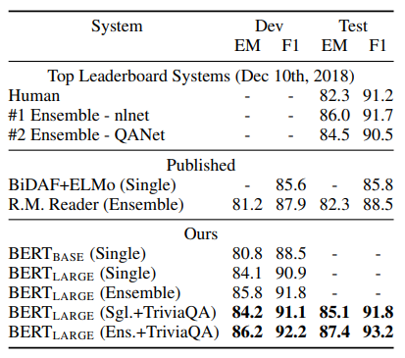
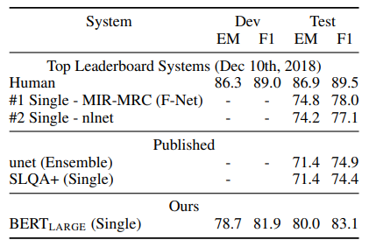
Experimental Results: SQuAD
SQuAD 1.1
SQuAD 2.0

Slide 16
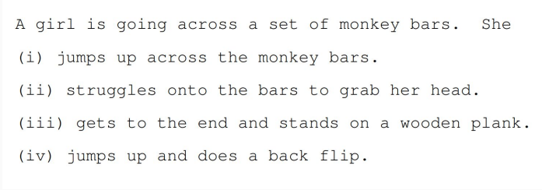
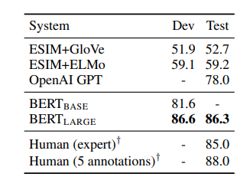
Experimental Results: SWAG

Slide 17
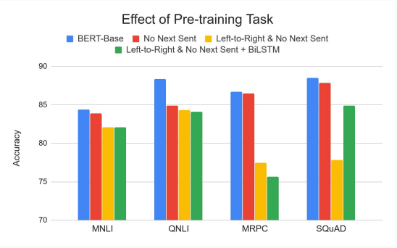
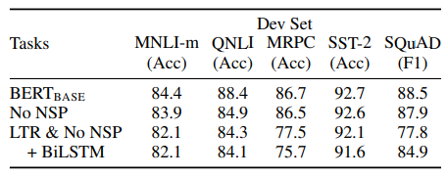
Ablation Studies: Effect of Pretraining
Masked LM (compared to left-to-right LM) is very important on some tasks, and Next Sentence Prediction is important on other tasks.
Left-to-right model does very poorly on word-level tasks (SQuAD), although this is mitigated by BiLSTM

Slide 18
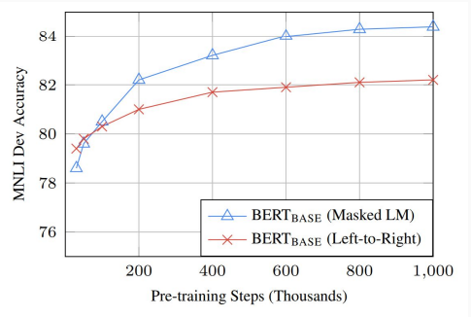
Ablation Studies: Directionality and Training Time
Masked LM takes slightly longer to converge because we only predict 15% instead of 100%
But absolute results are much better almost immediately

Slide 19
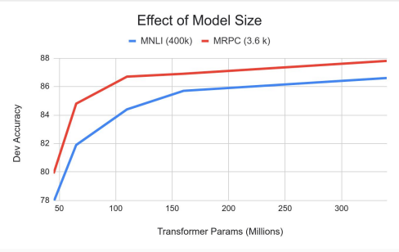
Ablation Studies: Effect of Model Size
Going from 110M -> 340M params helps even on datasets with 3,600 labeled examples
Improvements have not asymptoted

Slide 20
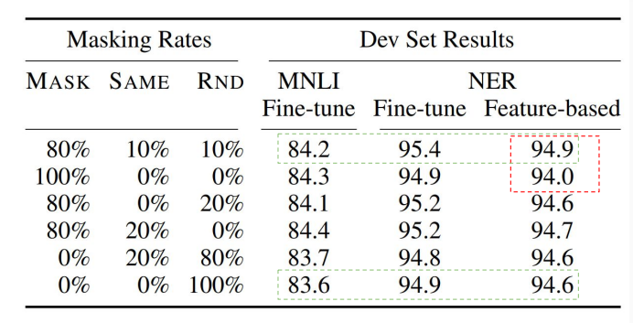
Ablation Studies: Masking Strategy
Masking 100% of the time hurts on feature-based approach
Using random word 100% of time hurts slightly

Slide 21
Conclusion
unsupervised pre-training is an integral part of many language understanding systems.
We have trained deep bidirectional architectures, allowing the same pre-trained model to successfully tackle a broad set of NLP tasks

Slide 22
Thank You!!!

