Slide 1
Temperature Calibration Challenge
Hong Tang
https://www.linkedin.com/in/hong-tang/

Slide 2
Summary and Recommendation
Why: Primary objective is to output a value for air temperature that is more accurate and reliable than the raw value from our main air temperature sensors
Method: build regression model to calibrate Mark data from sensor to reference data (Gold standard)
Findings and Challenges
Missing value, outliers
Challenges on resampling and joint Mark data and reference data:
selection on join with tolerance of 10min
Strong collinearity among features Band downwelling watts (Potnetial overfitting)
Compare with lasso regression, Random Forest Model with pipeline achieves almost perfect score (R2, MSE)
Further work on cost function to investigate the residual (predict T vs reference T)
Lessons Learned and Best Practices
Focus on feature engineering, and data QC
ML Pipeline avoid data leakage, makes modeling easy to read and maintain
Communication with stakeholders for business drivers
Plan Forward:
Improve feature engineering;
Investigate unsupervised classification

Slide 3
ML Process
Cycle 1
Feature EDA
Existing numerical features
Model Selection
Simple Linear regression
Cycle 2
Feature EDA
Time features
Numerical features Categorical features
More data cleaning
Joint resample Data decisions
Modeling
RandomForest Model
Pipeline
Validation
Cycle 3
Future feature engineering
Time Series Analysis
Different Cost function focus on residual trends
Model Deployment
Summary
recommendation

Slide 4
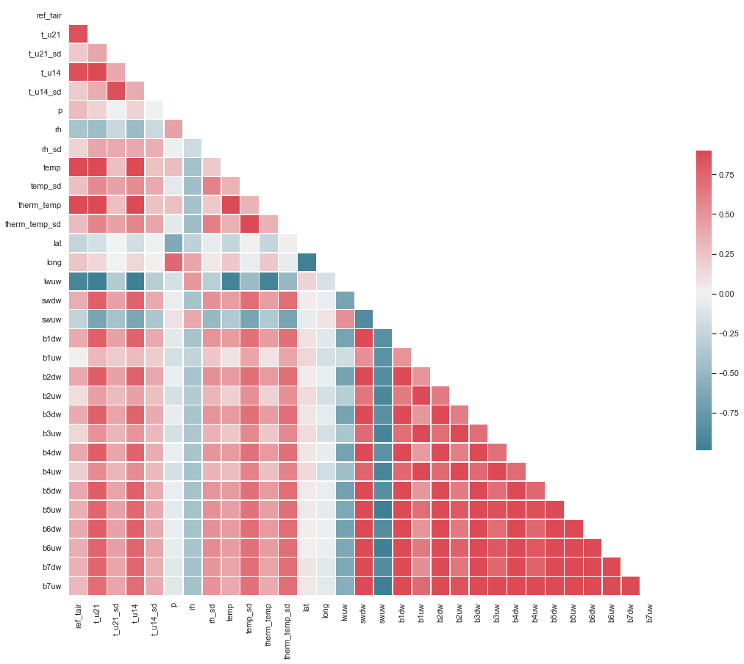
Summary
Internal temperature measurements
Direct and strong correlation with reference temp
Very high collinearity between features
Internal T. and P, humidity
T measurements
Direct and strong correlation with reference temp
Temp Measure
Other factors
Temp. measurements
Decrease lwuw, swuw increases temp
Latitude increases temp decrease(North cooler)
Other Measure.
Band downwelling watts
Increase bxdw increase T.
Weak positive correlation with temp
Strong colinearlity
Feature Correlation
With Target

Slide 5
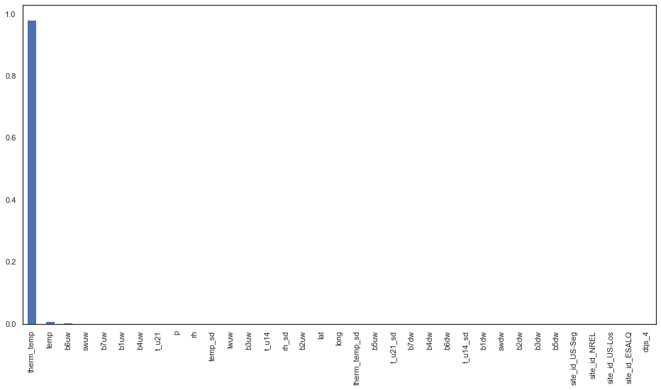
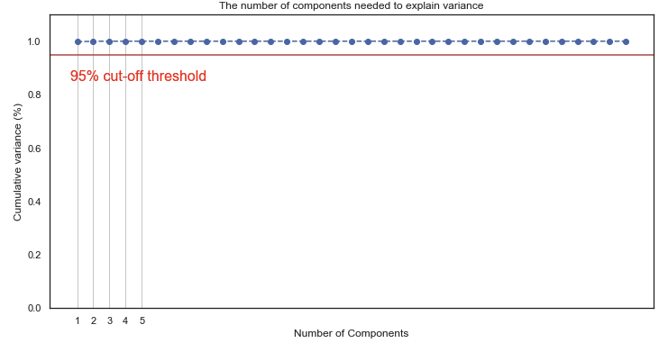
Importance of Influence and PCA component analysis all indicate temp and therm_temp overshadow other features for reference temp prediction
PCA no. comp. need to explain variance
T measurements dominates the prediction

Slide 6
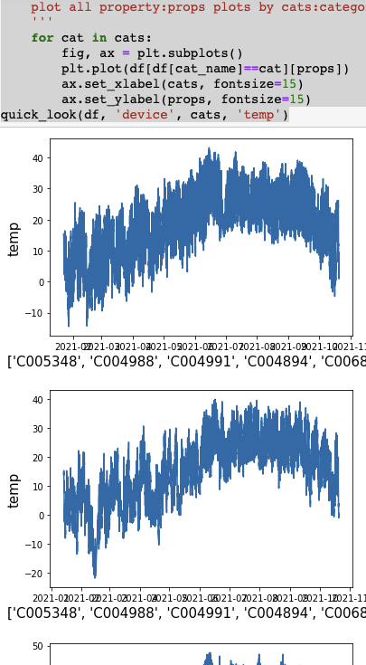
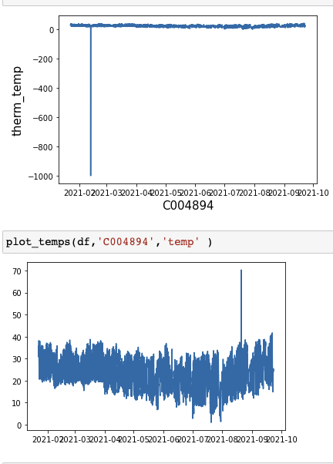
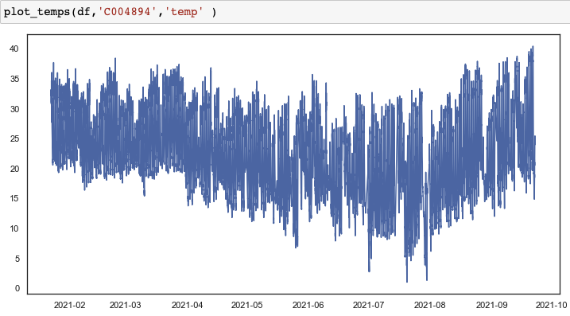
EDA and Feature Engineering
Batch Visualization
Visual QC
Drop lwdw due to more than 90% missing data
Outliers removal
rescaling
Remove outliers in batch

Slide 7
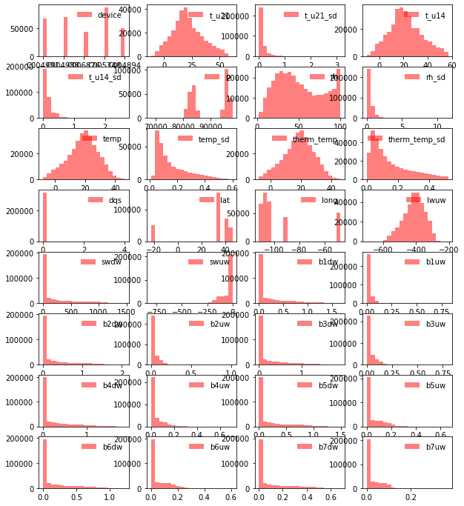
Feature EDA
IQR outlier treatment
Internal tempratures are trianglar or “normal-ish” distribution
Temp. standard deviation are skewed distribution
Band downwelling watts are very simiar skewed distribution with long tails. Will be interesing to color code with temperature
Wide range of values, rescaling is needed. Three scalers are tested decide to use standard scaler

Slide 8
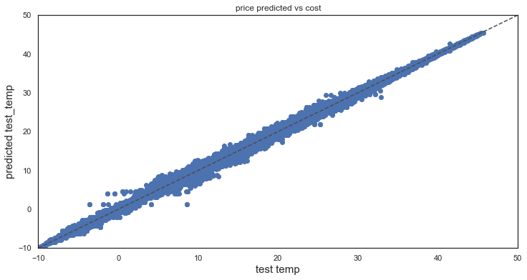
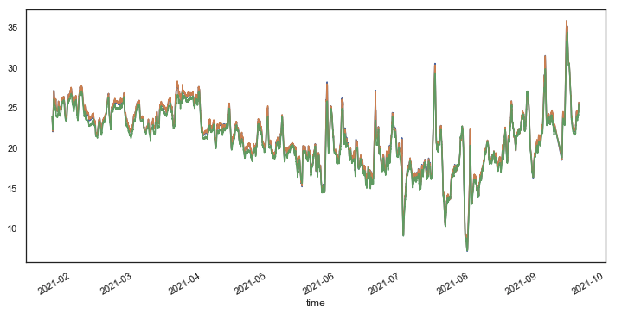
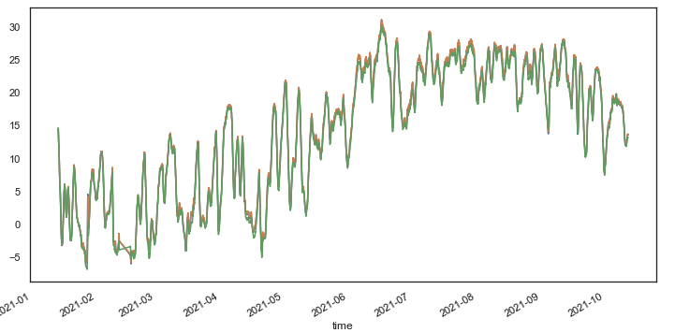
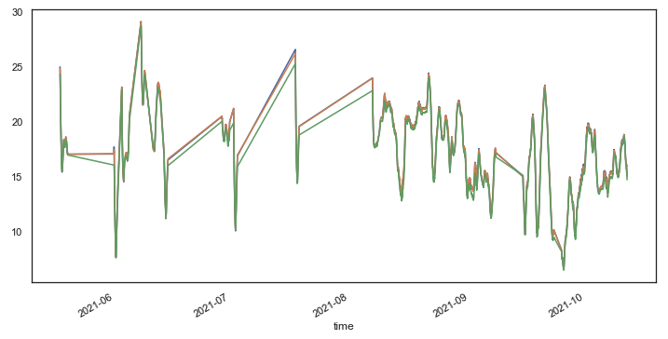
Model improvement from additional feature creation AUC improves from 90-94%
Linear Regression does not have enough predictability (R2)
Different Scaler and PCA tested
RandomForest has great R² ,MSE for both train and test data
ESALQ
US-LOS
NREAL
‘funny looking data’ need to check

