Slide 1
Design Pattern
Serious mode by Hong Tat

Slide 2

Why Design Pattern?
Model to use as a guide when developing code.
Help you think about how to solve a software problem.
More formally – A proven solutions to a common problem in a specified context.

Slide 3
Types of Design Pattern
Creational Patterns :
These patterns deals mainly with creation of objects and classes.
Structural Patterns :
These patterns deals with Class and Object Composition.
Behavioural Patterns :
These mainly deals with Class - Object communication. That means they are concerned with the communication between class and objects.

Slide 4
Creational
Simple Factory
Factory Method
Abstract Factory
Builder
Singleton

Slide 5

Simple Factory - Definition
It's not a design pattern, but a technique we use very often. It encapsulates the object instantiation process.

Slide 6
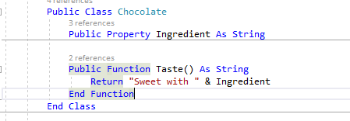

Simple Factory - Scenario
Imagine without factory design
After factory design

Slide 7
Factory Method - Scenario
Consider a high-class grocery store in London that stocks avocados all year round.
It relies on a buyer to ensure that avocados arrive regularly, no matter what the time of year.
The store is operating as a Factory Method, returning Kenyan, South African, or Spanish avocados depending on the time of year.
January to march – Kenyan
April to September – South Africa
October to December - Spanish

Slide 8
Abstract Factory - Scenario
Factory produces Shoes and Bags for original and fakes.
For example: Gucci and Cucci
Different between those 2 are the materials
We will have Gucci Factory and Cucci Factory

Slide 9
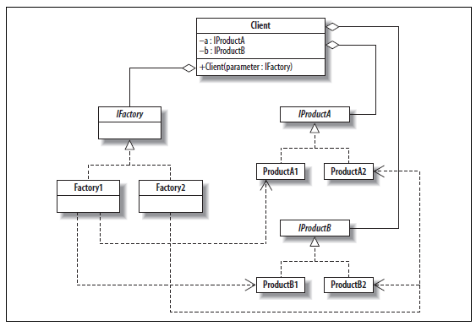
Abstract Factory - Scenario

Slide 10
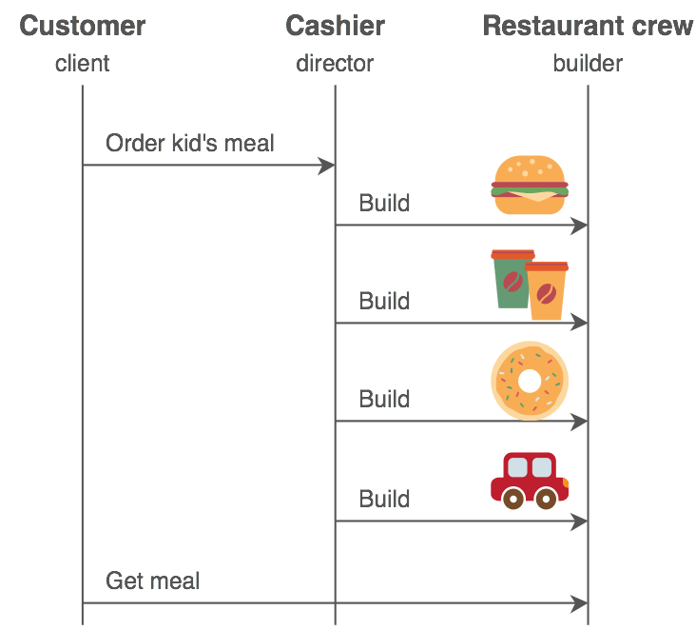
Builder - Scenario
Notes:
Base –> Framework -> Wall -> Root

Slide 11
Singleton - Scenario
The best example is ViewPoint master file screen
Only one instant is allowed to show up at a time.

Slide 12
Structural
Decorator
Proxy
Bridge
Composite
Flyweight
Adapter
Facade

Slide 13
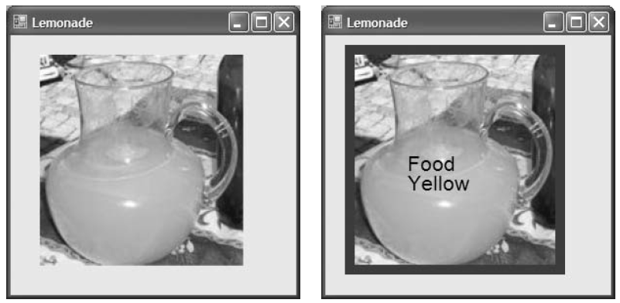
Decorator - Scenario

Slide 14
Decorator
VB.Net – Extension

Slide 15

Proxy - Scenario
Client - You
Proxy - Facebook
Subject - Facebook User
Facebook (Proxy) will determine whether you can see Facebook’s user posts by your relationship with the user.

Slide 16
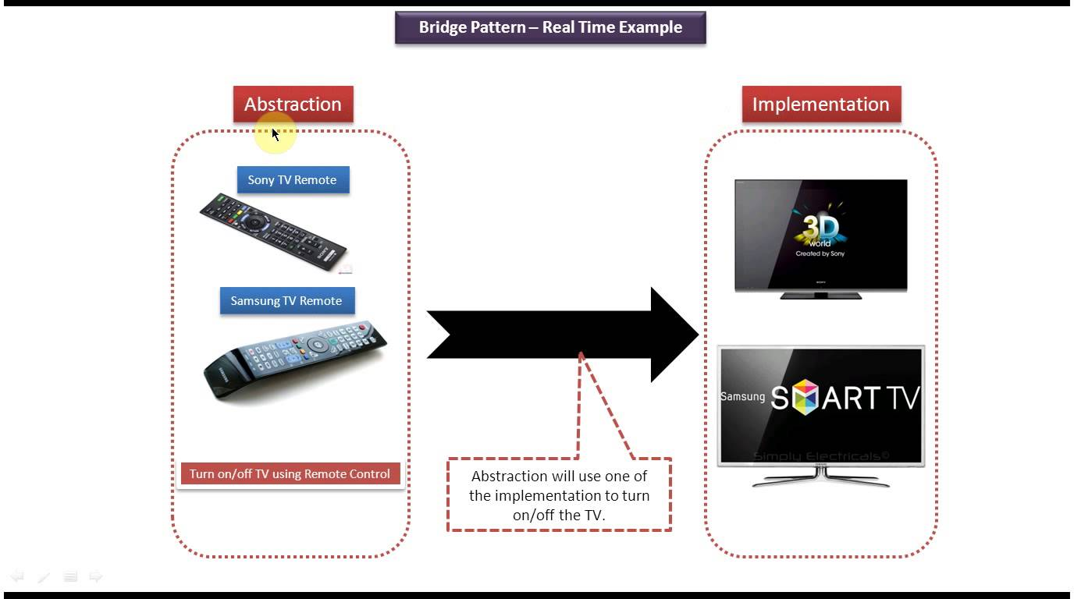
Bridge - Scenario
Notes:
Builder and Bridge patterns solve a different purpose. Builder pattern is used when the construction of an Object is more complex than just saying new ....(). Imagine that a house needs to be constructed based on various designs, choices and amenities selected by the customer. In this case, typically you will use Builder pattern to "CONSTRUCT" the house PER CUSTOMER based on various choices selected by her. Hence, the creation of the House object or end product is complex based on external factors. On the other hand, Bridge pattern is used vary the abstraction and implementation seamlessly. Suppose there is a car demo for, say, Sports car and economy car. You would like to seamlessly switch between the two so that Client code is not affected.

Slide 17
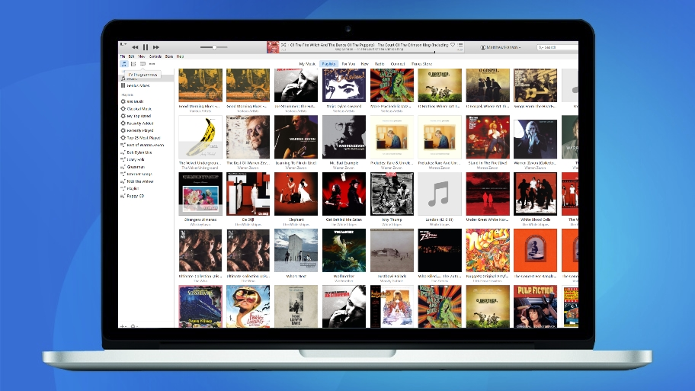
Composite - Scenario
Notes:
Song
Listen
Delete
Rename
Album (Many song)
Listen
Delete
Rename

Slide 18
Flyweight - Scenario
Use to reduce huge memory of an object.
Picture
2MB
When loading in an album, if we load the real size, the computer will be suffering running out of memory if the album has more than 100 pictures
Intrinsic (Unshared)
Thumbnail
Extrinsic
Real Image

Slide 19
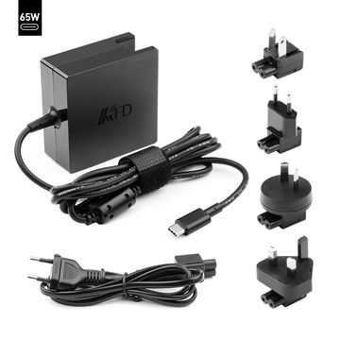
Adapter - Scenario
ViewPoint Business Application
Notes:
The Bridge pattern is going to allow you to possibly have alternative implementations of an algorithm or system.
The Adapter pattern is more about getting your existing code to work with a newer system or interface.

Slide 20
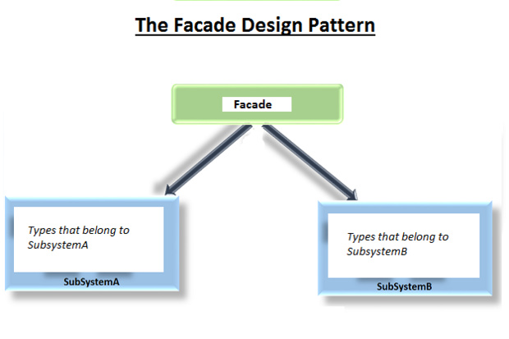
Façade - Scenario
ViewPoint Setup – One interface setup multiple components

