Slide 1
QCM detectors for classification of alcohol
Wen Hongwei
2020,5,8

Slide 2
Background
Alcohols have different structures;
Successful detection of different alcohol types is important and necessary
Five different types of alcohol:
1-octanol, 1-propanol, 2-butanol, 2- propanol and 1-isobutanol

Slide 3
Goal & Data source
Five different quartz crystal microbalance(QCM) gas detectors:
QCM6, QCM7, QCM10, QCM12, QCM13
Goal: To classify alcohol by building models with experimental measurements from five QCM detectors.
Measurements:
Each QCM detector has two channels.
Each type of alcohol is mixed with air by five different ratios, ranging from 0.799/0.201 to 0.400/0.6000.

Slide 4
Data Size
N size: 5 QCM * 25 observations
Dimension: 2 channel * 5 ratios & 5 labels (5 class; one-hot vector)
Label: Indicate the type of alcohol
Transform 5 dimension one-hot vector into 1 label (value: 1,2,3,4,5)

Slide 5
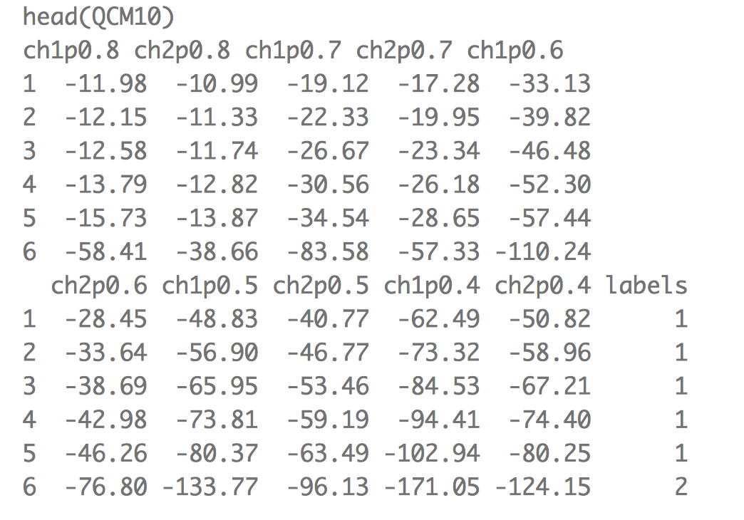
Data Processing

Slide 6
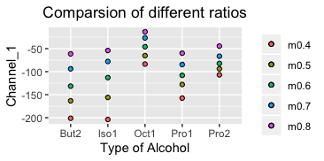
Data Exploring: Figure measurement of channel 1 in QCM10 :

Slide 7
Data Exploring:
For each type of alcohol, different ratio corresponds to different levels of measurement.
However two types of alcohol(But2 & Iso1) have similar measurement for different alcohol/air ratios;
Difficult for differentiate them only according to channel 1.

Slide 8
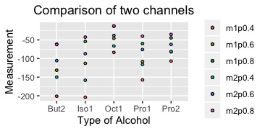
Data Exploring: Figure measurement of two channels in QCM10 :

Slide 9
Data Exploring:
Trend of measurement of two channel is similar.
Difference between But2 and Iso1 in channel 2 is significant compared with channel 1, which helps to classify them by data both from two channels.

Slide 10
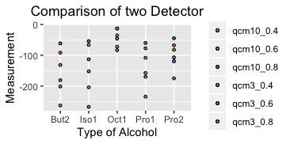
Data Exploring: Figure measurement of two detectors(QCM10 & QCM3):

Slide 11
Data Exploring:
The trends between QCM10 and QCM3 detectors are similar.
Different QCM data have correlations.
Distinct measurement between different types of alcohol gives detectors chance to classify correctly.
Integrate QCM data maybe leads to better classification.

Slide 12
Models: Each detector has one model
For every QCM data, we fit a random forest model
70/30 training/test data split
Repeat 10 times

Slide 13
Models: Each detector has one model
> print(acc_vec_all)
[,1] [,2] [,3] [,4] [,5]
[1,] 1 1 1 1.000 0.875
[2,] 1 1 1 1.000 0.750
[3,] 1 1 1 0.875 0.875
[4,] 1 1 1 1.000 1.000
[5,] 1 1 1 1.000 1.000
[6,] 1 1 1 1.000 1.000
[7,] 1 1 1 1.000 1.000
[8,] 1 1 1 1.000 1.000
[9,] 1 1 1 1.000 1.000
[10,] 1 1 1 1.000 1.000

Slide 14
Results Analysis & New problem
Each column represents the classification accuracy of one detector on test set.
Three QCM detectors(QCM10, QCM12, QCM3) achieve perfect prediction by its own random forest model.
The results appear to be satisfying, but there are two problems.
Q1: One model to predict five dataset. (Five models are inconvenient)
Q2: If new data is from other QCM detector, not any of the five we studied here, how can we classify?

Slide 15
Q1: One model to predict five dataset. .
Bind five QCM dataset together by column and obtain a large dataset.
The concatenated dataset are split with 0/7/0.3 ratio into training and test dataset.
Fit one random forest model with the training set and predict the test data.
Repeat 10 times

Slide 16
Q1: One model to predict five dataset.
Repeat 10 times:
Mean of accuracy is 0.9763158
Variance of accuracy is 0.0009926131
An Acceptable Result, but can be better
Variable Importance Figure

Slide 17
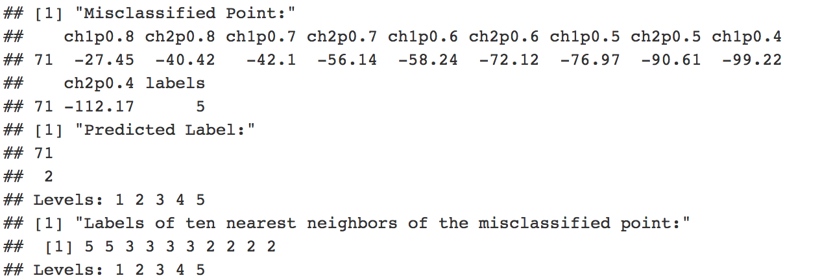
Misclassified point analysis
Although the nearest neighbor of the 71th point belongs to the same class as themselves， a large proportion of nearest ten neighbors do not belong to the same class. Meanwhile, the ten points all have large possiblility to reside in the same leaf cell with the 7171th point when the parameter “node size” is set by 5.

Slide 18
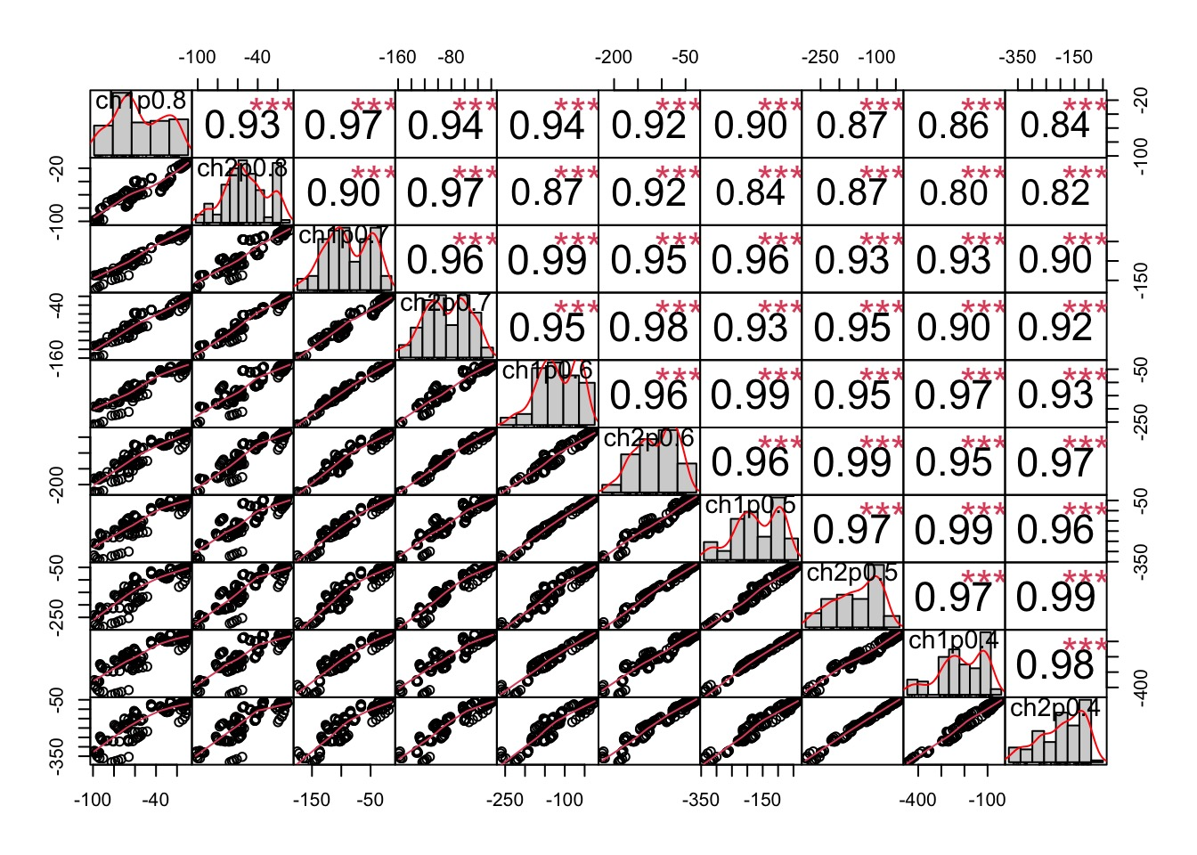
Chance for improving accuracy
Correlation between different decision trees is preferably low.
However, correlation between feature space are high

Slide 19
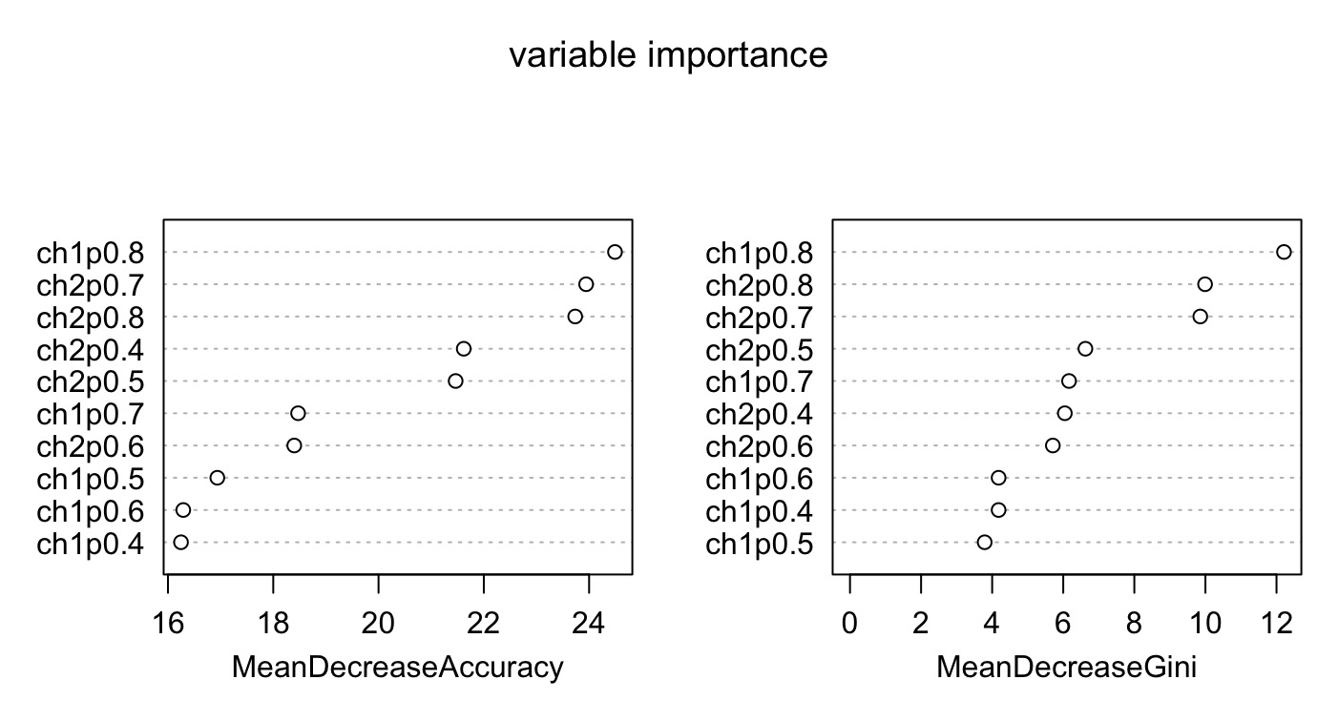

Slide 20
More Analysis
Three problems:
Naive concatenated dataset ignore which QCM detector the data is from.
Information of five QCM detectors is not included in data.
Q2 is still not solved.
Method:
Add some info related to QCM detectors(e.g. material, structure, …)
New info/features are generalized to all QCM detector, not only restricted to these five.

Slide 21
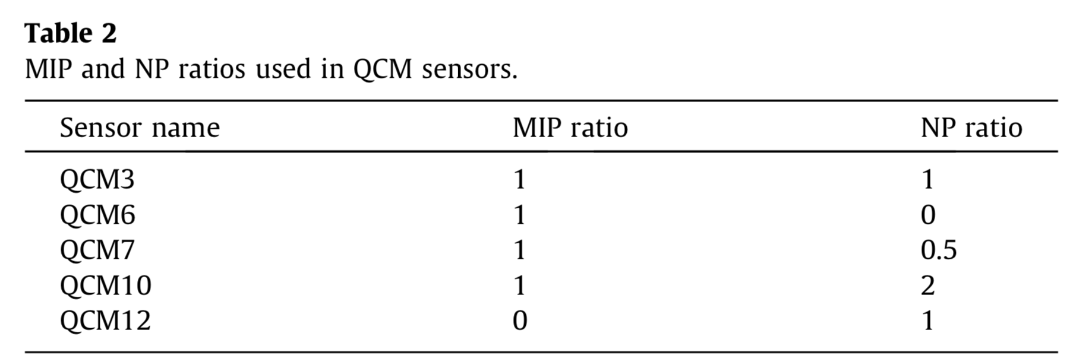
Improvement
The ratio of component in two channals of different QCM detectors is different.
One of two channels includes molecularly imprinted polymers (MIP), and the other includes nanoparticles (NP).

Slide 22
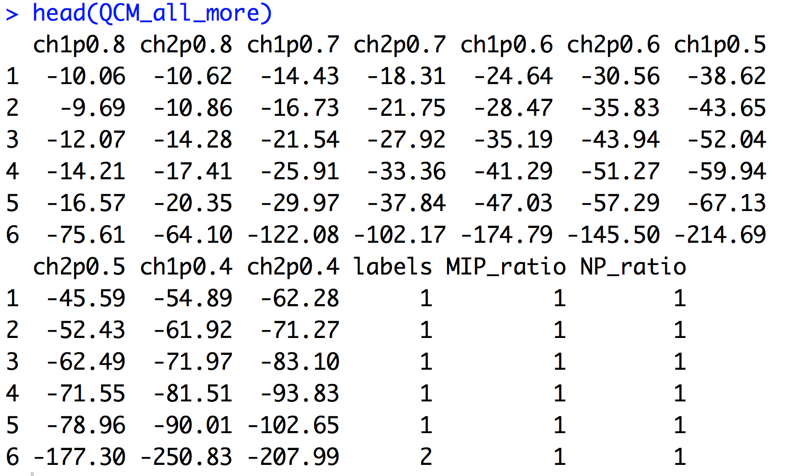
Improvement
Add new columns MIP_ratio and NP_ratio.

Slide 23
Model
Fit a new model with the refined data.
Repeat 10 times:
Mean of accuracy is 1
Variance of accuracy is 0
An Excellent Result
Variable Importance Figure
New correlation plot: low correlation between new feature(MIP_ratio, NP_ratio) and measurements.

Slide 24
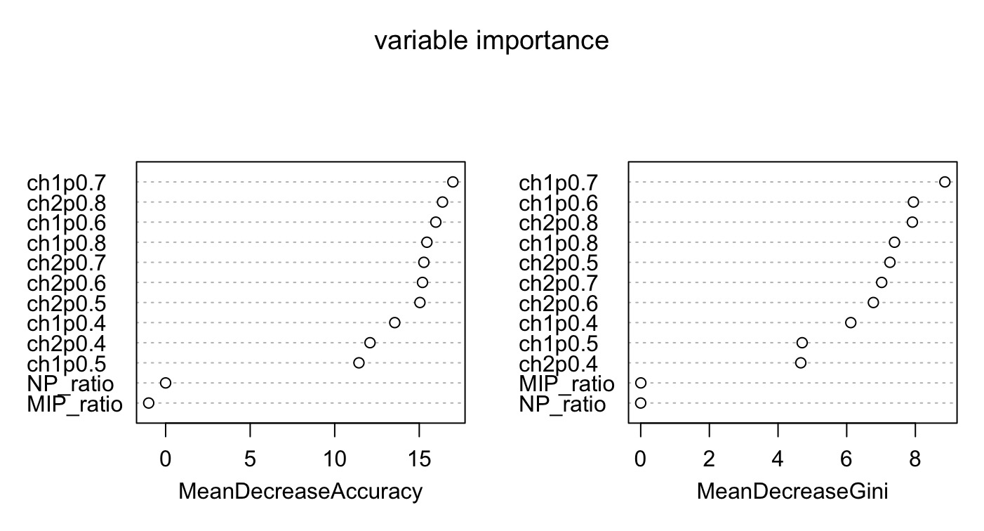

Slide 25
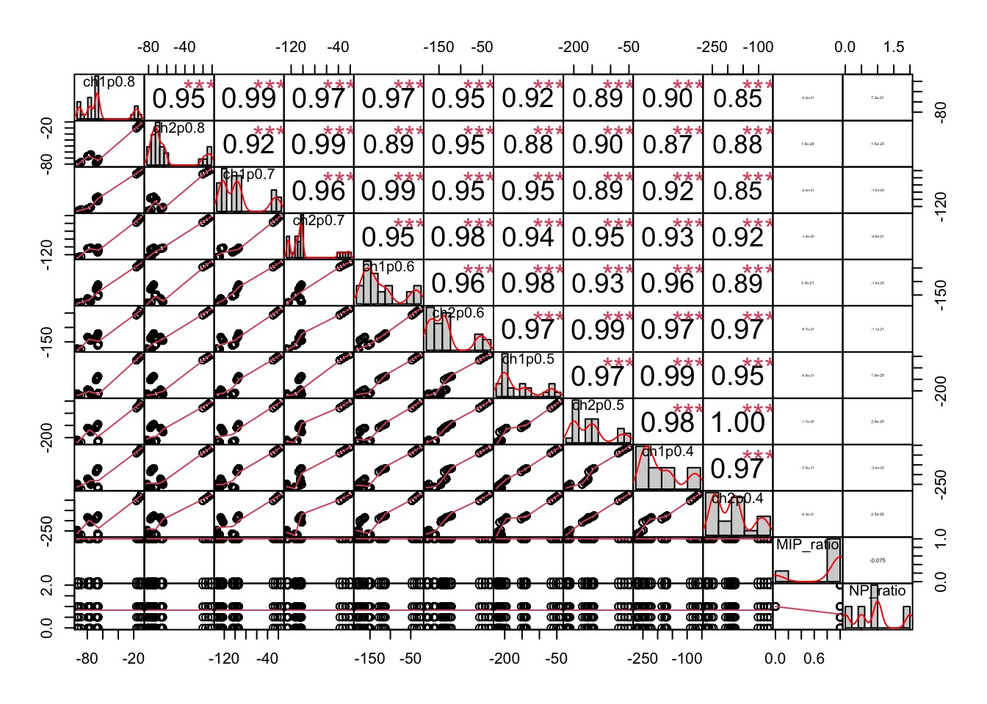

Slide 26
Result Analysis
Both solve Q1 and Q2
MIP_ratio and NP_ratio indeed work
Data from new QCM detector with different MIP and NP ratio can be predicted now.

