Slide 1
The Cost of a Rainy Day
Quantifying Weather Risk for the Citi Bike Business

Slide 2
Executive Summary

Slide 3
Executive Summary
The Citi Bike business is increasingly vulnerable to weather risk
Bad weather events such as rain, snow, fog, as well as high temperatures affect pass sales
24-hour passes customers are more affected compared to year-long membership subscribers
Our random forest model can predict pass sales based on weather
Model outperforms benchmark and achieves high out of sample accuracy
Model can be used to simulated sales fluctuations in hypothetical scenarios
Our model-based pricing schema can help Citi Bike hedge weather risk
Using weather predictions, Citi Bike can adjust pass prices based on predicted demand
With our pricing schema, Citi Bike can increase sales by an estimated $1.8 million dollars/year

Slide 4
Agenda
QUANTIFYING RISK
What is the effect of a weather event on pass sales?
How does the same weather event affect sales for different products, and for different consumer groups?
SIMULATING RISK
What is the best/average/worst case effect of weather risk in a given time period, according to our predictive model?
How may climate change potentially affect the business?
MITIGATING RISK
How much is the business exposed to weather risk, and how is this risk evolving?
By adopting our weather based pricing model, how much money will the business save?

Slide 5
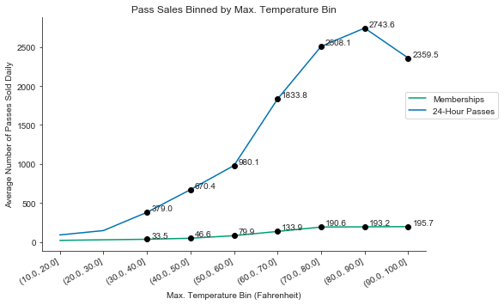
Too hot to bike?
Pass sales increases as max. temperature increases, until it exceeds the (80°F, 90°F] bin.

Slide 6
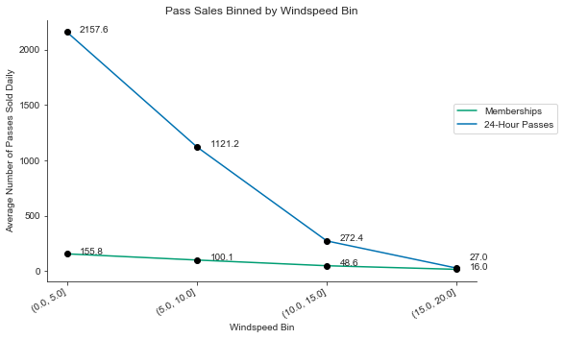
Too windy to bike?
Pass sales decreases as wind speed increases.

Slide 7
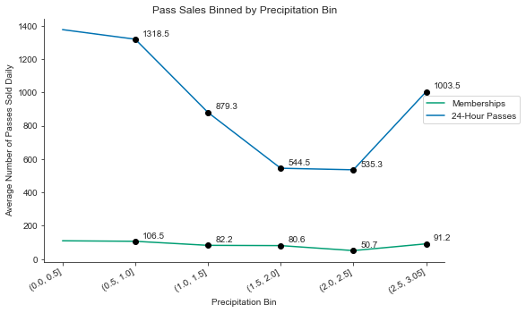
Precipitation vs. Sales
Pass sales and precipitation don’t quite follow a linear relationship.

Slide 8
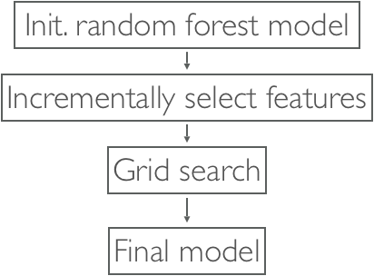
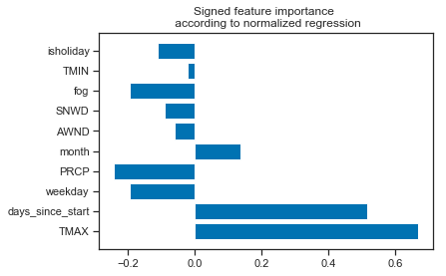
Model Features vs. Benchmark
R^2:
Weather-based Model for Customers & Subscribers
(time & weather features):
Train R^2: : 0.944
Test R^2: : 0.667
Baseline Model
(time features only):
Train R^2: 0.822
Test R^2: 0.299
Weather-based Model
(time & weather features):
Train R^2: : 0.957
Test R^2: : 0.785

Slide 9
If it didn’t rain on Aug 11th, 2018 ...
 | 24-hour Pass Sales | Membership Sales
Actual | $35928 | $19773
Predicted | $48852 | $30082
Best Case | $74064 (+$25212) | $33462 (+$3380)

Slide 10
If it rained like it did in Aug 2011 ...
 | Rainfall (cumulative inches) | 24-hour Pass Sales
Actual | 3.34 | $905196
Worse Case | 18.95 | $842340 (-$62856)
Best Case | 0 | $960180 (+$54984)

Slide 11
If it got warmer by 10 °F due to climate change ...
 | 24-hour Pass Sales
Average Case | $1,890,609
Climate Change | $1,884,989 (-$5620)

Slide 12
Customer v. Subscriber
SNOW:
results in 96.66% loss on 24-Hour pass sales.
results in 94.13% loss on membership.
RAIN:
results in 58.55% loss on 24-Hour pass sales.
results in 53.73% loss on membership.
FOG:
results in 37.8% loss on 24-Hour pass sales.
results in 33.72% loss on membership.

Slide 13
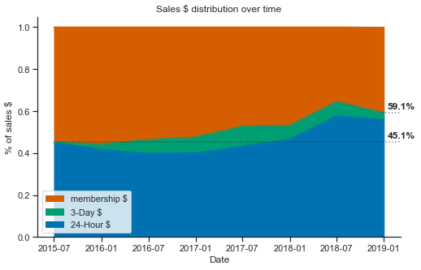
Risk increase plot
We have seen that customer pass sales are more vulnerable to weather risk.
As the percentage of customer passes sales increases, Citi Bike’s exposure to weather risk also increases.

Slide 14
Pricing Schema
Assuming linear price-demand curve, the business can reduce pass prices to the percentage of sales decrease as predicted by our model in order to hedge weather risk.
Deploying the pricing model on 2018 data would result in an increase in sales by
 | 24-hour Pass Sales | Membership Sales | Total Sales
Actual | $9,916,848 | $7,487,545 | $17,404,393
Predicted | $8,773,908 | $8,123,661 | $16,897,569
Best Case | $10,261,272 (+$1,487,364) | $8,499,179 (+$375,518) | $18,760,451 ($1,862,882)

Slide 15
Fin

