Slide 1
The cost of a rainy day
Quantifying weather risk for the Citi Bike business

Slide 2
Citi bike is vulnerable to weather risk
QUANTIFYING RISK
What is the effect of a weather event on pass sales?
How does the same weather event affect sales for different products, and for different consumer groups?
SIMULATING RISK
What is the best/average/worse case affect of weather risk in a given time period?
How can climate change potentially affect the business?
MITIGATING RISK
How much is the business exposed to weather risk?
What are some strategies the business should consider leveraging to minimize weather risk?

Slide 3
Merging Citi bike sales dataset with weather
CITI BIKE DAILY RIDERSHIP AND MEMBERSHIP DATA
24-Hour/3-Day Passes Purchased (midnight to 11:59 pm)
Total annual membership sold
Trips over the past 24-hours (midnight to 11:59pm)
WEATHER DATA FROM NATIONAL CENTERS FOR ENVIRONMENTAL INFORMATION
Daily measurements from the Central Park Station
July 2015 - March 2019
Min/Max temperature, precipitation, snow, wind speed, extreme weather event flags

Slide 4
Single Weather event EFFECT - Binary Variables
INCLEMENT WEATHER DAMAGE
SYNTHETIC CONTROL METHOD
Compares event affected group against simulated control group, calculates percentage loss due to weather event
RESULTS:
SNOW:
results in 96.66% loss on 24-Hour pass sales.
results in 95.85% loss on 3-Day pass sales.
RAIN:
results in 58.55% loss on 24-Hour pass sales.
results in 58.81% loss on 3-Day pass sales.
FOG:
results in 37.8% loss on 24-Hour pass sales.
results in 34.23% loss on 3-Day pass sales.
results in 34.23% loss on 3-Day pass sales.
Given the same weather event, 24-hour pass sales generally showed a slightly higher percentage loss than 3-day pass sales.

Slide 5
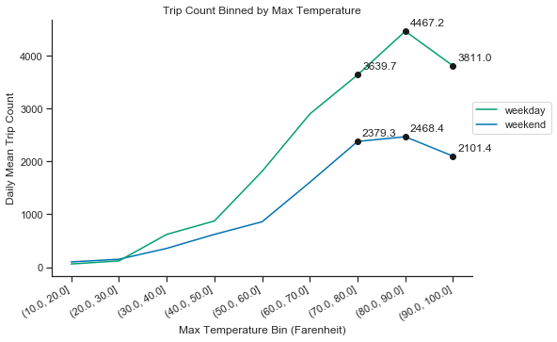
Single Weather event EFFECT - Quantitative VARIABLES
TOO HOT TO BIKE?
Trip count increases as max. temperature increases, until it exceeds
the (80°F, 90°F] bin.

Slide 6
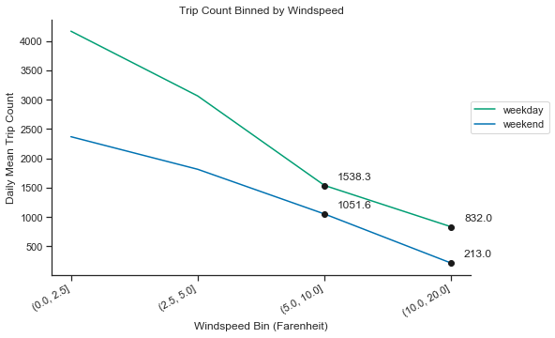
Single Weather event EFFECT - Quantitative VARIABLES
TOO WINDY TO BIKE?
Trip count decreases as windspeed increases.

Slide 7
Single Weather event EFFECT - Binary Variables
BAD WEATHER AFFECTS OUTLOOK
SNOW:
results in 96.66% loss on 24-Hour pass sales.
results in 95.85% loss on 3-Day pass sales.
results in 94.13% loss on membership.
RAIN:
results in 58.55% loss on 24-Hour pass sales.
results in 58.81% loss on 3-Day pass sales.
results in 53.73% loss on membership.
FOG:
results in 37.8% loss on 24-Hour pass sales.
results in 34.23% loss on 3-Day pass sales.
results in 33.72% loss on membership.
We do see a decrease in membership sales conditional on each weather event, though the loss rate is slightly less than that for 24-hour sales.
Though the membership lasts for a year, people still tend to purchase it more on days with better weather.

Slide 8
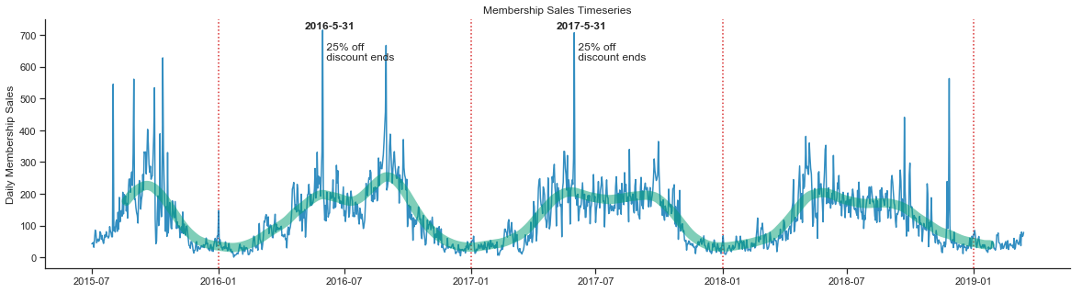
Membership Sales Time series - SEASONALITY
Membership sales exhibit strong seasonality, and spike at promotions.

Slide 9
Single Weather event EFFECT - CUSTOMER v. SUBSCRIBER
SNOW:
results in 96.31% loss on Customer trips
results in 93.19% loss on Subscriber trips.
RAIN:
results in 60.32% loss on Customer trips.
results in 53.65% loss on Subscriber trips.
FOG:
results in 39.4% loss on Customer trips.
results in 35.82% loss on Subscriber trips.
Given the same weather, customer trips (those with 24-hour or 3-day passes) are more affected than subscriber trips (those with year-long memberships).

Slide 10
Single Weather event EFFECT - FEMALE v. MALE
SNOW:
results in 93.68% loss on female trips
results in 93.09% loss on male trips.
RAIN:
results in 54.85% loss on female trips.
results in 53.26% loss on male trips.
FOG:
results in 36.3% loss on female trips.
results in 35.58% loss on male trips.
Trips made by females are slightly more affected by weather than those made by males.
This may imply that women are more risk averse when it comes to biking in inclement weather.

Slide 11
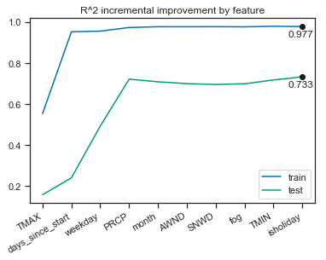
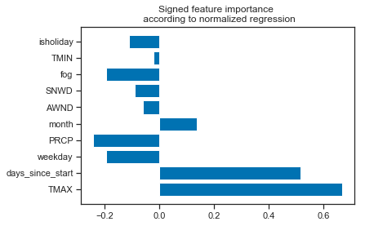
PREDICTIVE MODEL using random forest
Init. random forest model
Incrementally select features
Grid search
Final model
R^2
Train: 0.974
Test: 0.733

Slide 12
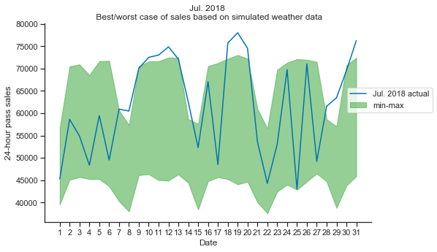
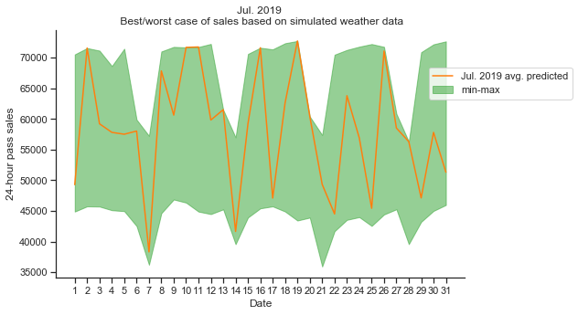
Simulating WEATHER RISK USING PREDICTIVE MODEL
Best/avg./worst case scenerio: Jul. 2018/Jul. 2019
Best: $25,143,215
Worst: $16,201,849 (-$8,941,366)
Actual: $22,962,684 (-$2,180,531)
Best: $25,366,527
Worst: $16,265,888 (-$9,100,639)
By Avg.: $21,625,402 (-$3,741,125)

Slide 13
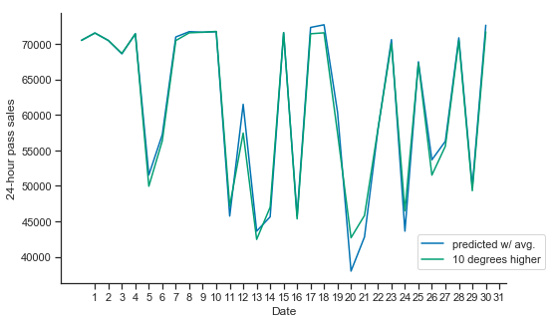
The Effect of CLIMATE CHANGE in dollars
Hypothetical: If max. and min. temperature both went up by10° F …
Predicted w/ avg.: $1,890,609
10° F higher : $1,884,989 (-$5620)

Slide 14
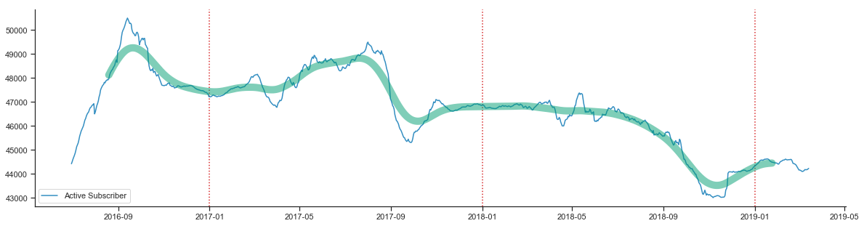
ACTIVE RIDERSHIP is going down
The number of active subscribers has gone down by 10% since 2016.

Slide 15
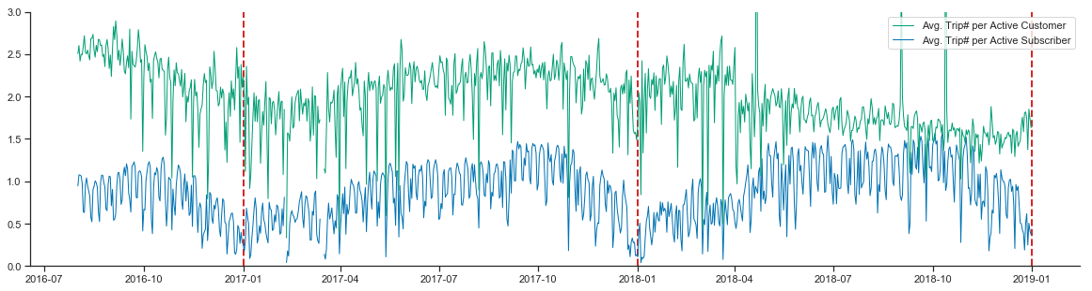
Number of Trips Per active customer/subscriber
Gung-ho customers, seasonal subscribers.

Slide 16
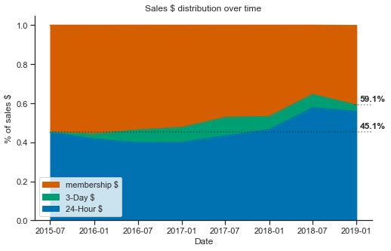
WEATHER RISK is going up
We have shown that customer pass sales are more vulnerable to weather risk.
As the percentage of customer passes sales increases,
Citi Bike’s exposure to weather risk also increases.

Slide 17
Call to action: Hedging for weather risk
Citi Bike should consider weather based pricing schemas for both customer and subscriber products.
Use weather based predictive model and supply-demand curve to adjust pass pricing to maximize profitability.
Estimate and incorporate average weather risk into membership pricing.
Citi Bike should consider introducing new products of different time-horizon variations (monthly/seasonal passes) based on weather predictions and seasonality.
Attract consumers who are aware of and/or especially affected by weather risk (women, low-income groups, temporary residents.)

Slide 18
Thanks for listening!

