Slide 1
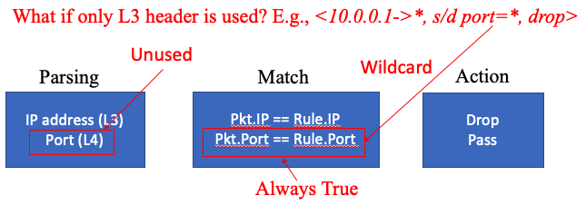
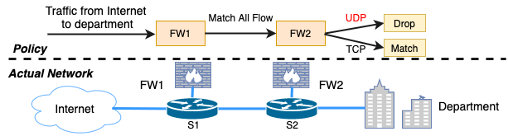
NFOpt: Eliminating Redundant Logic in NF Programs using Operation-Time Configurations Bangwen Deng, Wenfei Wu IIIS, Tsinghua University
Introduction
Background
Network functions (NFs) are critical components in the network data plane. Their efficiency is important to the whole network’s end-to-end performance.
And a lot of works recognize this critical efficiency issue and propose the corresponding optimization, such as accelerating the NF execution, parallelizing NF (chains), and consolidating NFs. A recent trend of DevOps inspires us to propose an orthogonal approach — using the operation-time configurations to optimize NF programs.
Contributions:
Show the existence of redundant logic in NFs in the scenario of DevOps.
Design compiler-based solutions called NFOpt to eliminate the redundant logic.
Evaluation NFOpt on commodity NFs and platform NFs completely.
NFReducer Overview
Eliminating three kinds of NF redundant logic：
Unused Logic.
Duplicate Logic.
Overwritten Logic.
Figure 1: NFReducer Overview
Taking as input:
NF Source Code,
NF Configuration
Identified Variables
and Actions
Program Analyzing Techniques:
Constant Propagation & Expression Fold
Dead Code Elimination
Common Sub-expression Elimination
Copy Propagation
Symbolic Execution
Program Slicing
Evaluation
Unused Logic Redundancy
Unused Layer Redundancy
The throughput of the two IDSes and the firewall increase significantly. (e.g., 15% for Snort, 21% for OpenNetVM-Firewall, 15%-10× and 40% to 3× for Suricata in single-thread mode and multi-thread mode, respectively)
Unused Protocol Redundancy
When the proportion of UDP packets increases to 50%, removing the redundancy can achieve 40% and 2.5× performance gain for Snort and Suricata, respectively. In OpenNetVM-Firewall, configurations are embedded in code, the compiler would apply some optimizations before we apply NFOpt, the performance gain is moderated.
Duplicated Logic Redundancy
The Duplicated Logic elimination can help improve throughout by more than 25% for monitor and Snort IDS chain, and improve throughout by nearly 55% for the two OpenNetVM-Firewall instances.
Overwritten Logic Redundancy
After the elimination of the Overwritten Logic elimination Optimized program can achieve about 7% performance gain in both case when UDP proportion reaches to 50%.
Figure 2: Eliminate Unused Layer Logic Performance Gain of OpenNetVM-FW(left), Snort (middle), Suricata (right)
Figure 3: Eliminate Unused Protocol Logic Performance Gain of OpenNetVM-FW(left), Snort (middle), Suricata (right)
Figure 4: Performance Gain of Eliminating Duplicate Logic and Overwritten Logic
References
[1] https://llvm.org/.
[2] https://www.snort.org/.
[3] J. Khalid, A. Gember-Jacobson, R. Michael, A. Abhashkumar, and A. Akella. Paving the way for NFV: Simplifying middlebox modifi- cations using statealyzr. In 13th USENIX Symposium on Networked Systems Design and Implementation (NSDI 16), pages 239–253, Santa Clara, CA, 2016. USENIX Association.
[4] A. Saadaoui, H. Benmoussa, A. Bouhoula, and A. Kalam. Automatic classification and detection of snort configuration anomalies - a formal approach. pages 27–39, 01 2015.
[5] W. Wu, Y. Zhang, and S. Banerjee. Automatic synthesis of nf models by program analysis. In Proceedings of the 15th ACM Workshop on Hot Topics in Networks, HotNets ’16, pages 29–35, New York, NY, USA, 2016. ACM.

