Slide 1
Share App
Yipeng hong
001228971

Slide 2
introduction
Allow user to sign up or login
User can post a new picture with discrition
User can add comments below the picture
User can take a new photo and save it to library
User can search others and follows or unfollows others
If user follow other, user can also see his or her picture in home page
User can like or unlike other picture
User can view his account to check what he posted before

Slide 3
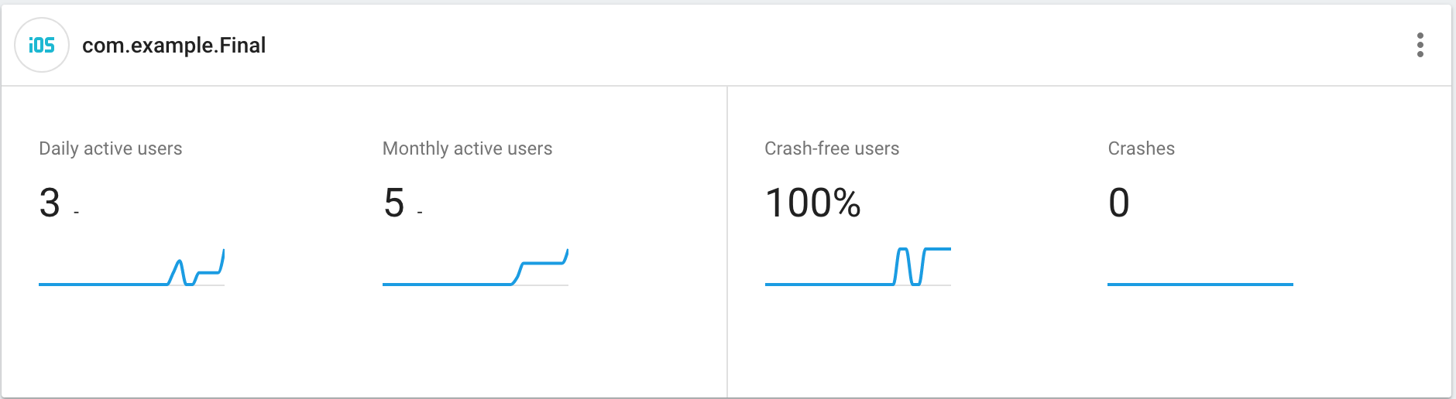
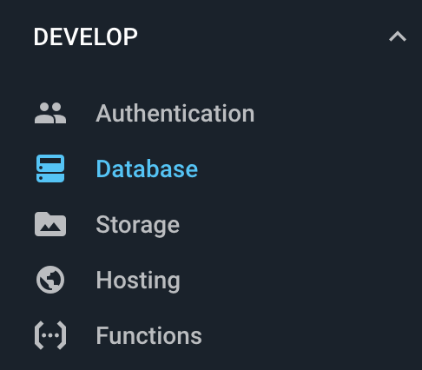
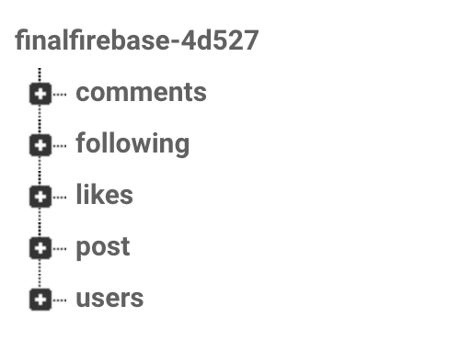
Firebase
Create new project and connect to xcode
through bundle identifier
Create new Pod files
Import Firebase and use it ( syntax )
Authentication for sign in/up
Five tables to store different information and
connect to each other through unique key
Storage for storing user image url

Slide 4




structure
TabBar
Home, Search, Add, Likes, Account
NavBar
Logo, Title, Loggout
Post
Likes, Comments, Message, Tag
Name, Description
Time

Slide 5
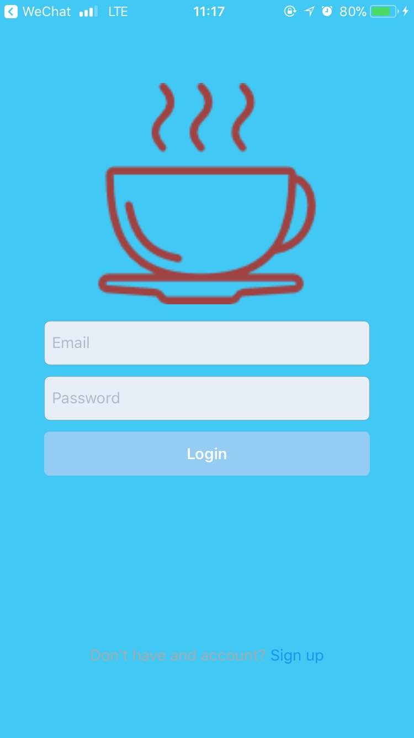
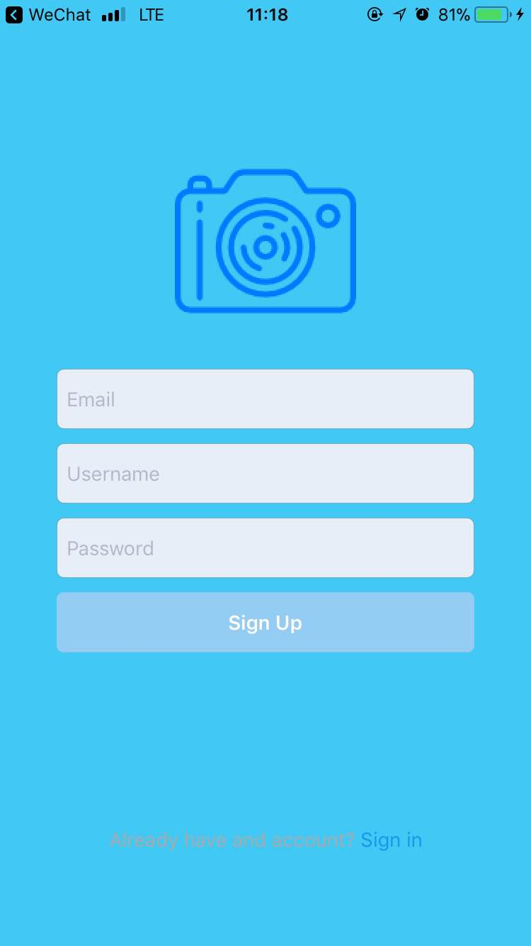
Sign in/up
Login with email address and password
Sign up with email address, username and password
Can also add a photo as avatar by clicking logo
Switch page by clicking

Slide 6

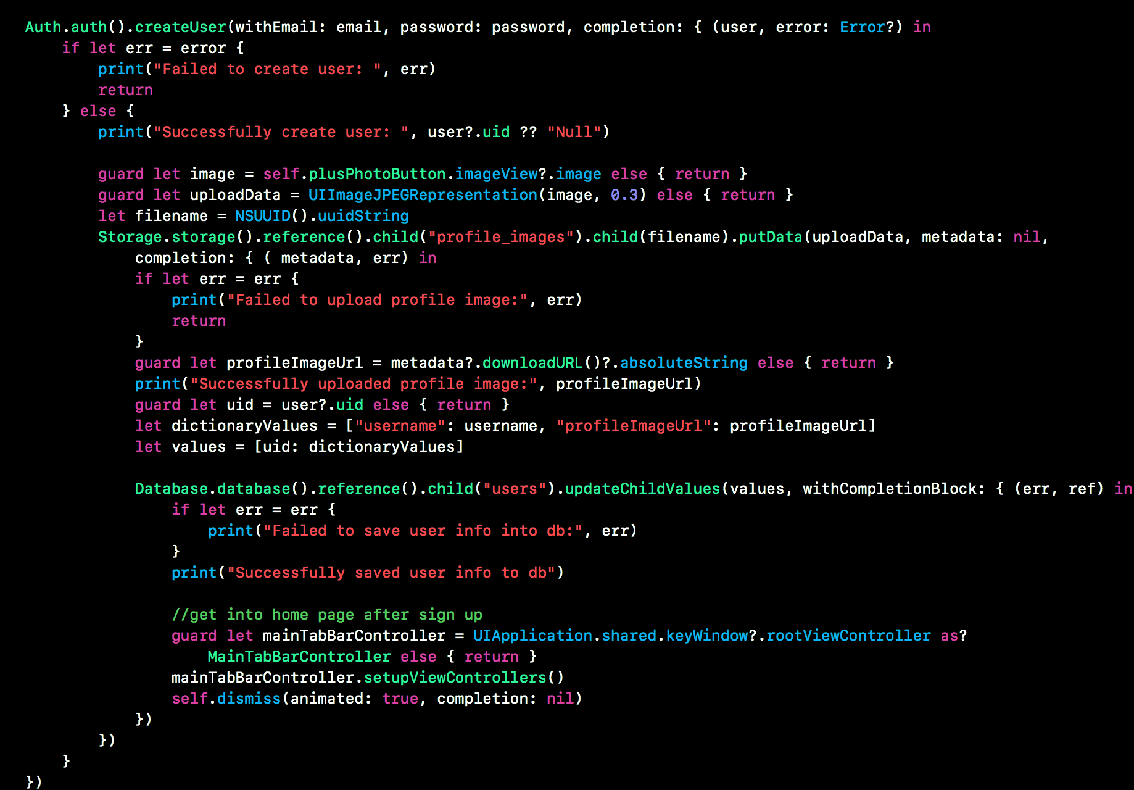
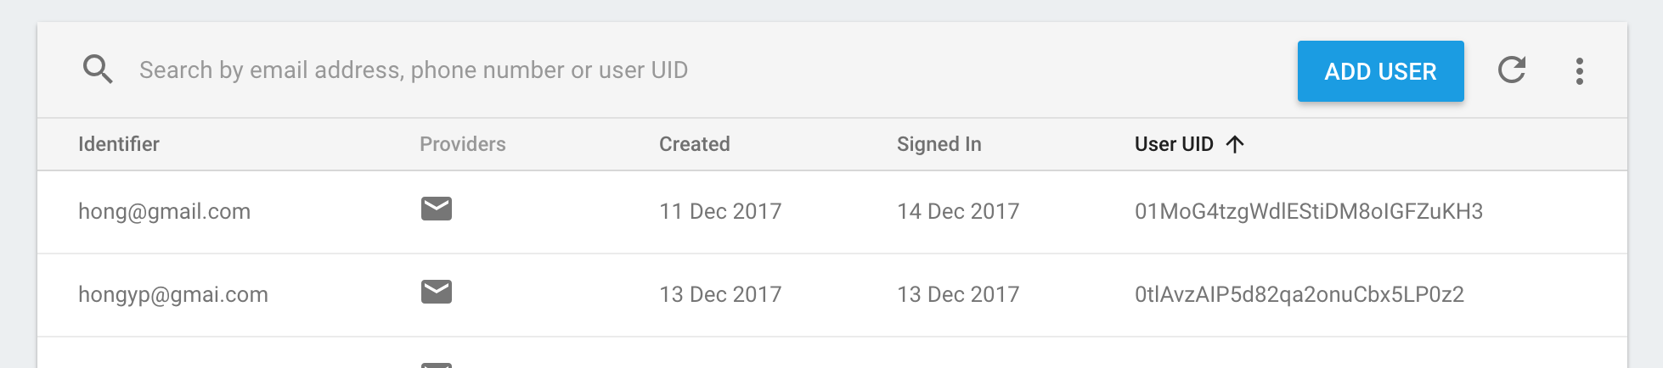
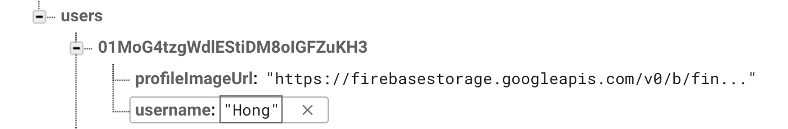
COde

Slide 7
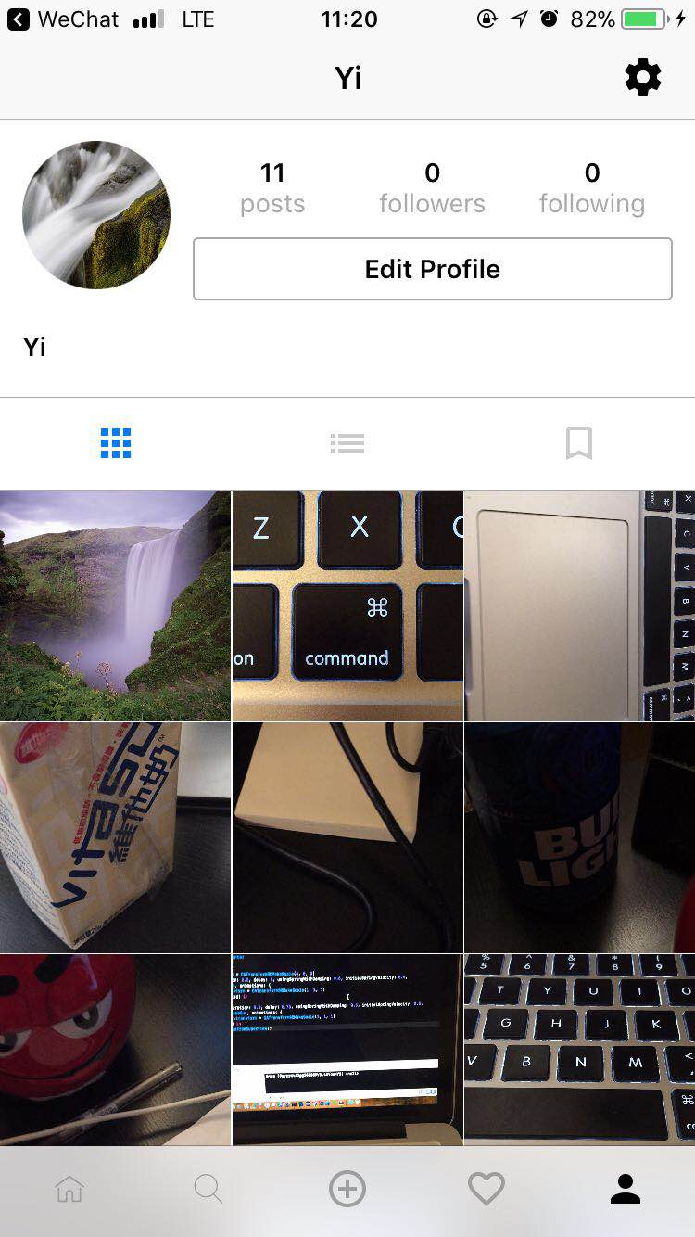
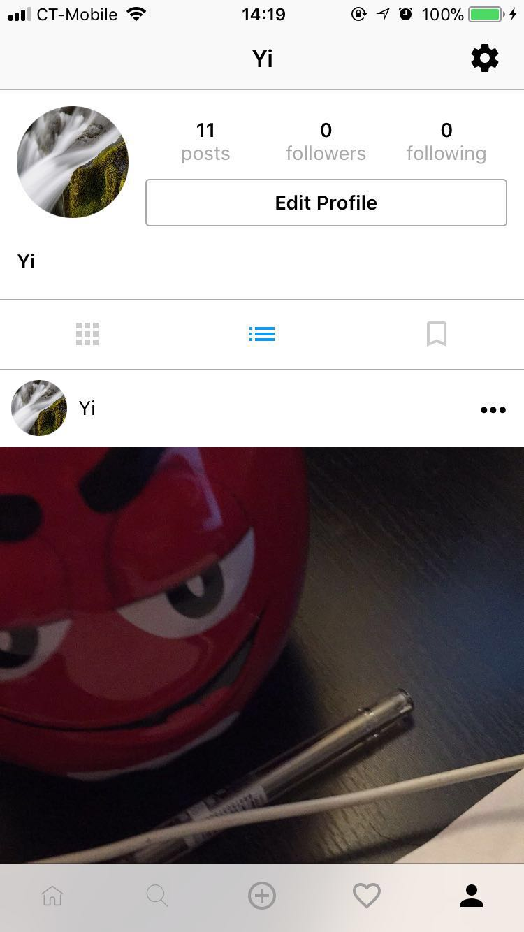
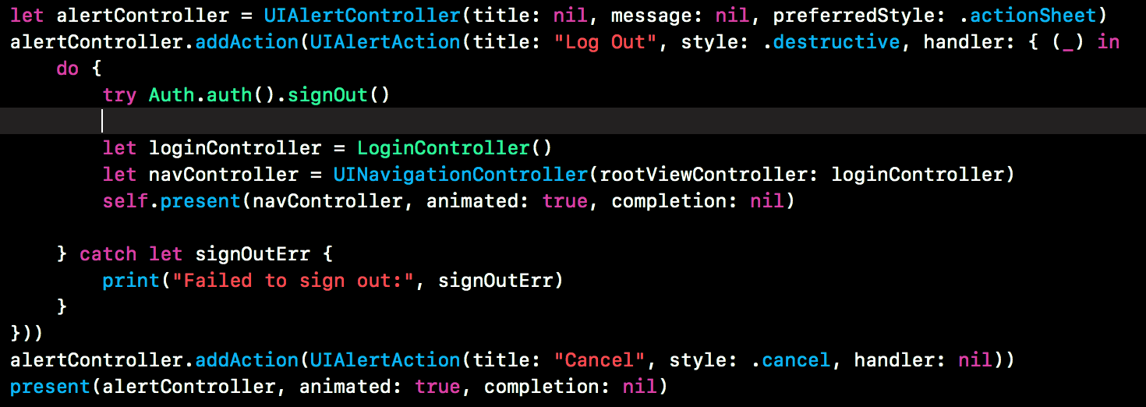
Account
Show user’s detail
List out the items that users posted
Change the layout of the items
Logout
Show the number of posts followers and following

Slide 8

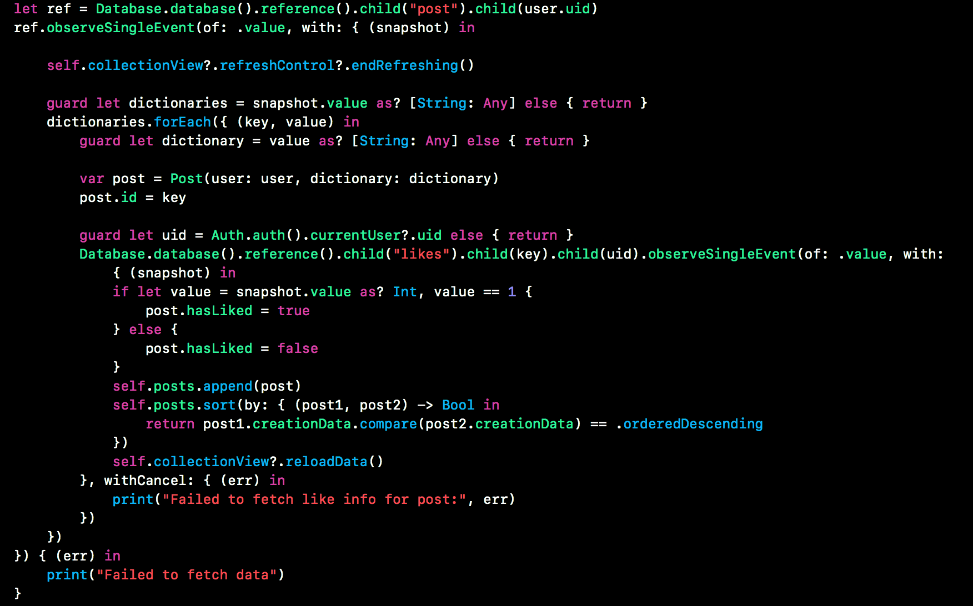
Home
List of the posted items
Username, user avatar, details
Likes, comments, message, tag
Item description
Also show the items from others
Who has been followed

Slide 9
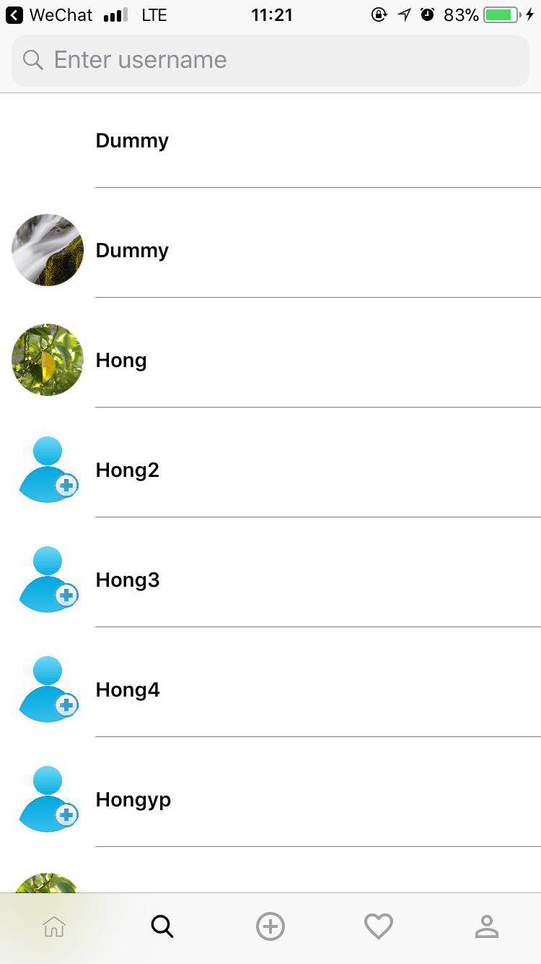
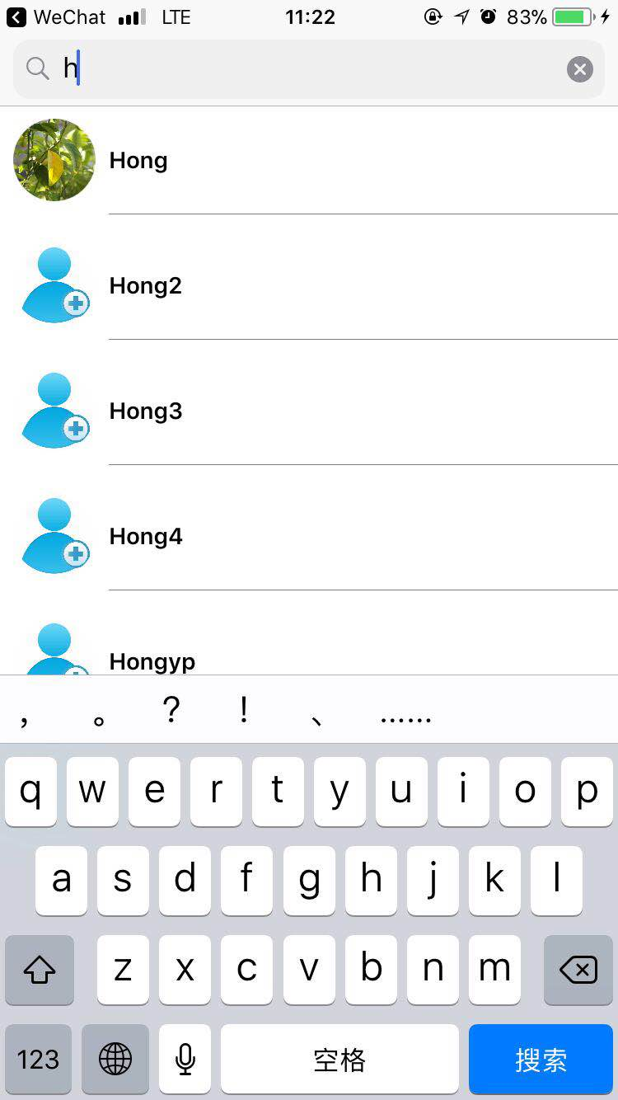
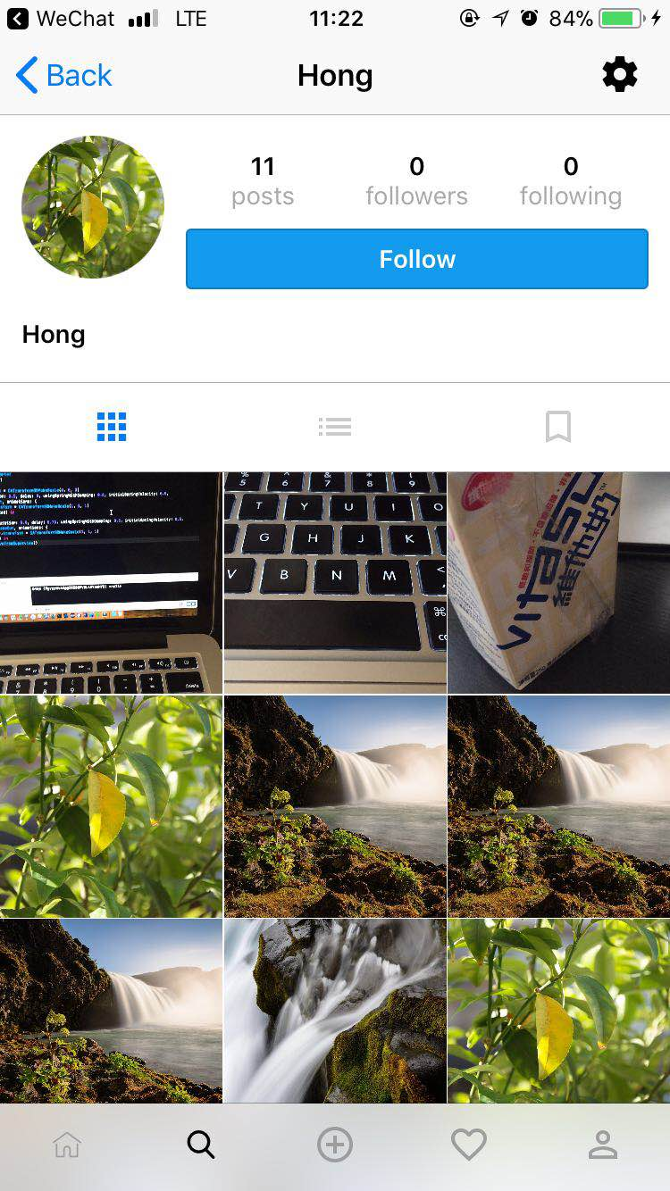
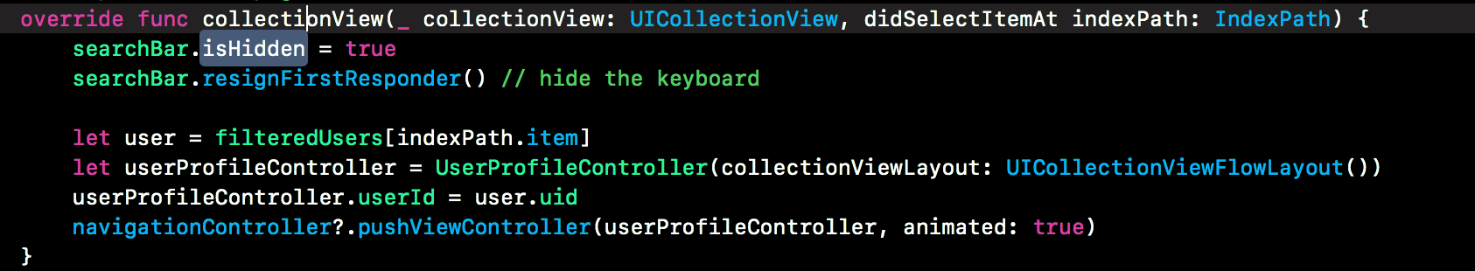
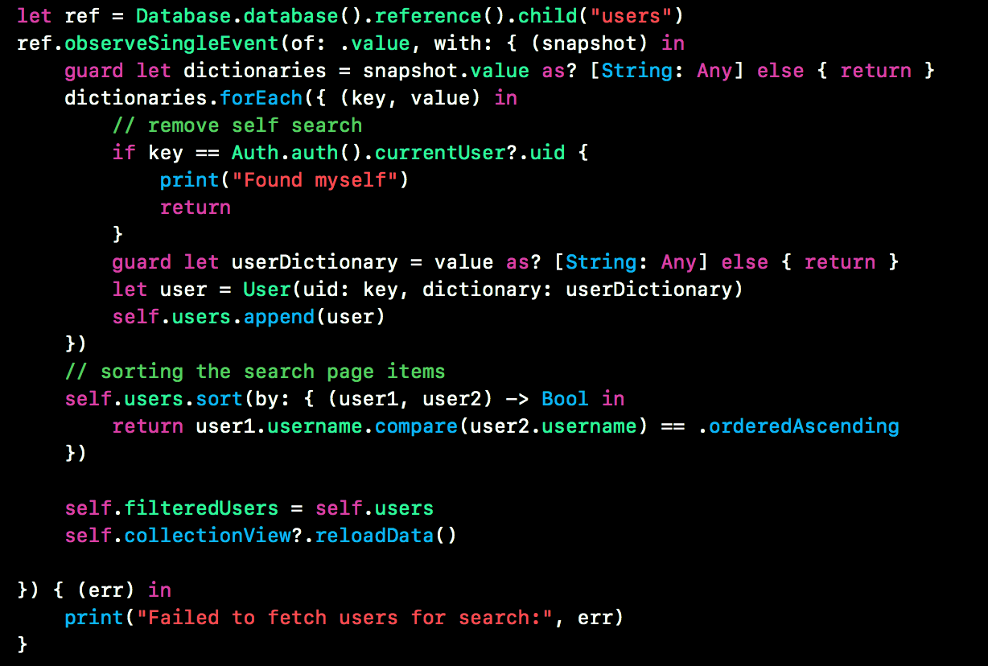
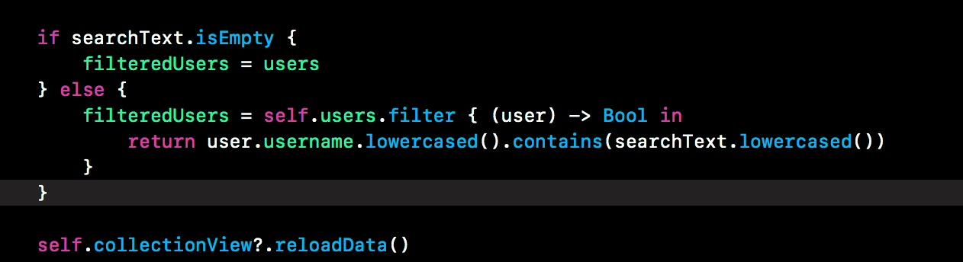
Search
Search other user by key word
Can see the user’s profile by clicking one
Can follow or unfollow other user
The items of user you followed will be listed in homepage
The number of followers will be updated

Slide 10
Search

Slide 11
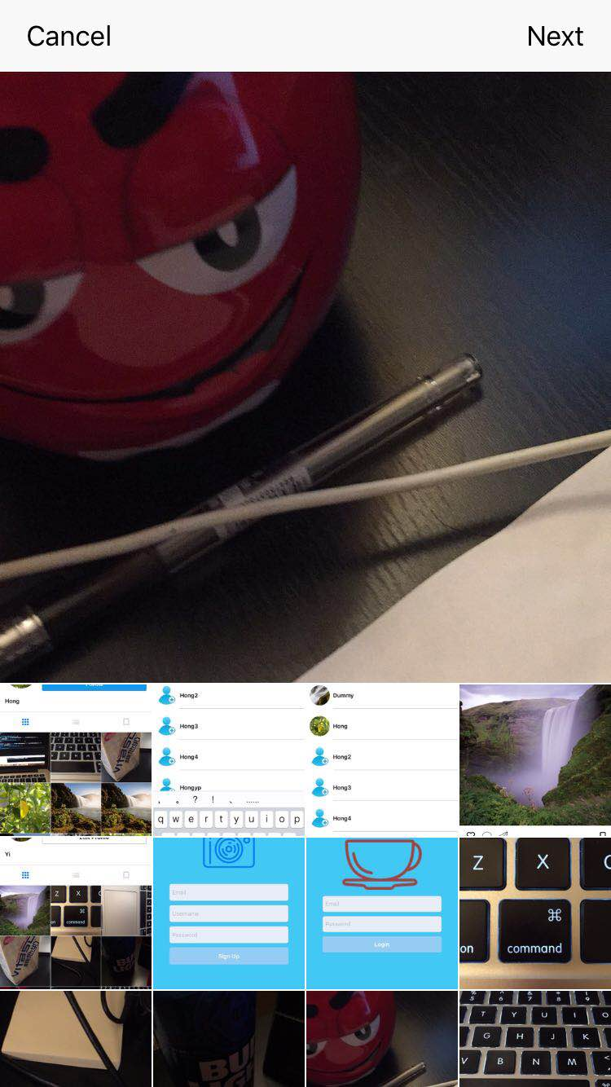
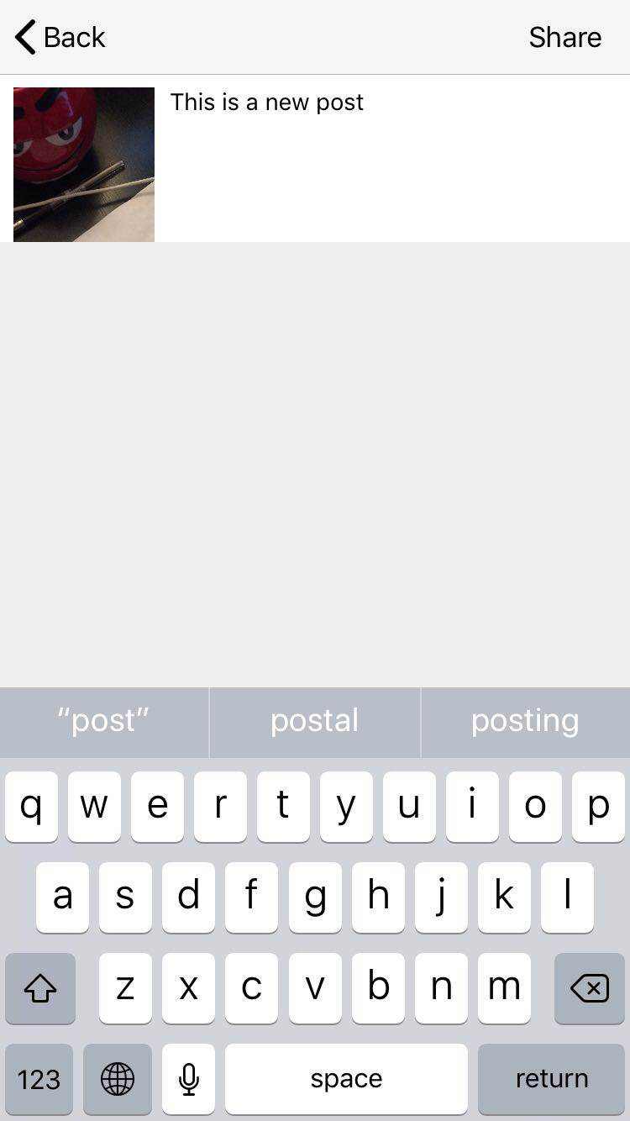
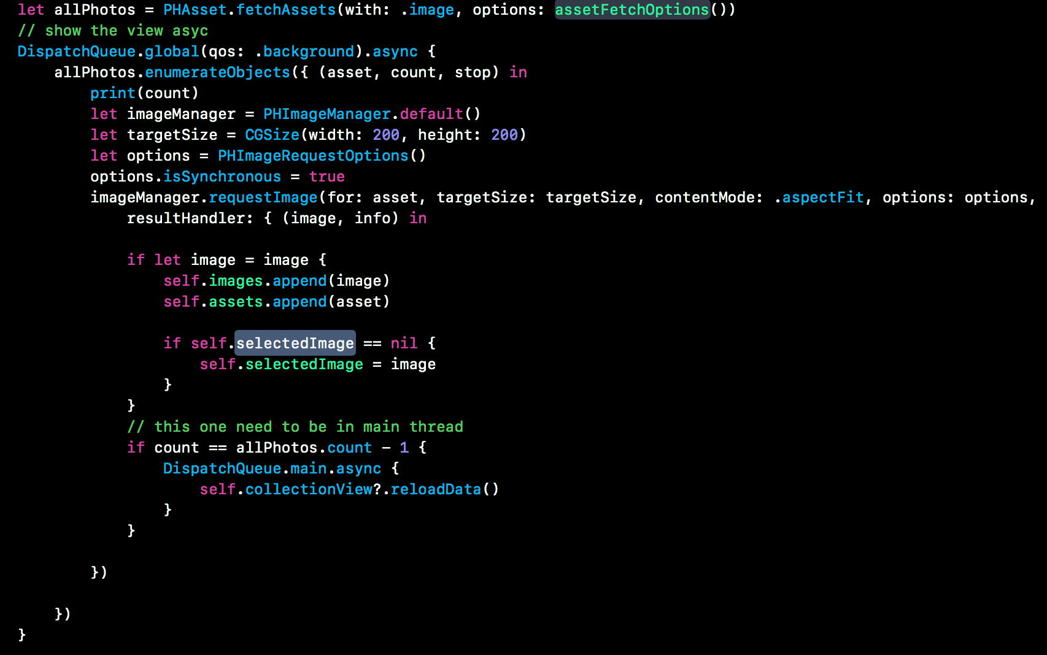
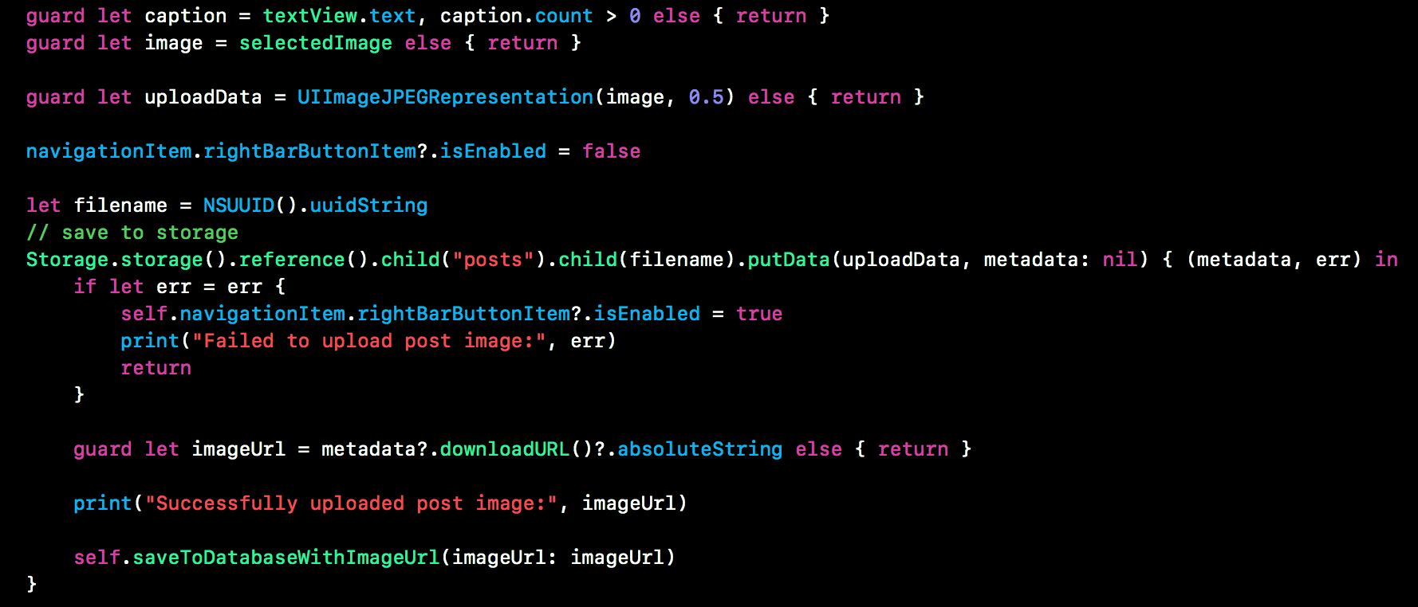
Post
click add button -> select picture
-> add description
-> share

Slide 12
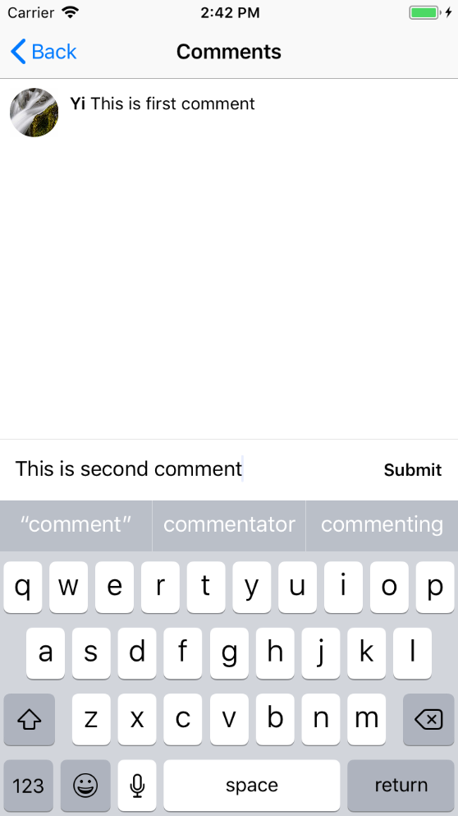
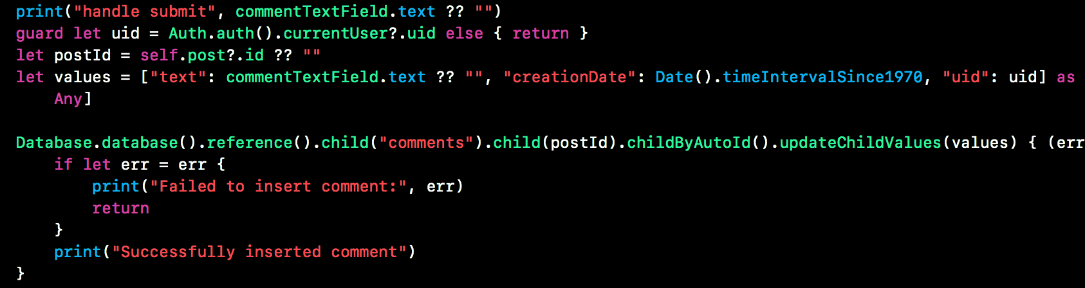
comments
List out all comments of this item
Add new comment to it

Slide 13
That’s all Thanks

