Slide 1


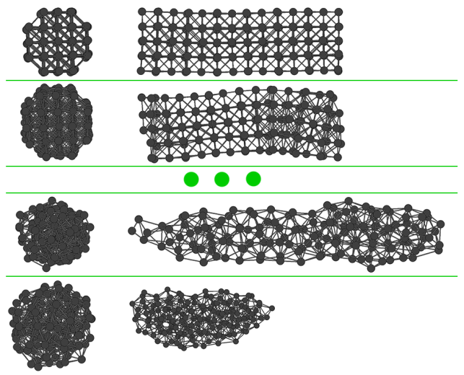
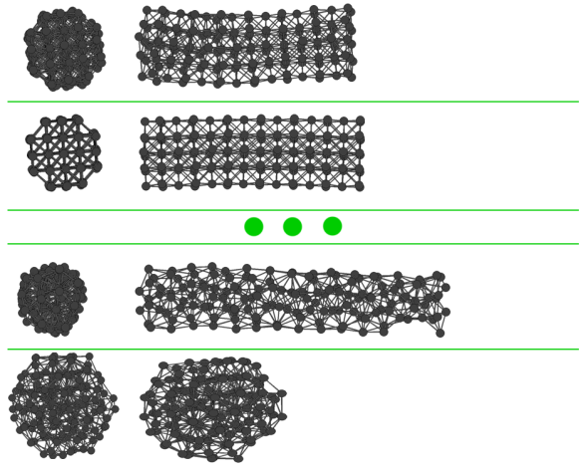
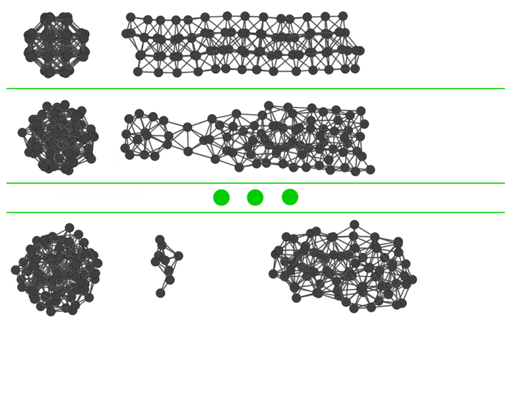
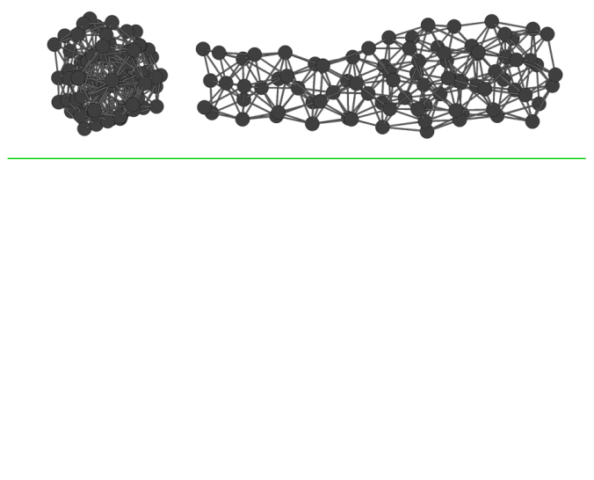
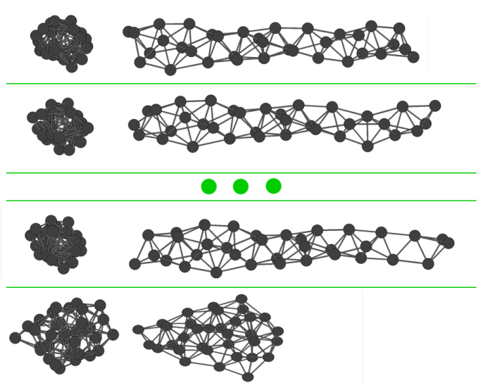
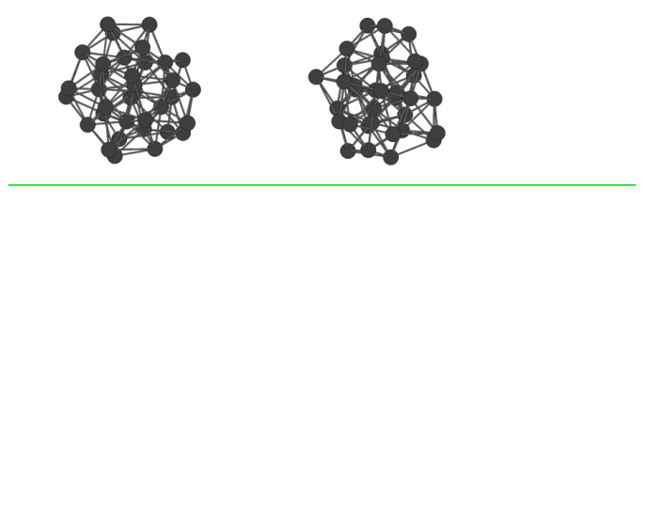
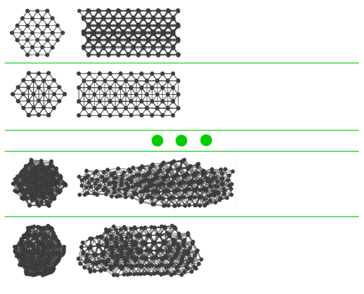
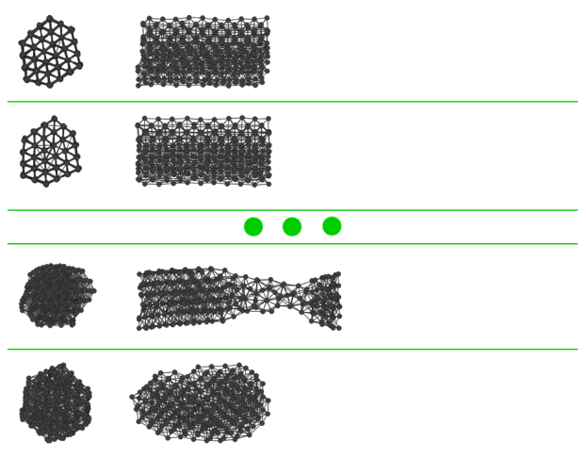
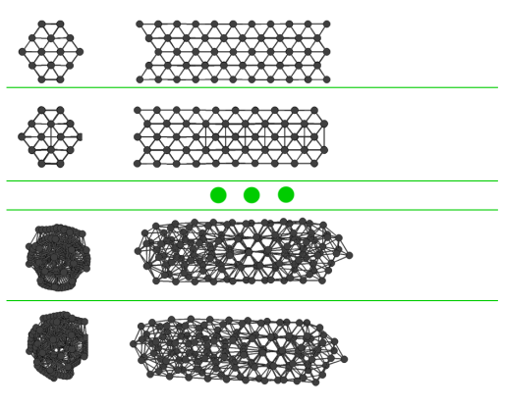
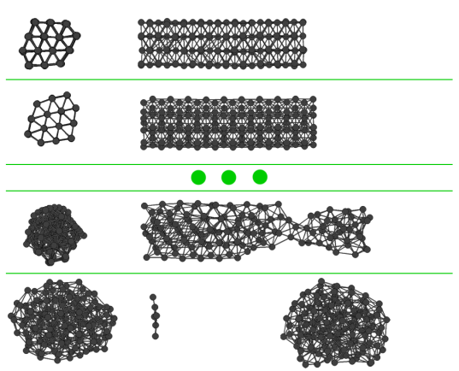
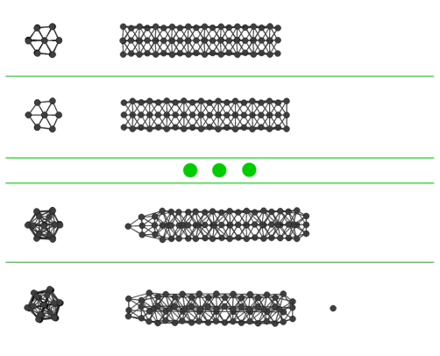
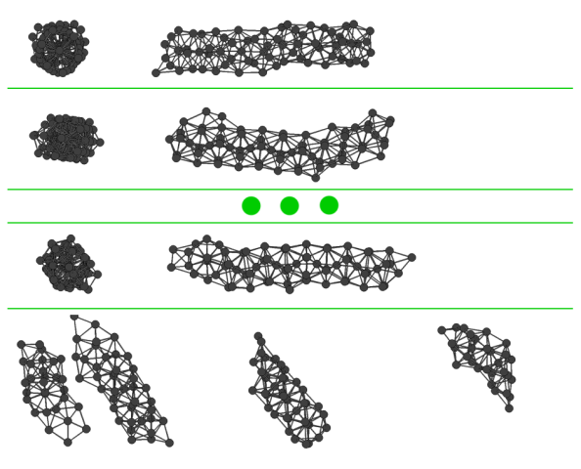
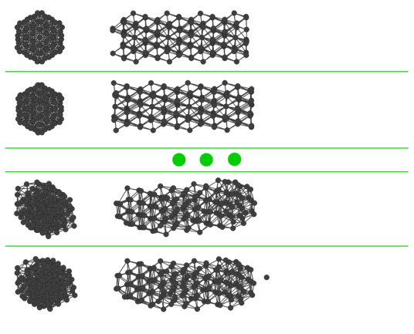
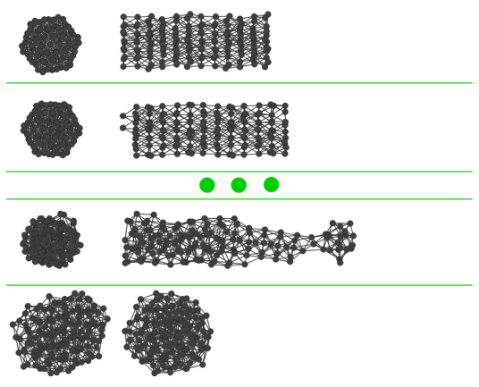
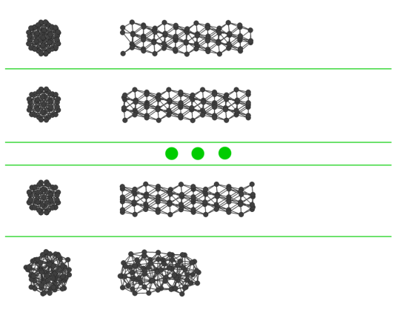
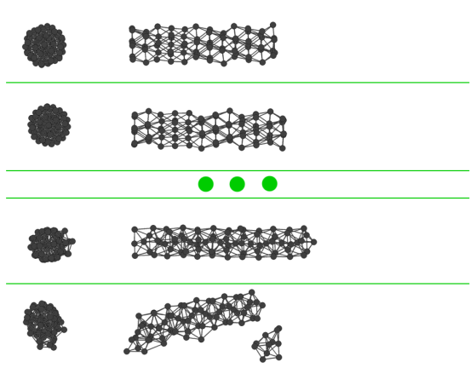
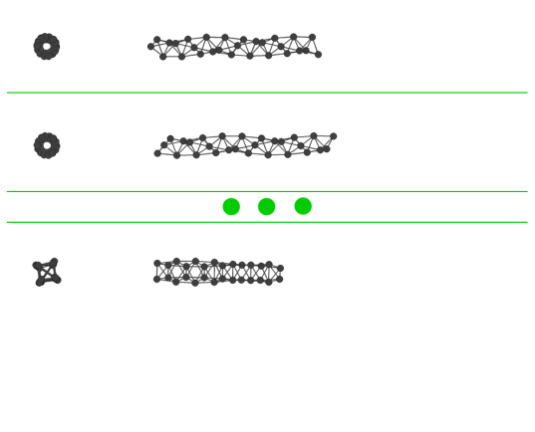
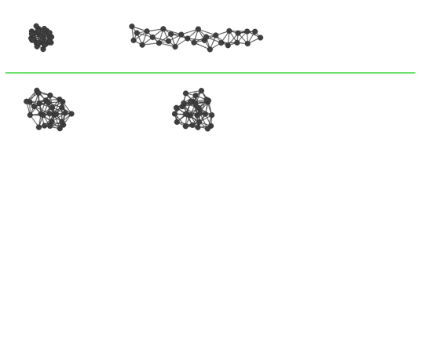
Structural Properties of Copper Nanorods under Strain: Molecular Dynamics Simulations
Hüseyin Yağlı¹, Şakir Erkoç^{1,2}
1. Micro and Nanotechnology Program, 2. Department of Physics, METU, 06531, Ankara
Abstract
Results
Atomistic level computer simulations using empirical model potentials can be done using Molecular-Dynamics. The interaction between atoms is calculated using a predefined potential energy function. The total force applied on single atom is found by calculating the potential energy between each of all the atoms in the system and summing the resulting forces.
The main computational load in the problem is to calculate the total force applied to each atom by all other atoms. This function’s computational load increases with O(n2) when increasing number of atoms. In solving the problem, my main focus was to parallelize this force calculation.
Using the GPU, the problem size solvable in tolerable time increased greatly.
Introduction
The problem in this project was that while the algorithm produced good results in small systems with atoms less than 200, it was not feasible to use with larger systems. With the number of atoms increasing, the time it took to run the simulations increased to a few weeks from a few hours.
The algorithm was implemented in FORTRAN more than 20 years ago. In an attempt to parallelize the code, I used OpenMP. The only part of the code which was parallelizable was the force function. The CPU parallel code ran 3.9 times faster in quad core CPU which showed a very successful result.
In the CUDA version, a kernel computes the forces applied to each atom by all the other atoms. Each thread computes the forces for one atom. Each thread requires accessing the coordinates of all atoms. The coordinates are held in textures for cached memory access. A coarse grain parallelization was chosen to prevent the high number of reduction needed in fine grain method.
Figure 1: Stretching of nanorods until breaking.
References
[1] S. Erkoc, "Empirical Potential Energy Functions Used in the Simulations of Materials Properties", in "Annual Review of Computational Physics", Ed. D. Stauffer, Vol. IX, World Scientific, Singapore, 2001, pp. 1-103.
[2] S. Erkoc, "An Empirical Many-Body Potential Energy Function Constructed from Pair-Interactions", Z. Phys. D: Atoms Molecules and Clusters 32, 257(1994).

