Slide 1
Structural Properties of Copper/Silver/Gold Nanorods under Strain
Molecular DynamIcs SImulatIons

Slide 2
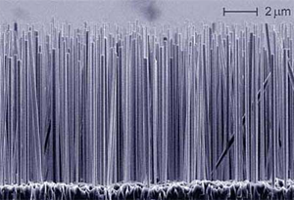
Nanorods
Because of the high surface to volume ratio in nanowires, their properties depend very much on the surface conditions and geometry.
Nanowires of the same material can show different properties depending on their aspect ratios, surface conditions and crystal phases which depend on the synthesis methods used.
Fig.1: An array of silicon wires
Notes:
Important advances in the research and development of nanowires and nanorods took place after advances in microscopy and characterization techniques reached smaller length scales down to individual atoms.
Characterization of nanowires is important in order to establish a reproducible relationship with the characteristics of nanowires and the desired functionality. Because of the high surface to volume ratio in nanowires, their properties depend very much on the surface conditions and geometry. Nanowires of the same material can show different properties depending on their aspect ratios, surface conditions and crystal phases which depend on the synthesis methods used.

Slide 3
Nanorods
The small sizes and high surface-to-volume ratios of one-dimensional nanostructures endow them with a variety of interesting and useful mechanical properties.
One-dimensional nanostructures often feature a mechanical strength approaching the theoretical limits of perfect crystals
Notes:
The small sizes and high surface-to-volume ratios of one-dimensional nanostructures endow them with a variety of interesting and useful mechanical properties. Their high stiffness and strength lend them to applications in tough composites and as nanoscale actuators, force sensors and calorimeters. One-dimensional nanostructures also showcase unique stability effects driven by the dominance of their surfaces and internal interfaces. As the scale of materials reduces to nanometers, the tendency of surfaces to minimize their free energy may drive structural changes that propagate into the bulk. Nanowire synthesis techniques can yield single-crystalline structures with a much lower density of line defects than is typically found in bulk materials. As a result, one-dimensional nanostructures often feature a mechanical strength, stiffness, and toughness approaching the theoretical limits of perfect crystals, making them attractive for use in composites and as actuators in nanoelectromechanical systems (NEMS).

Slide 4
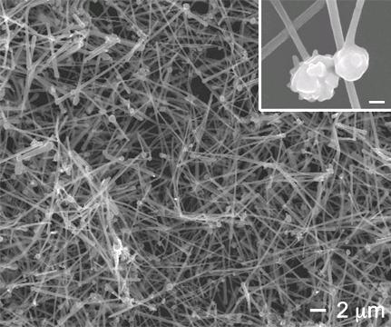
Copper Nanorods
Copper wire is the most commonly used one.
Copper nanorods and nanowires may play an essential role in the future
Fig.2: Cu Nanowires with spherical copper particles attached at one end
Notes:
Among all metal wires, copper wire is the most commonly used one. From electric power leads to interconnects in electronic circuits, copper plays the role that no any other metal can assume. With the rapid shrinking in size in electronic devices, copper nanorods and nanowires may play an essential role for connecting the future generation of electronic nanodevices.
Copper nanowires like the ones in the pictures can be produced with crystal growth in water solution. They can form transparent, conductive and cheap films that may be used in bendable electronic displays and solar cells.

Slide 5
Atomistic Computer Simulations
Simulations are usually used to calculate the properties of atoms which interact through a potential energy function (PEF).
The PEF, in principle, describes the behavior of the ground state electronic energy as a function of the nuclear coordinates.
Cu
Cu
Cu
Cu
Cu
Notes:
The computer simulation techniques are usually used to calculate the properties of a collection of atoms which interact with one another through a potential energy function (PEF). Such a PEF, in principle, describes the behavior of the ground state electronic energy as a function of the nuclear coordinates, so that all of the basic quantum physics is implicitly captured in the functional behaviour of the PEF. In practice, the PEF cannot yet be determined in any consistent fashion from quantum mechanical methods, so that semi–empirical (or totaly empirical) models must be utilized.

Slide 6
Molecular Dynamics Method
Newton’s equations of motion is solved for a collection of N particles interacting via an assumed potential energy function, Φ.
The atoms and molecules are allowed to interact for a period of time, giving a view of the motion of the atoms.
Fig.3: Variation of total energy versus time steps in a Molecular– Dynamics run.
Notes:
In a Newtonian Molecular–Dynamics simulation one simply solves Newton’s equations of motion for a collection of N particles interacting via an assumed potential energy function, Φ, subject to periodic boundary conditions.
When the simulated system is in thermal equilibrium. After equilibration, the total kinetic energy is about 3Nk_{B}T/2 and the velocity distribution remaines Maxwellian, at the same time, the particle displacement distribution becomes a gaussian form.

Slide 7
Potential Energy Function
Empirical interatomic potentials can handle large systems.
Do not contain electronic information or nuclear information
Atoms are considered as point like particles
Notes:
Quantum mechanical methods are currently applicable for systems involving only a few tens of atoms. On the other hand, empirical interatomic potentials can handle much larger systems and they can be used to study static as well as dynamic properties.
In atomistic level simulations atoms are considered as point–like particles. They are structureless and they contain no electronic information and no nuclear information.

Slide 8
Empirical Potential Energy Function
Many-body expansion and interaction energy
E_{N} = φ₁ + φ₂ + φ₃ + ··· + φ_{n} + ··· + φ_{N}
Φ = φ₂ + φ₃ + ··· + φ_{n} + ··· + φ_{N}
Notes:
According to many-body expansion method, the total energy of the system can be expressed as the sum of energies of single bodies, the interaction between two bodies, three bodies and so on.
If we remove the one body energies from the equation, it leaves us with the interaction energies.
The greatest contribution to total energy in the equation of interaction energy comes from the two-body and three-body interactions.
If we insert linear combination parameters to the first terms of the expansion, we can truncate the remaining terms.
These linear parameters are found by fitting the potential functions to experimentally determined values which makes these equations Empirical potential energy functions.

Slide 9
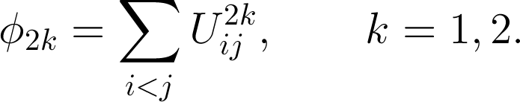

Empirical Potential Energy Function
Empirical PEF used (Erkoç)
Φ = D₂₁ϕ₂₁ + D₂₂ϕ₂₂
Notes:
The empirical potential energy function used here is formed from pair interactions, which contains many-body effects and it has been parameterized for the fcc metal elements copper, silver and gold.
The pair interaction function is split into two parts to allow the insertion of more linear parameters. The parts consist of a repulsive term and an attractive term.
D 21 and D 22 are many body expansion terms.
Phy two-one (ϕ₂₁) and Phy two two (ϕ₂₂) are the two body energies. The third equation is the atomic interactions in terms of inter-atomic distances. This equation contains there parameters (A, alpha and lambda) which will be changed according to material used and the repulsive-attractive term.

Slide 10
Algorithm
READ PEF parameters
Initialize system
Until a predefined number of steps is completed:
Calculate velocities of particles
Move particles to new positions
Calculate forces on the particles
Calculate velocities and kinetic energies
Scale temperature, adjust velocities
After the simulation is complete, the system is relaxed
Elongate the nanorods by 5% and run simulations again until relaxes
Notes:
The simulations are completed when the rod breaks.

Slide 11
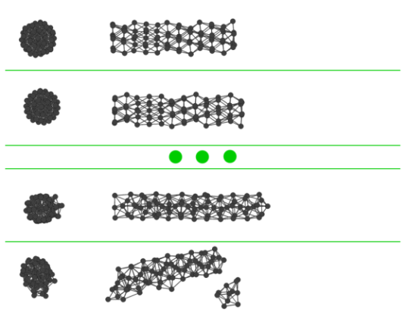
Simulations
Notes:
Here is an example simulation result.
Images on the left column are the front view of the nanorods. The right column images show the elongation and the breaking of the nanorods.

Slide 12
Code complexity
The complexity of the algorithm is O(n²)
For systems with less than 200 atoms, relaxation takes a few hours.
For larger systems, relaxation takes more than a week.
Complete the whole simulation until the rod breaks from the strain may take more than a month.
Notes:
Since the algorithm calculates the forces applied to each atom by every other atom in the system, the mathematical complexity of the algorithm increases by n square.
With rods having less than 200 atoms, the simulations can be completed within hours. But when the system has more than 200 atoms, the simulation start taking more than one week for each relaxation. The nanorods may elongate more than a few times before breaking so that means even more time.

Slide 13
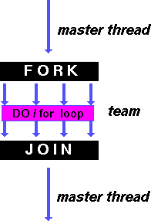
OpenMP
The first efforts to improve the simulation was done by parallelizing the current code using OpenMP
The most resource consuming task is Force calculation which is done twice in each step.
The performance increased as the number of CPU cores increased.
Fig.4: OpenMP architecture
Notes:
In an attempt to parallelize the code, I used OpenMP. The only part of the code which was parallelizable was the force function. Other loops in the program didn’t give raise to any improvement since more than 90 percent of the computational load in the code was in the force calculation. Also the launching of threads in OpenMP has also its costs and thus OpenMP requires large parts of codes to be parallelized at once. At the end, my code ran 3.9 times faster in quad core CPU which showed a very successful result. But this result only reduced the week-length simulations to days.

Slide 14
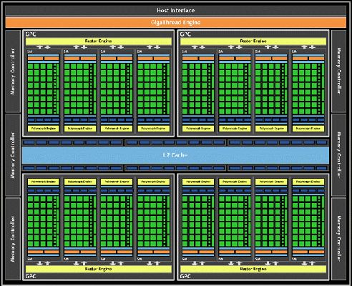
CUDA Architecture
CUDA is parallel computing platform used to program the computers graphics card.
Unlike CPUs, GPUs have a very high number of cores that executes the commands slower but execute a higher number of commands concurrently.
Fig.4: CUDA Kepler architecture
Notes:
Unlike CPUs, GPUs have a parallel throughput architecture that emphasizes executing many concurrent threads slowly, rather than executing a single thread very quickly.

Slide 15
CUDA Performance Results
Notes:
During the timing tests, while the number of atoms increased, the time for CPU computation increased logarithmically.
But the GPU times increased linearly even reaching 300 atoms.
So the time it took to run simulations that ran for weeks before was reduced to a few hours.

Slide 16
Nanowire Preparations
Fig.6: Unit cell to generate fcc (111) surface
Notes:
The program needs the coordinates of atoms as input. So coordinates need to be calculated using crystal structure information of the material.
The atoms coordinates are generated by taking the unit cell information for the related surface and replicating the unit cell in 3 dimensions as much as needed.
This replication results in a orthorhombic structure. Then the necessary atoms need to be removed from this group to obtain a wire-like shape.

Slide 17
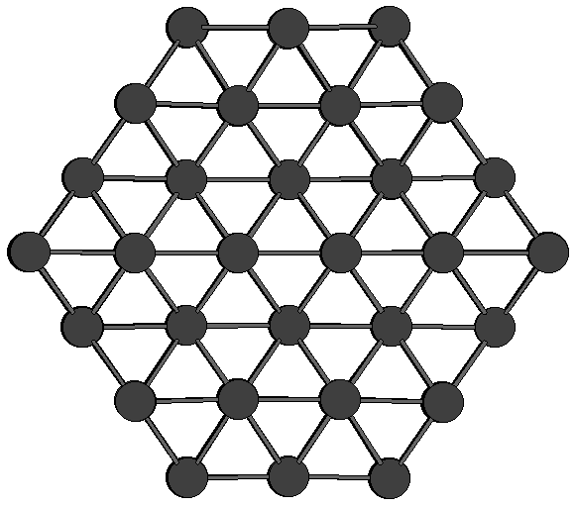
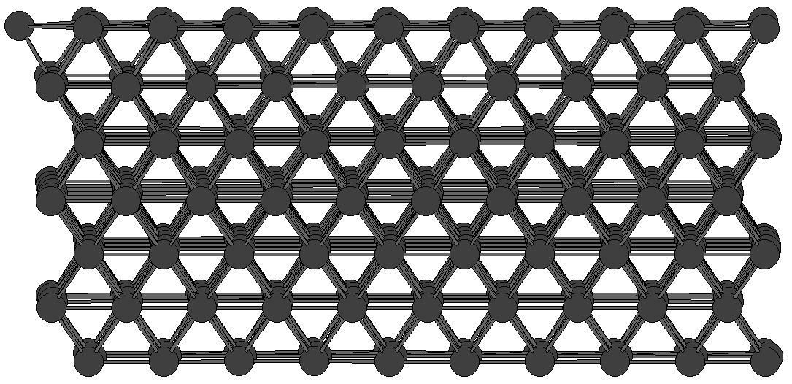

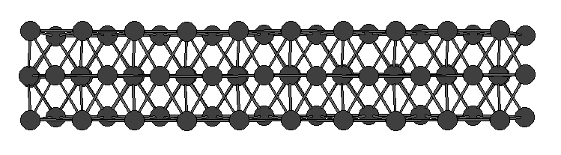
Nanowire Preparations
Fig.5: (110) large and small size nanorods
Notes:
For the simulations, 3 different sized nanowires were prepared for 3 surfaces (100), (110) and (111)

Slide 18
Simulation Results
Fig.6: Strain energy (eV) vs. Strain for the big nanorod along (100) surface
Notes:
Here the increase in the graph shows the increase in the potential energy of the system as the strain increases.
After breaking, the nanorod relaxes and the potential energy drops.

Slide 19
Simulation Results
Fig.7: Strain energy (eV) vs. Strain for the big nanorod along (110) surface

Slide 20
Simulation Results
Fig.8: Strain energy (eV) vs. Strain for the big nanorod along (111) surface

Slide 21
Simulation Results
Fig.9: Strain energy (eV) vs. Strain for the medium nanorods

Slide 22
Simulation Results
Fig.10: Strain energy (eV) vs. Strain for the small nanorods

Slide 23
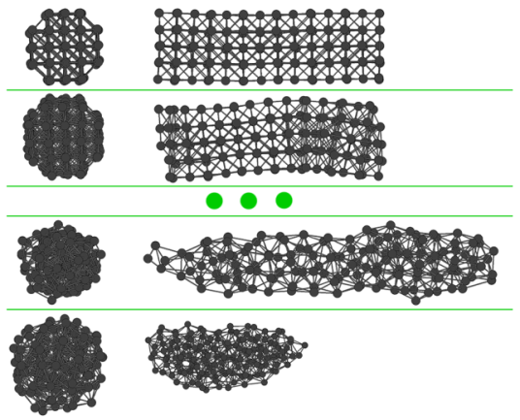
Example nanorods
Fig.11: (100) surface large nanorod at 1K

Slide 24
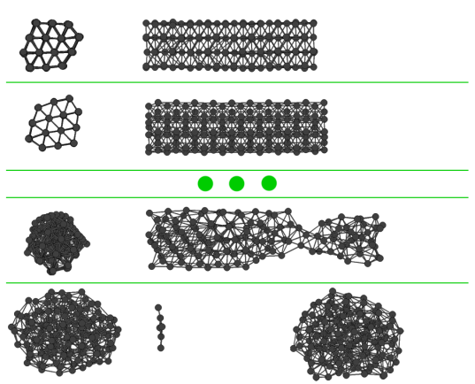
Example nanorods
Fig.11: (110) surface medium nanorod at 300K

Slide 25
Conclusion
It has been shown that uni-axial strain shows cross-section geometry dependent characteristics.
The nanorods generated from (100) and (110) surfaces are relatively stronger against uniaxial strain with respect to the nanorods generated from (111) surfaces.
These results could help future researches for copper nanorods applications for their mechanical strength properties.

Slide 26
References
[1] Yu Chang, Mei Ling Lye, and Hua Chun Zeng. Large-Scale Synthesis of High-Quality Ultralong Copper Nanowires. Langmuir 2005, 21, 3746-3748
[2] I.Lisiecki and A. Filankembo, H. Sack-Kongehl and K. Weiss, M.-P. Pileni, J. Urban. Structural investigations of copper nanorods by high-resolution TEM. (2000) PHYSICAL REVIEW B VOLUME 61, NUMBER 7.
[3] Rathmell, A. R.; Bergin, S. M.; Hua,Y.-L.; Li, Z.-Y.; Wiley, B. J. The Growth Mechanism of Copper Nanowires and Their Properties in Flexible, Transparent Conducting Films. Adv.Mater. 2010, DOI:10.1002/adma.201000775.
[4] X. G. Wen, Y. T. Xie, C. L. Choi, K. C. Wan, X. Y. Li, S. H. Yang; Copper-Based Nanowire Materials: Templated Syntheses, Characterizations, and Applications. Langmuir, 2005, 21 (10), pp 4729–4737 DOI: 10.1021/la050038v
[5] Reijnen, L.; Meester, B.; Goossens, A.; Schoonman, J. Chem. Vap. Deposition 2003, 9, 15.
[6] S. Erkoc, "An Empirical Many-Body Potential Energy Function Constructed from Pair-Interactions", Z. Phys. D: Atoms Molecules and Clusters 32, 257(1994).
[7] S. Erkoc, "Empirical Potential Energy Functions Used in the Simulations of Materials Properties", in "Annual Review of Computational Physics", Ed. D. Stauffer, Vol. IX, World Scientific, Singapore, 2001, pp. 1-103.

